Slide 1
UNIT1_PPT
Maggie Sha

Slide 2
Data
USDA database selector
13238 observations of 21 variables
NAs, empty columns, single repeated values
only 8 out of 21 columns containing meaningful data

Slide 3
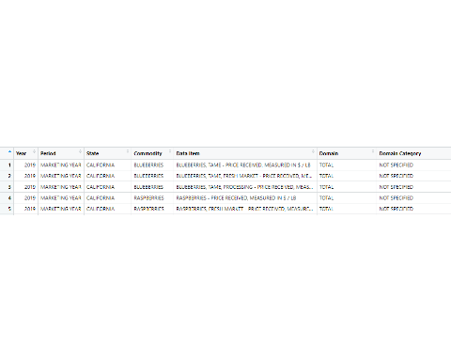
berry data

Slide 4
Overview
Data Cleaning and Organization
strawberry data
unfood data
Visualization
Values of chemicals being used in 2016, 2018 and 2019 in all States
FUNGICIDE usage in California, Florida and Washington
PCA

Slide 5
Data cleaning and Organization
Filter out data other than strawberries
Split the variables in one column into several different columns
Eliminate Redundancy
Join columns to make the data meaningful
Reorder columns
filter chemicals being applied to food

Slide 6
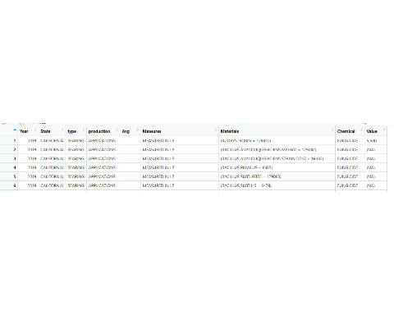
strawberry data

Slide 7
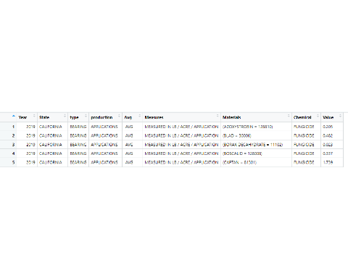
chemicals being applied to food

Slide 8
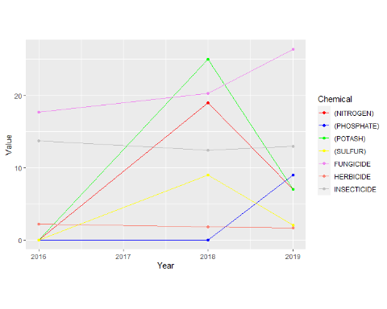
Values of chemicals being used in 2016, 2018 and 2019 in all States

Slide 9
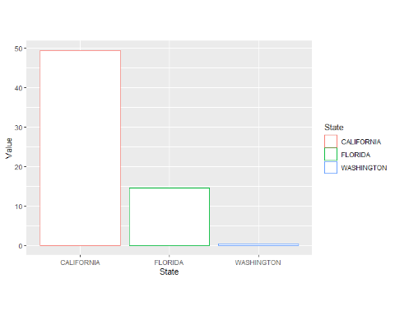
FUNGICIDE usage in California, Florida and Washington

Slide 10
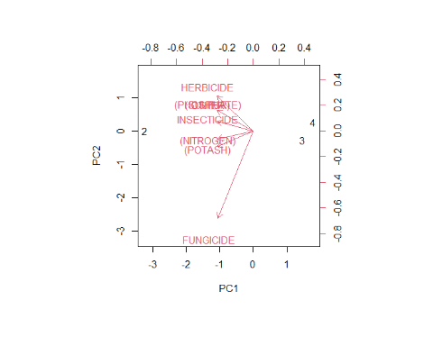
PCA

Slide 11
References
## ## To cite the 'knitr' package in publications use: ## ## Yihui Xie (2020). knitr: A General-Purpose Package for Dynamic Report ## Generation in R. R package version 1.29. ## ## Yihui Xie (2015) Dynamic Documents with R and knitr. 2nd edition. ## Chapman and Hall/CRC. ISBN 978-1498716963 ## ## Yihui Xie (2014) knitr: A Comprehensive Tool for Reproducible ## Research in R. In Victoria Stodden, Friedrich Leisch and Roger D. ## Peng, editors, Implementing Reproducible Computational Research. ## Chapman and Hall/CRC. ISBN 978-1466561595 ## ## To see these entries in BibTeX format, use 'print(<citation>, ## bibtex=TRUE)', 'toBibtex(.)', or set ## 'options(citation.bibtex.max=999)'.

Slide 12
References
## ## Dietrich J (2020). _citation: Software Citation Tools_. R package ## version 0.4.1. ## ## A BibTeX entry for LaTeX users is ## ## @Manual{, ## title = {citation: Software Citation Tools}, ## author = {Jan Philipp Dietrich}, ## year = {2020}, ## note = {R package version 0.4.1}, ## }

Slide 13
References
## ## To cite ggplot2 in publications, please use: ## ## H. Wickham. ggplot2: Elegant Graphics for Data Analysis. ## Springer-Verlag New York, 2016. ## ## A BibTeX entry for LaTeX users is ## ## @Book{, ## author = {Hadley Wickham}, ## title = {ggplot2: Elegant Graphics for Data Analysis}, ## publisher = {Springer-Verlag New York}, ## year = {2016}, ## isbn = {978-3-319-24277-4}, ## url = {https://ggplot2.tidyverse.org}, ## }

Slide 14
References
citation(package=“tidyverse”)
Wickham et al., (2019). Welcome to the tidyverse. Journal of Open Source Software, 4(43), 1686, https://doi.org/10.21105/joss.01686

