Slide 1
Cultural Resources Training
For NRCS field personnel
For SWCD partners
For clients and contractors

Slide 2
Modules 1-6 Web-Based Training
Provides cultural resources background
NRCS policy and procedures
Legal responsibilities
Context in conservation planning

Slide 3
Module 7
State Level Agreements with State Historic Preservation Office and Tribal Agreements
State compliance procedures
Resource References (Undertakings List, Handbook for Cultural Resources, etc.)
Videos/Lectures on state or regional culture history and early technologies

Slide 4
Module 8
Field Exercises to identify cultural sites (burial mounds, prehistoric habitation sites, historic structures)
Hands-on artifact identification
Museum visits

Slide 5
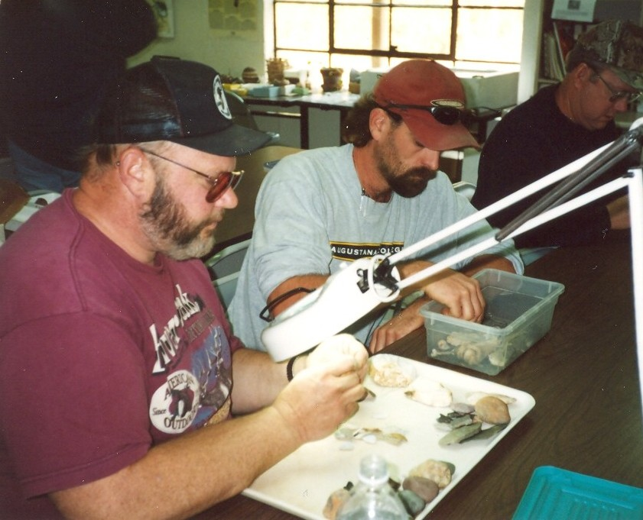
Artifact Identification

Slide 6
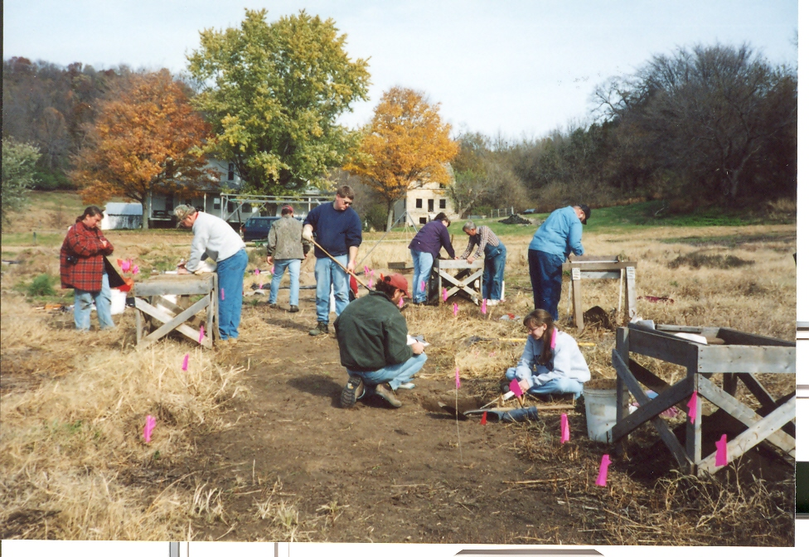
Shovel-Testing at Koster Site

Slide 7
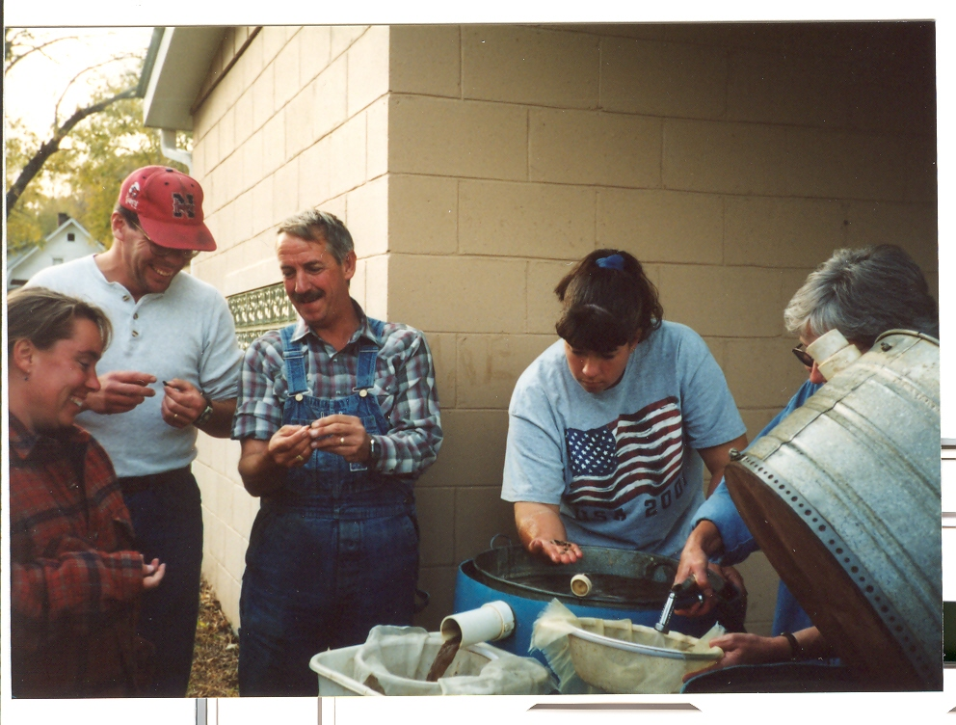
Soil Flotation

