Slide 1
Blockchain technology in Healthcare
Benefits and Challenges
By,
Shreeja Mithinti

Slide 2

Agenda
Blockchain Technology: Overview
Blockchain in healthcare
Benefits
Challenges and Risks
Current Applications
Conclusion
How it works

Slide 3
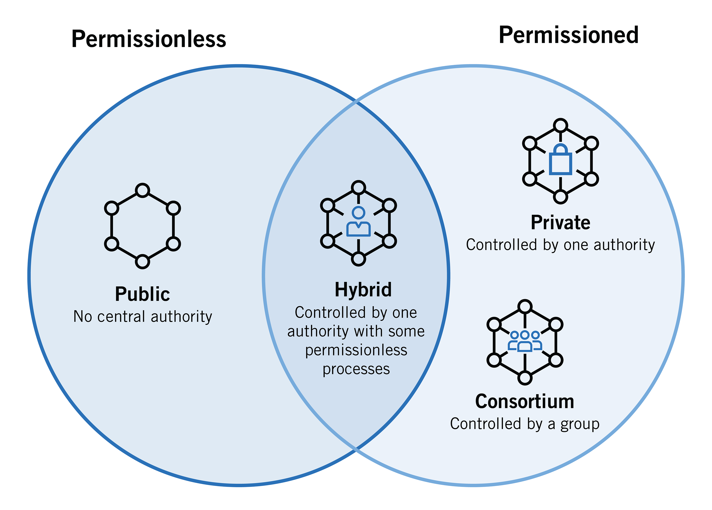
Blockchain Overview
Features
Distributed Ledger
Decentralized
Access Control
Immutability
Enhanced Security
A blockchain is a digitally distributed ledger that covers a network.
Data is stored across networks rather than a central database in Blockchain, decentralized.
Peer-to-peer
Types of Blockchain:
Public
Private
Hybrid
Consortium

Slide 4
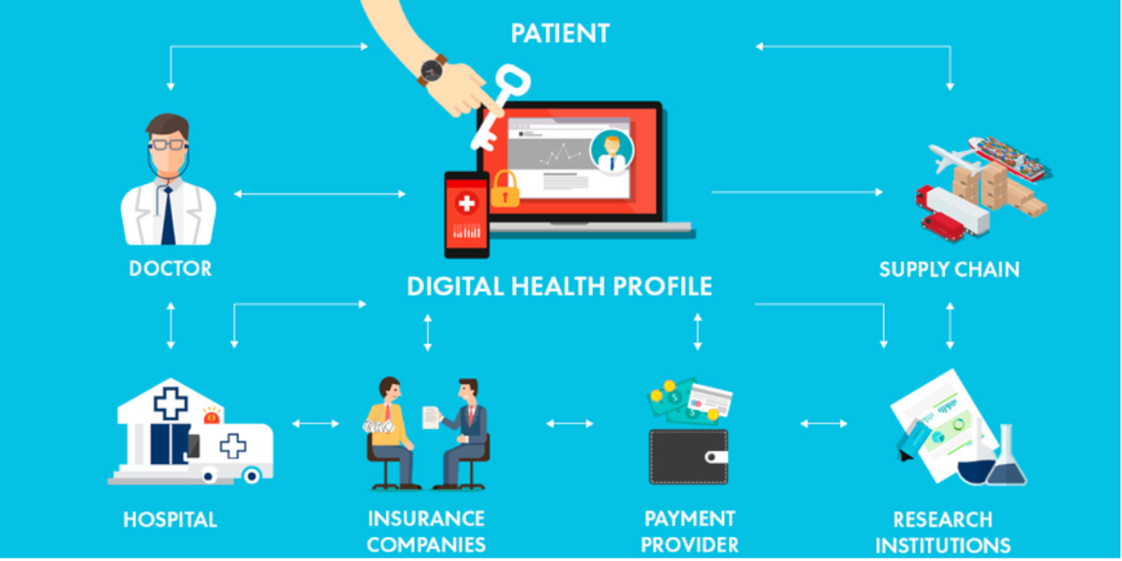
Blockchain in healthcare
Medical records, laboratory test results, invoices, clinical trials, remote monitoring, and other sources generate fresh data every day, which is often locked in several different, isolated databases.
By streamlining the sharing of medical records, securing sensitive data, and giving patients more control over their information, blockchain can improve the quality.

Slide 5





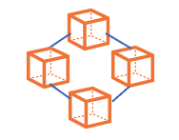







How it works..
Database
Patient
EHR
Customized user access
Blockchain
Doctor
Healthcare providers and other services
Cloud storage

Slide 6
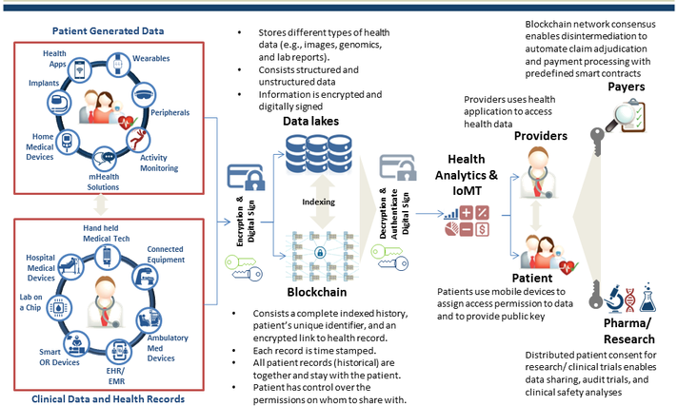

Slide 7
Benefits
Patient Data and Consent management
Drug Supply Chain
Insurance and Billing
R&D
Authenticating the origin of medicine
Transparency
Immutability
Traceability
Identity Management
Patient history
IoT and Remote Monitoring
Patient’s full access of data
Simplify insurance process
Automating the identity and coverage details
Easy payment
Trustworthiness of data
Accuracy of data analysis
Integrity of data trails
Users can be rewarded when data is shared

Slide 8

Challenges and Risks
Scalability
Data Storage
Lack of Governance
Adoption challenges
Protocols
Social Acceptance
Security risks
Early stage of development

Slide 9
Integration Challenges
Block size limit
Big data
Number of nodes
Different types of data
Data Storage
Scalability
Low Processing Speed
Transaction
Transaction costs
High transaction volume
Maintaining interoperability
Private clinics, Rural hospitals, Insurance providers, etc. cooperating for this.
Development , installation cost
Expert knowledge, technical skills
Computational Power/energy usage
Validation of every node

Slide 10
Adoption Challenges
Protocols and Regulations
Social Acceptance
Lack of Governance
Adoption Challenges
Different consensus
Complex protocols
What happens if a service provider don’t cooperate?
A cultural transformation from existing systems is tough
Lack of motivation
Financial help
Smooth integration
Different cryptocurrencies
Different countries – different laws and jurisdictions
No Clarity on compliance

Slide 11
Risks
Immutability issue
Infancy, early stage
Security risks
Sometimes, Not able modify the data is a drawback
still in their infancy
More work in technical discovery and research is required.
Data Sharing might be a risk
51% attack is not impossible
Interpretability

Slide 12
What can be done..
Use of hybrid blockchains
Single cryptocurrency under a well-defined consensus
Having a law and proper regulations
More research and improvement

Slide 13
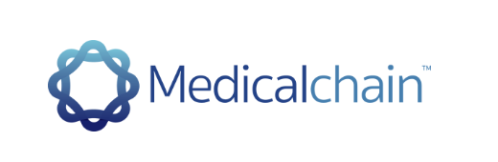


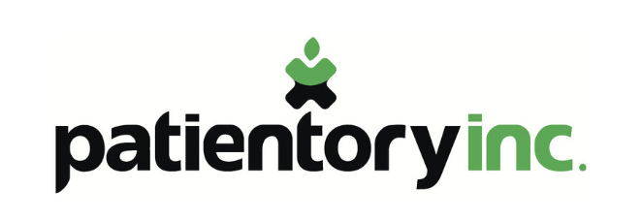

Current Applications

Slide 14
Conclusion
A very long way to go
Can’t totally rely on this technology
Trust and stability is important

Slide 15

References
https://sci-hub.se/10.1109/esmarta52612.2021.9515747
https://ieeexplore-ieee-org.mtrproxy.mnpals.net/stamp/stamp.jsp?tp=&arnumber=8968381
https://consensys.net/blockchain-use-cases/healthcare-and-the-life-sciences/
https://www.forbes.com/sites/reenitadas/2017/05/08/does-blockchain-have-a-place-in-healthcare/?sh=74cf6c71c31e
https://www.news-medical.net/health/Blockchain-Applications-in-Healthcare.aspx
https://mentormate.com/blog/blockchain-in-healthcare-challenges-and-opportunities/
Video:
https://www.youtube.com/watch?v=CsxjlsBYmrI

Slide 16
Thank you
Any questions?

