Slide 1
Eurovision
Trends
from 2016 to 2022

Slide 2
About the Project
Topics:
    Eurovision Poll, Public / Tele-vote and Jury Results comparison
Sites:
    Collection of Jury and Populace Voting (Eschome)
    Collection of Populace Polling (Kaggle)

Slide 3
How are Poll opinions compared to the Public over the years?

Slide 4
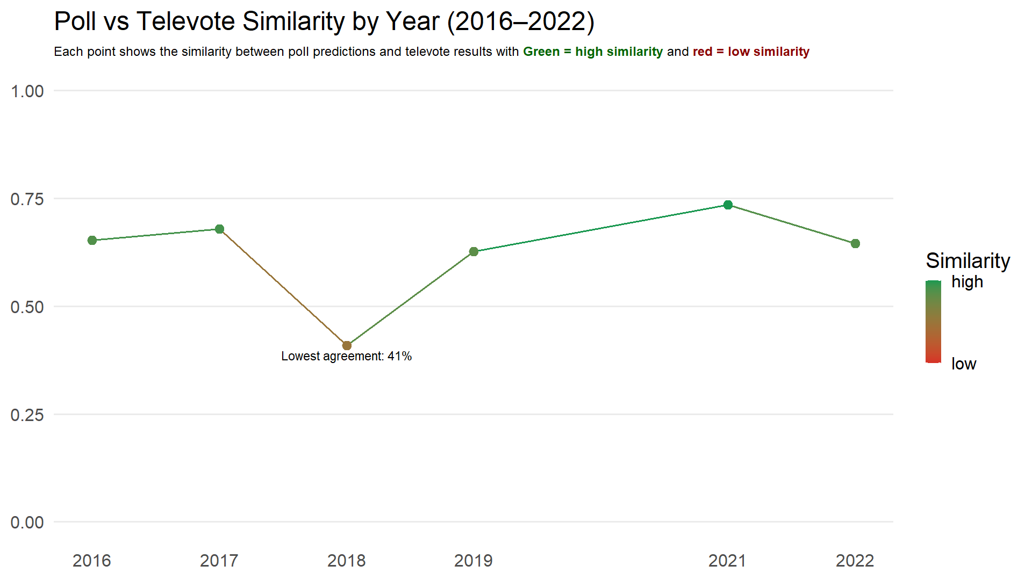

Slide 5
# | Data Attributes | Attributes Types | Visual Channel
1 | Current correlation | Quantitative | Point colour gradient: green = high red = low
2 | Next year correlation | Quantitative | Line colour gradient
3 | Year | Ordinal | X-axis
4 | Similarity | Quantitative | Y-axis
5 | Lowest agreement | Categorical | Text annotation

Slide 6
How did country rankings change from Poll Public results in the year with the least similarity?
How did jury rankings further influence the final outcomes?

Slide 7
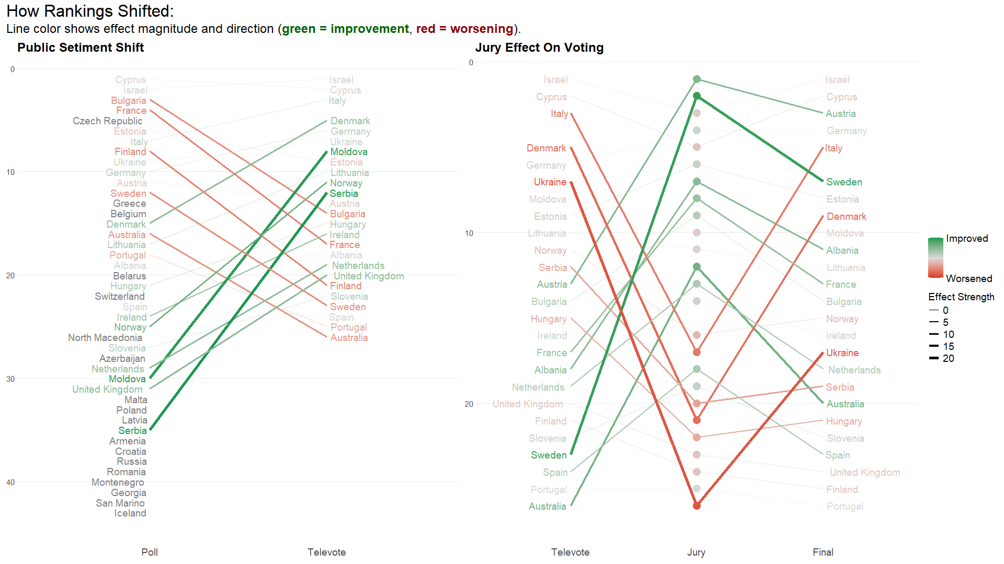

Slide 8
1
Stage
Ordinal
X-axis
#
Data Attributes
Attributes Types
Visual Channel
2
Rank
Ordinal
Y-axis (reversed)
3
Effect magnitude
Quantitative
Line width
4
Effect direction
Quantitative
Line colour gradient
5
Category (improved/worsened/neutral)
Categorical
Line alpha (opacity)
6
Country
Categorical
Line grouping & labels

Slide 9
WorkFlow
Tableau
Superset
R
Python (pyplot)
Kaggle
Eschome
Information Retrieval and Data Cleaning
Initial Plot and general idea realization
Final Graphs and Presentation Preparation
Topic inspiration
Python
(Pandas)
LibreOffice

Slide 10
Thank You For Your Attention
Mutua Fadhla Mohamed
SM3201434

