Slide 1

Eurovision
Trends
from 2016 to 2022

Slide 2
About the Project
Topics:
Eurovision Poll, Public and Jury Results comparison
Sites:
Collection of Jury, Public and Final Voting (Eschome)
Collection of Polling (Kaggle)

Slide 3
How are Poll opinions compared to the Public over the years?

Slide 4
How Eurovision is Scored
Poll
Live Voting by the general Public (Tele-Vote, mainly messaging)
The weighted sum of Publicand Jury
Internet and Fan Predictions
Public:
Jury
Experts of the industry
Final

Slide 5
Poll vs Public Similarity By Year (2016-2022)
Each point shows similarity between Poll prediction and what the Public voted
The polls were a moderate predictor of how the public would vote, though this varied year to year. The weakest year was 2018 (ρ ≈ 0.46), where an unusually performance-heavy lineup meant the live spectacle on the night drove televoting decisions more than the songs themselves; something polls were poorly equipped to capture.

Slide 6
Graph Information
# | Data Attributes | Attributes Types | Visual Channel
1 | Year | Ordinal | X-axis
2 | Similarity | Quantitative | Y-axis
3 | Lowest agreement | Categorical | Text annotation

Slide 7
How did Jury influence the Final outcomes in the worst Year?

Slide 8
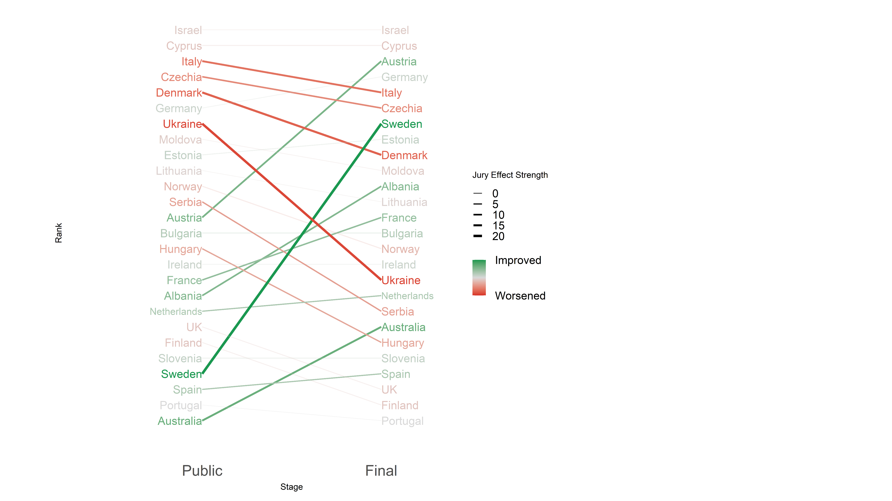
How Ranking Shifted in 2018
Line Colour Shows Effect Magnitude and Direction
Jury Effect on Voting
In 2018, the jury rewarded vocal polish, lifting Sweden and Austria despite public indifference, while penalising Ukraine's theatrical spectacle that crowds had embraced. Where production, craft and showmanship diverged, the jury and public went in completely opposite directions.

Slide 9
Graph Information
# | Data Attributes | Attributes Types | Visual Channel
1 | Stage | Ordinal | X-axis
2 | Rank | Ordinal | Y-axis (reversed)
3 | Effect Magnitude | Quantitative | Line Width
4 | Effect Direction | Quantitative | Line Colour Gradient
5 | Category | Categorical | Line alpha (opacity)
6 | Country | Categorical | Line Grouping & Labels

Slide 10
WorkFlow
Kaggle
Eschome
Tableau
R
Information Retrieval and Data Cleaning
Initial Plot and General Idea Realization
Final Graphs and Presentation Preparation
Topic Inspiration
Python
Microsoft PowerPoint

Slide 11
Thank You For Your Attention
Mutua Fadhla Mohamed SM3201434

