Slide 1







The 2019 Stack Overflow Developer Survey Results Are In
SOUMIK MITRA
9 JULY 2022

Slide 2



OUTLINE
Executive Summary
Introduction
Methodology
Results
Visualization – Charts
Dashboard
Discussion
Findings & Implications
Conclusion
Appendix

Slide 3

EXECUTIVE SUMMARY
Company details with its survey and goals
Methodology Description
Data collection and cleaning
Data analysis
Data visualization
Result presentation with charts of trends
Discussion and depth regarding of each database declared in results
Dashboard presentation of all trends with demographics
Conclusion of each research

Slide 4

INTRODUCTION
Stack Overflow’s annual Developer Survey is the largest and most comprehensive survey of people who code around the world
But the results don’t represent everyone in the developer community evenly.
We’ll make the anonymized results of this year’s survey publicly available under the Open Database License (ODbL) in May.
To address these characteristics of our survey sample, we often summarize results by
Country
Gender
highlight results for underrepresented racial/ethnic group and use survey weighting to correct for demographic skew.

Slide 5

METHODOLOGY
Data collection
Collecting Data using APIs
Collecting Data using Web Scraping
Data Wrangling
Finding and removing Duplicates
Finding and Imputing Missing Values
Normalizing Data
Exploratory Data Analysis
Analyzing Data Distribution
Hanging Outliers
Correlations
Data Visualization
Visualizing Distribution of Data
Finding Relation using different types of graphs and comparing them
Dashboards Cognos

Slide 6

RESULTS
Creating visualizations using the developer survey data. The visualizations highlight the distribution of data, relationships between data, the composition of data, and comparison of data.
Creating dashboards using IBM Cognos Analytics .
Dashboards will contain data analysis, which should be intuitive and allow for the drill-down of data.

Slide 7
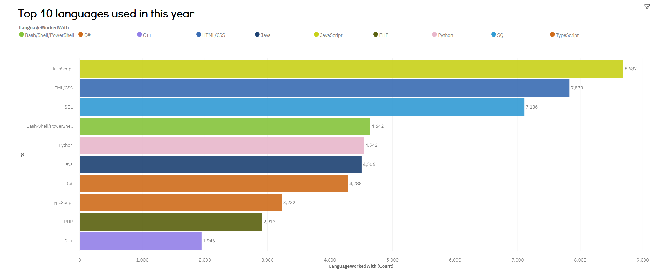
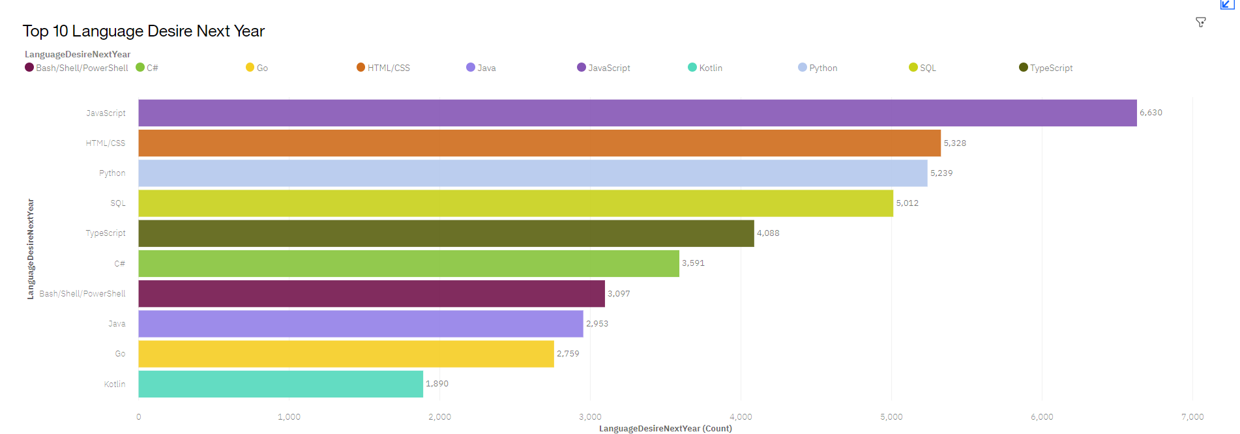
PROGRAMMING LANGUAGE TRENDS
Current Year
Next Year

Slide 8
PROGRAMMING LANGUAGE TRENDS - FINDINGS & IMPLICATIONS
Findings
JavaScript is the most leading programing language
Python, the fastest-growing major programming language
Interest in TypeScript
Implications
Python is the Future of the Programming World
Shift of programmers from JavaScript to TypeScript

Slide 9
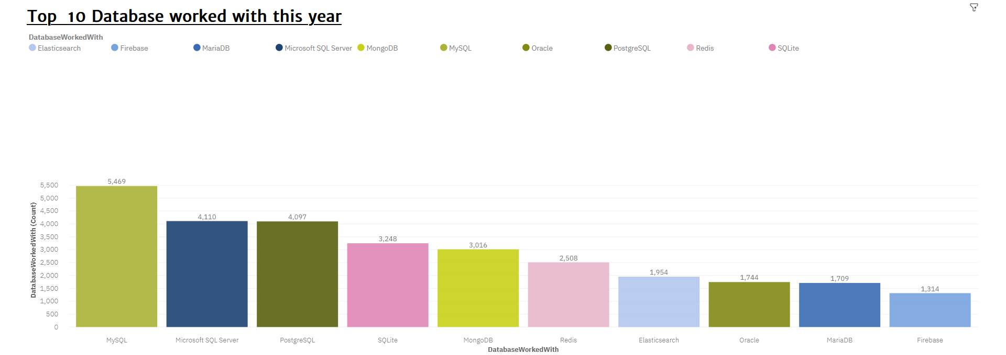
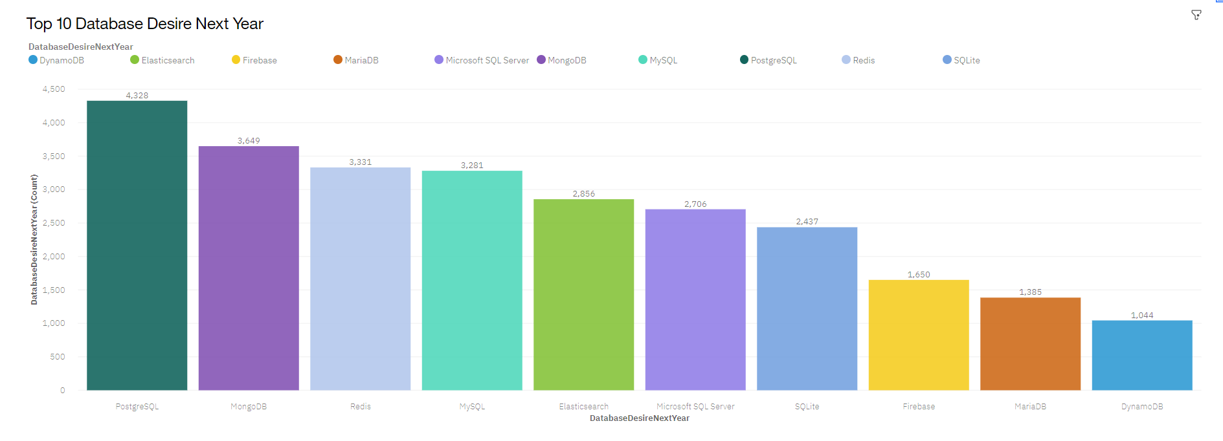
DATABASE TRENDS
Current Year
Next Year
< Bar
chart of top 10 databases for the current yer goes here >

Slide 10
DATABASE TRENDS - FINDINGS & IMPLICATIONS
Findings
MySQL is the most leading database
Increase interest in MongoDB and PostgreSQL
Decrease in passion towards Microsoft Server and SQLite
Implications
PostgreSQL and MongoDB will establish the future Database market
MySQL losing its pinnacle in the market
Microsoft Server and SQLite losing feats in the market

Slide 11

DASHBOARD
https://dataplatform.cloud.ibm.com/dashboards/0518a081-a7c1-429c-a6e8-a1cfa017a590/view/6c62d42a358f0b9243c1eee4079b7a527a3f7159babb8601d2817b490c617897f06c1296c87c4f5edf110167f6bd440bce

Slide 12
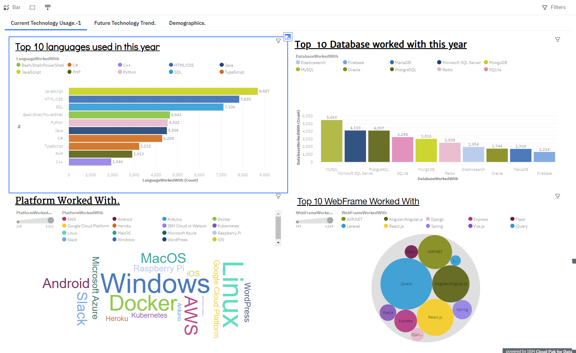
DASHBOARD TAB 1

Slide 13
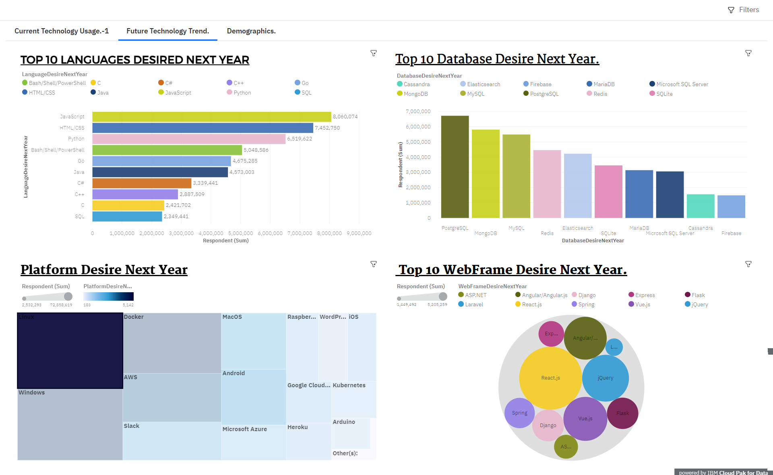
DASHBOARD TAB 2

Slide 14
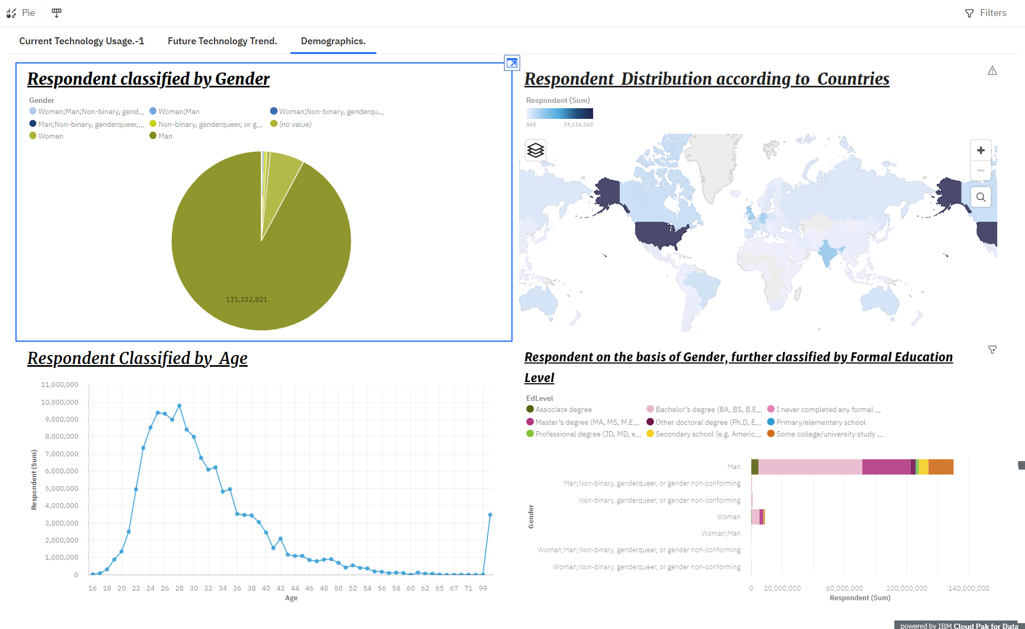
DASHBOARD TAB 3
Screenshot of dashboard tab 3 goes here

Slide 15

DISCUSSION

Slide 16
OVERALL FINDINGS & IMPLICATIONS
Findings
Python, the fastest-growing major programming language, has risen in the ranks of programming languages.
Edging out Java this year and standing as the second most loved language (behind Rust).
Over half of respondents had written their first line of code by the time they were sixteen, although this experience varies by country and by gender.
Implications
More than 90% of young male especially with bachelor degree are leading the world to new coding era.
Only developed countries are progressing towards development
Linux will be ruling the platform for developers. Change in shift from windows to Linux is visible.
JavaScript has gained huge programmers in both language and web frame fields.

Slide 17

CONCLUSION
Developed countries with its young male population of Bachelor Degree are setting up a wide platform for coding.
US and India are going to become a huge coding hub with lots of innovation and development
A good popularity of trends of languages , platform and web frames are obtained.
Developing countries are in transition phase towards developer era.

Slide 18
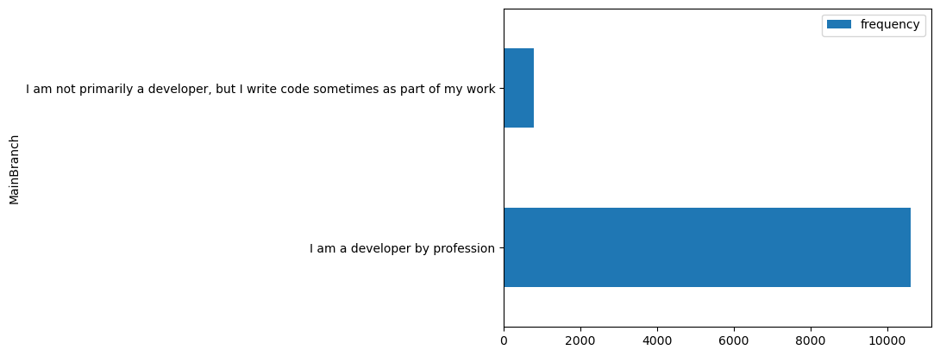

APPENDIX

Slide 19
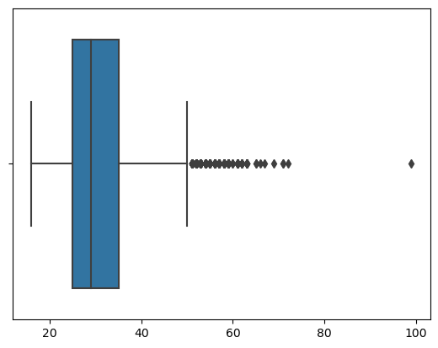
Boxplot of Age

Slide 20
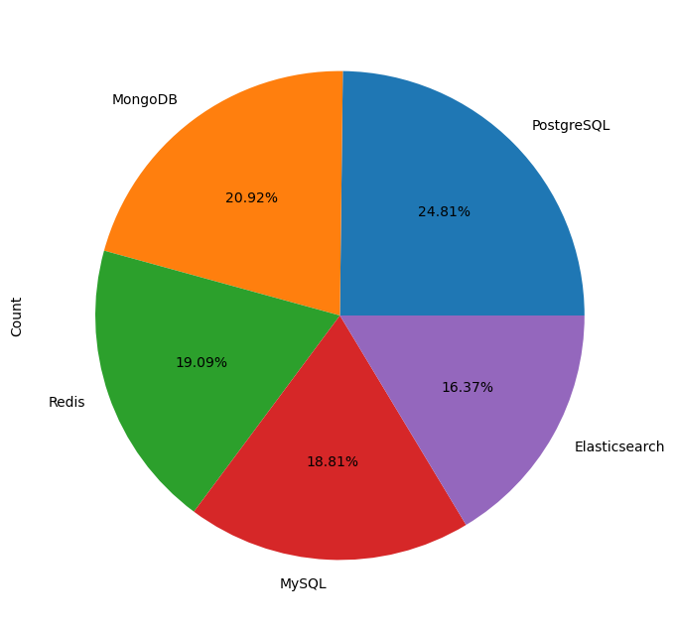
Pie chart of the top 5 databases that respondents wish to learn next year

Slide 21
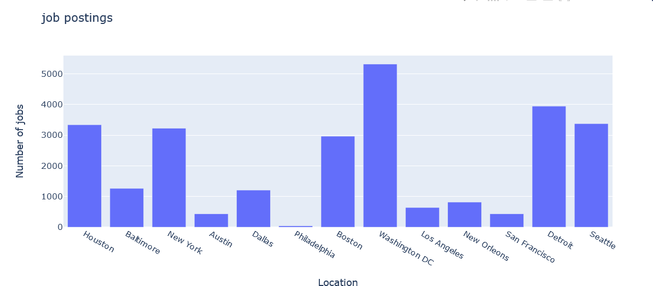
JOB POSTINGS
.

Slide 22
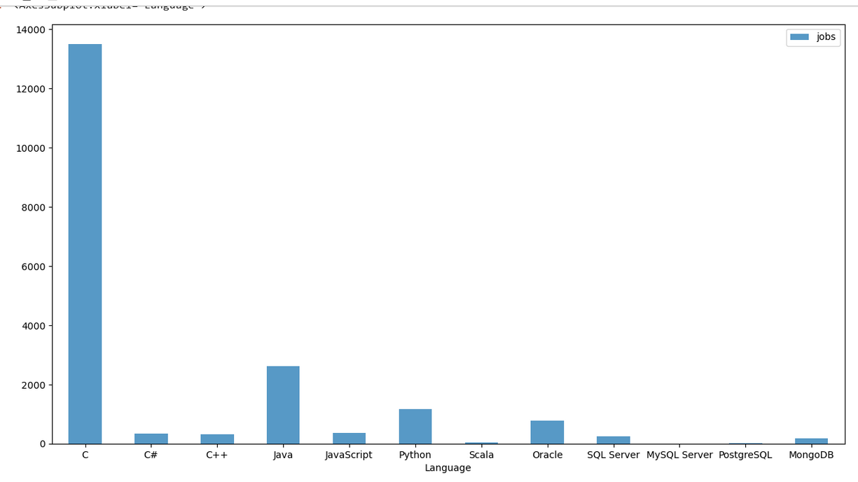
POPULAR LANGUAGES

