Slide 1
Customer Churn Prevention Presentation
Banking Analytics Report • February 2026

Slide 2
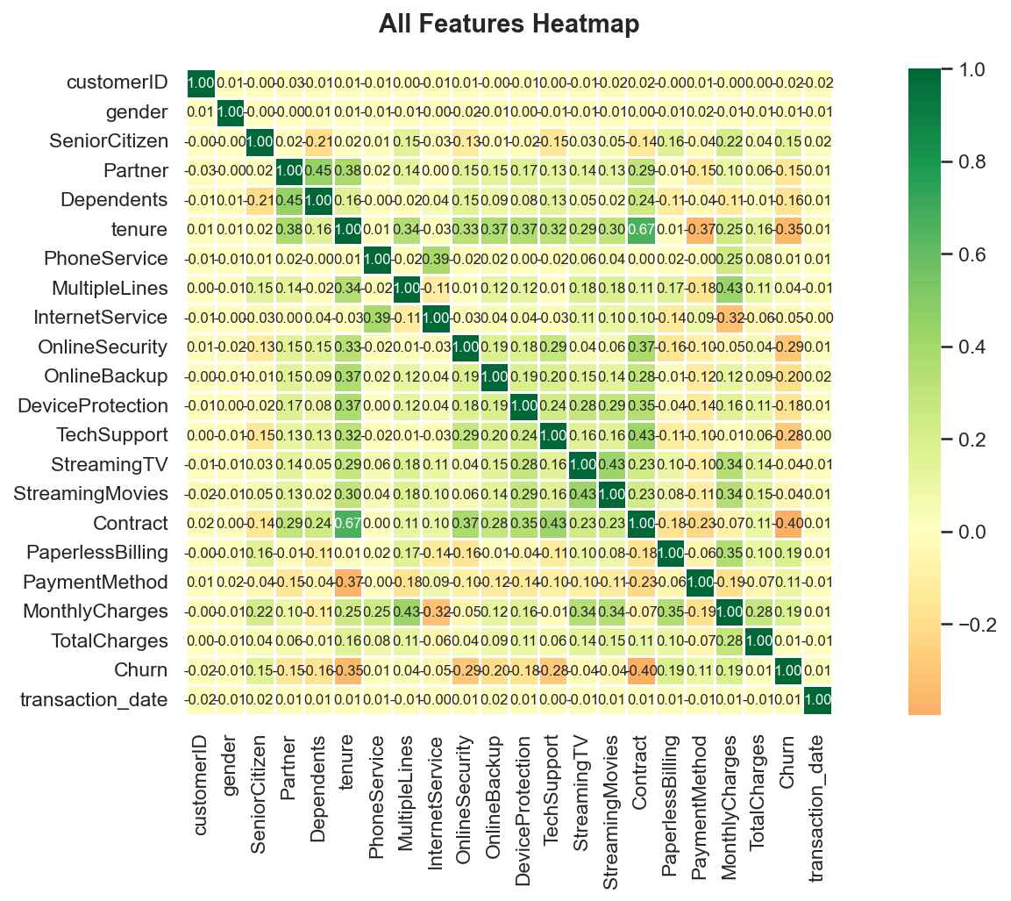
Visualisation 1: Heatmap Churn Encoded 20260223 211657

Slide 3
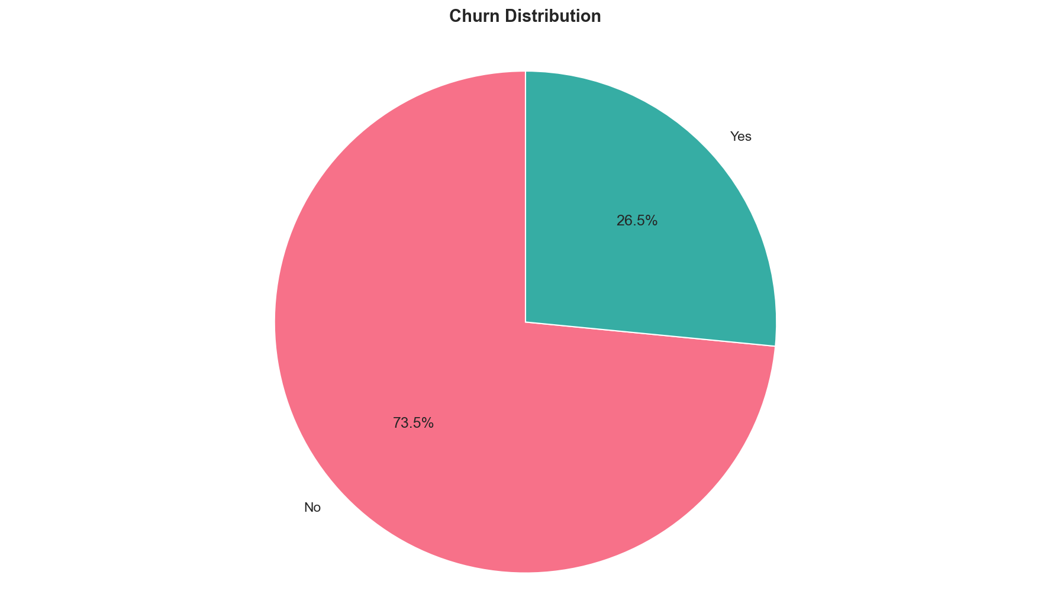
Visualisation 2: Pie Churn 20260223 211731

Slide 4
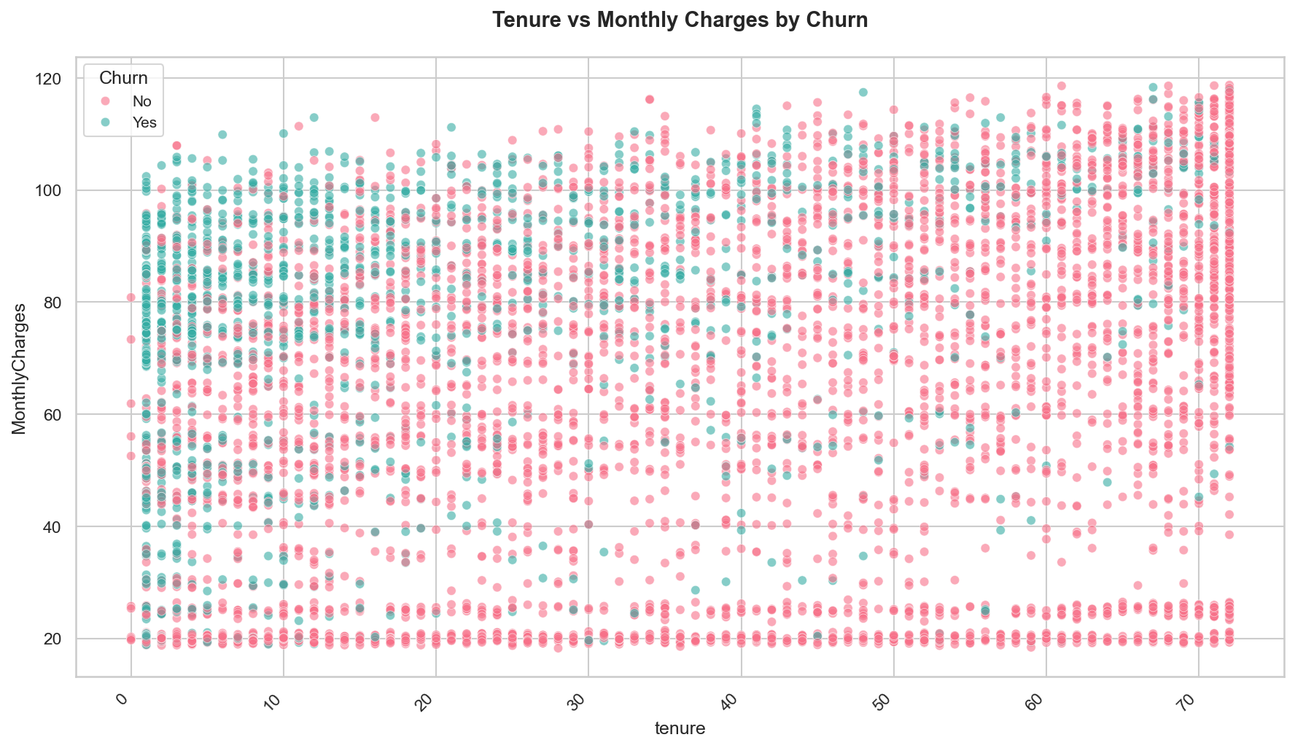
Visualisation 3: Scatter Churn 20260223 211749

Slide 5
Thank You
Questions & Discussion

