Slide 1
Churn Prevention Strategy Presentation
Banking Analytics Report • February 2026

Slide 2
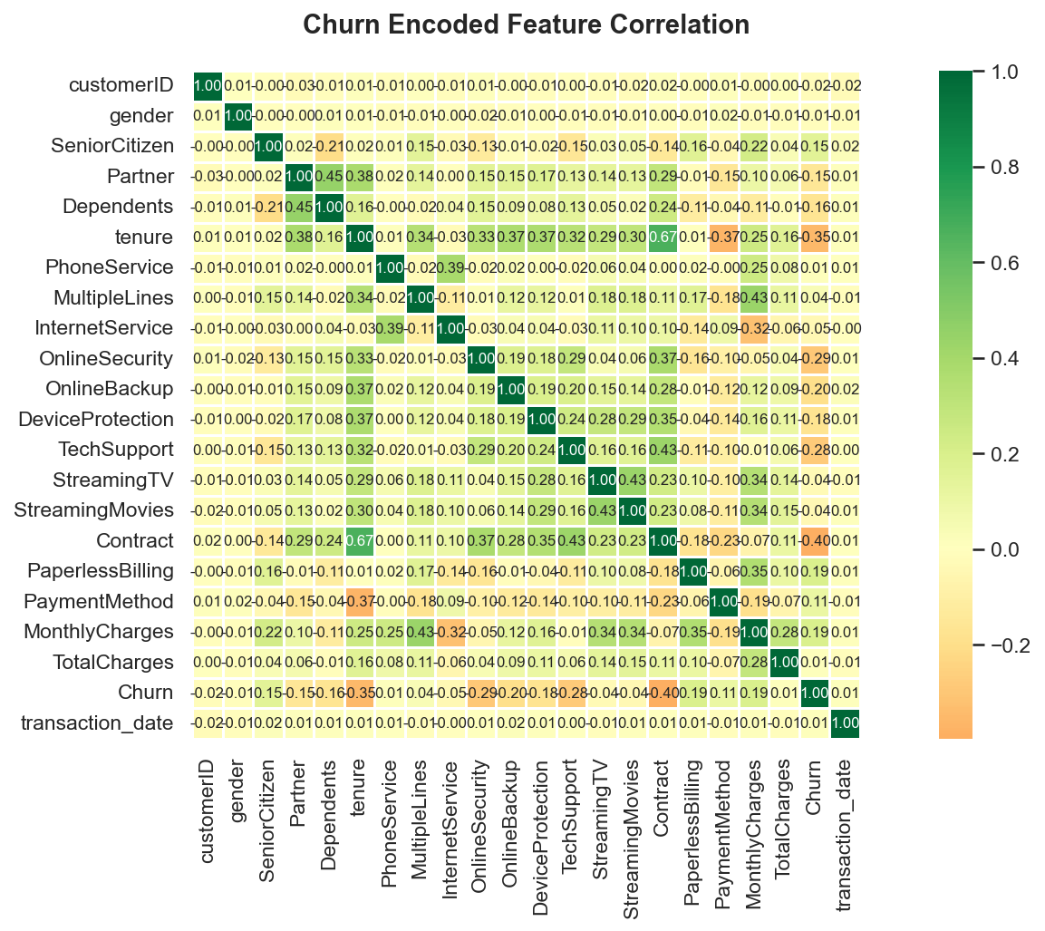
Visualisation 1: Heatmap Churn Encoded 20260223 213056

Slide 3
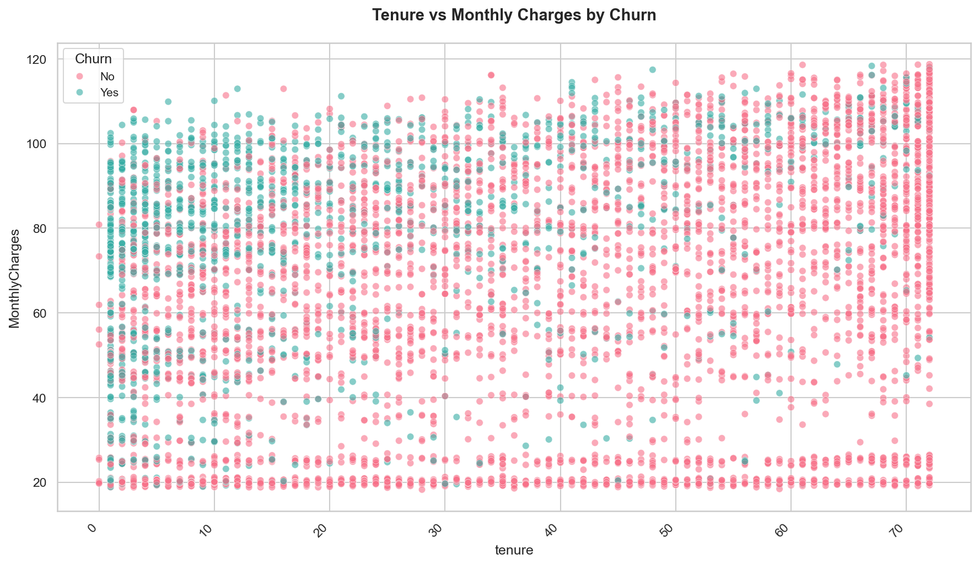
Visualisation 2: Scatter Churn 20260223 213132

Slide 4
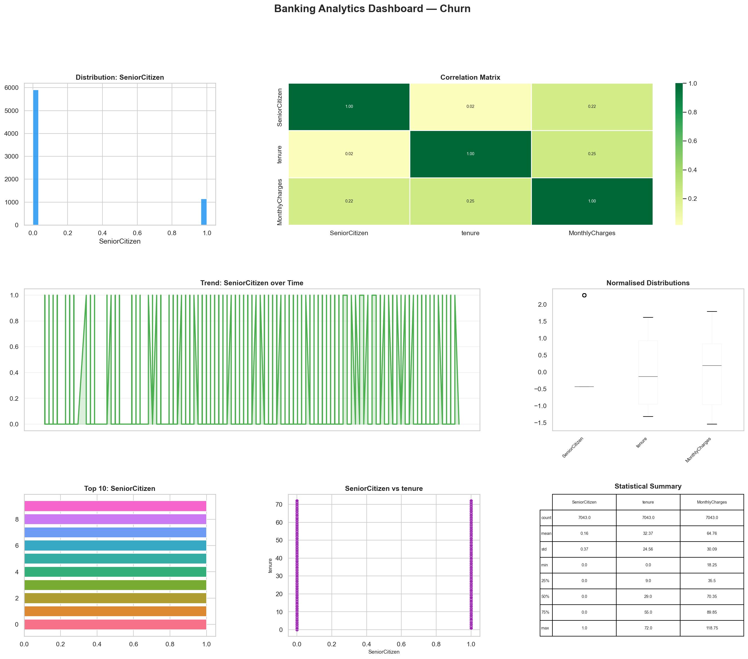
Visualisation 3: Dashboard Churn 20260223 213203

Slide 5
Thank You
Questions & Discussion

