Slide 1
]
DGVMTools
logo here
[
DGVMTools – Introduction and Overview
Matthew Forrest
LPJ-GUESS Developers Meeting, Lund
12/03/2019

Slide 2
Motivation
Much duplicated work in our field
Systematic approach could:
Save coding time
Reduce bugs
Optimise run time of analysis code
Facilitate easy comparisons/benchmarking
Allow newcomers to be effective faster
This package grew from my own R functions based on requirements from a broad range of projects.
Overall, spend less time on technical tasks, and more on actual science!

Slide 3
DGVMTools
Implemented as an R-package.
R is widely used
Accessible to ‘young scientists’ and newcomers.
R is open source and extensively developed and extended
(Yes, R can be memory inefficient but there are tricks)
“Unique Selling Proposition” of DGVMTools is that it is focussed on typical DGVM workflow.
Convenient
Extensive functionality
Reads raw model data
Metadata (PFT properties)
Irregular grids, multiple resolutions on plots
Notes:
rgdal

Slide 4
Some Technical Details
Data is stored internally as a data.table (faster than data.frame).
DGVM-related concepts encapsulated as S4 class objects
Plotting done with ggplot2
DGVMTools data can be very easily converted to other R objects such Rasters or data.frames or written as netCDF.

Slide 5
And this “typical DGVM workflow”?
Reading model output and observed datasets
Selecting and aggregating regions in space/time
Calculating new quantities for example:
Tree LAI, Summer NPP, Dominant PFT, Biomes
Plotting (maps, time series, seasonal cycle, benchmarks)
Comparing models to data – model evaluation, benchmarking
Comparing models to models – model development, MIPs
Statistical analyses
[Also averaging model ensembles, saving to disk]

Slide 6
Conceptual structure of DGVM output
Model run
+ …
LAI
C veg
transpiration
+ …
PFT 1
PFT 2
PFT 3
+ …
[also could be C pools, N pools, soil layers, … ]

Slide 7
Formalised DGVMTools structure
Source (model or data)
+ …
Field e.g. quantity such as LAI over some dimensions
+ …
Layer
(e.g. PFT 1)
Layer
(e.g. PFT 2)
Layer
(e.g. PFT 3)
+ …

Slide 8
Source
eg. “SF1 simulation”
directory on disk
unique identifier
climate forcing
+ … (other metadata)
Format
eg “LPJ-GUESS”
how to read a particular type of data
model/dataset specific
Field
main object of the package!
conceptually similar to a raster stack
DATA!
Lon Lat Year PFT1 …
.... .... .... .... ….
.... .... .... .... ….
.... .... .... .... ….
.... .... .... .... ….
.... .... .... .... ….
Quantity
name
units
plot colours
(‘just’ metadata)
STAInfo
“dimensions” of the data
(‘just’ metadata)
Layer 1
Layer 2
Layer 3
possibly a PFT
possibly a PFT
possibly a PFT

Slide 9
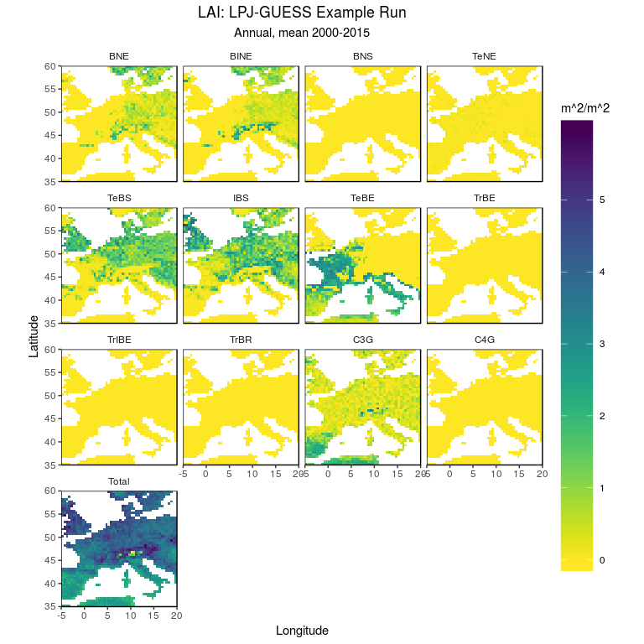
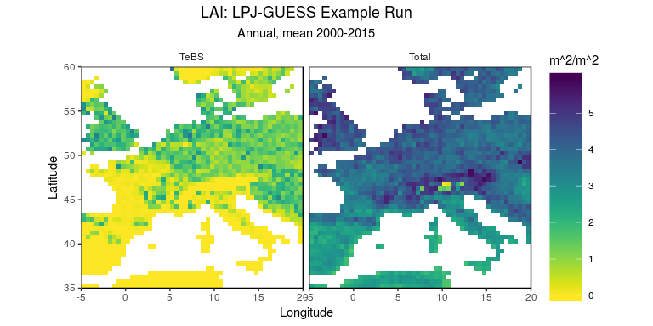
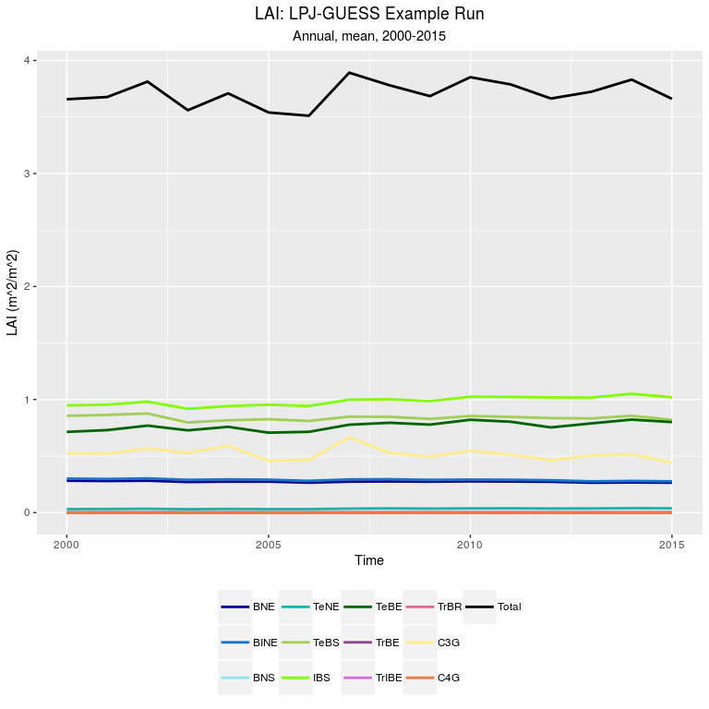
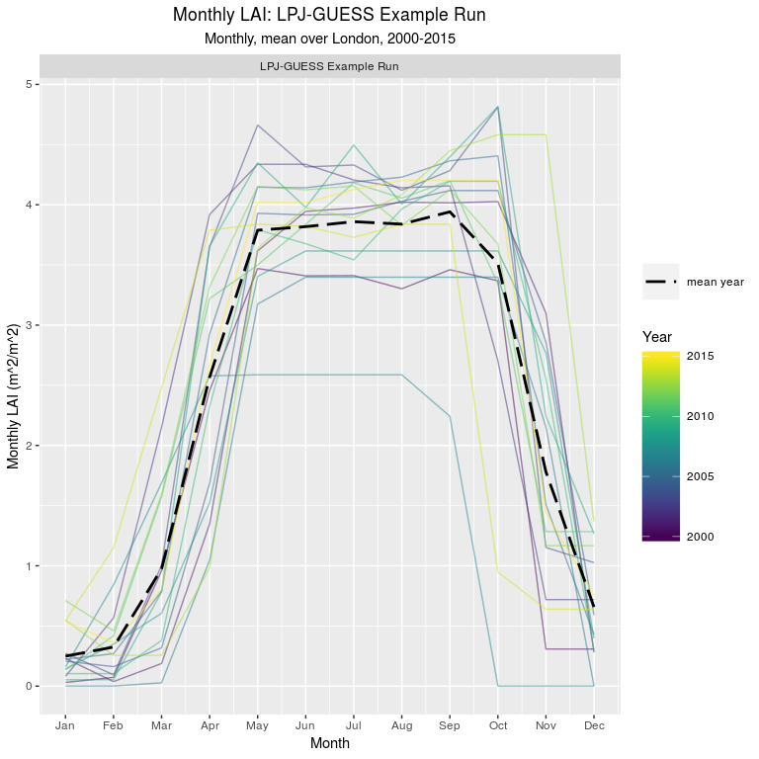
What can one do with Layers in a Field?
Field
Layer 1
Layer 2
Layer 3
Layer 4
= 1+3
Layer 5
= 2/3
Layer 6
= max(1,2,3)
Operation on layers to calculate new layers
Plot one or more layers

Slide 10
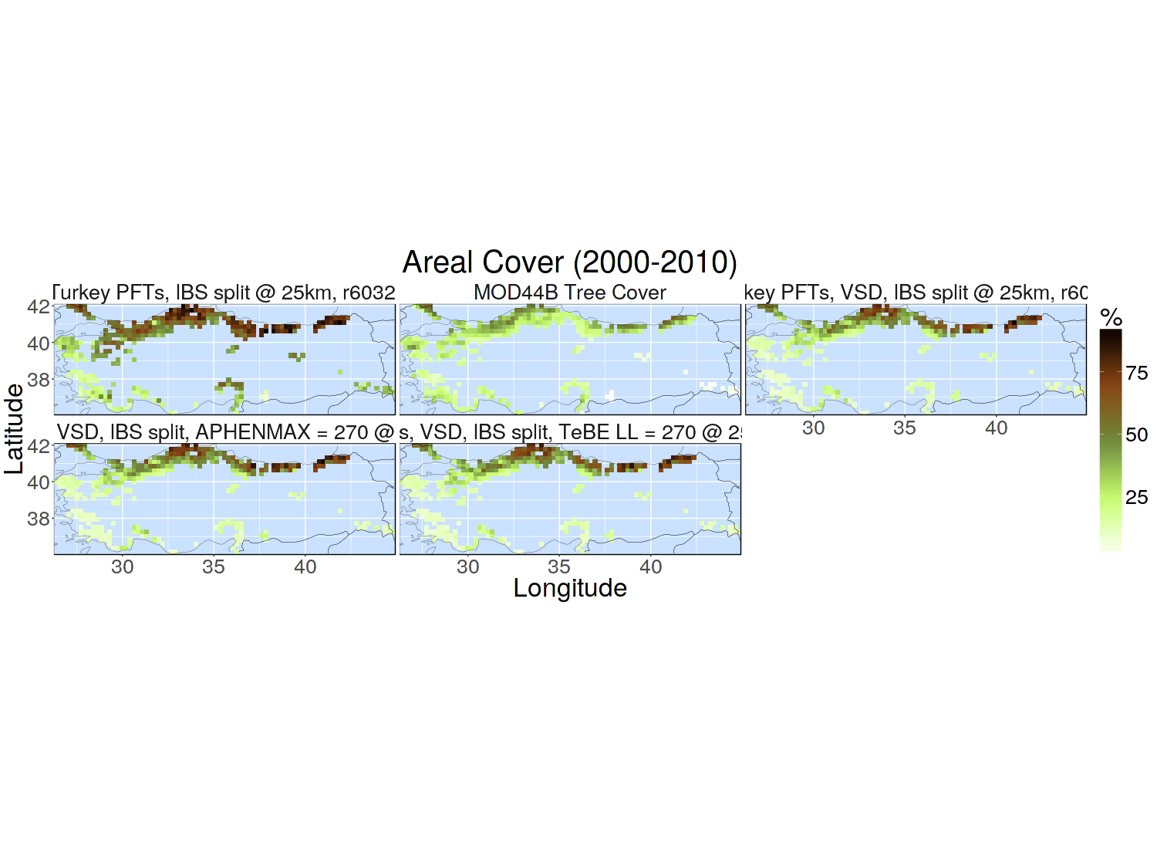
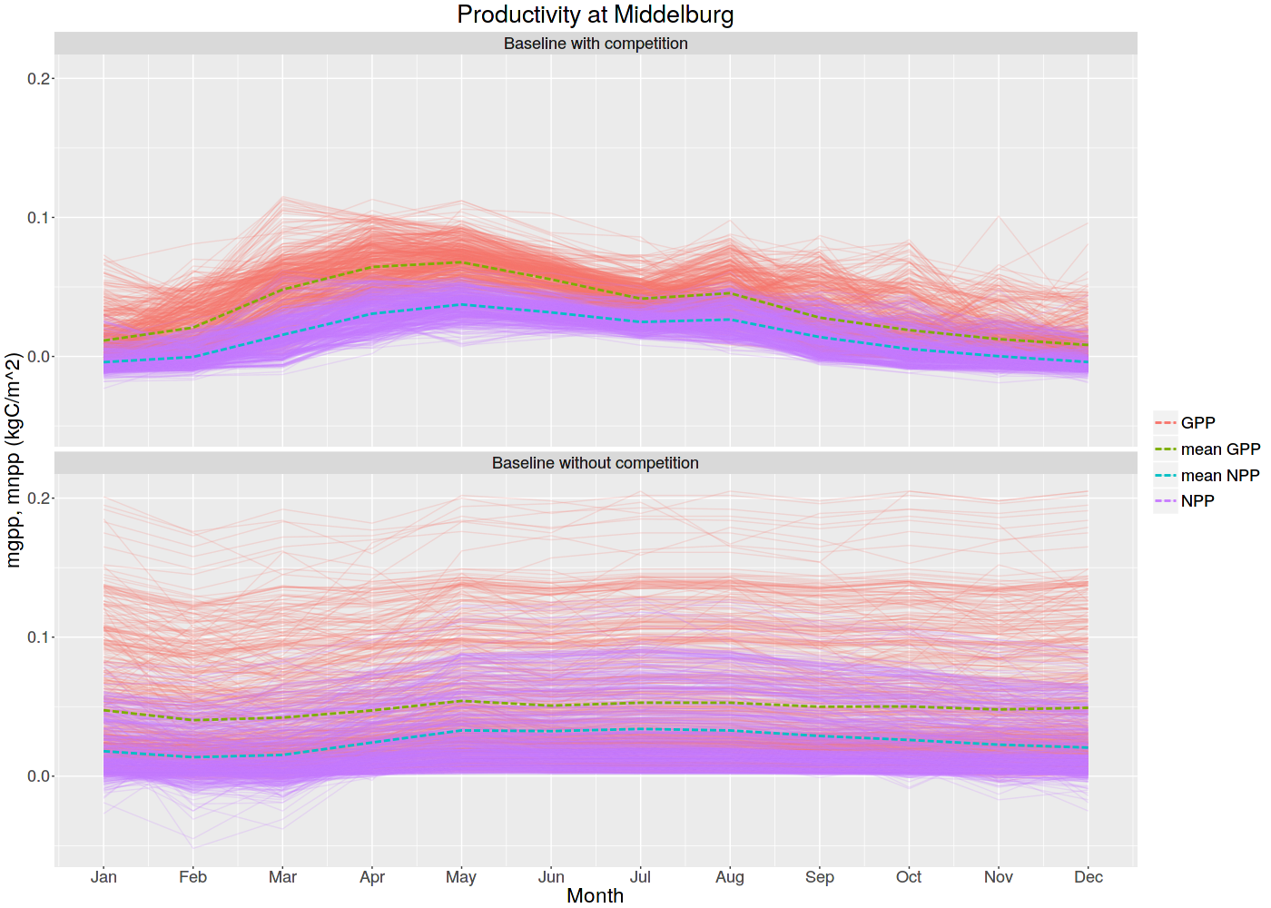
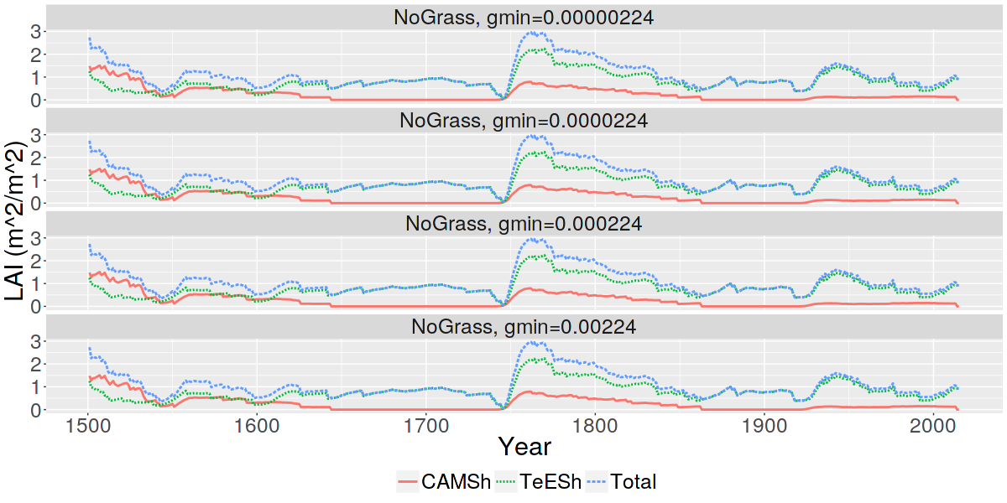
What can one do with many Fields?
Field 1
+
Field 2
=
Field 3
Field 1
x
Field 2
=
Field 4
Operations on Fields to calculate new Fields
Plot many Fields at once

Slide 11
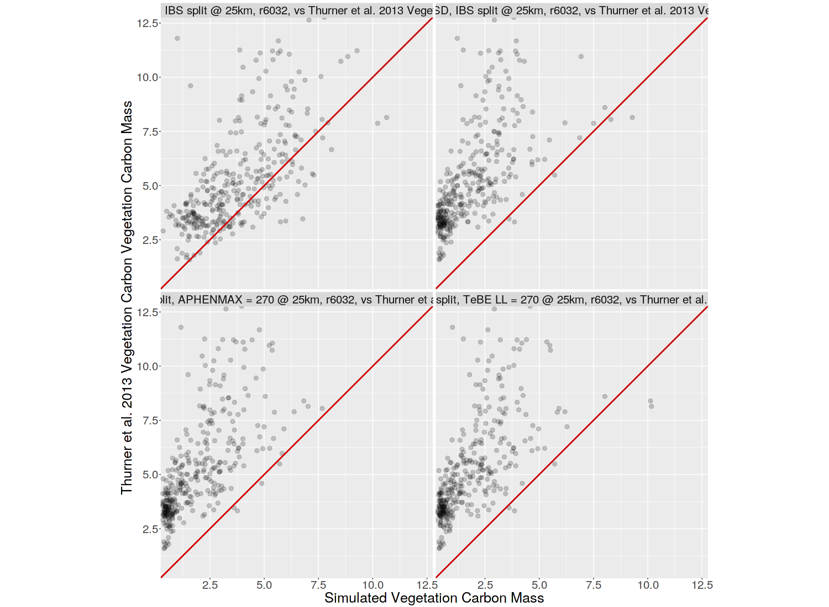
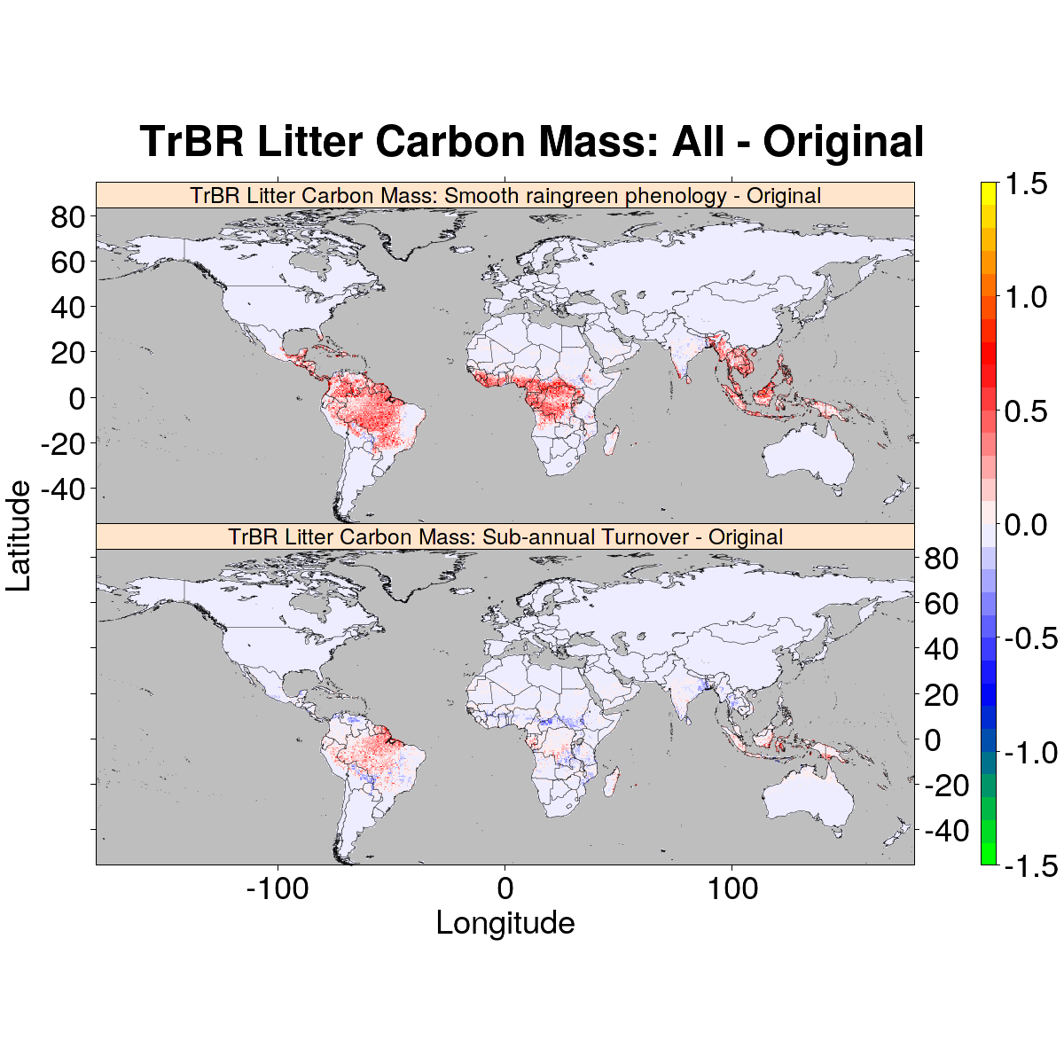
Field 1
Field 2
Layer X
Layer Y
Comparison
Compare Layers from Fields to make a Comparison
Summary stats/metrics:
R², NME, RMSE, Kappa, etc
Comparison

Slide 12
How many dimensions in our data?
I count five! (or maybe even six or seven)
1. Longitude
2. Latitude
Lon
Lat
3. Time (years)
Year
D
J
F
N
M
Subannual
4. ‘Subannual’ (days, months, seasons)
A
O
S
J
M
A
J
5. ‘Layers’ (PFTs, carbon pools)
Layers
6. ‘Z’ (elevation/depth)
(see Layers)

Slide 13
DGVMTools contains functions specifically for working with these dimensions:
Aggregate across space and time dimensions (mean, sum, min, max, var, …):
aggregateYears(…), aggregateSpatial(…), aggregateSubannual(…)
Select within space and time dimensions :
selectYears(…), selectMonths(…), selectDays(…), selectSeasons(…), selectGridcells(…), raster::crop(…)
Select and operate on layers:
selectLayers(…), layerOp(…)
Plot data given dimensions:
plotSpatial(…), plotTemporal(…), plotSeasonal(…)

Slide 14
Also featured but not covered here:
Automatically combining PFT layers (for example ‘all trees’, or ‘all evergreen’)
Reading standard datasets (DGVMData Format)
Efficient saving and re-opening of already processed files
Deriving biomes
Writing to CF-compliant netCDF
Exporting to standard R objects (data.frame, raster)

Slide 15
Current status and trying it out:
Package on GitHub. Code is pretty stable, a few extra improvements to make.
Plan to soon upload to CRAN and write up a paper.
In general LPJ-GUESS is very well supported.
Feel free to try it out, I try to offer comprehensive support and documentation.
Tutorial/workshop tomorrow in Litosphären, 13:00-16:00 (also on Zoom)
Bring a laptop with your own data.

