Slide 1
ERIC and NON-eric classification
A system project
by haodong wu, louis gao, olivia che

Slide 2
problems
Basic sentiment analysis of comments from the Internet is not enough for a deeper understanding of a text
positive and negative comments are just two polarities so we want to classify the corpus based on another rule called ERIC vs. Non-ERIC

Slide 3
definition of eric
ERIC is abbreviation of Engaging, Respectful, Informative and Constructive comments.
It is first defined in Finding Good Conversations Online: The Yahoo News Annotated Comments Corpus by CourtneyNapoles et al.

Slide 4

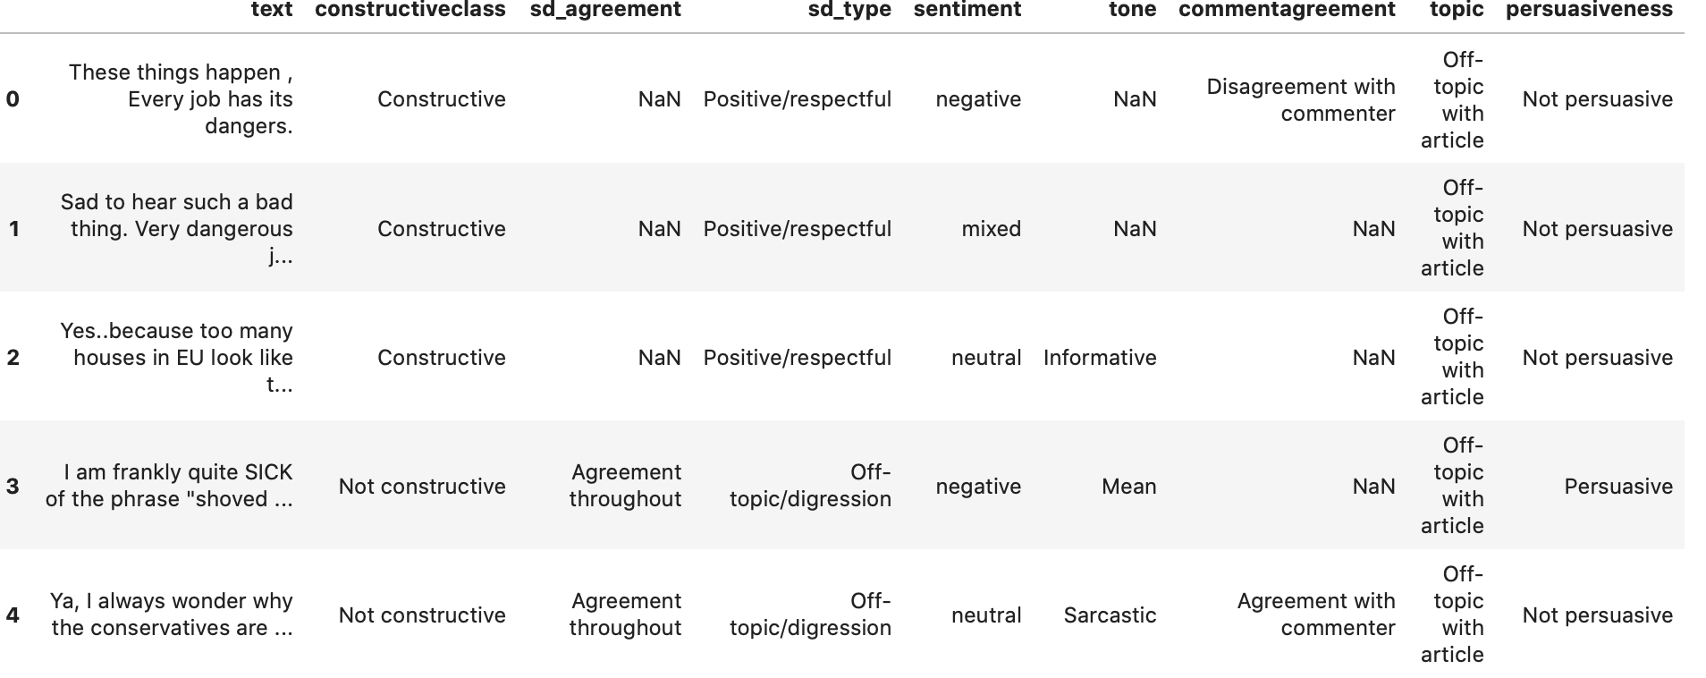
Data sets
We are using the Yahoo News Annotated Comments Corpus (YNACC)
The comments contain 2.4k threads and 10k comments from Yahoo articles
Each comment has already been annotated and has multiple attributes

Slide 5
Approaches
Since the data sets did not annotate ERIC or Non-ERIC comments but only label the attributes, we try to make our own rule to classify ERIC
Currently we define the comments with a constructive, positive/respectful sd_type, and persuasive to be ERIC and all the others belong to Non-ERIC

Slide 6
Approaches
Then we try to use machine-learning models such as Naive Bayes, Logistic Regression and Tf-idf to evaluate the result of our classification
The accuracy score for these models are : accuracy score screen shot

