Slide 1
Worker Behavior Audit
Project LDR: Anomaly Detection Mark London

Slide 2
Summary
Total Workforce: 50 Workers
Anomalies Detected: 2 High-Risk Cases
Method: Dimensionality Reduction (PCA)
This system automatically filtered the “Territory” to find the 2 workers who deviate from the standard “Map”.

Slide 3
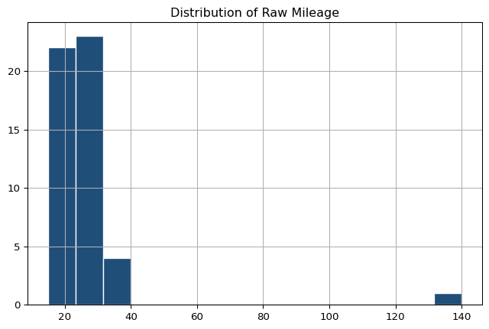
Stage 1: The Distribution

Slide 4
```

