Slide 1
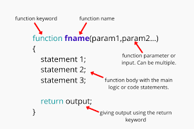
Functions

Slide 2
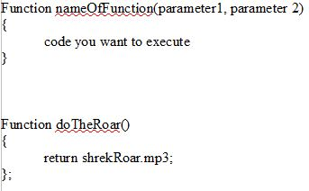
Syntax
Block of code doing a specific task/function
Invokes

Slide 3
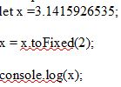
Built in functions
.toFixed()
Returns a number with x decimals

Slide 4

ToPrecision()
Rounds up

Slide 5
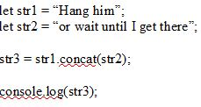
.concat()
Concatenates two or more strings

Slide 6

.blink()
Blink as if it has a BLINK tag

Slide 7

Custom functions
The functions you'll use the most

Slide 8
Anonymous functions
Functions without name
Not directly accessible
Best used right away
=>

Slide 9



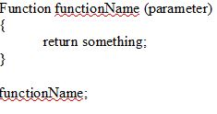

Invocation
Call function

Slide 10
Parameters & Arguments
No specific data type
Not checked
Left empty will result in undefined

Slide 11
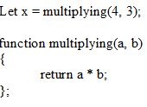
Return values
Returns a certain “value”
Stop executing

