Slide 1
Robustness of CNNs to Test-Time Image Degradation on Fashion-MNIST
Custom 4-Layer CNN vs ResNet-18
Anthony Huang
May 2026

Slide 2
Background: Kaggle Fashion-MNIST Dataset
60,000 training images + 10,000 test images
10 clothing classes (T-shirt, Trouser, Pullover, Dress, Coat, Sandal, Shirt, Sneaker, Bag, Ankle boot)
28×28 grayscale images
Small enough for fast experimentation, complex enough to reveal generalization issues

Slide 3

Research Question & Methodology
Research Question: How does test-time image degradation affect CNN performance?
Train:Val:Test = 7:2:1
40 epochs, early stop if validation loss does not improve for 5 consecutive epochs
Degradation: Gaussian Blur (kernel=5) + High Contrast (factor=2.5)
Six degradation levels on Test set: 0% (clean), 10%, 30%, 50%, 70%, 100%
Both model shared degradation test set for fair model comparison
Evaluation metrics: Accuracy, Loss, Predictive Entropy, Confusion Matrix, ROC, t-SNE
GitHub: https://github.com/MagicalAnt/AI_DS.git

Slide 4
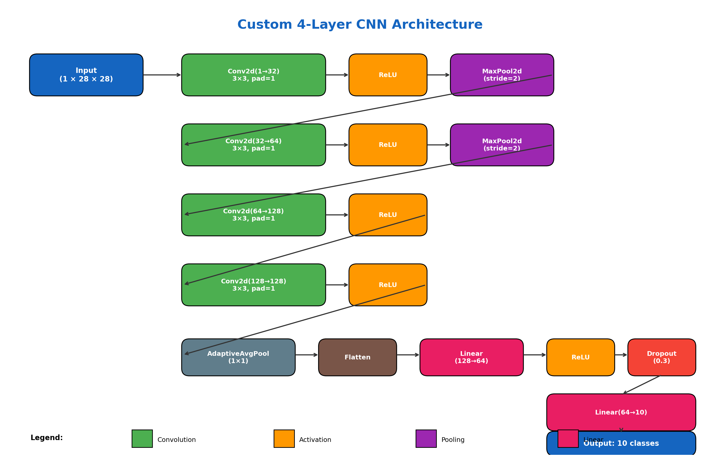
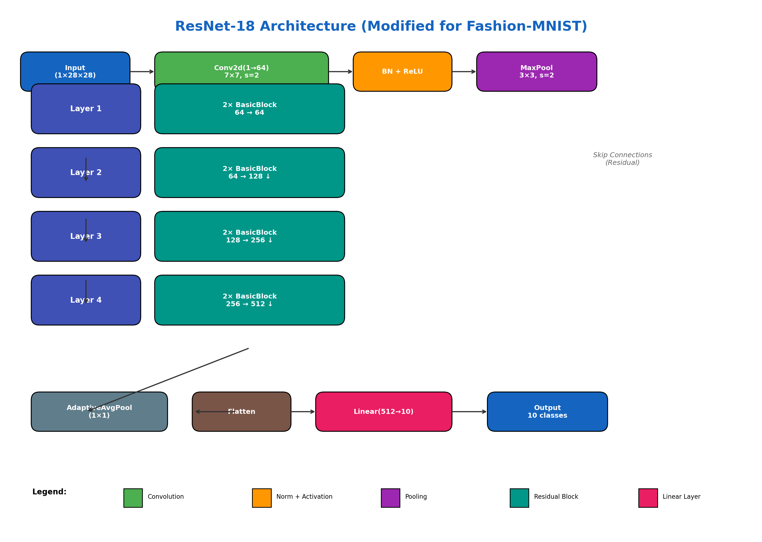
Models: Custom CNN vs ResNet-18
Custom 4-Layer CNN (249,162 parameters) - Simple architecture, 4 conv layers - CrossEntropyLoss + Classifier + Early stopping + weight decay to prevent overfitting | ResNet-18 (11,175,370 parameters, 45x ) - Pretrained on ImageNet, 18 layers with residual con - CrossEntropyLoss + simple Classifier + Early stopping + weight decay to prevent overfitting

Slide 5
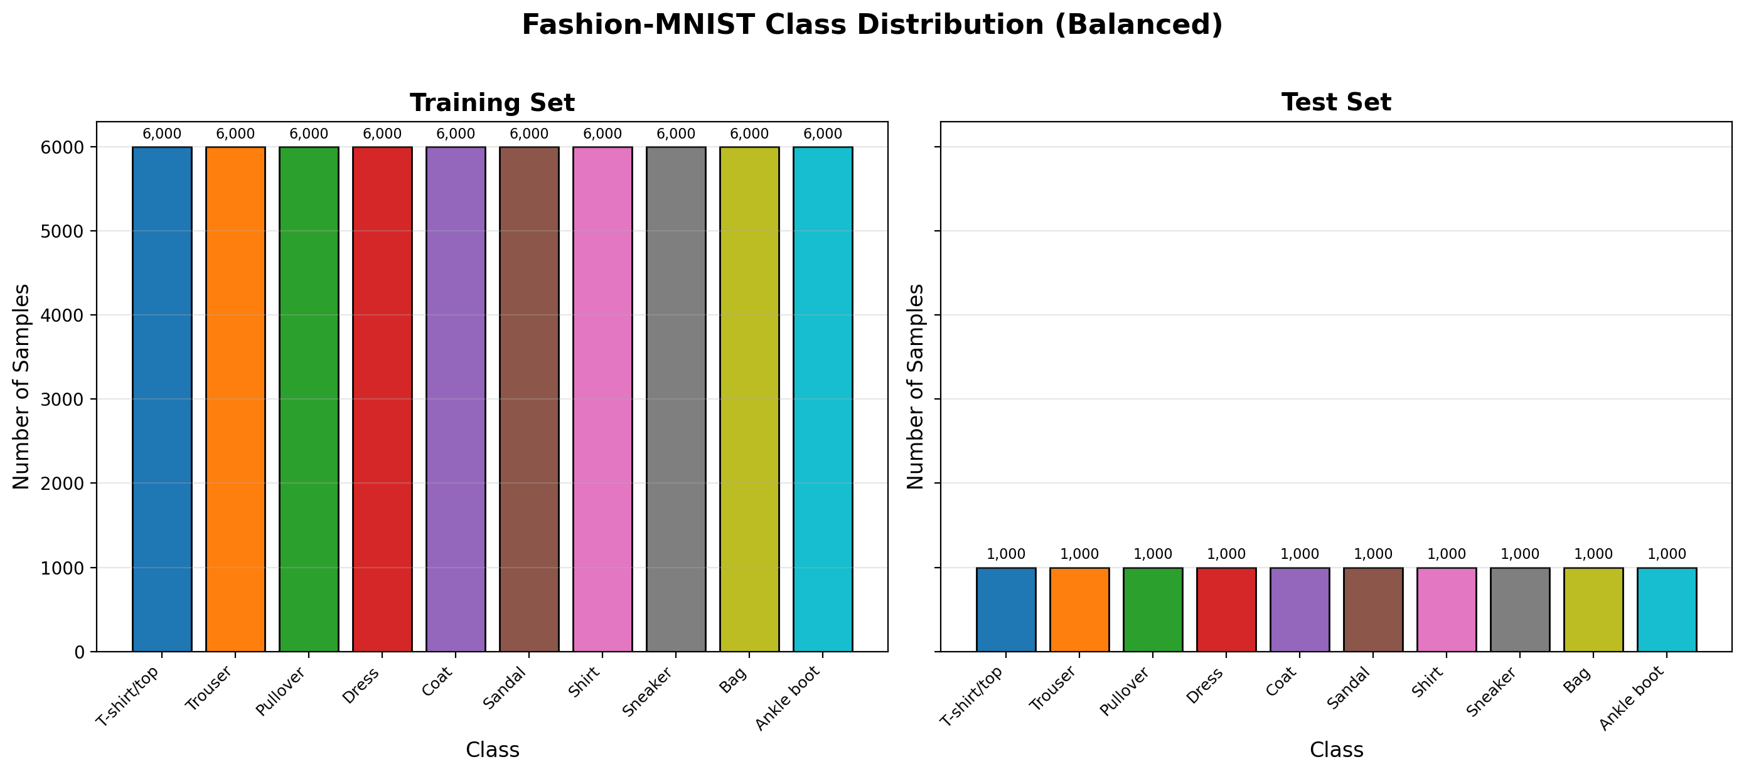
Dataset Balance Check

Slide 6
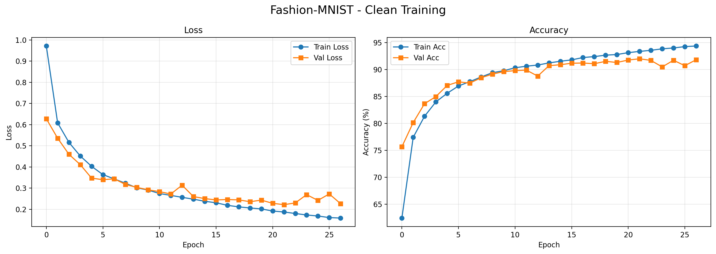
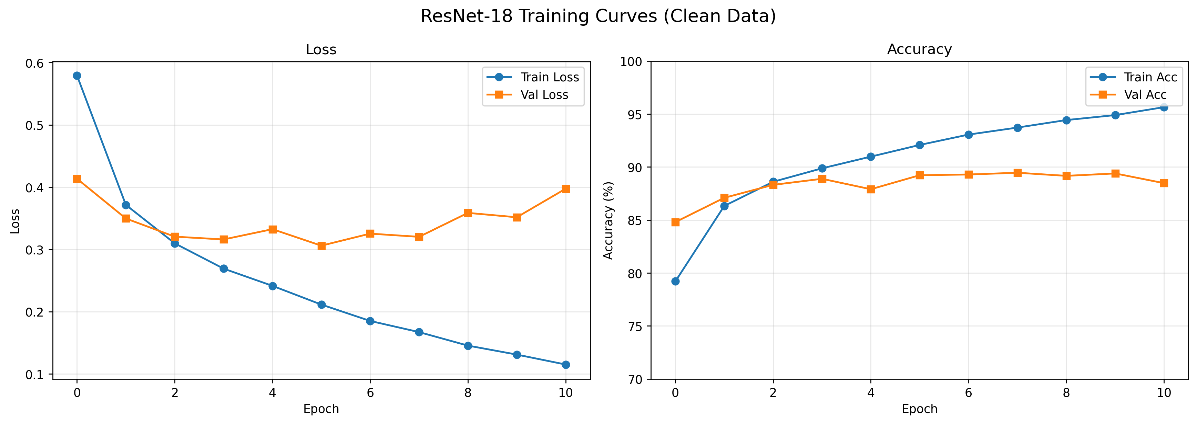
Training Dynamics: Accuracy vs Degradation (both triggered early stop)
Custom CNN
Resnet-18

Slide 7
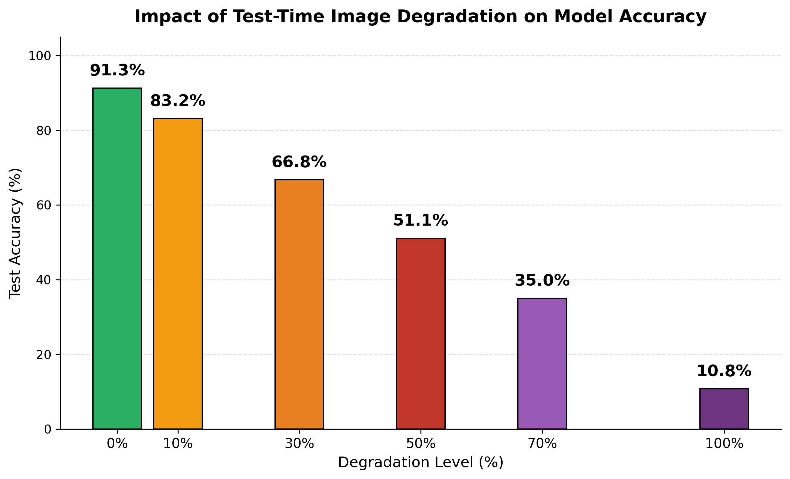
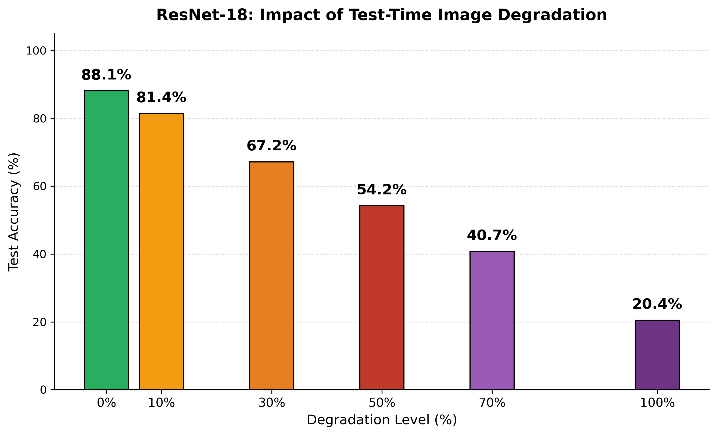
Accuracy vs Degradation: accuracy declines as degradation level goes up
Custom CNN
Resnet-18

Slide 8
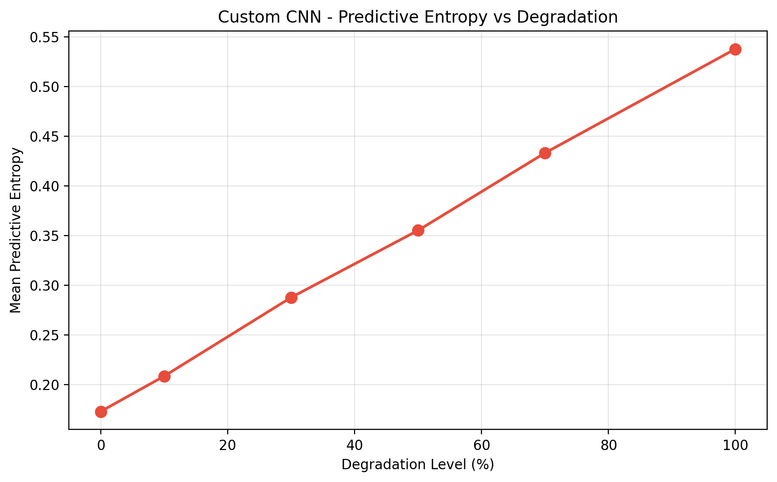
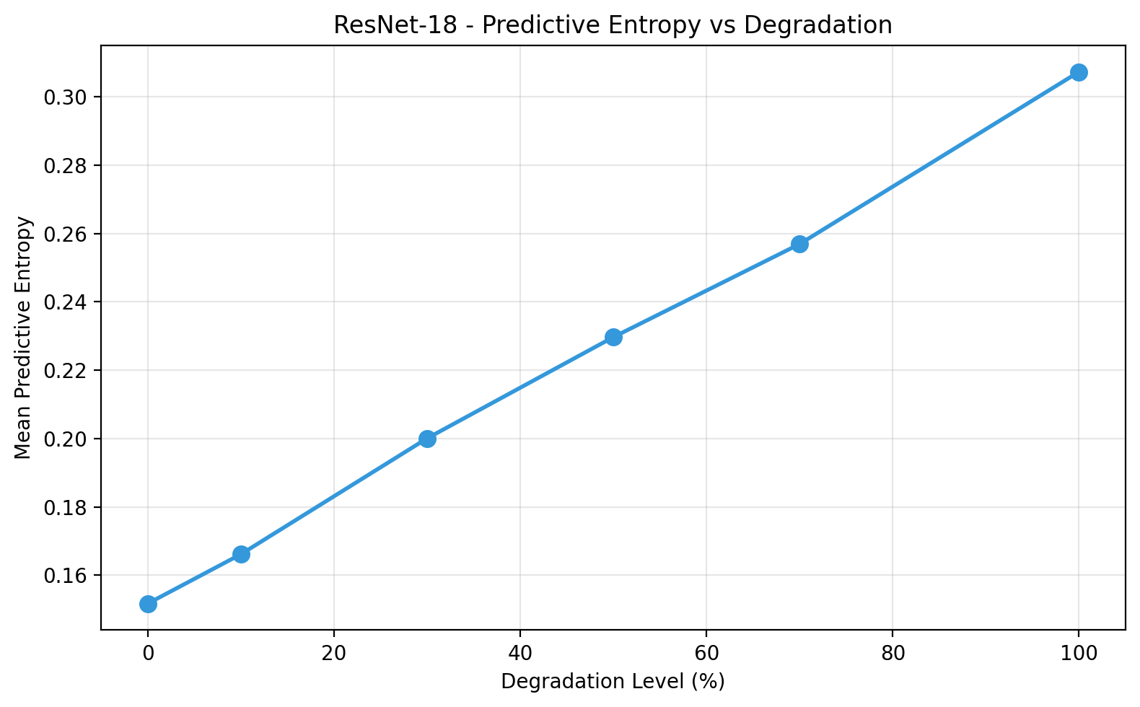
Predictive Entropy: Model Uncertainty Increases with Degradation
Custom CNN
Resnet-18

Slide 9
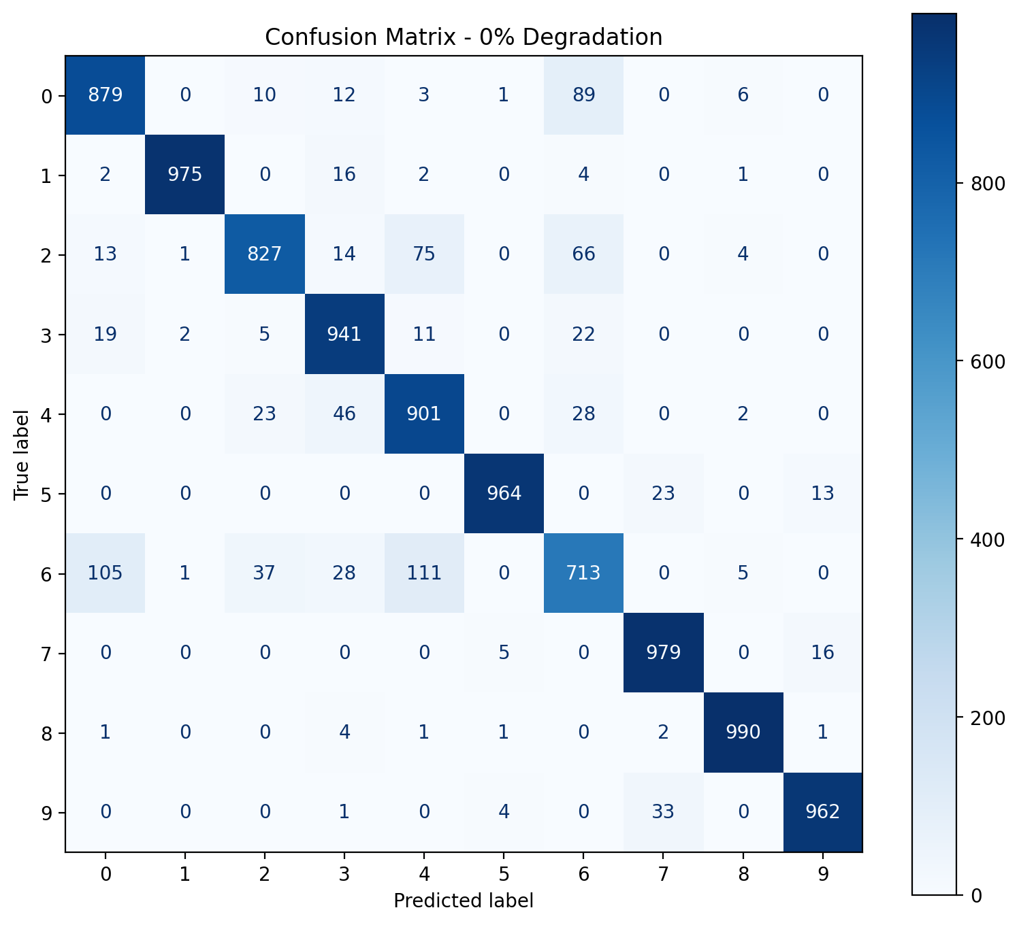
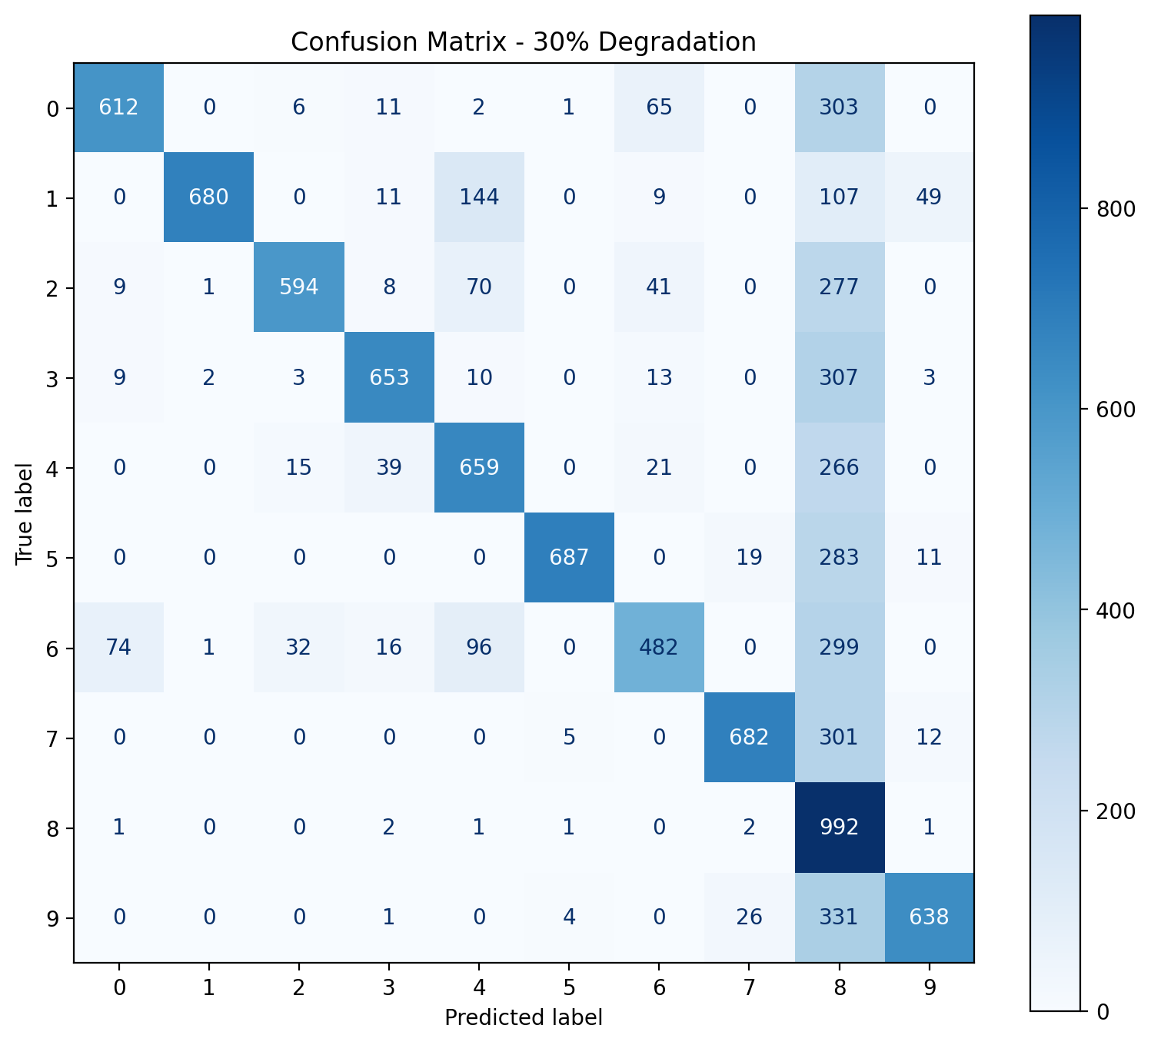
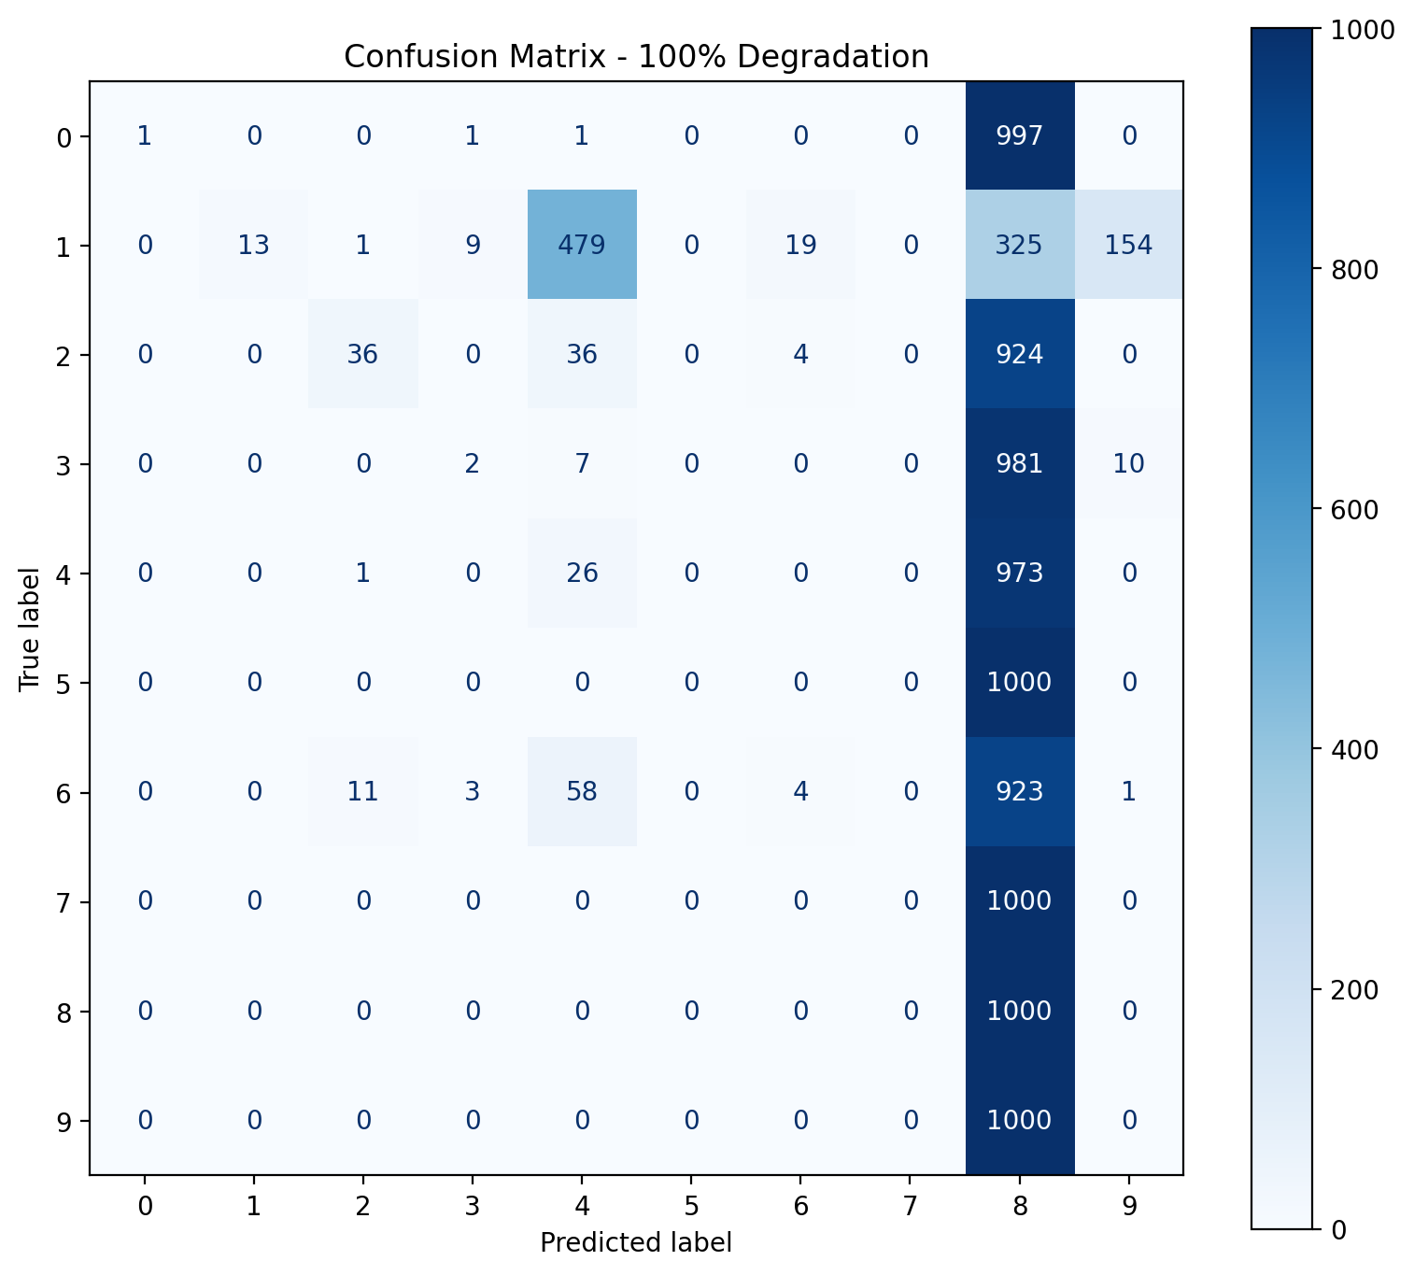
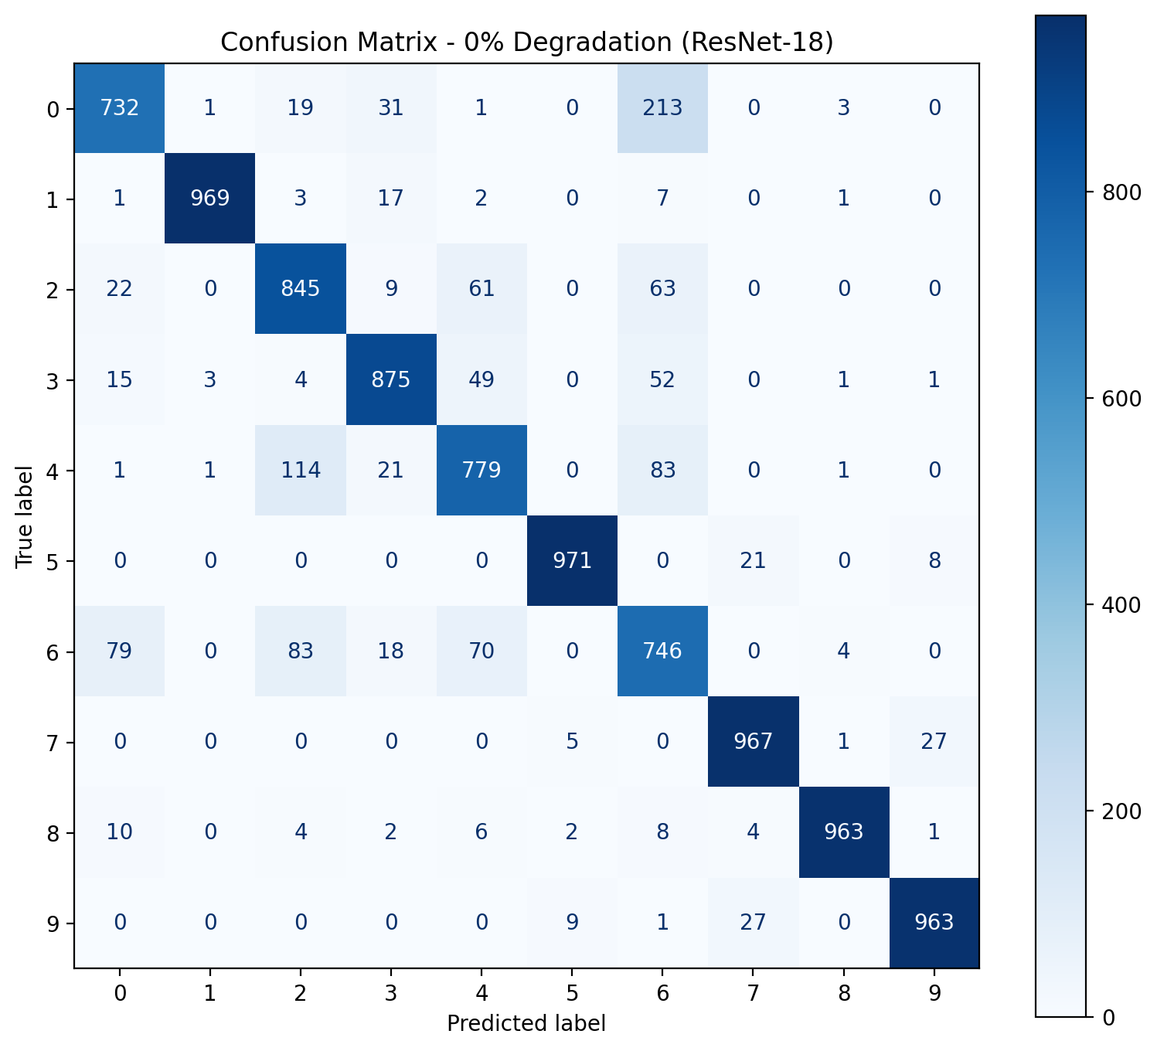
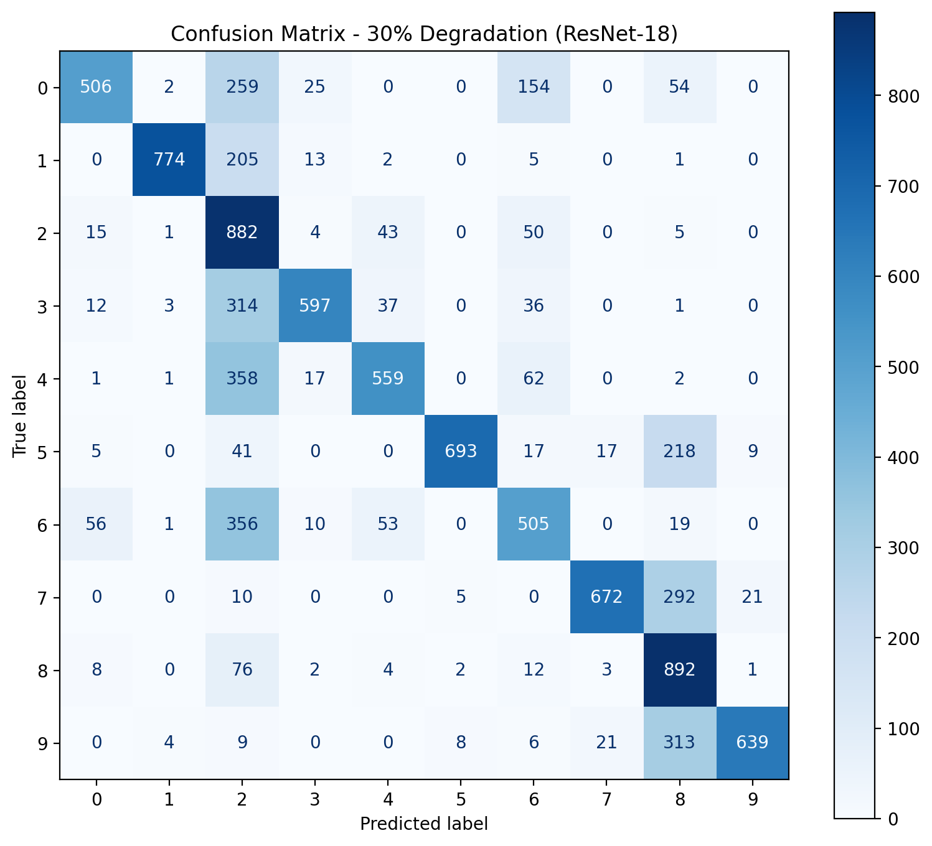
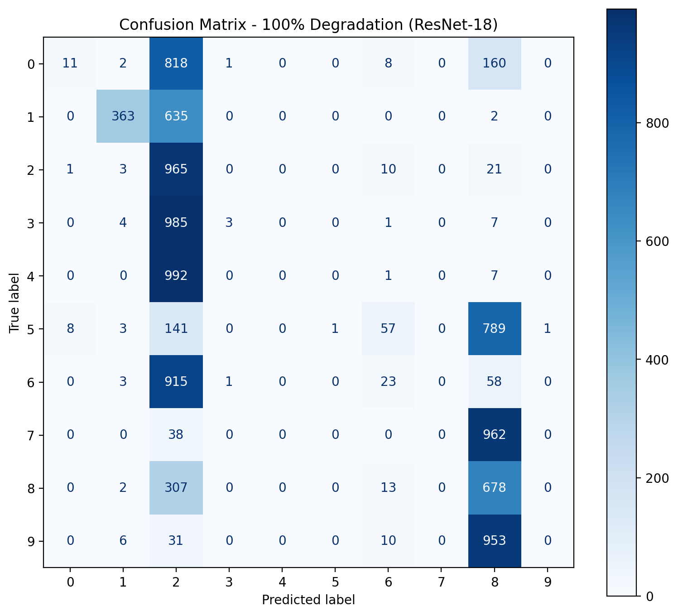
Confusion Matrices: Clean vs 30% vs 100% Degradation
Custom CNN
0% degradation
30% degradation
100% degradation
Resnet-18

Slide 10
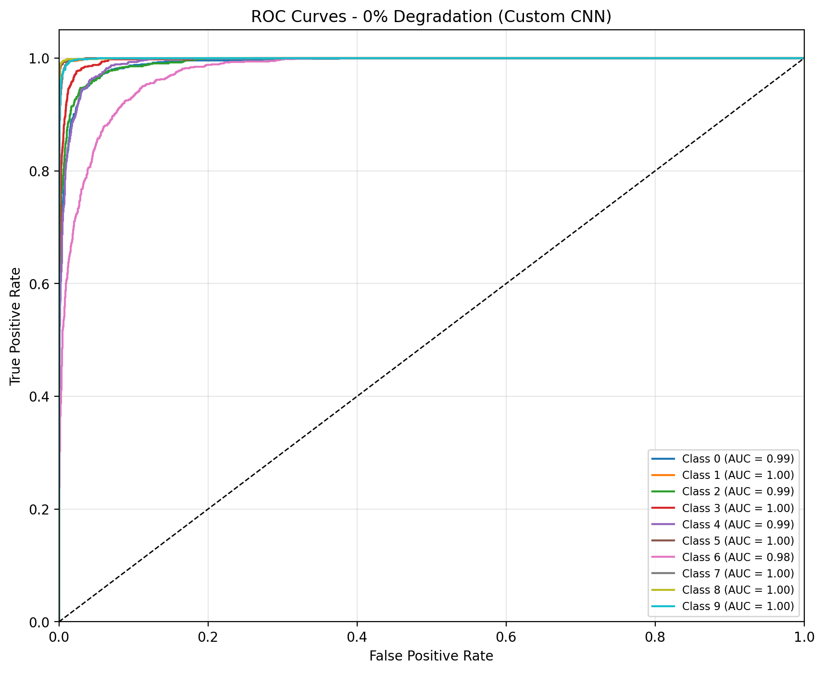
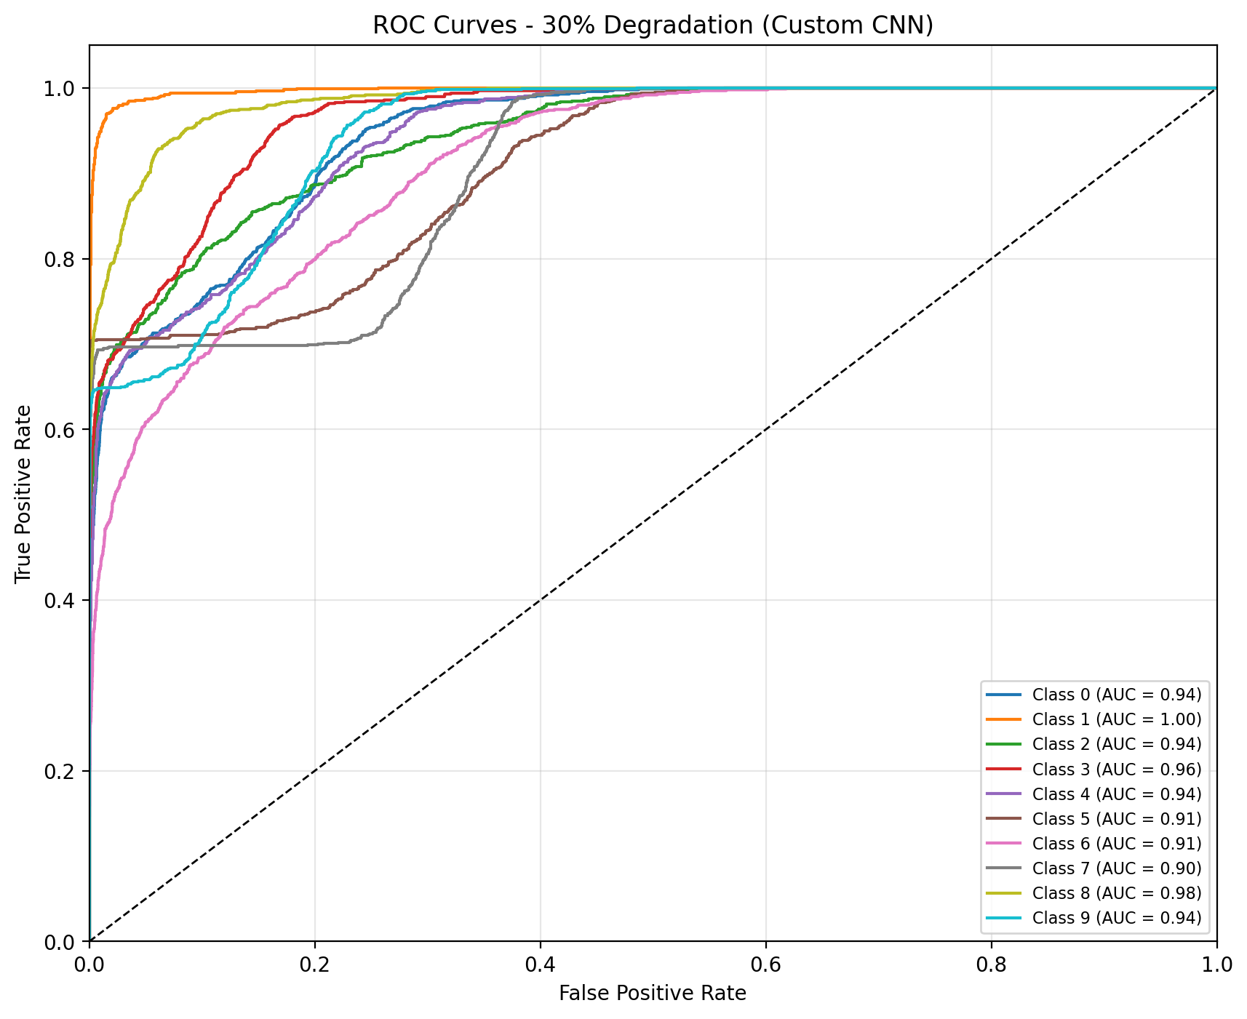
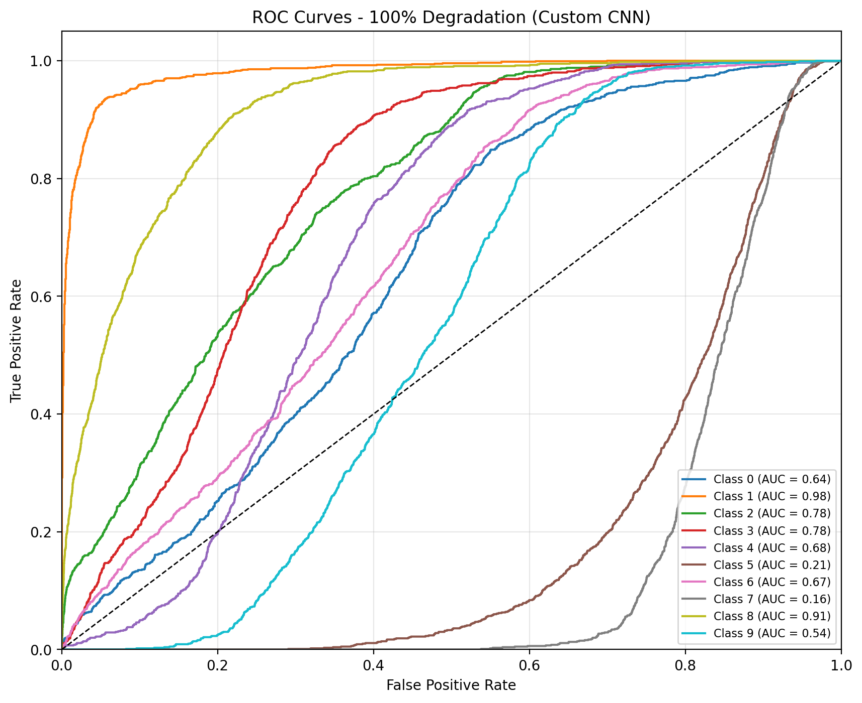
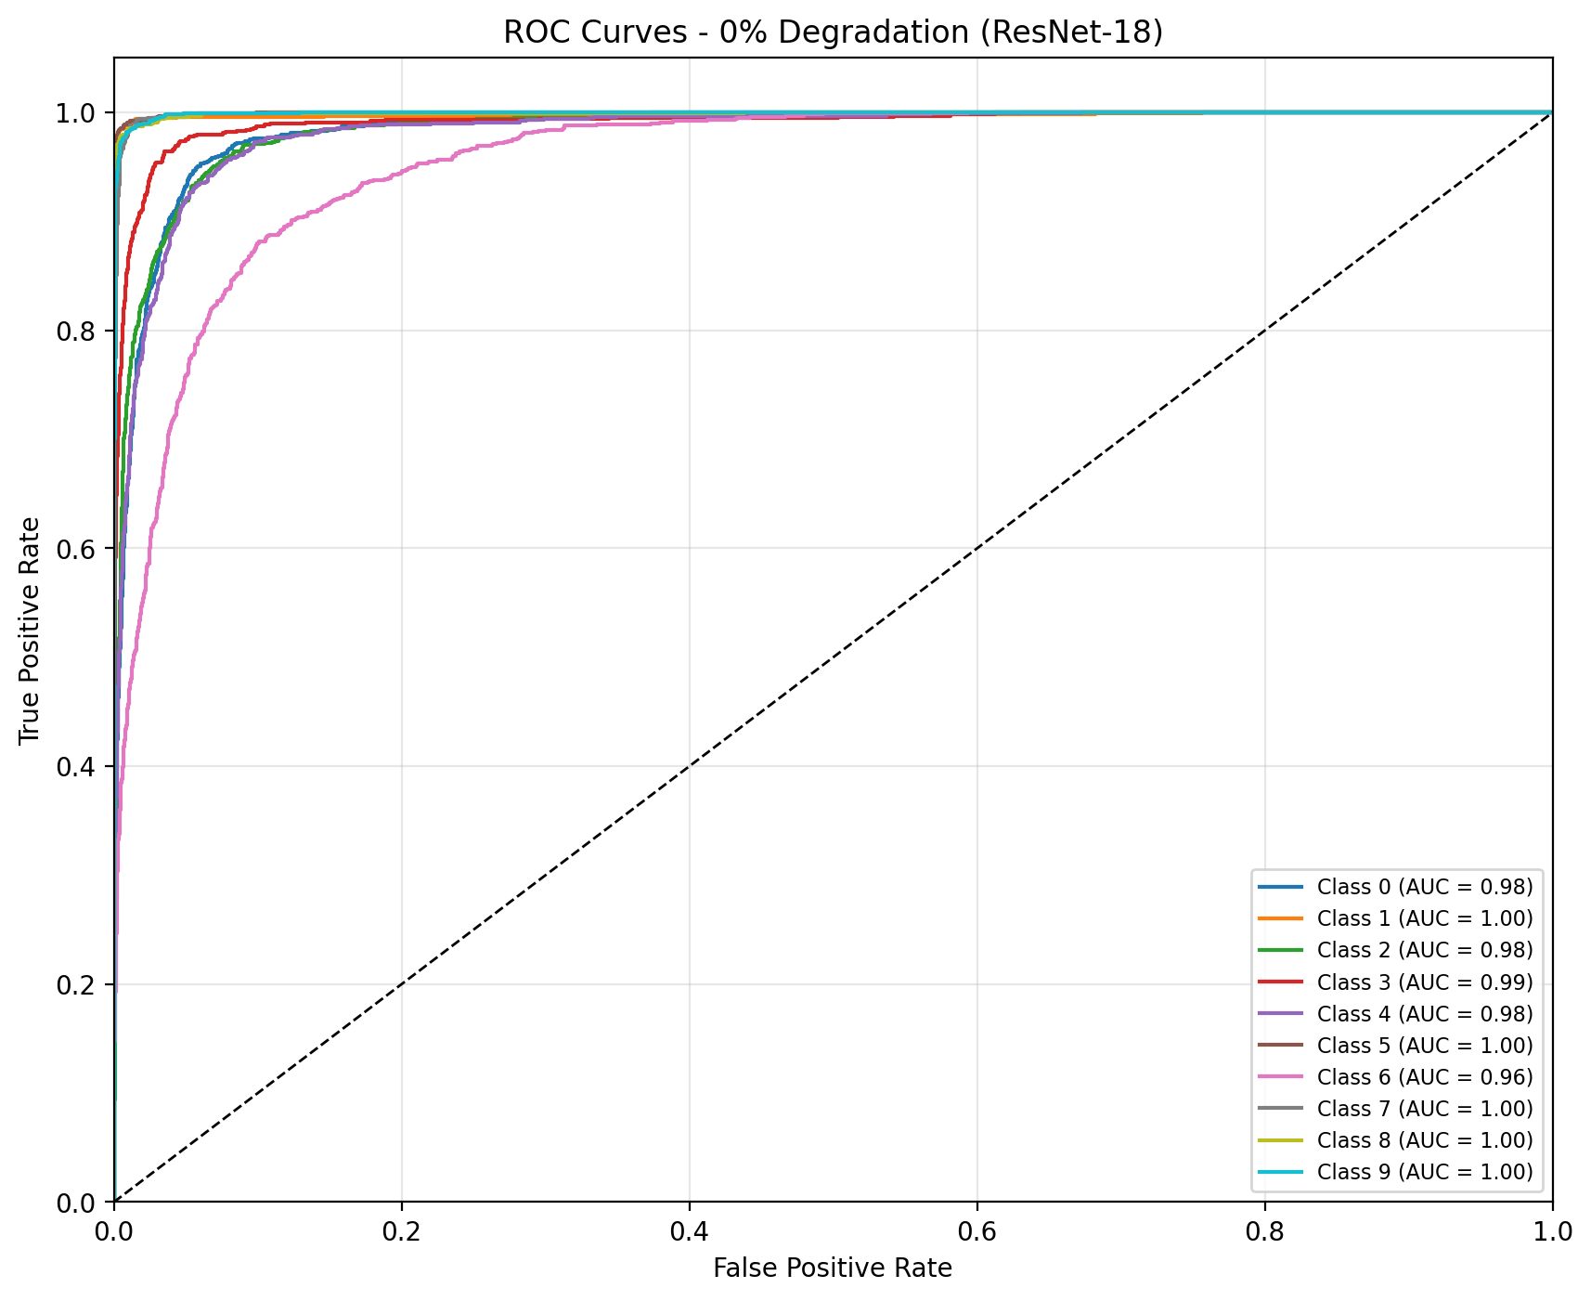
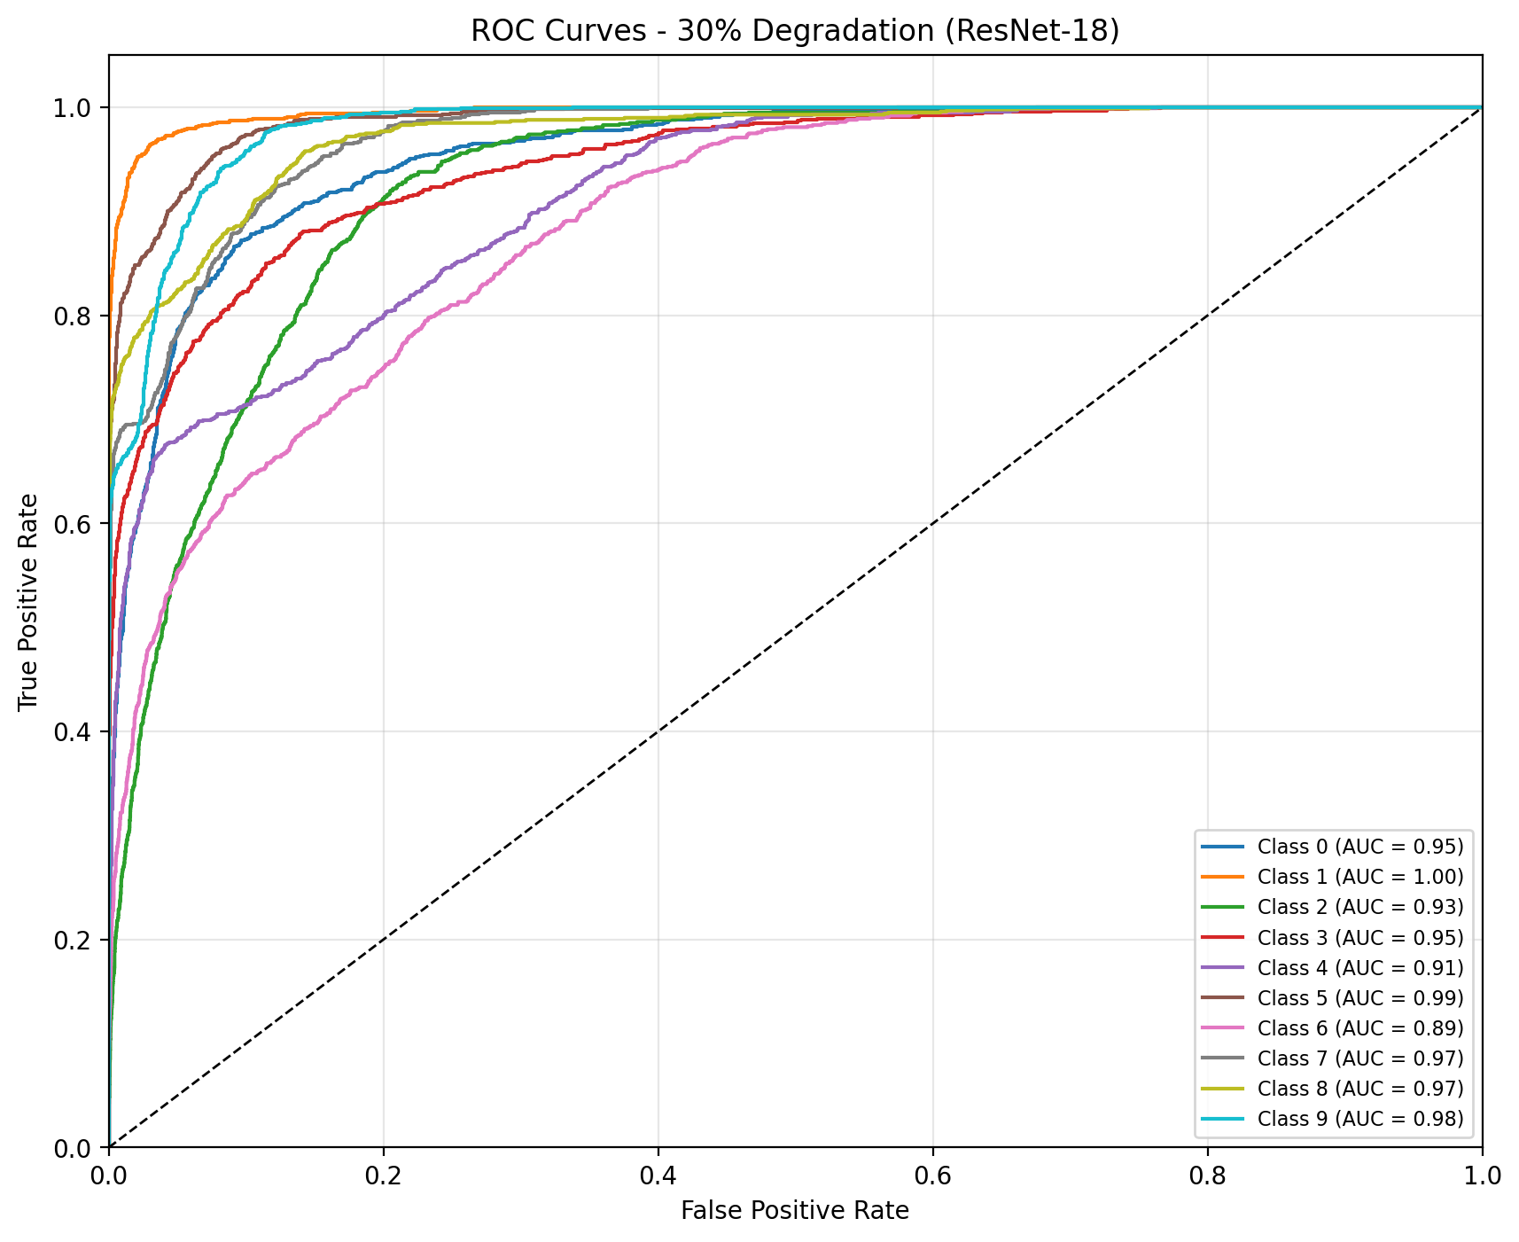
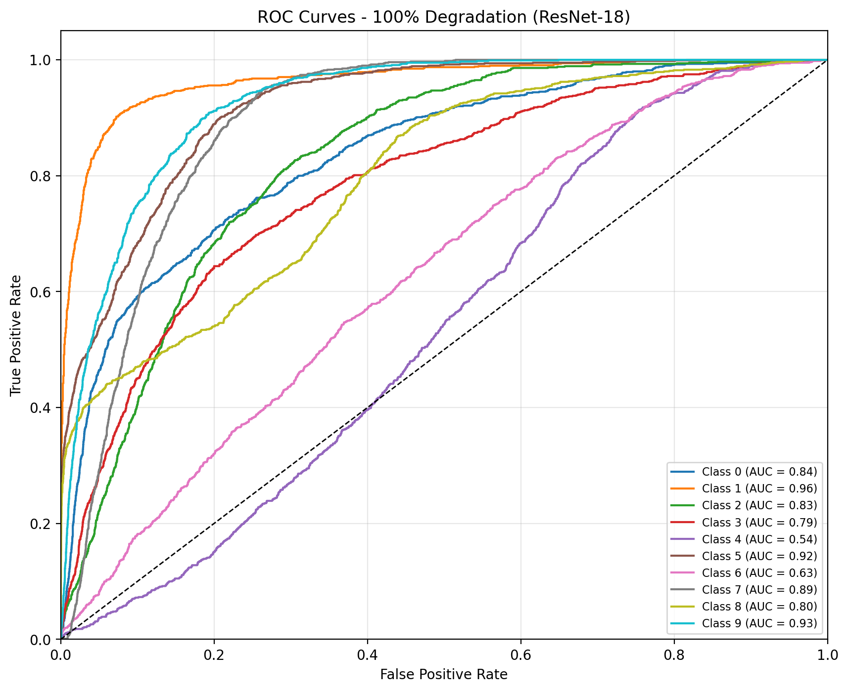
ROC Curves: Discrimination Ability Drops Sharply as degradation goes up (AUC)
Custom CNN
0% degradation
30% degradation
100% degradation
Resnet-18

Slide 11
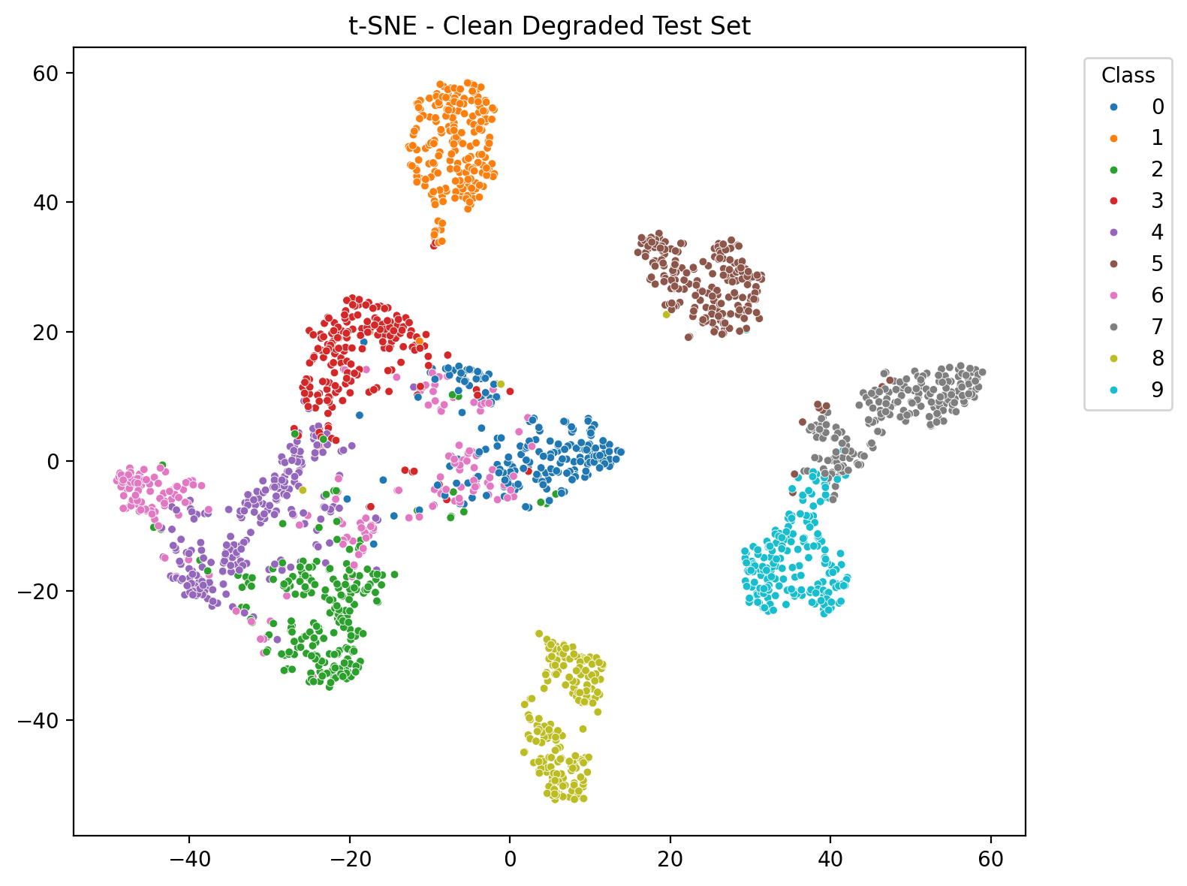
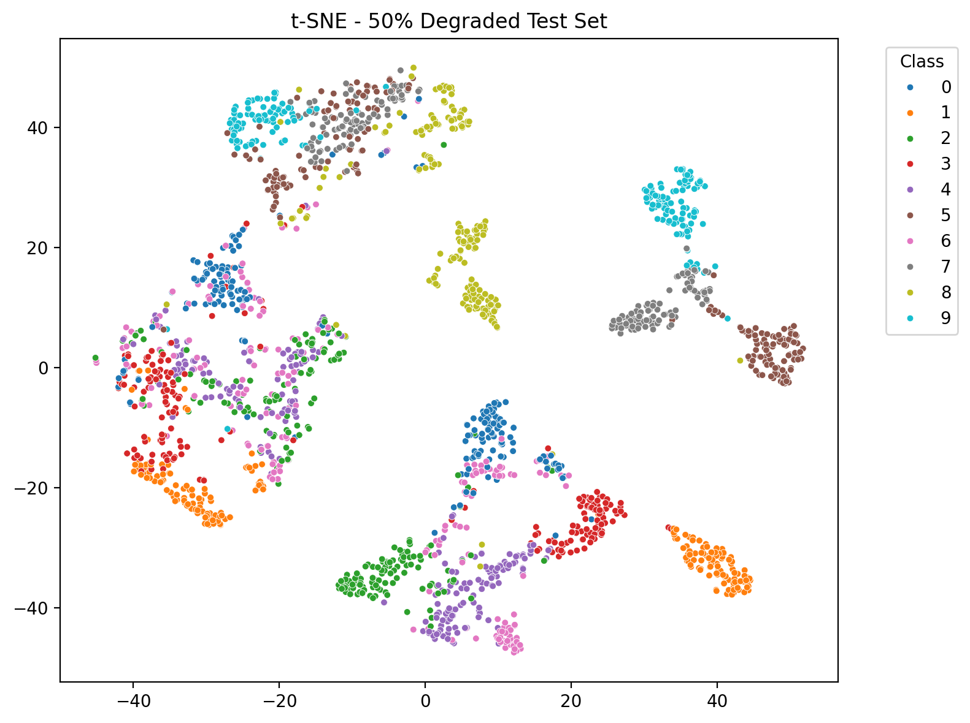
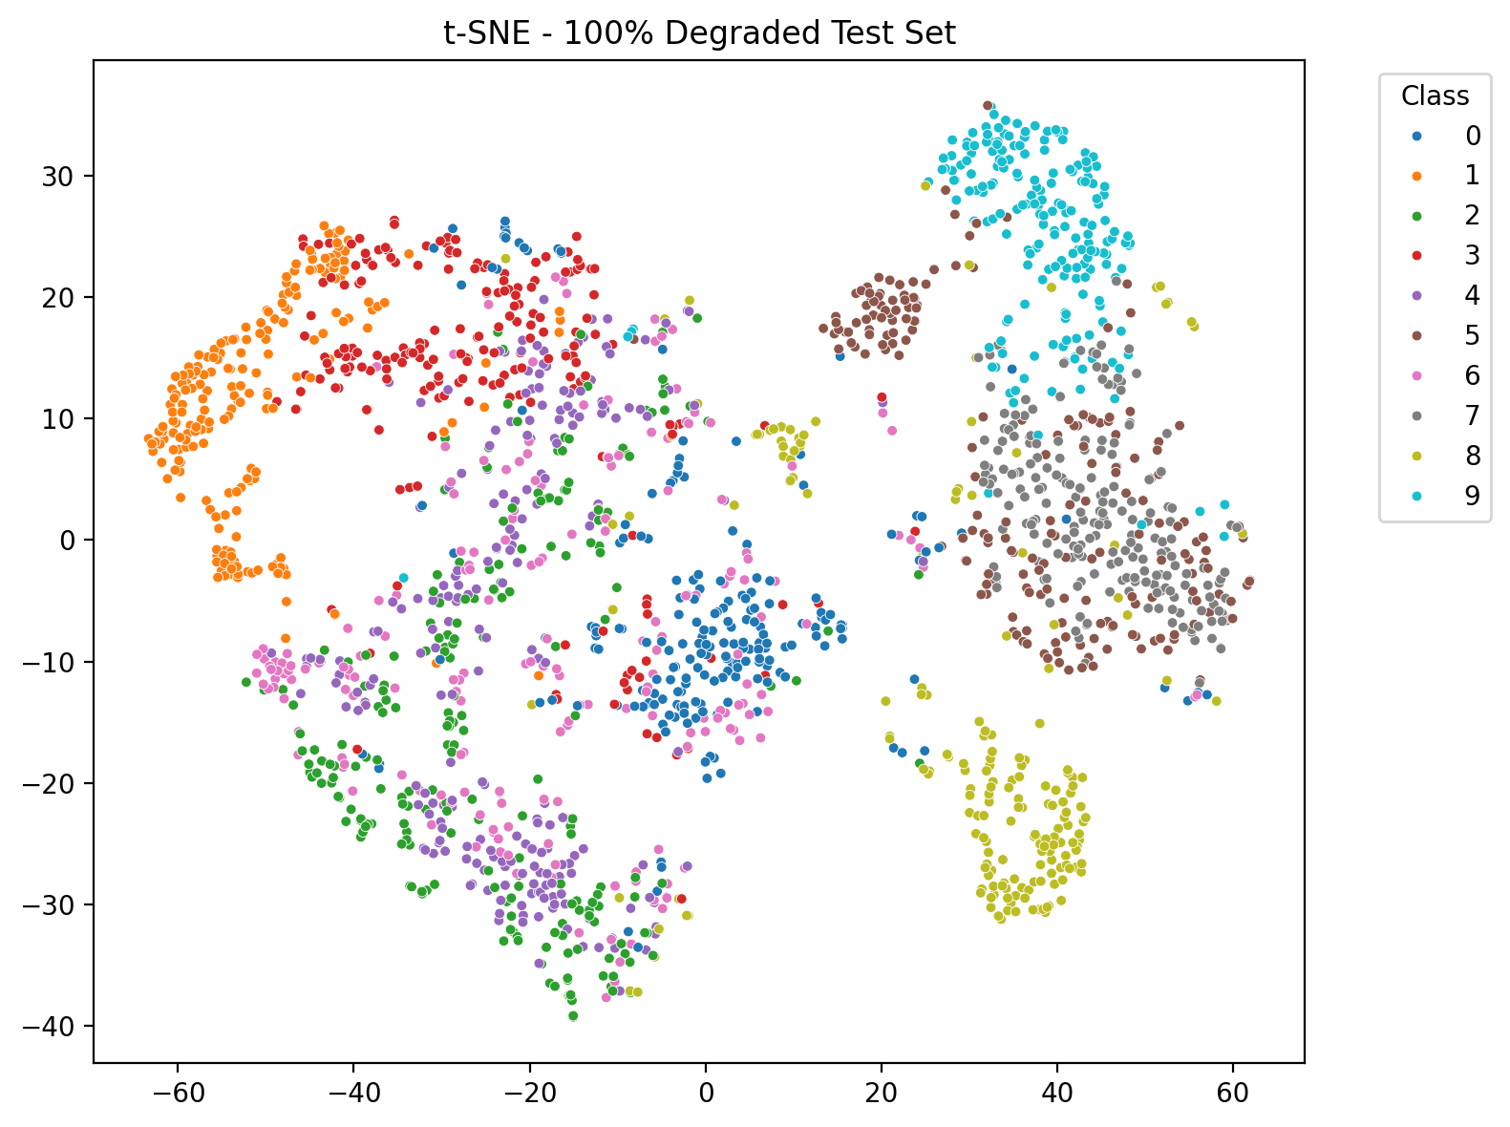
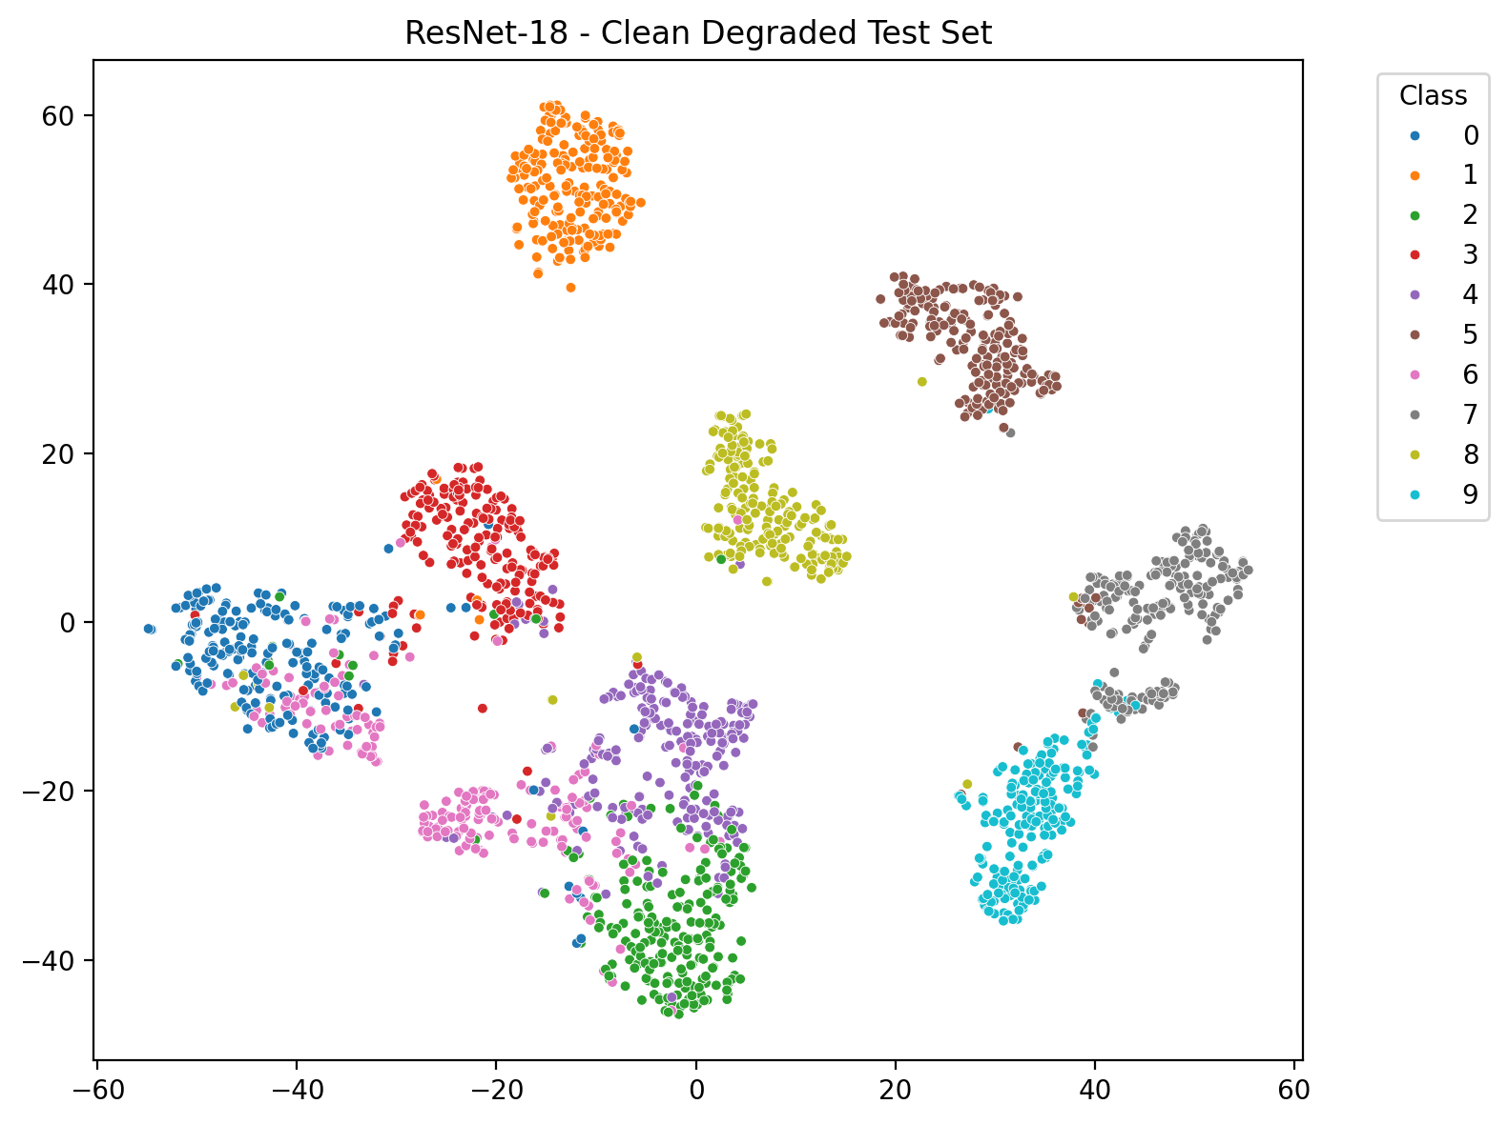
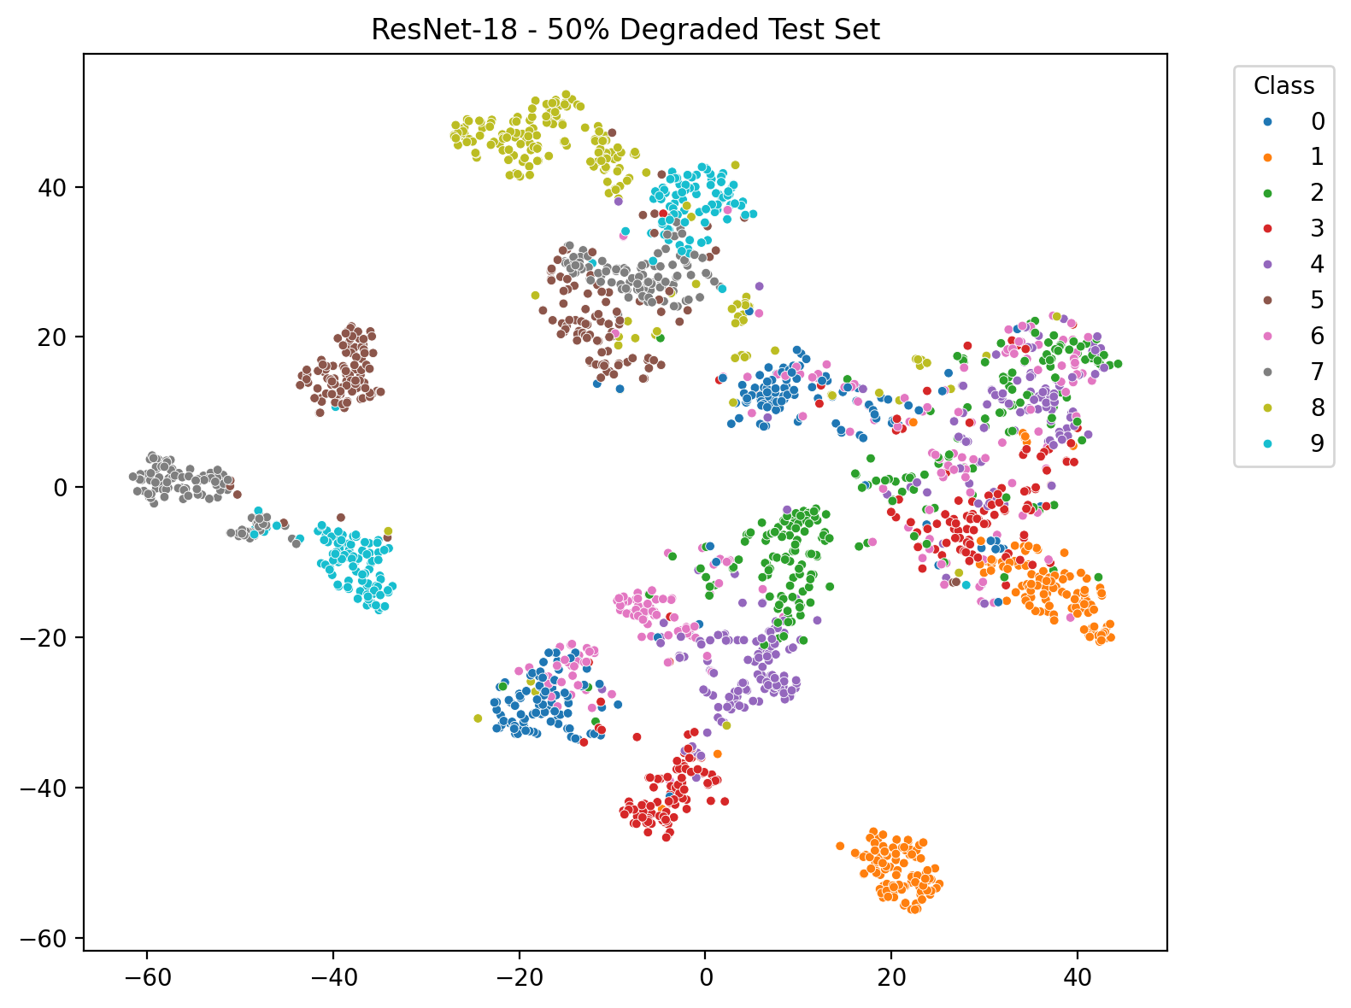
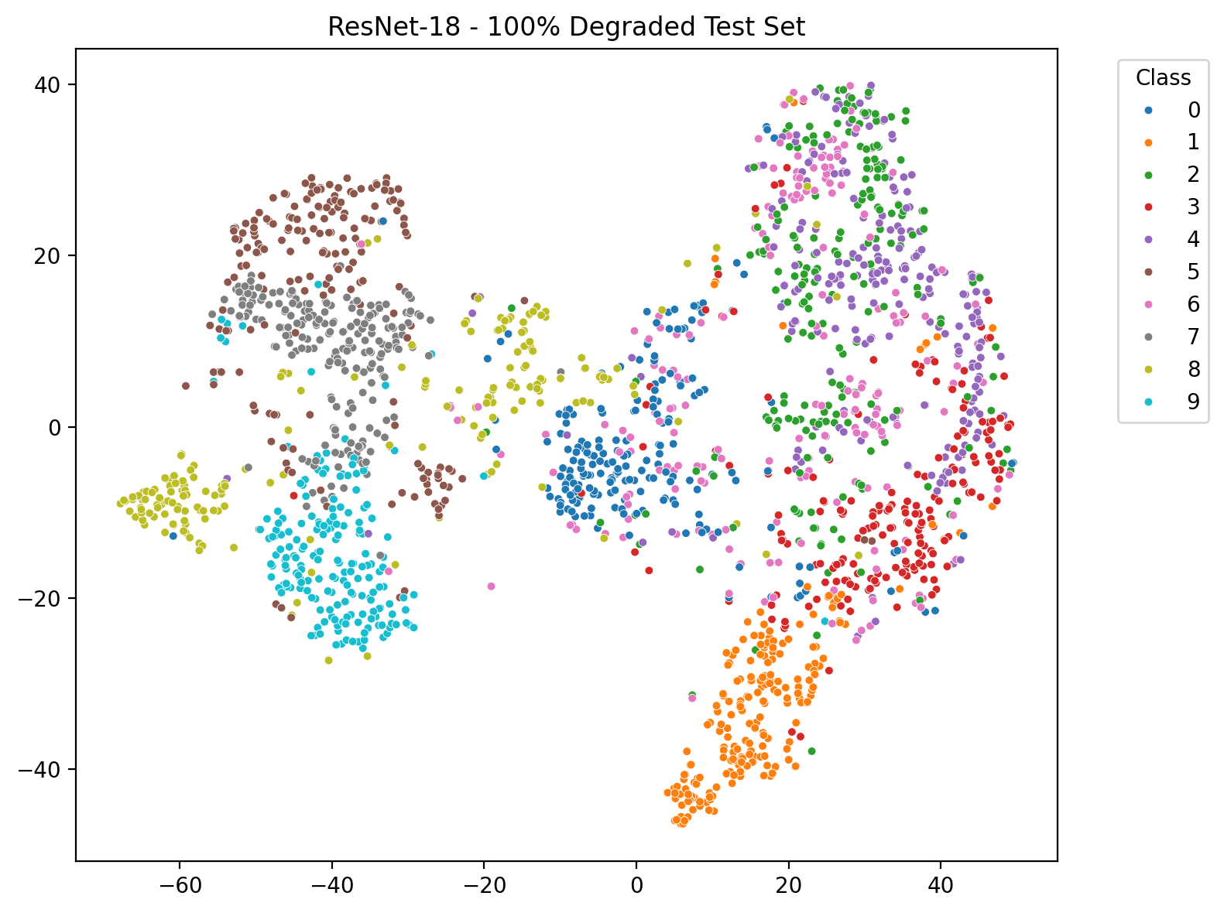
10. t-SNE: Feature Space Collapse Under Severe Degradation
Custom CNN
Resnet-18
0% degradation
50% degradation
100% degradation

Slide 12
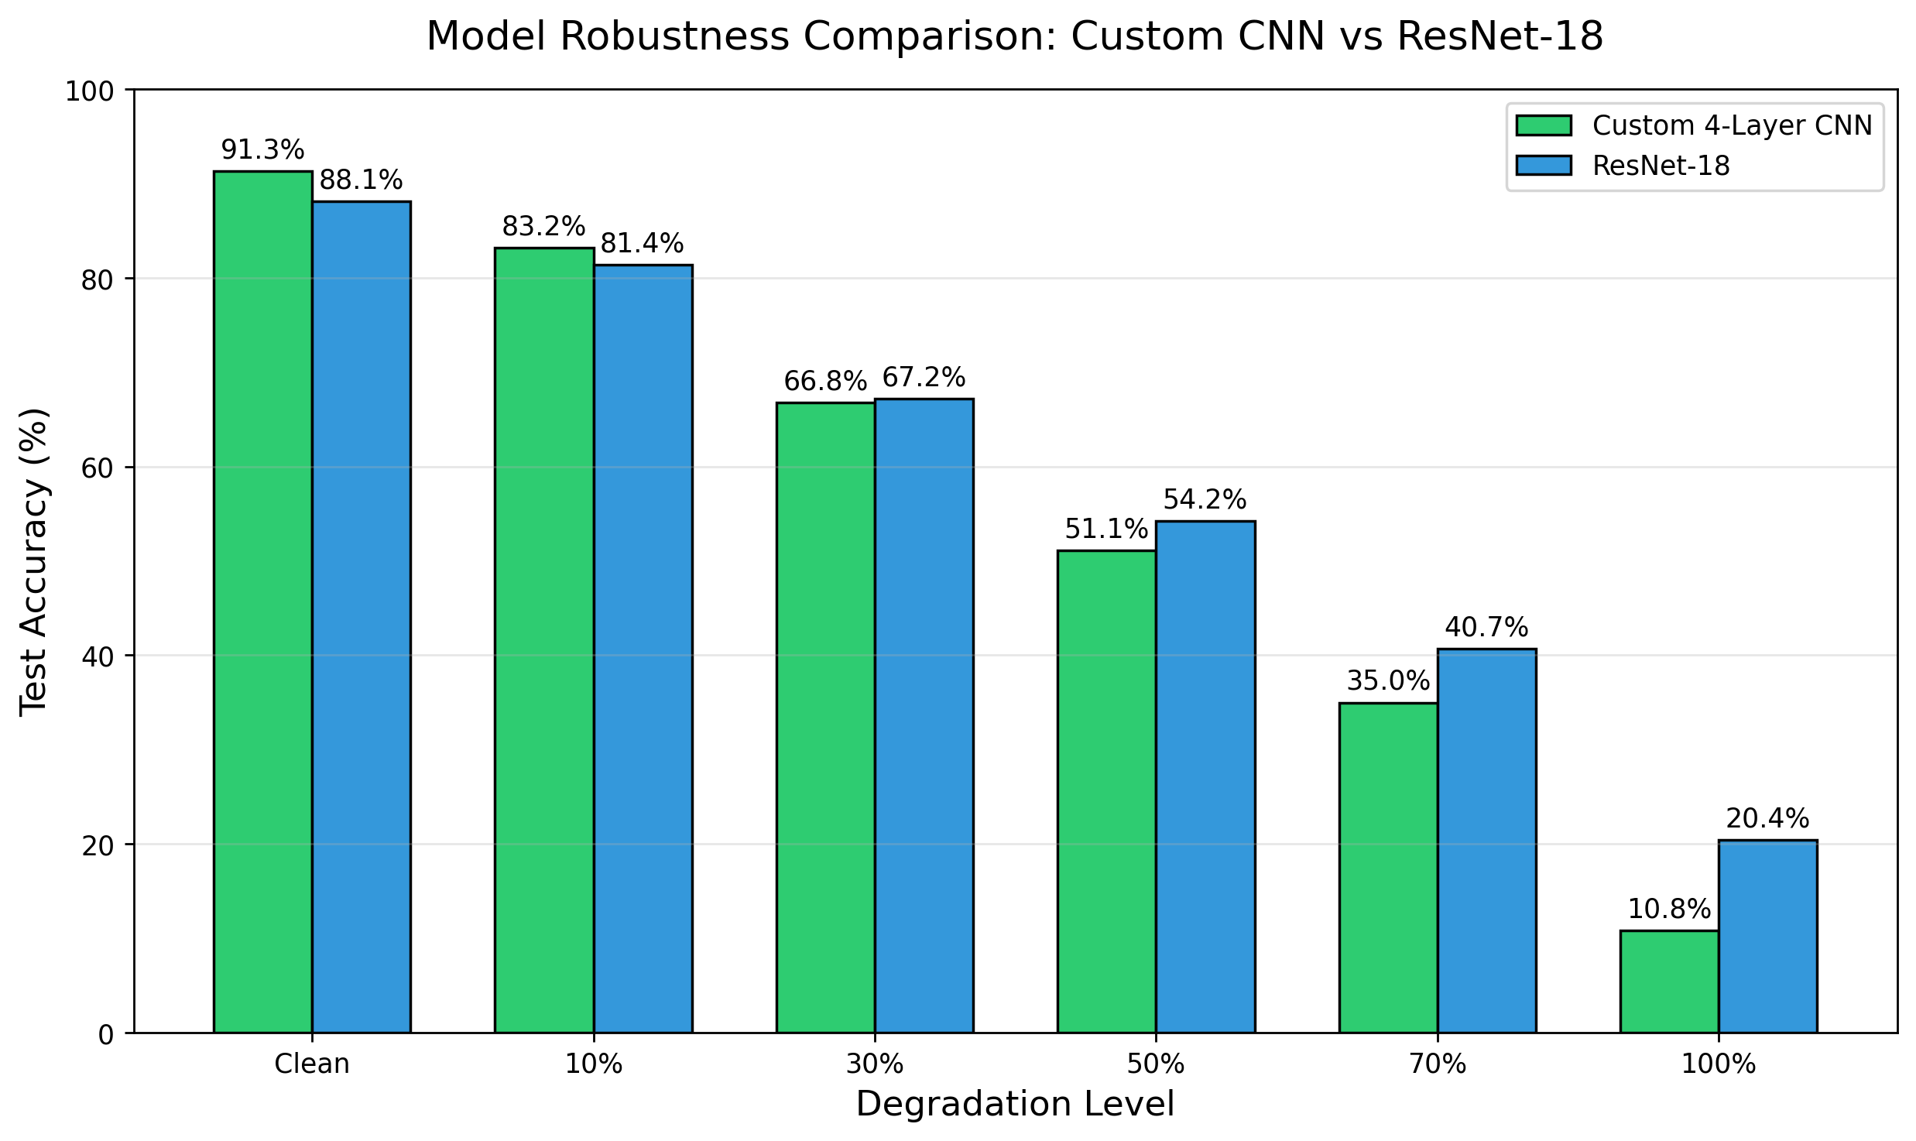
Comparison: Resnet-18 shows more robustness against degradation

Slide 13
11. Key Takeaways & Conclusion
Both the custom CNN and Resnet-18 are highly sensitive to test-time image degradation
ResNet-18 shows modest robustness advantage, likely due to pretraining and residual connection
Predictive entropy rises sharply, indicating increasing uncertainty with degradation
t-SNE reveals dramatic loss of class separability at high degradation
Future work: Data augmentation, blur-contrast-resistant architectures

