Slide 1
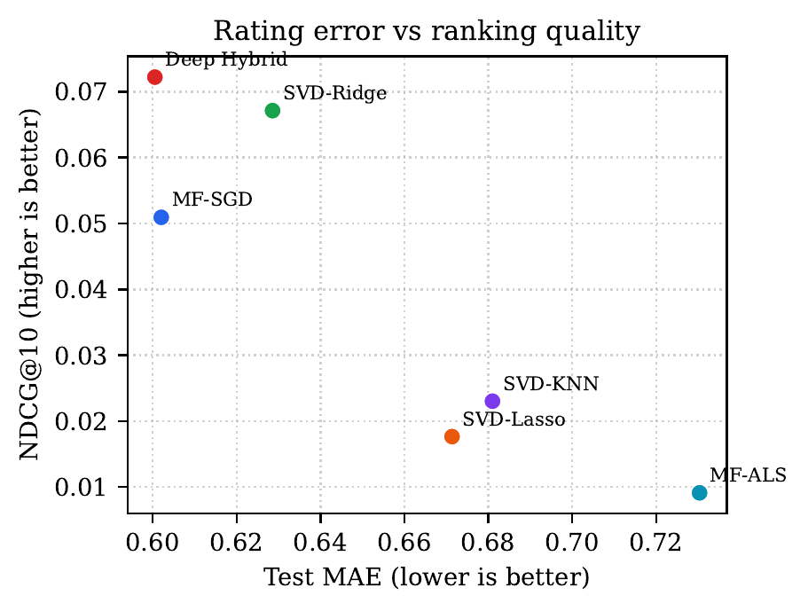
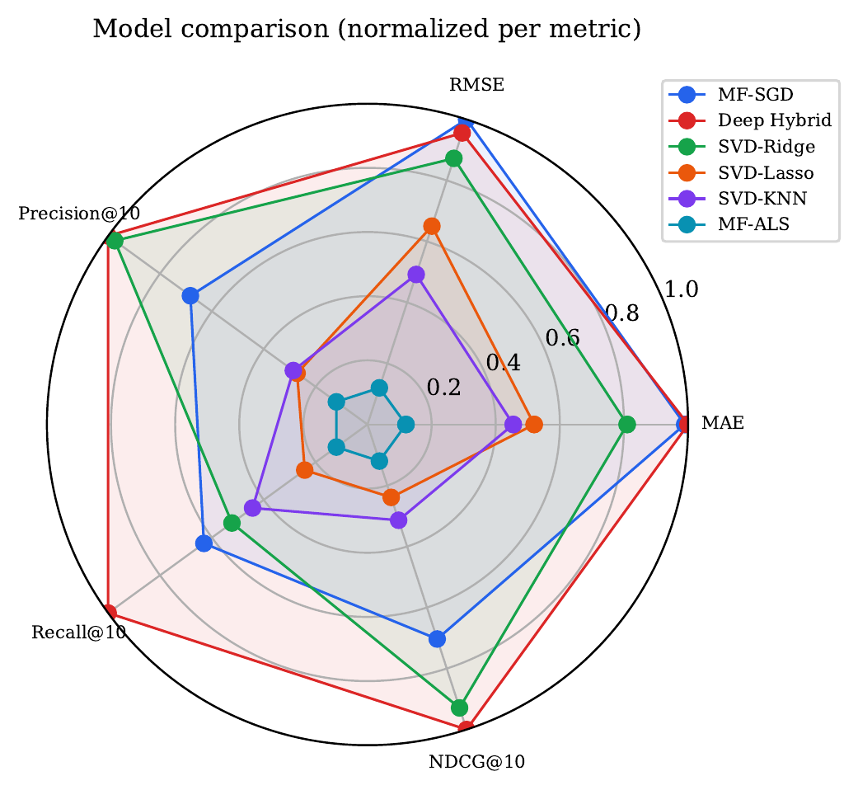
Movie Recommendation
Executive result
Comparative Study of Collaborative Filtering Methods
Deep Hybrid is the best overall model.
SVD-Ridge is the strongest lightweight baseline.
0.6005
0.8061
0.0722
27.1M / 6.77M
MovieLens Latest | 34M ratings | explicit-feedback recommendation
Best MAE: Deep Hybrid
Best RMSE: MF-SGD
Best NDCG@10
Train / test ratings
MAE vs. NDCG@10 frontier
Normalized multi-metric profile
Technical presentation deck generated from report.pdf

Slide 2
RESEARCH FRAMING
Problem Definition and Evaluation Lens
Goal
TWO COMPLEMENTARY OBJECTIVES
Learn a scoring function that predicts user-item ratings and ranks candidate movies for each user under a shared, reproducible split.
Rating Prediction
Top-10 Recommendation
Point-wise error over all held-out ratings
Rank candidate items and score the top-10 list
Why this is hard
The matrix is sparse, user activity is heavy-tailed, item popularity is heavy-tailed, and rating error does not always translate into ranking quality.
MAE
RMSE
P@10
R@10
F1
Mean absolute error
Root mean squared error
Precision@10
Recall@10
F1@10
Evaluation split
Per-user 80/20 random holdout with a fixed seed: 27,065,494 training ratings and 6,766,668 held-out test ratings.
Lower is better
NDCG@10
Higher is better
The protocol treats every held-out test item as relevant for top-10 metrics.
Absolute top-N scores are small because each user can have many held-out items.
MovieLens Latest recommendation study
02

Slide 3
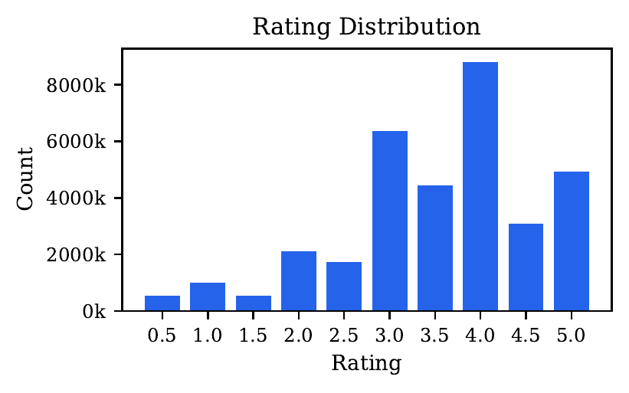
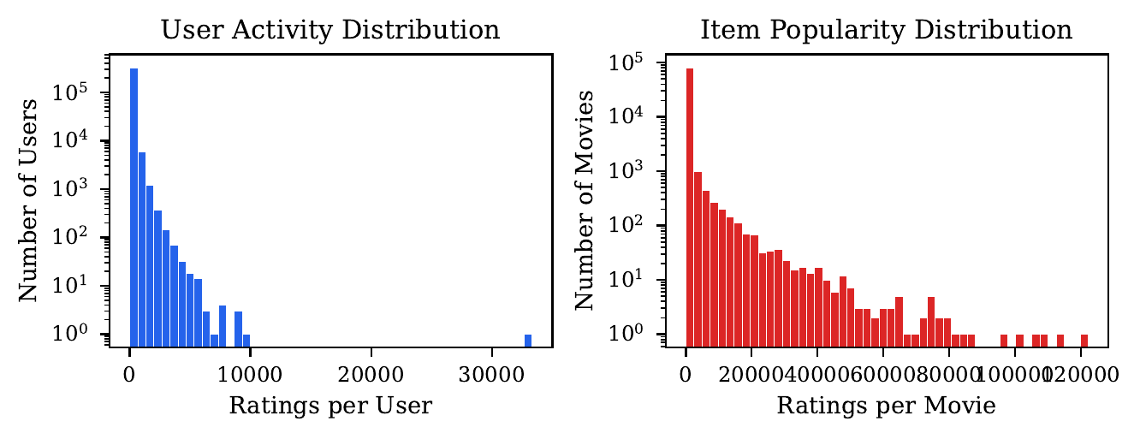
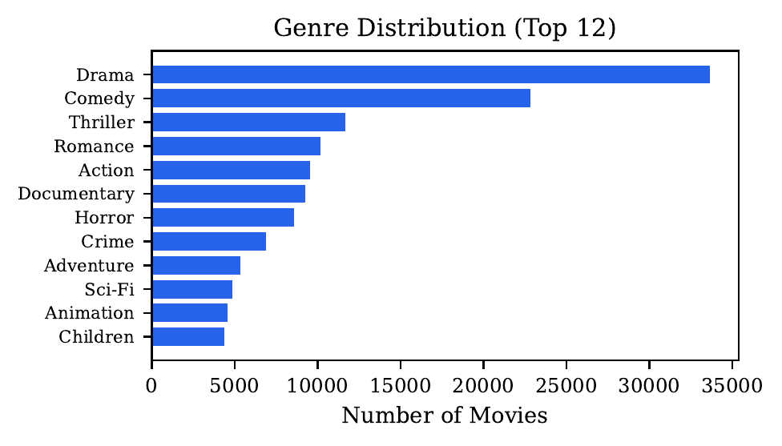
MOVIELENS LATEST
Dataset Scale and Distribution Shape
Statistic
Value
Users
330,975
Rated movies
83,239
Ratings
33,832,162
Density
0.12%
Rating values are concentrated around 3.0 and 4.0
Log-scaled activity and popularity tails
Sparsity
99.88%
Mean rating
3.54
Median ratings/user
31.0
Catalog imbalance matters: frequent genres dominate metadata, while long-tail movies carry sparse collaborative signal.
Median ratings/item
5.0
Data behavior
Top genres: Drama, Comedy, Thriller.
User Gini approx. 0.70; item Gini approx. 0.95.
Model capacity should help where explicit ratings are sparse.
Ratings are left-skewed and both user activity and item popularity follow heavy-tailed distributions. This makes tail-item generalization and ranking calibration central to the comparison.
Top catalog genres
MovieLens Latest recommendation study
03

Slide 4
METHODOLOGY
Model Families Compared Under One Pipeline
MF-SGD
Deep Hybrid
SVD Hybrids
MF-ALS
Matrix factorization trained by SGD with user/item biases.
PyTorch tower with IDs, genres, titles, Huber loss, and GPU minibatches.
Sparse SVD embeddings plus Ridge/Lasso calibration or KNN latent scoring.
Alternating least squares baseline with validation early stopping.
latent IDs
IDs + content
SVD factors
ALS factors
Shared data split, shared evaluation driver, persisted metrics and per-epoch histories
MF-SGD
Deep
SVD-R/L
SVD-KNN
MF-ALS
k=64
k=96
k=48
k=48
k=96
MovieLens Latest recommendation study
04

Slide 5
CONTROLLED COMPARISON
Experimental Setup and Training Presets
Implementation
Preset
MF-SGD
Deep
SVD-R/L
SVD-KNN
MF-ALS
Python 3.11 with a shared tabular pipeline. MF-SGD and Deep Hybrid were migrated to PyTorch; SVD variants use sparse linear algebra; ALS stays NumPy-based.
Factors
64
96
48/48
48
96
Epochs
150
50
1
1
40
Batch
131k
65k
-
-
-
LR
0.0050
0.0008
-
-
-
Reliability guard
Reg
0.05
1e-5
0.1/0.1
-
0.16
The evaluator checks vectorized predict_batch results against scalar predict on sampled inputs, then falls back automatically if inconsistencies are detected.
Bias reg
-
-
10.0
12.0
6.0
Early stop
pat. 6
best ckpt
-
-
pat. 6
Loss
MSE
Huber
-
-
MSE
Scale target
Large minibatches and persisted histories make tens of millions of explicit ratings tractable while preserving comparable evaluation conditions.
Takeaway: the study controls the split and metrics, but lets each model use a practical tuned preset for MovieLens Latest.
MovieLens Latest recommendation study
05

Slide 6
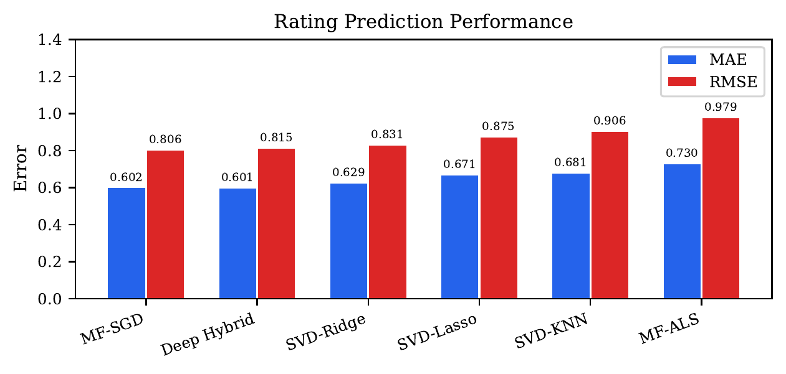
RESULTS
Rating Prediction: Deep Wins MAE, MF-SGD Wins RMSE
Model
MAE
RMSE
1.05
Interpretation
Deep Hybrid
0.6005
0.8148
Deep Hybrid achieves the best absolute-error profile, but MF-SGD slightly improves RMSE. SVD-Ridge is the strongest linear model after retuning.
MF-SGD
0.6020
0.8061
0.79
SVD-Ridge
0.6286
0.8312
SVD-KNN
0.6810
0.9058
0.53
SVD-Lasso
0.6714
0.8747
0.26
Deep Hybrid: best MAE at 0.6005.
MF-SGD: best RMSE at 0.8061.
MF-ALS trails on both point-wise metrics under this preset.
MF-ALS
0.7303
0.9786
0.00
Deep
MF-SGD
Ridge
KNN
Lasso
ALS
MAE
RMSE
Report figure: side-by-side error comparison
MovieLens Latest recommendation study
06

Slide 7
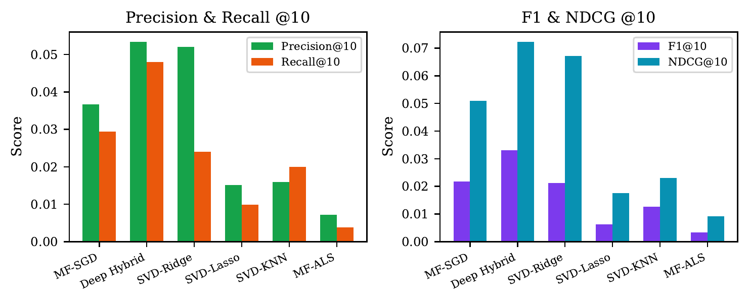
RESULTS
Top-10 Ranking: Deep Hybrid Leads, SVD-Ridge Is Close
Model
P@10
R@10
F1@10
NDCG
0.08
0.06
Deep Hybrid
0.0533
0.0480
0.0331
0.0722
0.06
0.04
SVD-Ridge
0.0520
0.0240
0.0212
0.0671
MF-SGD
0.0367
0.0294
0.0218
0.0509
0.04
0.03
SVD-KNN
0.0159
0.0200
0.0127
0.0230
0.02
0.01
SVD-Lasso
0.0152
0.0099
0.0063
0.0177
0.00
0.00
MF-ALS
0.0072
0.0038
0.0034
0.0091
Deep
Ridge
MF
KNN
Lasso
ALS
Deep
Ridge
MF
KNN
Lasso
ALS
NDCG@10
P@10
R@10
Ranking insight
MF-SGD is competitive on rating error, but ranks third for top-N quality. SVD-Ridge almost matches Deep Hybrid on NDCG@10 with lower complexity.
All top-N metrics
MovieLens Latest recommendation study
07

Slide 8
DIAGNOSTICS
Cross-Metric Trade-Offs Reveal Model Roles
Lower MAE and higher NDCG define the preferred frontier
Normalized profile across rating and ranking metrics
Operating point
Baseline choice
Failure mode
Deep Hybrid sits on the strongest overall frontier: best MAE and best NDCG@10. MF-SGD has excellent RMSE but loses ranking quality.
SVD-Ridge is attractive when training cost, interpretability, or deployment simplicity matter more than the final fraction of ranking lift.
MF-ALS and SVD-Lasso show that point-wise calibration and score diversity are critical for top-10 recommendation.
MovieLens Latest recommendation study
08

Slide 9
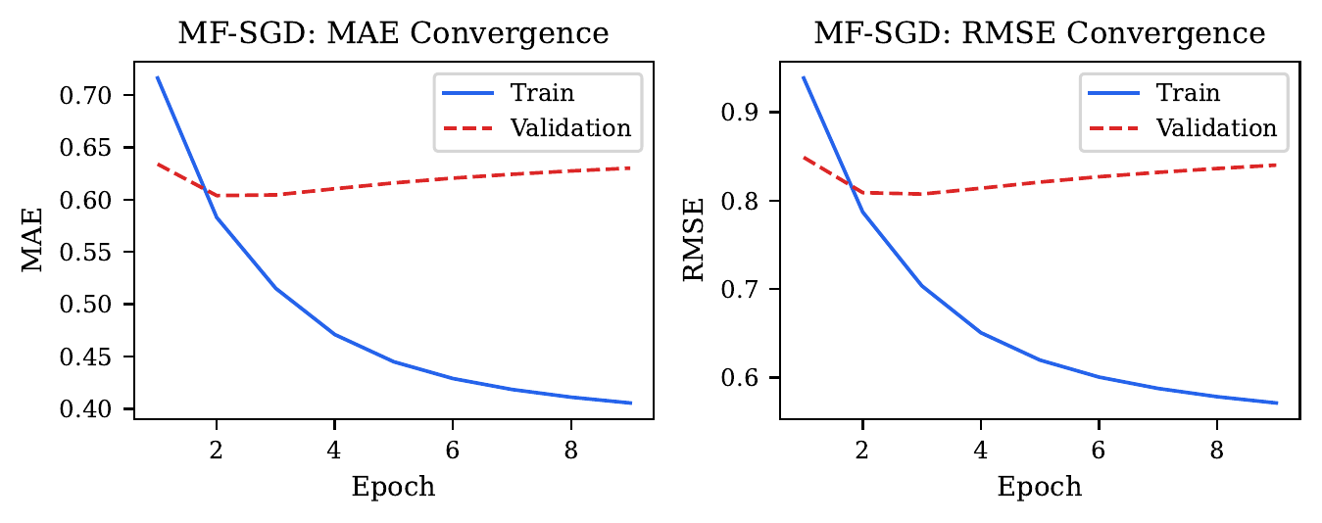
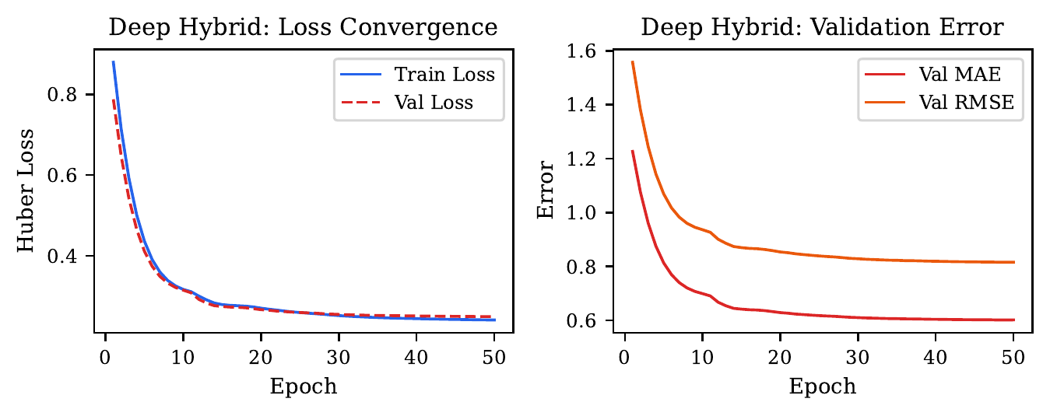
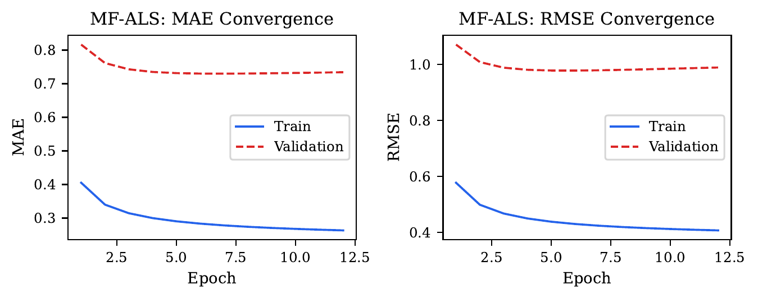
OPTIMIZATION
Training Dynamics Explain Generalization Patterns
MF-SGD: validation reverses early
Deep Hybrid: smoother stabilization
MF-ALS: train-validation divergence
MF-SGD
Deep Hybrid
MF-ALS
Rapid training progress but validation MAE/RMSE worsen after early epochs, motivating checkpoint restoration.
GPU-scale minibatches, Huber loss, and plateau learning-rate reduction stabilize validation error across 50 epochs.
Training error keeps decreasing while validation quality plateaus or drifts; current preset restores an earlier checkpoint.
Takeaway: optimization behavior is part of the model comparison. Better training loss is not sufficient when ranking calibration is weak.
MovieLens Latest recommendation study
09

Slide 10
ANALYSIS
Feature Signals Add Value Beyond Raw IDs
Feature block
Full R2
R2 w/o block
Delta R2
Full model
0.1116
-
-
Collaborative IDs
w/o Content
-
0.0582
0.0534
w/o Engagement
-
0.0815
0.0302
w/o Noise
-
0.1117
-0.0001
Deep Hybrid
item tower
Genre + title
MARGINAL CONTRIBUTION
Content
0.0534
Engagement
0.0302
Engagement
Noise
0.0001
How to read this
The ablation is an auxiliary MovieLens-Small probe, not a direct MovieLens Latest claim. It motivates the Deep Hybrid item tower: content and engagement features carry useful signal, but most variance remains latent.
Latent factor interpretation
PCA on item factors can recover semantically coherent directions, but full-scale exemplars are noisier across seeds. Interpret directions, not cherry-picked movies.
MovieLens Latest recommendation study
10

Slide 11
DISCUSSION
What the Results Mean for Model Selection
Use case
Best fit
Why
Risk
Metric signal
Best quality
Deep Hybrid
Strong MAE and top-N
GPU cost
MAE 0.6005 / NDCG 0.0722
Light baseline
SVD-Ridge
Strong ranking at low complexity
Less expressive
NDCG 0.0671
Point-wise RMSE
MF-SGD
Lowest RMSE
Weaker top-N
RMSE 0.8061
Interpretability probe
SVD-KNN
Geometry-aware profiles
Uncalibrated scores
NDCG 0.0230
Improve later
MF-ALS
Classic scalable baseline
Needs larger sweep
NDCG 0.0091
Core finding
Classical baseline
Ranking caveat
At approx. 34M interactions, the deep model's extra capacity is no longer just a liability. Content channels and robust training help align rating accuracy with ranking utility.
SVD-Ridge remains the practical challenger: simple, interpretable, and close to Deep Hybrid on NDCG@10 after retuning.
MSE/RMSE optimization does not guarantee top-10 quality. Score calibration and item separation dominate fixed-cutoff recommendation.
MovieLens Latest recommendation study
11

Slide 12
APPLICATION LAYER
StreamX Demo Architecture
Next.js Frontend
Django REST API
Model Artifacts
TMDB Enrichment
browse, details,
personalized recs
runtime model switcher
MF, Deep, SVD,
ALS checkpoints
posters, metadata,
similar movies
Online request flow
Step
Input
API action
Model output
UI result
1
User profile
candidate scoring
ranked movie IDs
recommendations
2
Movie ID
similarity lookup
neighbor titles
similar movies
3
Metadata
TMDB join
poster + details
rich detail page
Presentation angle
The demo turns offline metrics into an inspectable product surface: users can compare model behavior through recommendations and similar-movie suggestions.
MovieLens Latest recommendation study
12

Slide 13
RESEARCH HYGIENE
Limitations and Future Work
LIMITATIONS
NEXT EXPERIMENTS
MovieLens Latest is a development snapshot, so exact metrics are tied to the July 2023-era checkout.
Large-scale automated hyperparameter search was not run for every model.
Top-N relevance treats every held-out test item as relevant, which compresses absolute scores.
SVD-KNN averages rated items without rating or temporal weights.
Temporal dynamics, implicit feedback, and review text remain unexplored.
Dedicated MF-ALS and MF-SGD rank/regularization sweeps at web scale.
Frozen MovieLens benchmark splits for publication-grade comparability.
Learning-to-rank objectives aligned directly with NDCG.
Rating-weighted or attention-based SVD-KNN user profiles.
Implicit-feedback variants and temporal modeling.
Most important improvement path: move from point-wise rating loss toward ranking-aware objectives while preserving the shared evaluation guardrails.
MovieLens Latest recommendation study
13

Slide 14
FINAL TAKEAWAYS
Conclusion: Quality, Efficiency, and Ranking Are Separate Choices
1. Best overall
2. Best RMSE
3. Best lightweight baseline
Deep Hybrid achieves the best overall profile: MAE 0.6005 and NDCG@10 0.0722.
Tuned MF-SGD has the best RMSE at 0.8061, but it does not lead ranking quality.
SVD-Ridge is the strongest classical baseline: P@10 0.0520 and NDCG@10 0.0671.
Recommendation: use Deep Hybrid when maximizing quality is the goal; keep SVD-Ridge as the efficient, interpretable baseline; evaluate future work with ranking-aware objectives.
Frontier
Ranking metrics
MovieLens Latest recommendation study
14

