Slide 1

ROS - Lesson 5
Teaching Assistant: Roi Yehoshua
roiyeho@gmail.com

Slide 2
Agenda
Understanding costmaps
move_base package
Running ROS navigation in Stage
Using rviz with navigation stack

Slide 3
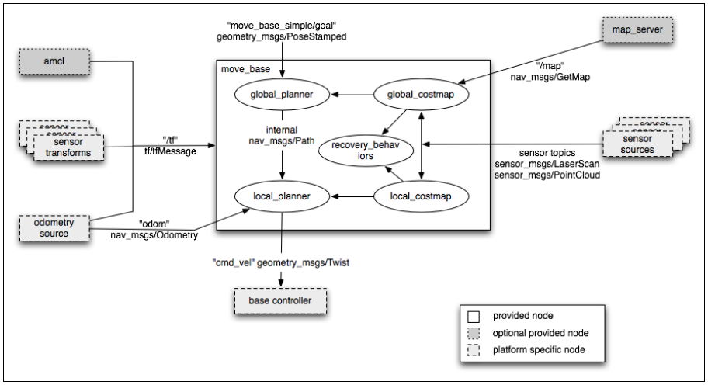
Navigation Stack

Slide 4
Costmap
The costmap is the data structure that represents places that are safe for the robot to be in a grid of cells
Usually, the values in the costmap are binary, representing free space or places where the robot would be in collision.

Slide 5
Costmap Types
Our robot will move through the map using two types of navigation—global and local.
The global navigation is used to create paths for a goal in the map or a far-off distance
The global costmap is used for the global navigation
The local navigation is used to create paths in the nearby distances and avoid obstacles
The local costmap is used for the local navigation

Slide 6
costmap_2d Package
http://wiki.ros.org/costmap_2d
The costmap_2d package uses sensor data and information from the static map to build a 2D or 3D occupancy grid of the data and inflate costs in a 2D costmap based on the occupancy grid and a user specified inflation radius.

Slide 7
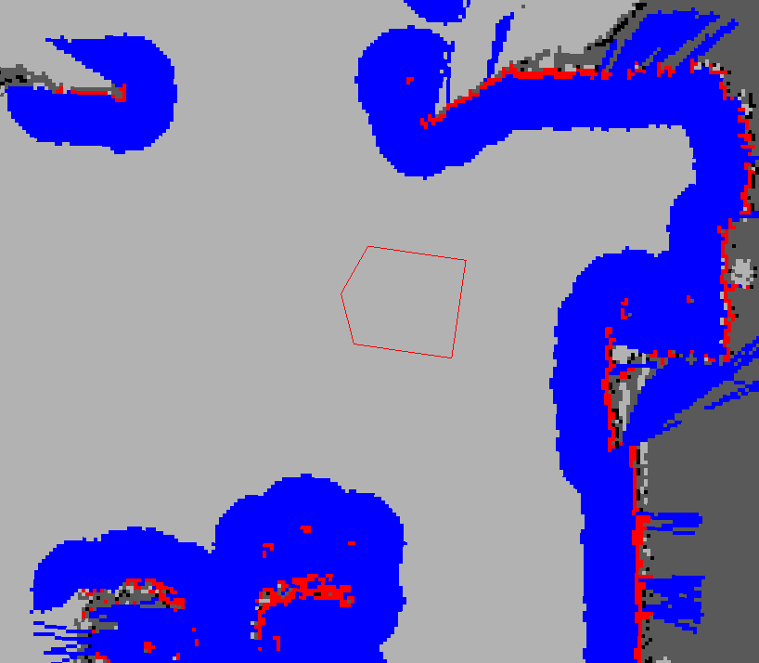
Costmap Example

Slide 8
Costmap Values
Each cell in the costmap has a value in the range [0, 255] (integers).
There are some special values frequently used in this range. (defined in include/costmap_2d/cost_values.h)
costmap_2d::NO_INFORMATION (255) - Reserved for cells where not enough information is sufficiently known.
costmap_2d::LETHAL_OBSTACLE (254) - Indicates a collision causing obstacle was sensed in this cell.
costmap_2d::INSCRIBED_INFLATED_OBSTACLE (253) - Indicates no obstacle, but moving the center of the robot to this location will result in a collision.
costmap_2d::FREE_SPACE (0) - Cells where there are no obstacles and the moving the center of the robot to this position will not result in a collision.

Slide 9
Map Types
There are two main ways to initialize a costmap:
Seed it with a user-generated static map
In this case, the costmap is initialized to match the width, height, and obstacle information provided by the static map.
This configuration is normally used in conjunction with a localization system, like amcl, that allows the robot to register obstacles in the map frame and update its costmap from sensor data as it drives through its environment.

Slide 10
Map Types
Define a width and height and set the rolling_window parameter to be true.
The rolling_window parameter keeps the robot in the center of the costmap as it moves throughout the world, dropping obstacle information from the map as the robot moves too far from a given area.
This type of configuration is most often used in an odometric coordinate frame where the robot only cares about obstacles within a local area.

Slide 11
Map Updates
The costmap performs map update cycles at the rate specified by the update_frequency parameter.
In each cycle:
sensor data comes in
marking and clearing operations are perfomed in the underlying occupancy structure of the costmap
this structure is projected into the costmap where the appropriate cost values are assigned as described above.
obstacle inflation is performed on each cell with a costmap_2d::LETHAL_OBSTACLE. This consists of propagating cost values outwards from each occupied cell out to a user-specified inflation radius.

Slide 12
Marking and Clearing
Each sensor is used to either mark (insert obstacle information into the costmap), clear (remove obstacle information from the costmap), or both.
A marking operation is just an index into an array to change the cost of a cell.
A clearing operation, however, consists of raytracing through a grid from the origin of the sensor outwards for each observation reported.

Slide 13
Inflation
Inflation is the process of propagating cost values out from occupied cells that decrease with distance.
For this purpose, there are 5 specific symbols defined for costmap values:
"Lethal" cost means that there is an actual obstacle in a cell. So if the robot's center were in that cell, the robot would obviously be in collision.
"Inscribed" cost means that a cell is less than the robot's inscribed radius away from an obstacle. So the robot is certainly in collision with an obstacle if the robot center is in a cell that is at or above the inscribed cost.

Slide 14
Inflation
"Possibly circumscribed“ cost is similar to inscribed, but using the robot's circumscribed radius as cutoff distance. Thus, if the robot center lies in a cell at or above this value, then it depends on the orientation of the robot whether it collides with an obstacle or not.
In addition, it might be that it is not really an obstacle cell, but some user-preference, that put that particular cost value into the map.
For example, if a user wants to express that a robot should attempt to avoid a particular area of a building, they may inset their own costs into the costmap for that region independent of any obstacles.

Slide 15
Inflation
"Freespace" cost is assumed to be zero, and it means that there is nothing that should keep the robot from going there.
"Unknown" cost means there is no information about a given cell. The user of the costmap can interpret this as they see fit.
All other costs are assigned a value between "Freespace" and "Possibly circumscribed" depending on their distance from a "Lethal" cell and the decay function provided by the user.

Slide 16
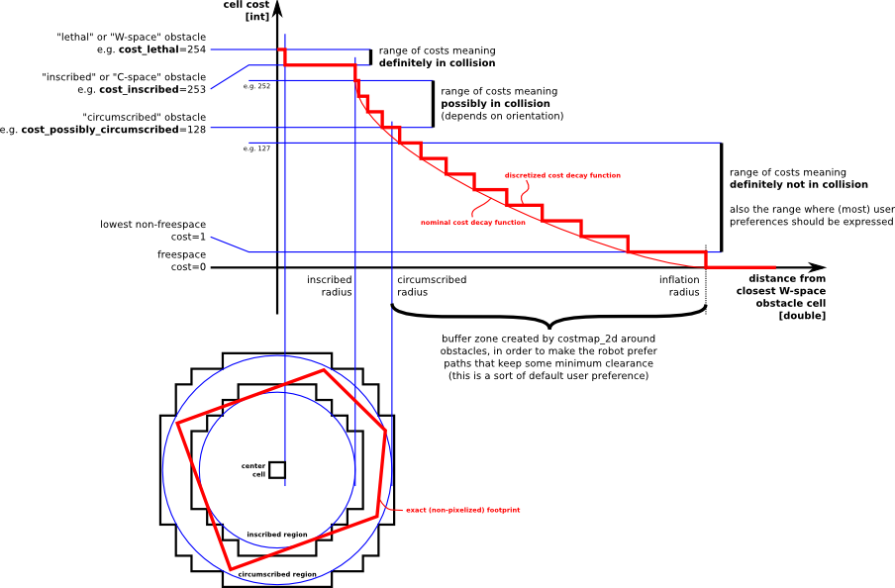
Inflation

Slide 17
Costmap Layers
In ROS Hydro, a new layered structure was created for costmap.
The static map, the sensed obstacles and the inflated areas are separated into distinct layers.
Users can specify additional layers using ROS plugins
For example, you can integrate a special "social" costmap plugin, where the values around sensed people is increased proportional to a normal distribution, causing the robot to tend to drive further away from the person.
Tutorial for creating a new costmap layer

Slide 18
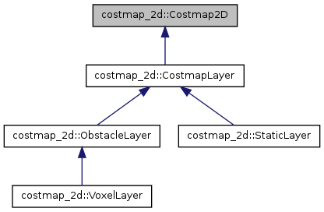
Costmap2D Class Hierarchy
costmap_2d.h header file:
http://docs.ros.org/electric/api/costmap_2d/html/costmap__2d_8h_source.html

Slide 19
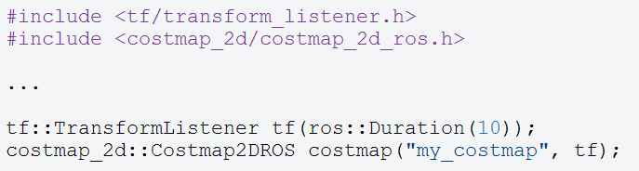
Costmap2DROS
The costmap_2d::Costmap2DROS object is a wrapper for a costmap_2d::Costmap2D object which contains the costmap
Example creation of a costmap_2d::Costmap2DROS object:
For C++ level API documentation on this class see Costmap2DROS C++ API

Slide 20
Costmap Parameters Files
Configuration of the costmaps consists of three files where we can set up different parameters:
costmap_common_params.yaml
global_costmap_params.yaml
local_costmap_params.yaml

Slide 21
Global Costmap Parameters
Default | Description | Parameter
2.5 | The default maximum distance from the robot at which an obstacle will be inserted into the cost map in meters. | obstacle_range
2.0 | The maximum height of any obstacle to be inserted into the costmap in meters. This parameter should be set to be slightly higher than the height of your robot. | max_obstacle_height
3.0 | The default range in meters at which to raytrace out obstacles from the map using sensor data. | raytrace_range
10.0 | A scaling factor to apply to cost values during inflation, according to the formula: exp(-1.0 * cost_scaling_factor * (distance_from_obstacle – inscribed_radius)) * (costmap_2d::INSCRIBED_INFLATED_OBSTACLE - 1) | cost_scaling_factor

Slide 22
Robot Description Parameters
Default | Description | Parameter
[] | The footprint of the robot specified in the robot_base_frame coordinate frame as a list in the format: [ [x1, y1], [x2, y2], ...., [xn, yn] ]. The footprint specification assumes the center point of the robot is at (0.0, 0.0) in the robot_base_frame and that the points are specified in meters, both clockwise and counter-clockwise orderings of points are supported. | footprint
0.55 | The radius in meters to which the map inflates obstacle cost values | inflation_radius

Slide 23
Coordinate Frame Parameters
Default | Description | Parameter
"/map" | The global frame for the costmap to operate in | global_frame
"base_link" | The name of the frame for the base link of the robot | robot_base_frame
0.2 | Specifies the delay in transform (tf) data that is tolerable in seconds. This parameter serves as a safeguard to losing a link in the tf tree while still allowing an amount of latency the user is comfortable with to exist in the system. | transform_tolerance

Slide 24
Rate Parameters
Default | Description | Parameter
5.0 | The frequency in Hz for the map to be updated | update_frequency
0.0 | The frequency in Hz for the map to be publish display information | publish_frequency

Slide 25
Sensor Management Parameters
Default | Description | Parameter
"" | A list of observation source names separated by spaces. This defines each of the <source_name> namespaces defined below. | observation_sources
source_name | The topic on which sensor data comes in for this source. Defaults to the name of the source. | <source_name>/topic
"PointCloud" | The data type associated with the topic, right now only "PointCloud", "PointCloud2", and "LaserScan" are supported. | <source_name>/data_type
0.0 | How often to expect a reading from a sensor in seconds. This parameter is used as a failsafe to keep the navigation stack from commanding the robot when a sensor has failed. It should be set to a value that is slightly more permissive than the actual rate of the sensor. | <source_name>/expected_update_rate
false | Whether or not this observation should be used to clear out freespace | <source_name>/clearing

Slide 26
Sensor Management Parameters (2)
Default | Description | Parameter
false | Whether or not this observation should be used to mark obstacles | <source_name>/marking
0.0 | How long to keep each sensor reading in seconds. A value of 0.0 will only keep the most recent reading. | <source_name>/observation_persistence
0.0 | The minimum height in meters of a sensor reading considered valid. This is usually set to be at ground height, but can be set higher or lower based on the noise model of your sensor. | <source_name>/min_obstacle_height
2.0 | The maximum height in meters of a sensor reading considered valid. This is usually set to be slightly higher than the height of the robot. | <source_name>/max_obstacle_height

Slide 27
Map Type Parameters
Default | Description | Parameter
"voxel" | What map type to use. "voxel" or "costmap" are the supported types, with the difference between them being a 3D-view of the world vs. a 2D-view of the world. | map_type
0.0 | The z origin of the map in meters | origin_z
0.2 | The z resolution of the map in meters/cell | z_resolution
10 | The number of voxels to in each vertical column, the height of the grid is z_resolution * z_voxels | z_voxels
z_voxels | The number of unknown cells allowed in a column considered to be "known" | unknown_threshold
0 | The maximum number of marked cells allowed in a column considered to be "free" | mark_threshold

Slide 28
Map Management Parameters
Default | Description | Parameter
true | Whether or not to use the static map to initialize the costmap. If the rolling_window parameter is set to true, this parameter must be set to false. | static_map
false | Whether or not to use a rolling window version of the costmap. If the static_map parameter is set to true, this parameter must be set to false. | rolling_window
0 | The value for which a cost should be considered unknown when reading in a map from the map server. A value of zero results in this parameter being unused. | unknown_cost_value
100 | The threshold value at which to consider a cost lethal when reading in a map from the map server | lethal_cost_threshold
"map" | The topic that the costmap subscribes to for the static map | map_topic

Slide 29
costmap_common_params.yaml (1)
#This file contains common configuration options for the two costmaps used in the navigation stack for more details on the parameters in this file, and a full list of the parameters used by the costmaps, please see http://www.ros.org/wiki/costmap_2d
#For this example we'll configure the costmap in voxel-grid mode
map_type: voxel
#Voxel grid specific parameters
origin_z: 0.0
z_resolution: 0.2
z_voxels: 10
unknown_threshold: 9
mark_threshold: 0
#Set the tolerance we're willing to have for tf transforms
transform_tolerance: 0.3
#Obstacle marking parameters
obstacle_range: 2.5
max_obstacle_height: 2.0
raytrace_range: 3.0
#The footprint of the robot and associated padding
footprint: [[-0.325, -0.325], [-0.325, 0.325], [0.325, 0.325], [0.46, 0.0], [0.325, -0.325]]
footprint_padding: 0.01

Slide 30
costmap_common_params.yaml (2)
#Cost function parameters
inflation_radius: 0.55
cost_scaling_factor: 10.0
#The cost at which a cell is considered an obstacle when a map is read from the map_server
lethal_cost_threshold: 100
#Configuration for the sensors that the costmap will use to update a map
observation_sources: base_scan
base_scan: {data_type: LaserScan, expected_update_rate: 0.4,
observation_persistence: 0.0, marking: true, clearing: true, max_obstacle_height: 0.4, min_obstacle_height: 0.08}

Slide 31
global_costmap_params.yaml
#Independent settings for the global planner's costmap. Detailed descriptions of these parameters can be found at http://www.ros.org/wiki/costmap_2d
global_costmap:
#Set the global and robot frames for the costmap
global_frame: /map
robot_base_frame: base_link
#Set the update and publish frequency of the costmap
update_frequency: 5.0
publish_frequency: 0.0
#We'll use a map served by the map_server to initialize this costmap
static_map: true
rolling_window: false
footprint_padding: 0.02
Note: change publish_frequency to 5.0 to see the costmap

Slide 32
local_costmap_params.yaml
#Independent settings for the local planner's costmap. Detailed descriptions of these parameters can be found at http://www.ros.org/wiki/costmap_2d
local_costmap:
#We'll publish the voxel grid used by this costmap
publish_voxel_map: true
#Set the global and robot frames for the costmap
global_frame: odom
robot_base_frame: base_link
#Set the update and publish frequency of the costmap
update_frequency: 5.0
publish_frequency: 2.0
#We'll configure this costmap to be a rolling window... meaning it is always
#centered at the robot
static_map: false
rolling_window: true
width: 6.0
height: 6.0
resolution: 0.025
origin_x: 0.0
origin_y: 0.0

Slide 33
Costmap_2d Subscriped Topics
Message Type | Description | Topic
sensor_msgs/PointCloud | For each "PointCloud" source listed in the observation_sources parameter list, information from that source is used to update the costmap. | <point_cloud_topic>
sensor_msgs/LaserScan | For each "LaserScan" source listed in the observation_sources parameter list, information from that source is used to update the costmap. | <laser_scan_topic>
nav_msgs/OccupancyGrid | The costmap has the option of being initialized from a user-generated static map (see the static_map parameter). If this option is selected, the costmap makes a service call to the map_server to obtain this map. | "map"

Slide 34
Published Topics
Message Type | Description | Topic
nav_msgs/GridCells | The occupied cells in the costmap | obstacles
nav_msgs/GridCells | The cells in the costmap that correspond to the occupied cells inflated by the inscribed radius of the robot | inflated_obstacles
nav_msgs/GridCells | The unknown cells in the costmap | unknown_space
costmap_2d/VoxelGrid | Optionally advertised when the underlying occupancy grid uses voxels and the user requests the voxel grid be published. | voxel_grid
Note: In Hydro costmaps are published as Map (in Groovy they were GridCells).

Slide 35
move_base
The move_base package lets you move a robot to desired positions using the navigation stack
The move_base node links together a global and local planner to accomplish its global navigation task.
The move_base node may optionally perform recovery behaviors when the robot perceives itself as stuck.

Slide 36
move_base Configuration File
<launch>
<!--
Example move_base configuration. Descriptions of parameters, as well as a full list of all amcl parameters, can be found at http://www.ros.org/wiki/move_base.
-->
<node pkg="move_base" type="move_base" respawn="false" name="move_base_node" output="screen">
<param name="footprint_padding" value="0.01" />
<param name="controller_frequency" value="10.0" />
<param name="controller_patience" value="3.0" />
<param name="oscillation_timeout" value="30.0" />
<param name="oscillation_distance" value="0.5" />
<!--
<param name="base_local_planner" value="dwa_local_planner/DWAPlannerROS" />
-->
<rosparam file="$(find navigation_stage)/move_base_config/costmap_common_params.yaml" command="load" ns="global_costmap" />
<rosparam file="$(find navigation_stage)/move_base_config/costmap_common_params.yaml" command="load" ns="local_costmap" />
<rosparam file="$(find navigation_stage)/move_base_config/local_costmap_params.yaml" command="load" />
<rosparam file="$(find navigation_stage)/move_base_config/global_costmap_params.yaml" command="load" />
<rosparam file="$(find navigation_stage)/move_base_config/base_local_planner_params.yaml" command="load" />
<!--
<rosparam file="$(find navigation_stage)/move_base_config/dwa_local_planner_params.yaml" command="load" />
-->
</node>
</launch>

Slide 37
Running ROS Navigation Stack in Stage
Download the navigation tutorials from git
https://github.com/ros-planning/navigation_tutorials
The navigation_stage package holds example launch files for running the ROS navigation stack in stage
$ cd ~/ros/stacks
$ git clone https://github.com/ros-planning/navigation_tutorials.git

Slide 38
Running ROS Navigation Stack in Stage
Description | Launch File
Example launch file for running the navigation stack with amcl at a map resolution of 5cm | launch/move_base_amcl_5cm
Example launch file for running the navigation stack with fake_localization at a map resolution of 10cm | launch/move_base_fake_localization_10cm.launch
Example launch file for running the navigation stack with multiple robots in stage. | launch/move_base_multi_robot.launch
Example launch file for running the navigation stack with gmapping at a map resolution of 5cm | launch/move_base_gmapping_5cm.launch

Slide 39
move_base_amcl_5cm.launch
<launch>
<master auto="start"/>
<param name="/use_sim_time" value="true"/>
<include file="$(find navigation_stage)/move_base_config/move_base.xml"/>
<node name="map_server" pkg="map_server" type="map_server" args="$(find navigation_stage)/stage_config/maps/willow-full-0.05.pgm 0.05" respawn="false" />
<node pkg="stage_ros" type="stageros" name="stageros" args="$(find navigation_stage)/stage_config/worlds/willow-pr2-5cm.world" respawn="false" >
<param name="base_watchdog_timeout" value="0.2"/>
</node>
<include file="$(find navigation_stage)/move_base_config/amcl_node.xml"/>
<node name="rviz" pkg="rviz" type="rviz" args="-d $(find navigation_stage)/single_robot.rviz" />
</launch>
To run this launch file type:
$ cd ~/ros/stacks/navigation_tutorials/navigation_stage/launch
$ roslaunch move_base_amcl_5cm.launch

Slide 40
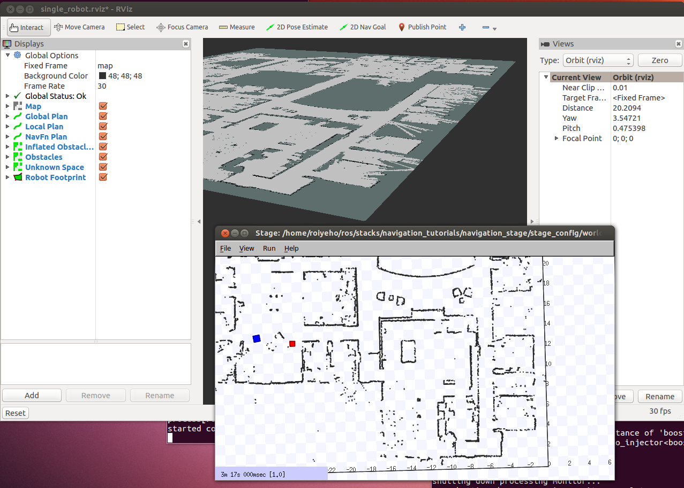
Running the Launch File

Slide 41
move_base_gmapping_5cm.launch
<launch>
<master auto="start"/>
<param name="/use_sim_time" value="true"/>
<include file="$(find navigation_stage)/move_base_config/move_base.xml"/>
<node pkg="stage_ros" type="stageros" name="stageros" args="$(find navigation_stage)/stage_config/worlds/willow-pr2-5cm.world" respawn="false" >
<param name="base_watchdog_timeout" value="0.2"/>
</node>
<include file="$(find navigation_stage)/move_base_config/slam_gmapping.xml"/>
<node name="rviz" pkg="rviz" type="rviz" args="-d $(find navigation_stage)/single_robot.rviz" />
</launch>
To run this launch file type:
$ cd ~/ros/stacks/navigation_tutorials/navigation_stage/launch
$ roslaunch move_base_gmapping_5cm.launch

Slide 42
Using rviz with Navigation Stack
You can setup rviz to work with the navigation stack. This includes:
Setting the pose of the robot for a localization system like amcl
Displaying all the visualization information that the navigation stack provides
Sending goals to the navigation stack with rviz.

Slide 43
Robot Footprint
It shows the footprint of the robot
In our case, the robot has a pentagon-shape.
This parameter is configured in the costmap_common_params file.
Topic: move_base_node/local_costmap/footprint_layer/footprint_stamped
Type: geometry_msgs/PolygonStamped

Slide 44
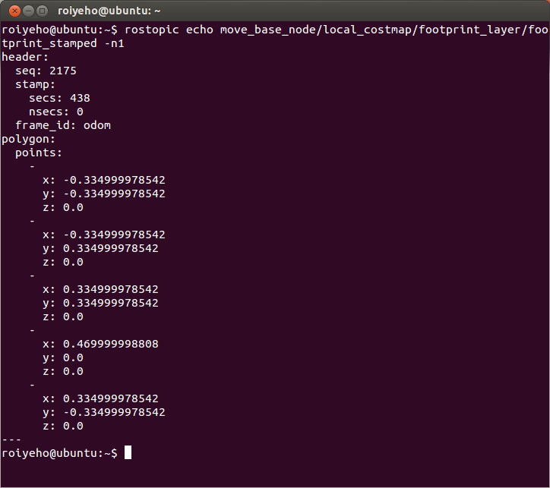
Robot Footprint

Slide 45
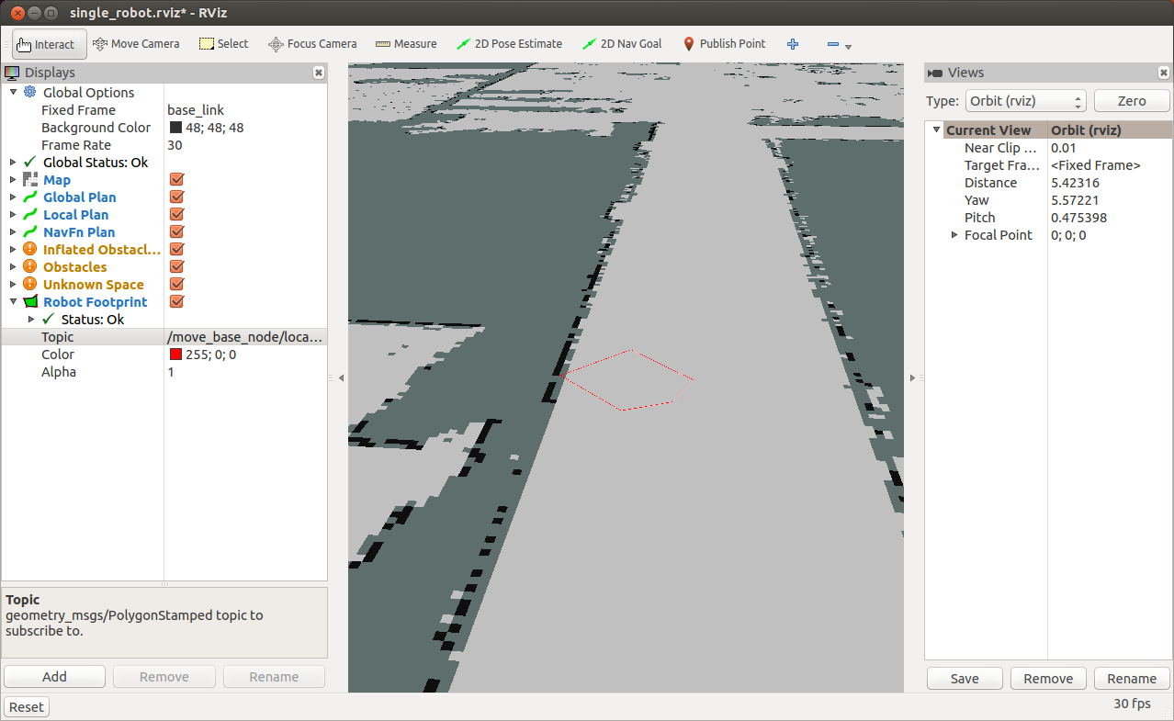
Robot Footprint

Slide 46
2D Pose Estimate
The 2D pose estimate (P shortcut) allows the user to initialize the localization system used by the navigation stack by setting the pose of the robot in the world.
The navigation stack waits for the new pose of a new topic with the name initialpose.
Click on the 2D Pose Estimate button and click on the map to indicate the initial position of your robot.
If you don't do this at the beginning, the robot will start the auto-localization process and try to set an initial pose.
Note: For the "2d Nav Goal" and "2D Pose Estimate" buttons to work, the Fixed Frame must be set to "map".

Slide 47
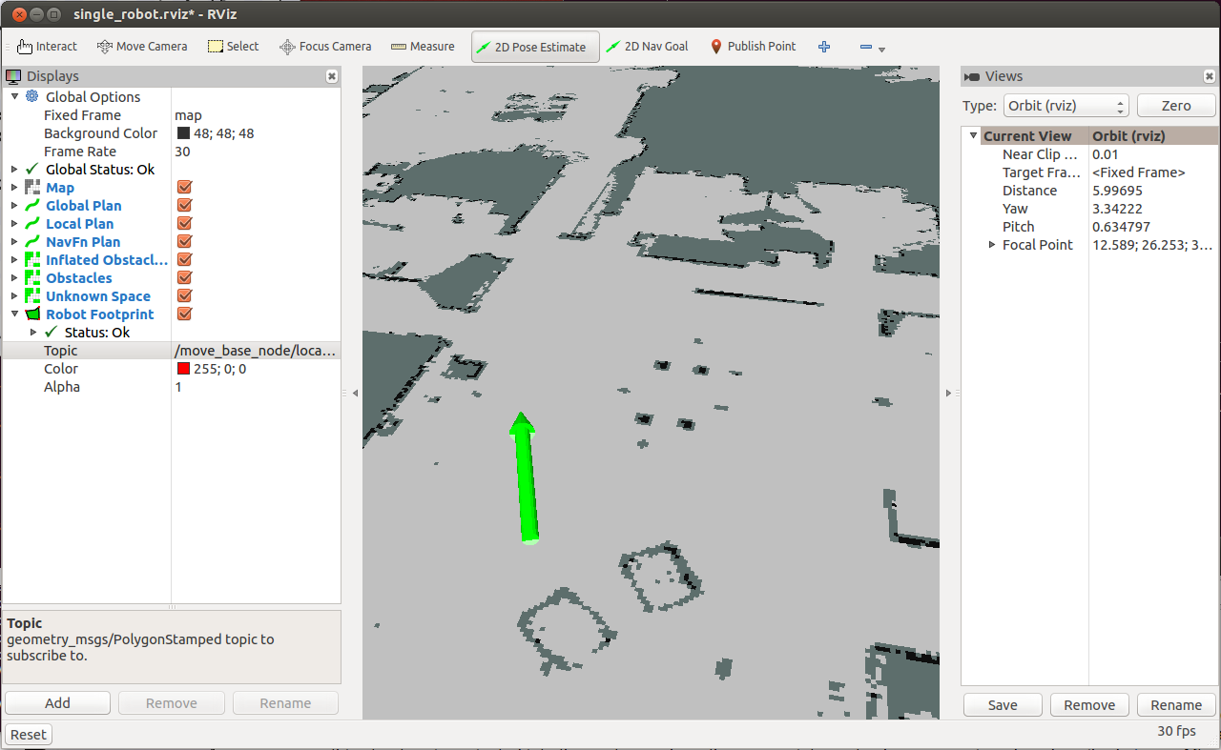
2D Pose Estimate

Slide 48
2D Nav Goal
The 2D nav goal (G shortcut) allows the user to send a goal to the navigation by setting a desired pose for the robot to achieve.
Click on the 2D Nav Goal button and select the map and the goal for your robot.
You can select the x and y position and the end orientation for the robot.

Slide 49
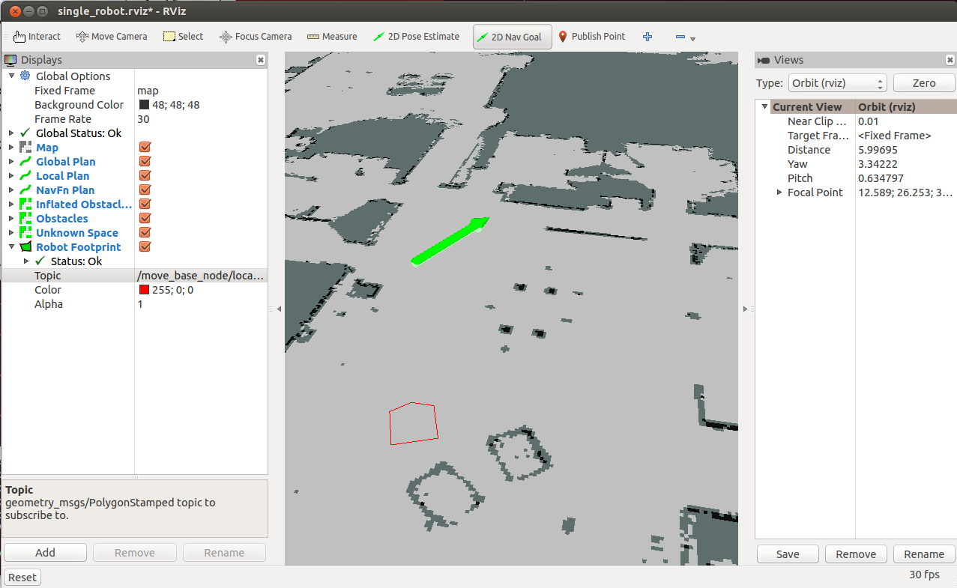
2D Nav Goal

Slide 50
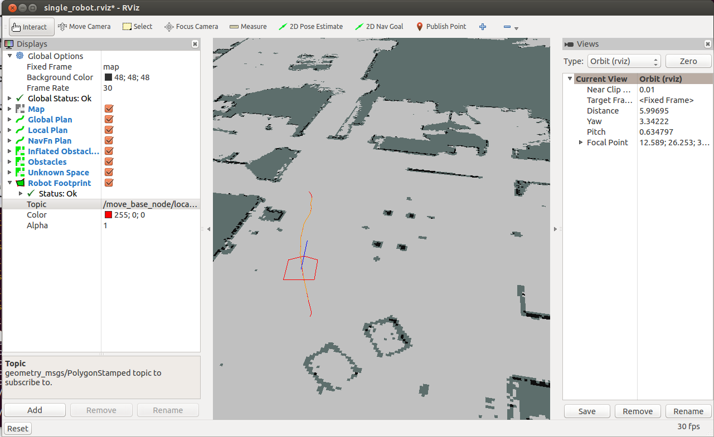
Robot Moves to Destination

Slide 51
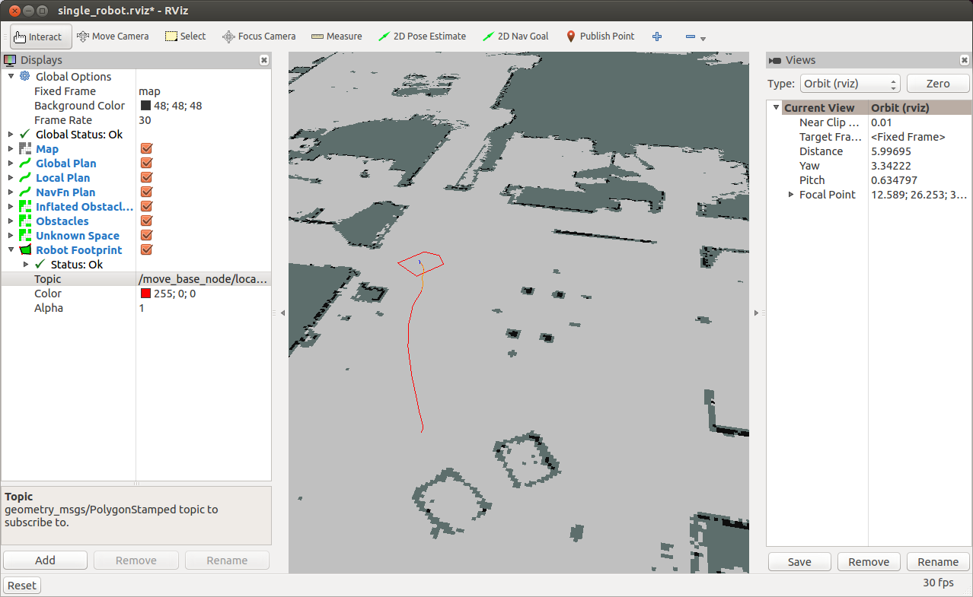
Final Pose

Slide 52
Current Goal
To show the goal pose that the navigation stack is attempting to achieve add a Pose Display
Set its topic to /move_base_simple/goal
You can see the goal pose as a red arrow
It can be used to know the final position of the robot

Slide 53
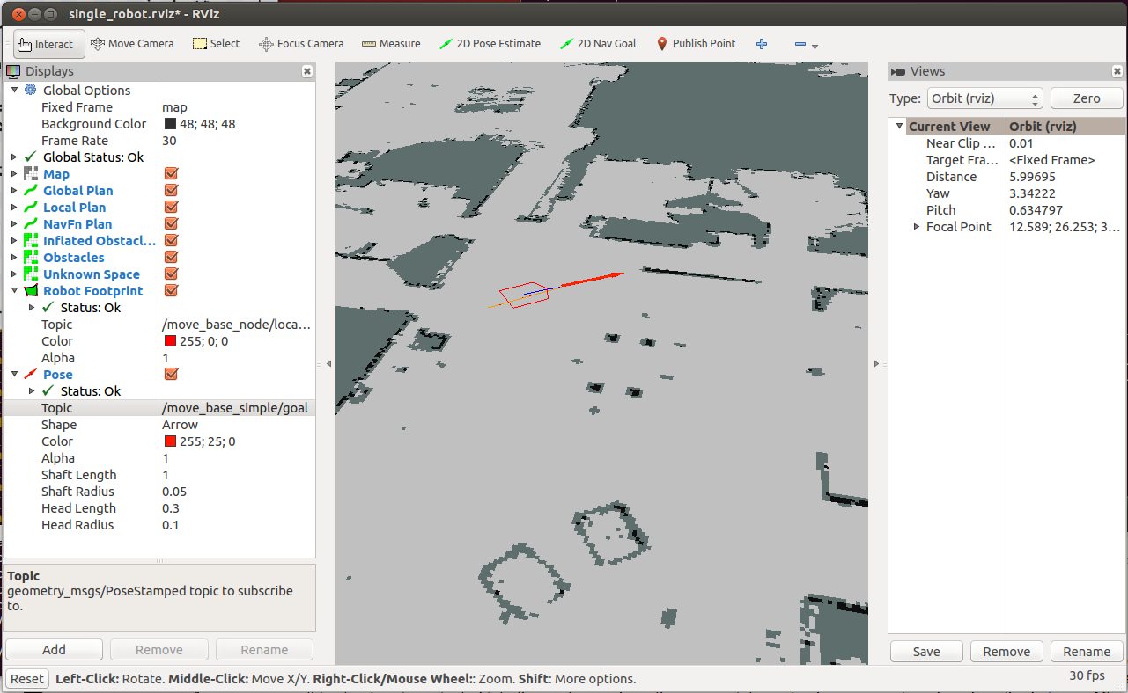
Current Goal

Slide 54
Costmap
To see the costmap in rviz add a Map display
To see the local costmap set the topic to:
/move_base_node/local_costmap/costmap
To see the global costmap set the topic to:
/move_base_node/global_costmap/costmap

Slide 55
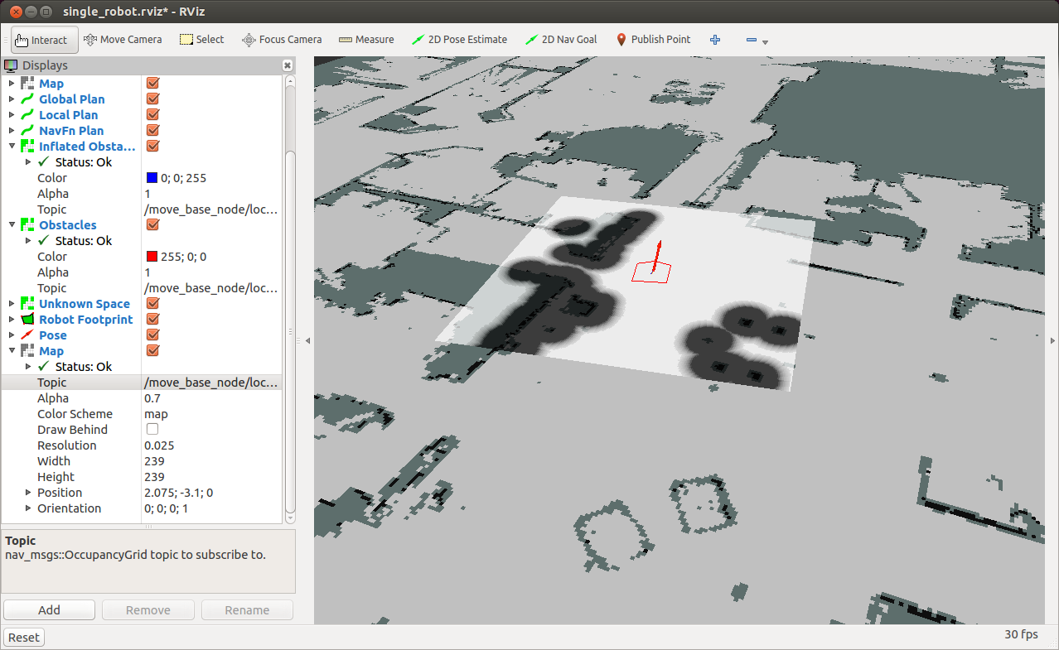
Local Costmap

Slide 56
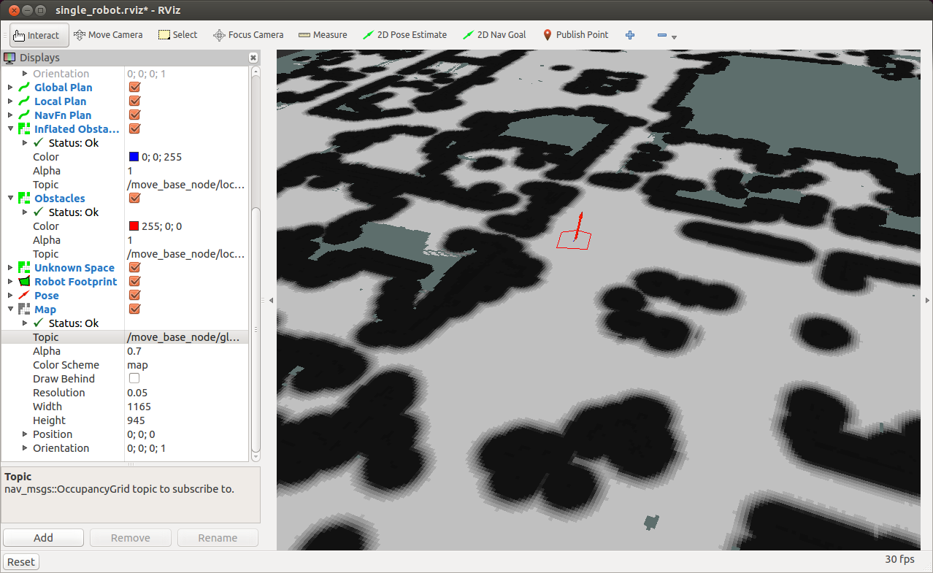
Global Costmap

Slide 57
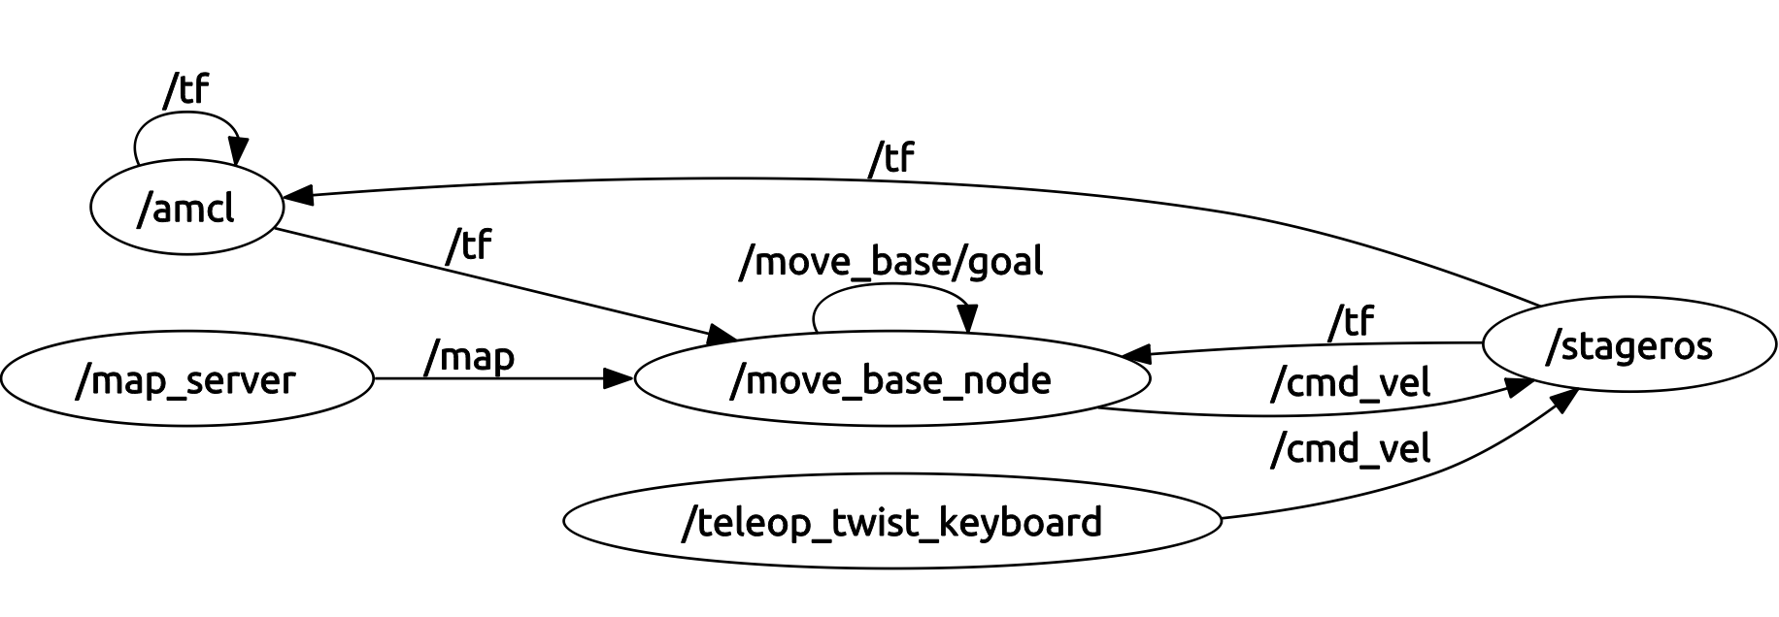
Nodes Graph

Slide 58
Homework (not for submission)
Install the navigation_stage package
Test the different launch files in this package
Send goals to the robot via rviz and examine the costmaps created
Create a ROS node that prints the local costmap to the screen

