Slide 1




Özhan GÜLAL
Software Technology Trainer, Developer ozhangulal.com

Slide 2
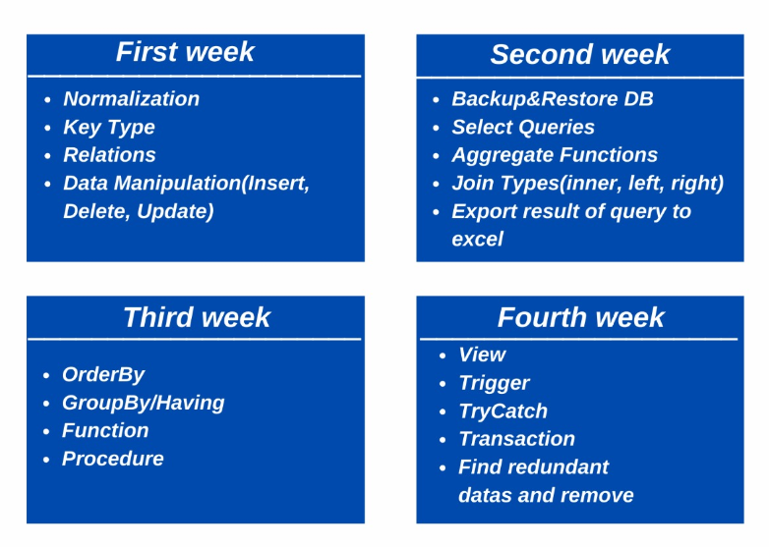

Slide 3
What is Database?

Slide 4
Database is a collection of structured information or data stored
electronically in a computer system. The database is controlled
by a data management system (DBMS).

Slide 5
Normalization
Normalization is a database design technique that reduces data redundancy and eliminates undesirable characteristics like Insertion, Update and Deletion Anomalies.
Normalization rules divides larger tables into smaller tables and links them using relationships.
The purpose of Normalization in SQL is to eliminate redundant (repetitive) data and ensure data is stored logically.

Slide 6
Normalization
Database Normal Forms
1NF (First Normal Form)
2NF (Second Normal Form)
3NF (Third Normal Form)
BCNF (Boyce-Codd Normal Form)
4NF (Fourth Normal Form)
5NF (Fifth Normal Form)
6NF (Sixth Normal Form)

Slide 7
Normalization
1NF (First Normal Form)
Each table cell should contain a single value.
Each record needs to be unique.

Slide 8
Normalization
2NF (Second Normal Form)
Rule 1- Be in 1NF
Rule 2- Single Column Primary Key

Slide 9
Normalization
3NF (Third Normal Form)
Rule 1- Be in 2NF
Rule 2- Has no transitive functional dependencies

Slide 10
Key Types
Candidate Key
Primary Key
Compound Key
Surrogate Key
Foreign Key

Slide 11
Primary Key
The PRIMARY KEY constraint uniquely identifies each record in a table.
Primary keys must contain UNIQUE values, and cannot contain NULL values.
A table can have only ONE primary key; and in the table, this primary key can consist of single or multiple columns (fields).

Slide 12
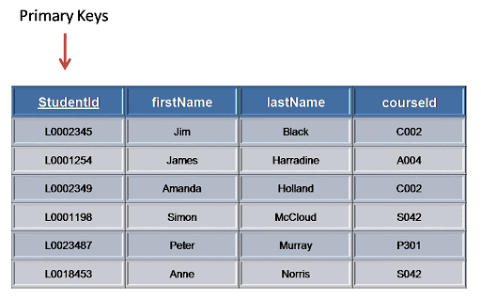
Primary Key

Slide 13
Foreign Key
The FOREIGN KEY constraint is used to prevent actions that would destroy links between tables.
A FOREIGN KEY is a field (or collection of fields) in one table, that refers to the PRIMARY KEY in another table.
The table with the foreign key is called the child table, and the table with the primary key is called the referenced or parent table.

Slide 14
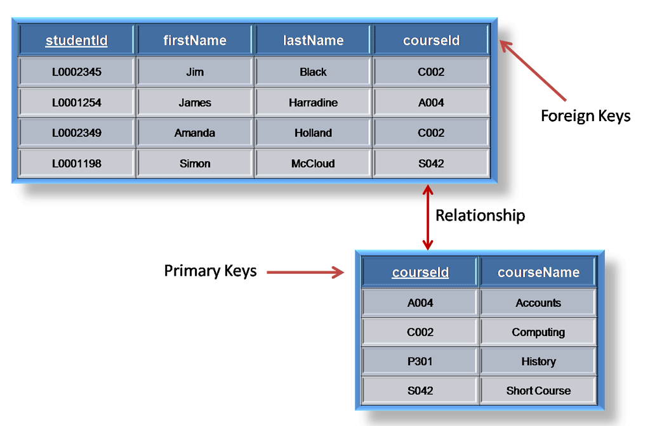
Foreign Key

Slide 15
Relationship on Database
1 to 1
1 to Many
Many to Many

Slide 16
Relationship on Database
1 to 1
In a one-to-one relationship, one record in a table is associated with one and only one record in another table.

Slide 17
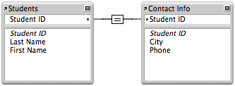
Relationship on Database
1 to 1
In a school database, each student has only one student ID, and each student ID is assigned to only one person.

Slide 18
Relationship on Database
1 to Many
In a one-to-many relationship, one record in a table can be associated with one or more records in another table.

Slide 19
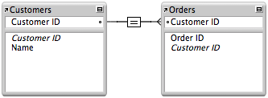
Relationship on Database
1 to Many
Each customer can have many sales orders.

Slide 20
Relationship on Database
Many to Many
A many-to-many relationship occurs when multiple records in a table are associated with multiple records in another table.

Slide 21
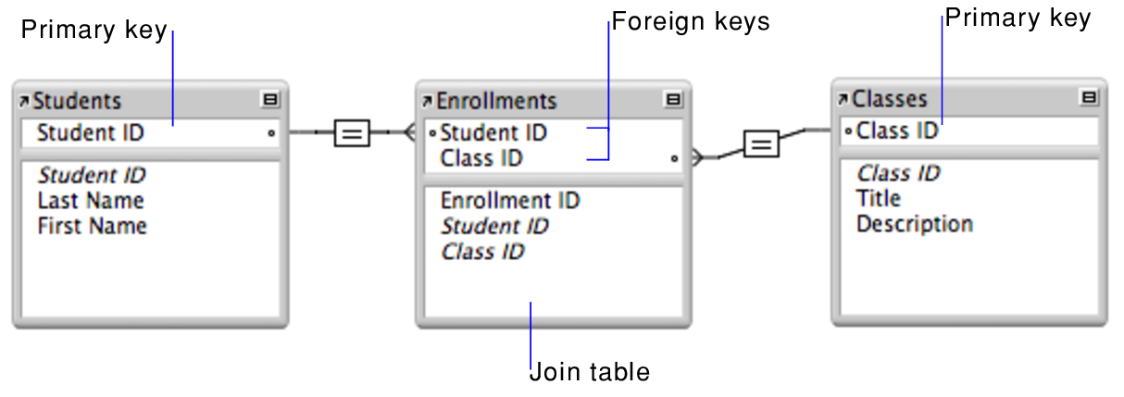
Relationship on Database
Many to Many
A many-to-many relationship exists between students and classes: students can select various classes, and classes can be selected by many students…

Slide 22

DEMO TIME ! LAUNCH SQL

Slide 23
Questions ???

Slide 24
Talk to me!
ozhangulal.com
linkedin.com/ozhangulal
ozhangulal@gmail.com

