Slide 1
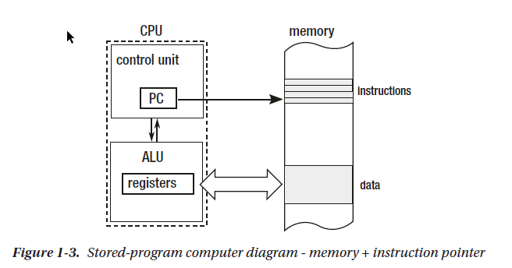
Von Neumann architecture diagram
- control unit - decodes program instructions (opcodes) read from
memory
- arithmetic and logic unit (ALU) - responsible for performing
operations like addition and subtraction. - register - memory location quickly accessible from ALU and/or
Control Unit - memory - responsible for storing data and the program itself. - Random Access Memory (RAM) - allows us to read data at the
same access time irrespective of the memory region we access

Slide 2
Basic Concepts
The Static Allocation
Most of the very first programming languages did allow only static memory allocation - the amount and the exact location of memory needed had to be known during compilation time, before even executing the program. (starting from machine or assembly code to the first versions of FORTRAN and ALGOL)
The Register Machine
The Stack Machine

Slide 3
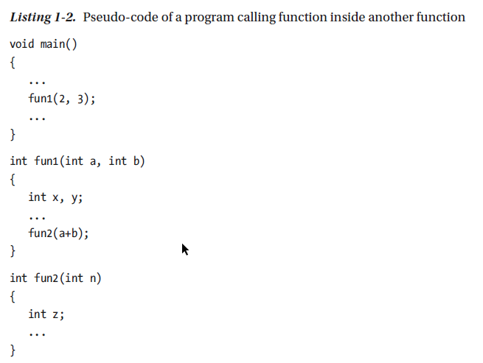
The Stack Machine

Slide 4
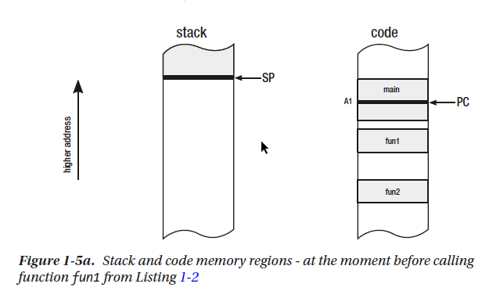
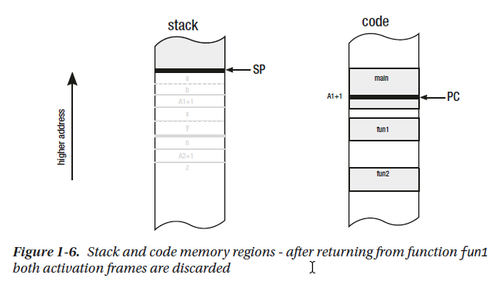
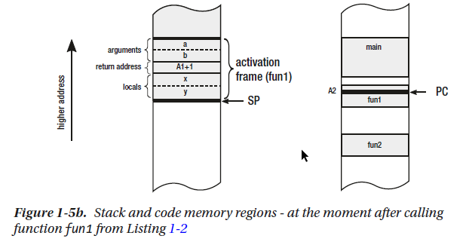
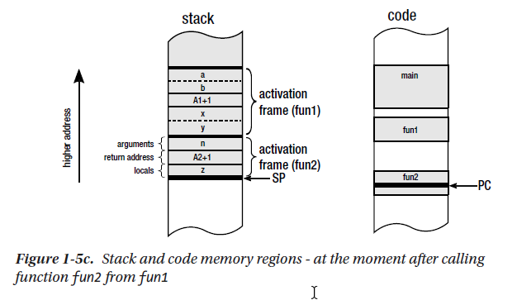

Slide 5
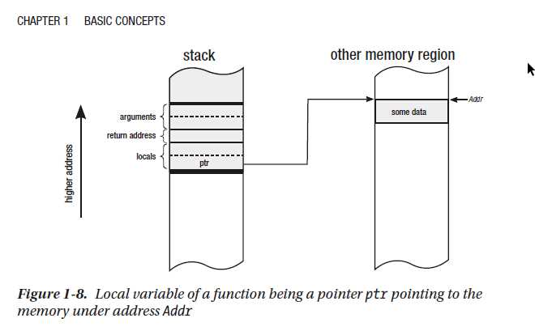
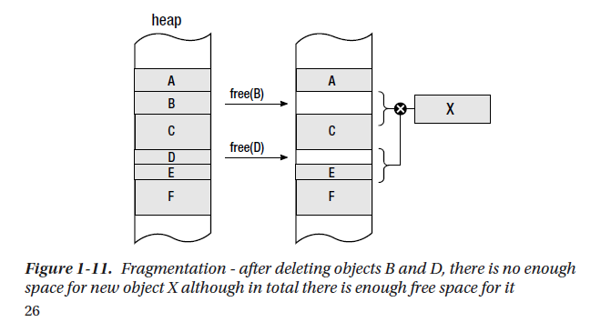
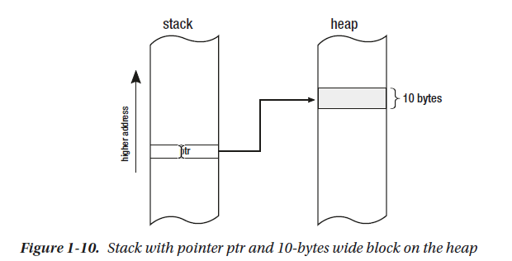
The Pointer and the Heap

Slide 6
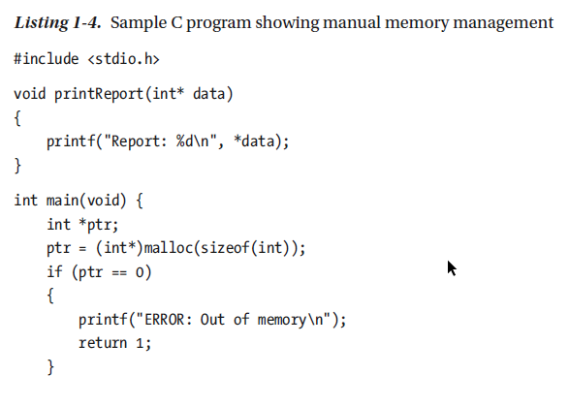
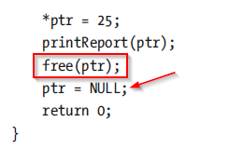
Manual Memory Management - a lot of “ceremony code”

Slide 7
Automatic Memory Management aka garbage collection
John McCarthy, one of the co-founders of Artificial Intelligence and the inventor of LISP, is also a father of the first garbage collection algorithms (in 1958 introduced the Mark and Sweep algorithm)

Slide 8
Allocator, Mutator, and Collector
The Mutator
New(amount)
Write(address, value)
Read(address)
The Allocator
Allocator.Allocate(amount)
Allocator.Deallocate(address) *Please note that in case of automatic memory management, this method is internal and not exposed to the Mutator
The Collector
Because knowing a liveness of an object is impossible, Collector is based on a less strict property of the object whether it is reachable by any Mutator.

Slide 9
Collector strategies
Reference Counting
Tracking Collector (Mark + Collect)

Slide 10
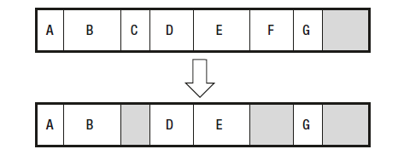
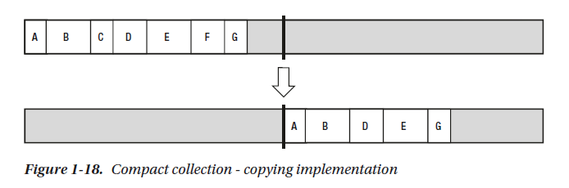
Mark-Plan-Sweep-Compact
Advantages:
• Complete transparency from the developer’s perspective - a memory is just abstracted as would be infinite, without having to worry about freeing memory of no longer needed objects.
• No problems with circular references.
• No big overhead on Mutators.
Disadvantages:
• More complicated implementation.
• Non-deterministic freeing objects - they will be released after some time not being reachable.
• Stop the world needed for Mark phase - but only in a non-concurrent flavor.
• Bigger memory constraint - as objects are not reclaimed as fast after not being needed, more memory pressure can be introduced (more
garbage lives for some period of time).

Slide 11
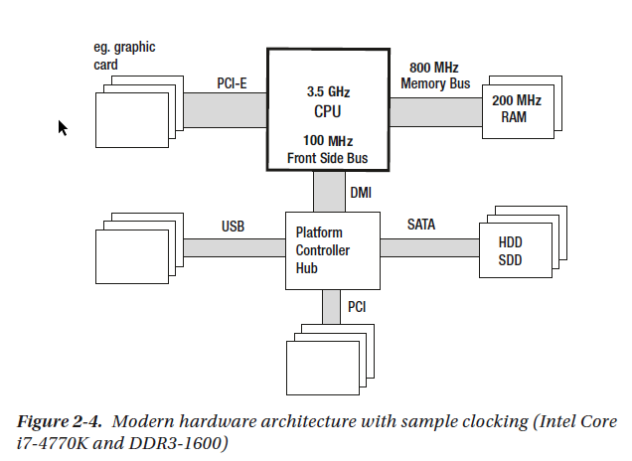
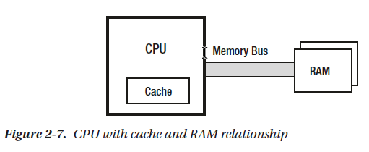
Hardware
The typical current processor operates at a frequency of 3 GHz or above. Meanwhile,
the memory works with an internal clock with frequencies of only 200–400 MHz. This makes the order of magnitude performance difference.

Slide 12
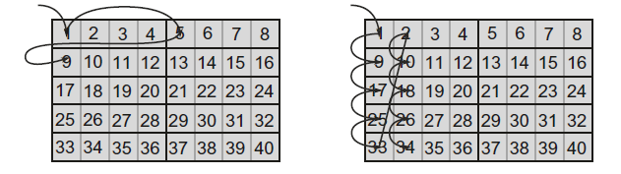
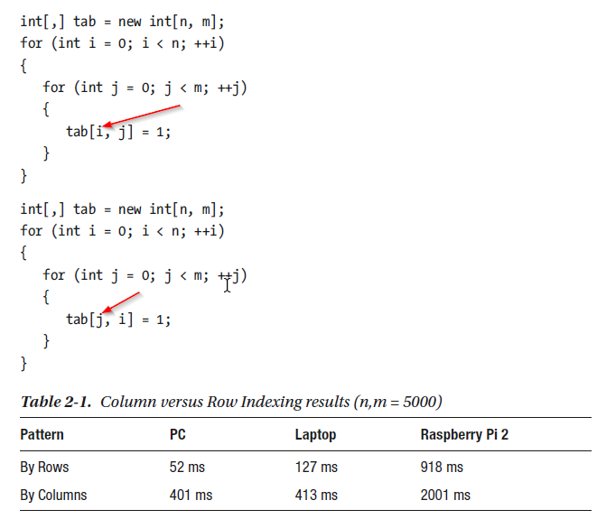
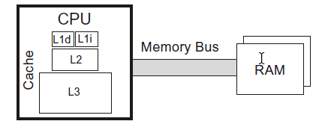
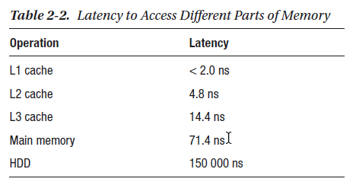
Cache Hit and Miss

Slide 13
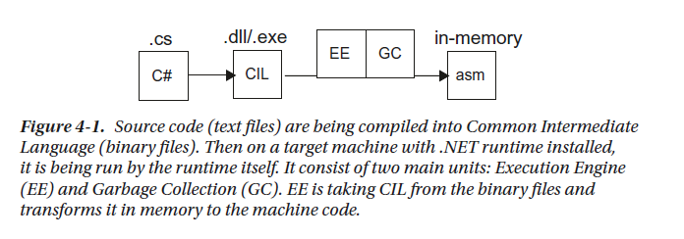
.NET Internals
Unlike programs written in C or C++, when you
write a program in C#, F#, or any other .NET compatible language, it is compiled into the so-called CIL (Common Intermediate Language). This code is then used by the Common Language Runtime (CLR). CLR is the place when all the managed magic happens.
Just-in-time compiler (JIT compiler)- Its function is to transform the CIL code into machine code.

