Slide 1
Introducing IO-SDK (v0.5)
Michele Sciabarrà

Slide 2
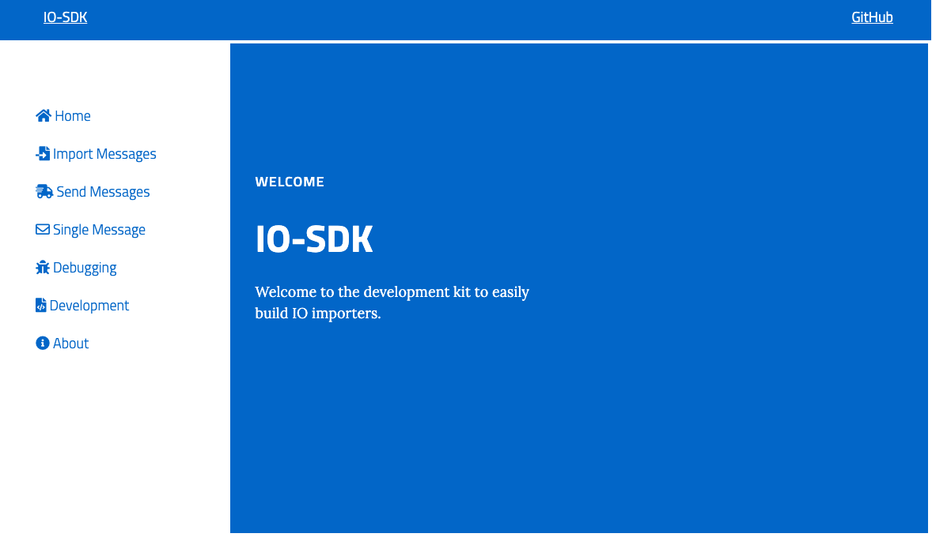
What is IO-SDK?

Slide 3
Features
Complete enviroment running single workstation
Very simple installation with installers
Provides Complete Server Side environment
Ready-to-Go development environment with Editor
A CLI to control the sdk
Portable: Windows, Mac and Linux
Only requirement: Docker and 8Gb of memory
Supports multiple programmin languages
Vendors are expected to release and update Open Source connectors on GitHub

Slide 4
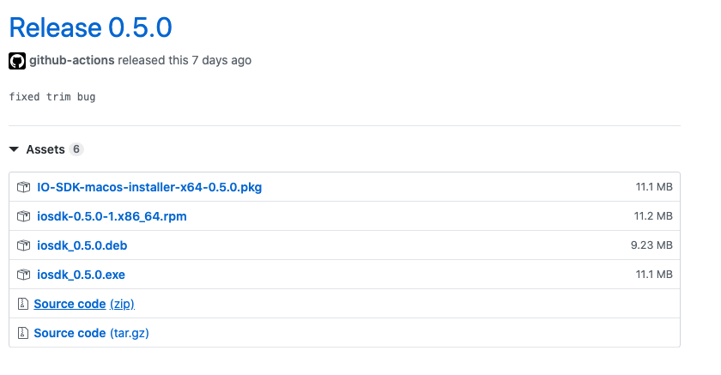
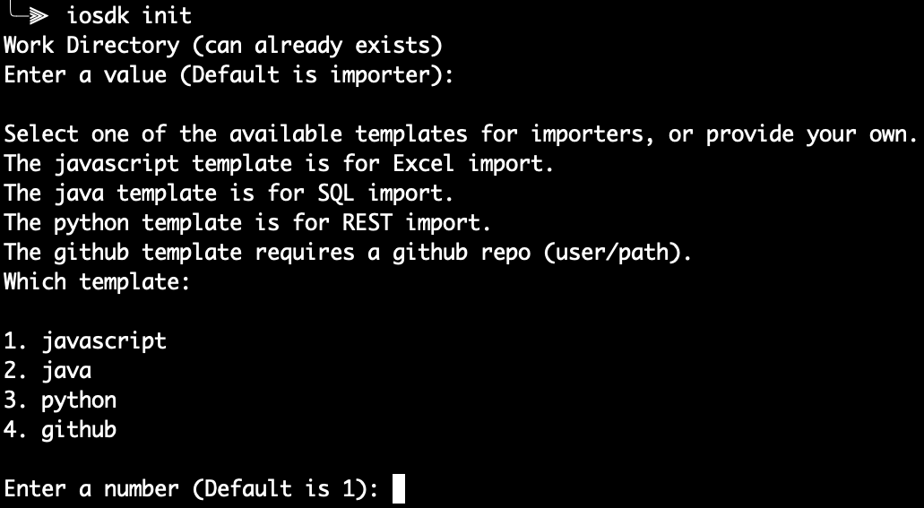
Installers and CLI
Installers for Windows, Linux, Mac
The only Prerequisite
A command
Line Interface

Slide 5
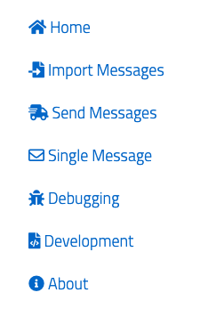
Overview
Import a batch of messages
Send collected messages
Send a single message
Debug message sending
Develop new connectors

Slide 6
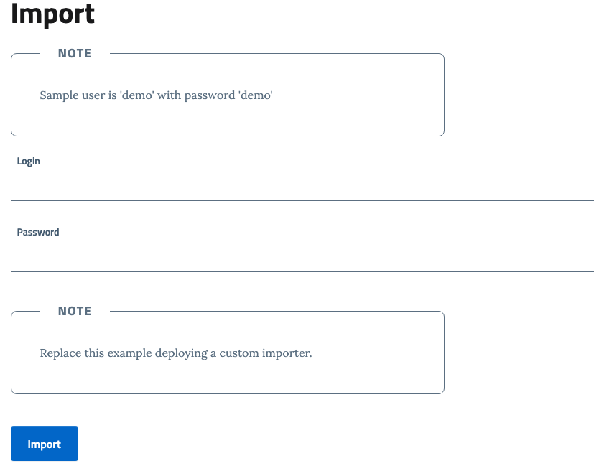
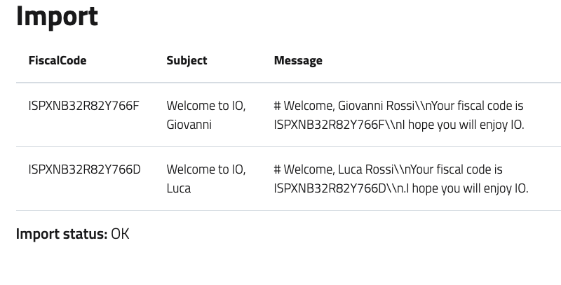
Import Messages with Sample Importer

Slide 7
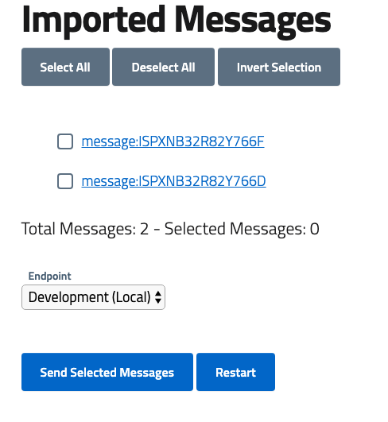
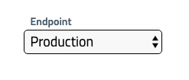

Send Multiple Messages

Slide 8
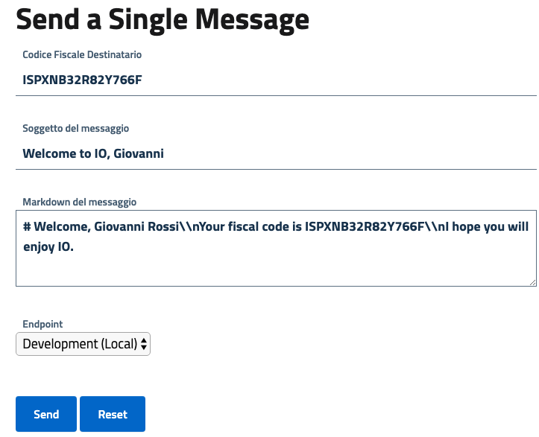
Send a Single Message

Slide 9
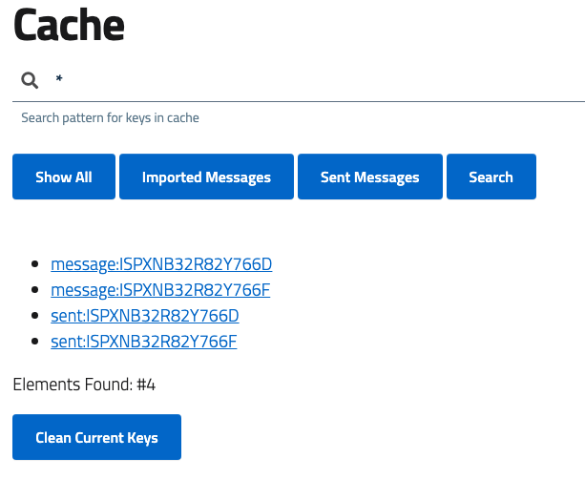
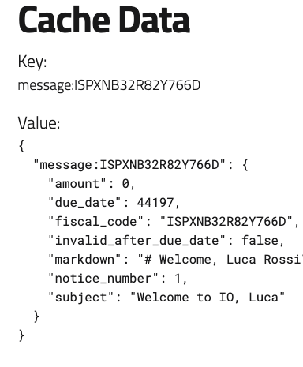
Debugging

Slide 10
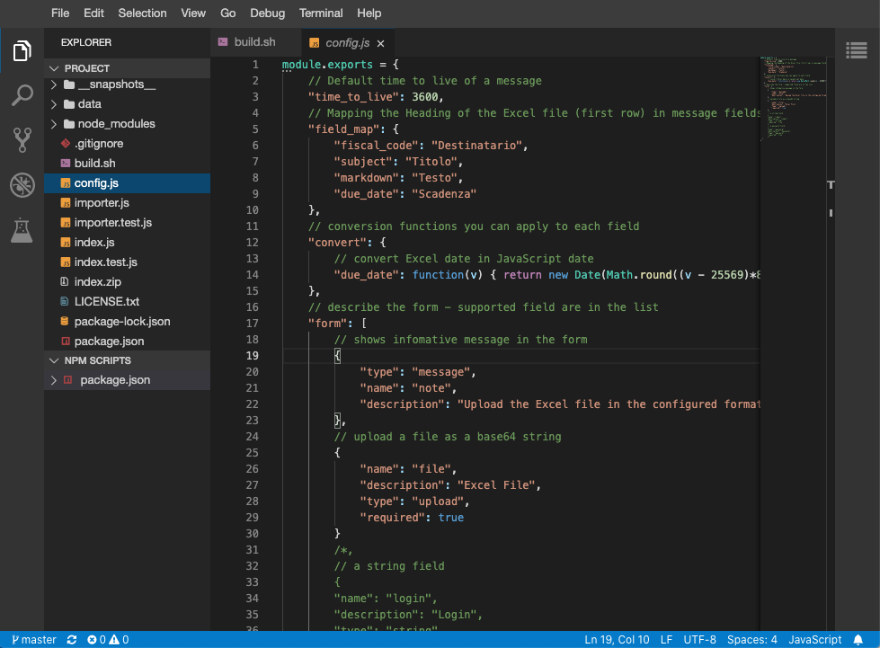
Development

Slide 11
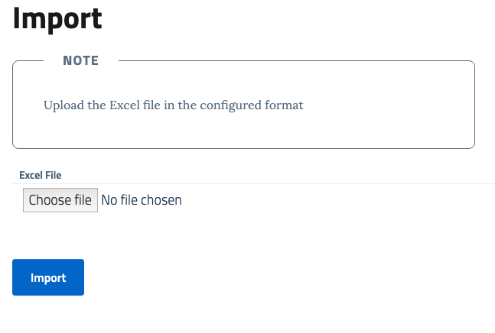
Custom Importer for Excel

Slide 12
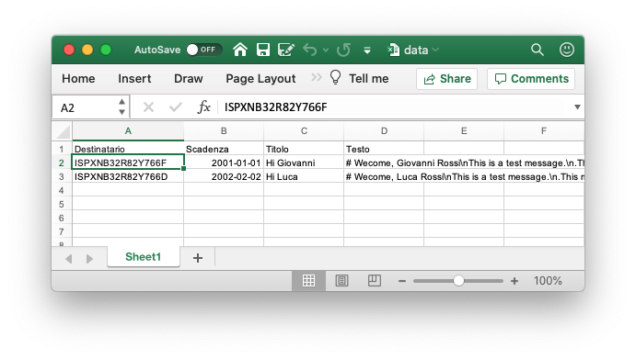
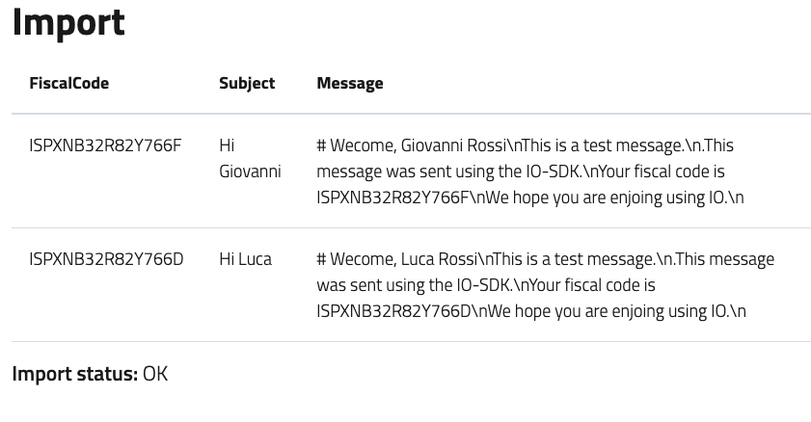
First Importer: Import Excel

