Slide 1
Overview
- **Founded:** April 1, 1976, by Steve Jobs, Steve Wozniak, and Ronald Wayne in Cupertino, California.
- **Key Products:** iPhone, iPad, Mac, Apple Watch, AirPods, Apple TV, HomePod, operating systems (macOS, iOS, iPadOS, watchOS, tvOS), and services (Apple Music, Apple TV+, iCloud, Apple Arcade, Apple Pay, Apple News+).
- **Monetization Model:** Hardware sales, services revenue, subscription services, App Store commissions, and accessory sales.
- **Target Customers:** Consumers, professionals and enterprises, education sector, and developers.
- **Ownership:** Publicly traded on NASDAQ (AAPL), owned by individual, institutional, and mutual fund investors, including Vanguard Group, BlackRock, and Berkshire Hathaway.
- **Marquee Customers:** Widely used by major corporations, educational institutions, government agencies, health care facilities, and creative professionals globally.
- **Sources:** Apple Inc. - About Us, SEC Filing Reports.

Slide 2
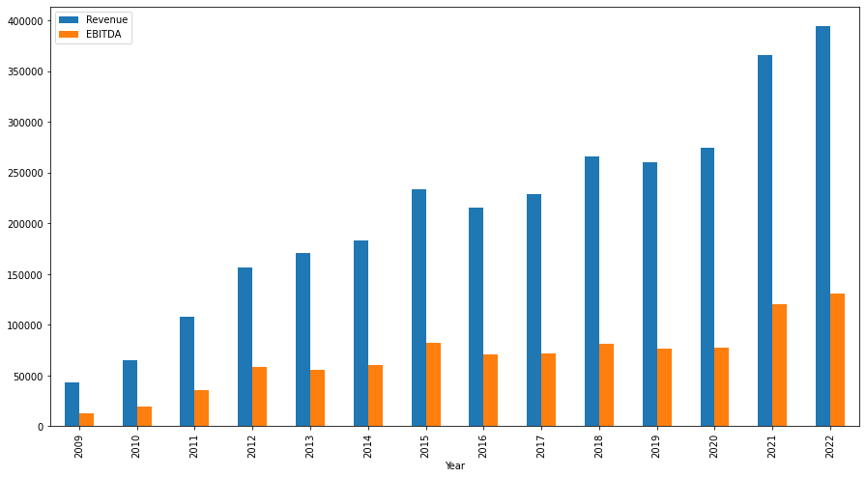
Financials
- **Historical Performance**: Apple’s stock has shown significant growth, closing at ~$227.48 on Nov 7, 2024, driven by successful product launches and strong financial results.
- **Stock Splits**: Conducted 7-for-1 split in June 2014 and 4-for-1 split in August 2020 to make shares more accessible.
- **Market Influence**: Share price influenced by product announcements, earnings reports, market trends, and economic conditions.
- **Valuation Multiples**: Key metrics include P/E, P/S, and P/B ratios, reflecting investor expectations and market valuation.
- **Financial Profile**: Strong revenue from hardware and services, high profitability, significant cash flow, and well-managed debt.
- **Equity Research Views**: Analysts provide target prices (e.g., $180-$200), ratings (buy, hold, sell), and earnings projections based on performance and market conditions.
- **Private Company Valuation**: Methods include precedent capital raises, comparable company analysis, and strategic investments.
Symbol | Market Cap | Price/Earnings | Earnings/Share | Price/Sales
GOOGL | $733.82BB | 31.48 | 22.27 | .
GOOG | $728.54BB | 40.29 | 22.27 | .
MSFT | $689.98BB | 25.76 | 2.97 | .
FB | $523.42BB | 27.9 | 5.39 | ..
V | $270.04BB | 32.72 | 2.8 | .
INTC | $211.54BB | 12.32 | 1.98 | .
ORCL | $202.3BB | 18.81 | 2.2 | .
CSCO | $199.43BB | 17.87 | 1.91 | .
MA | $187.1BB | 34.99 | 3.65 | .
IBM | $142.43BB | 10.67 | 6.11 | .

Slide 3
Geographic Mix
- **Headquarters:** Apple Inc. is based in Cupertino, California, at the Apple Park campus, known for its innovative ring-shaped design.
- **North America:** Major offices in Cupertino, CA (HQ), Austin, TX, and numerous retail stores across the US and Canada.
- **Europe:** Key offices in Cork, Ireland; Munich, Germany; London, UK; and retail stores in major cities like Paris, Berlin, Madrid, and Milan.
- **Greater China:** Operational hubs in Shanghai and Beijing, with multiple retail stores in cities including Shenzhen and Hong Kong.
- **Japan:** Tokyo office handling sales, marketing, and strategic partnerships.
- **Rest of Asia Pacific:** Regional hub in Singapore, maps development office in Hyderabad, India, and retail stores in Australia and South Korea.
- **Retail Network:** Significant global retail presence with flagship stores in New York City, San Francisco, Tokyo, Paris, and Dubai, enhancing direct consumer engagement.

Slide 4
Management
- **Tim Cook** – CEO since 2011, previously COO, responsible for worldwide sales and operations.
- **Luca Maestri** – CFO and Senior VP since 2014, oversees financial planning, investor relations, and more.
- **Jeff Williams** – COO since 2015, manages supply chain, service/support, and social responsibility.
- **Katherine Adams** – Senior VP and General Counsel since 2017, handles all legal matters globally.
- **Deirdre O’Brien** – Senior VP of Retail + People, manages global retail strategy and HR operations.
- **Greg Joswiak** – Senior VP of Worldwide Marketing since 2020, responsible for product management and marketing.
- **John Ternus** – Senior VP of Hardware Engineering since 2021, oversees hardware development.

Slide 5
Recent News
- **Product Announcements:**
- iPhone 13 series with enhanced camera, battery, and processing power.
- New iPads and Macs featuring the advanced M1 chip.
- **Financial Performance:**
- Record-breaking quarterly revenues despite supply chain challenges.
- Consistent revenue and earnings growth, surpassing Wall Street expectations.
- **Legal and Regulatory Matters:**
- Ongoing litigation with Epic Games over App Store commissions.
- Facing various antitrust investigations and lawsuits.
- **Stock Price Growth:**
- Significant growth from $20 in 2014 to over $227 in 2024.
- 4-for-1 stock split in August 2020 and regular dividends.
- **Profitability:**
- Strong revenue and net income growth, high gross and net margins.
- Extensive cash reserves for innovation and shareholder returns.
- **Material Change in Business Operations:**
- Transition to custom M1 chips, enhancing performance.
- Expansion of services like Apple Music, Apple TV+, and iCloud.
- **Recent Stock Price Data (November 2024):**
- Recent closing prices around $227, showing resilience and investor confidence.

Slide 6
M&A Profile
- No verified reports of Apple completing any M&A transactions in 2023.
- No significant announcements of new mergers or acquisitions by Apple in 2023.
- No public statements about terminated M&A deals involving Apple in 2023.
- Apple has not indicated plans to sell itself or any of its divisions in 2023.
- No official announcements from Apple about plans to acquire other companies or assets in 2023.
- The absence of M&A activity may suggest a focus on organic growth and innovation.
- Regularly check credible sources like Bloomberg, Reuters, and SEC filings for updates on Apple's strategic moves.

Slide 7
Miscellanea
- **Smartphones**: Competes with Samsung, Huawei, Google, and Xiaomi in the premium and budget-friendly segments.
- **Computers**: Faces competition from Microsoft (Surface), Dell (XPS, Alienware), and HP (Spectre) in high-end laptops and desktops.
- **Tablets**: Competes with Samsung (Galaxy Tab), Microsoft (Surface Pro/Go), and Amazon (Kindle Fire).
- **Wearables**: Rivals include Fitbit, Samsung (Galaxy Watch), and Garmin in the smartwatch and fitness tracker markets.
- **Streaming Services**: Apple TV+ competes with Netflix, Amazon Prime Video, and Disney+.
- **Music Services**: Apple Music faces competition from Spotify, Amazon Music, and YouTube Music.
- **Market Size**: Addressable markets include smartphones ($520B by 2025), personal computing ($200B in 2021), tablets (160M units in 2021), wearables ($70B in 2021), streaming services ($150B by 2026), and music streaming ($75B by 2027).

Slide 8
Discounted Cash Flow Analysis
- Overview of DFC (Discounted Free Cash Flow) analysis methodology
- Steps to project future free cash flows
- Calculation of discount rate using WACC (Weighted Average Cost of Capital)
- Present value of projected free cash flows
- Terminal value estimation and its present value
- Summation of present values to determine enterprise value
- Sensitivity analysis to assess impact of key assumptions on valuation

Slide 9
Leveraged Buyout Analysis
- **Definition**: Leveraged Buyout (LBO) involves acquiring a company using a significant amount of borrowed money.
- **Key Components**: Purchase price, financing structure, projected financial performance, and exit strategy.
- **Purchase Price**: Determined by valuation methods such as comparable company analysis, precedent transactions, and discounted cash flow (DCF).
- **Financing Structure**: Typically includes a mix of debt and equity, with debt often comprising a large portion.
- **Projected Financial Performance**: Involves forecasting revenue, expenses, and cash flows to assess the company's ability to service debt.
- **Exit Strategy**: Common exit options include selling the company, taking it public, or recapitalization.
- **Return Metrics**: Key metrics include Internal Rate of Return (IRR) and Multiple on Invested Capital (MOIC).

