Slide 1
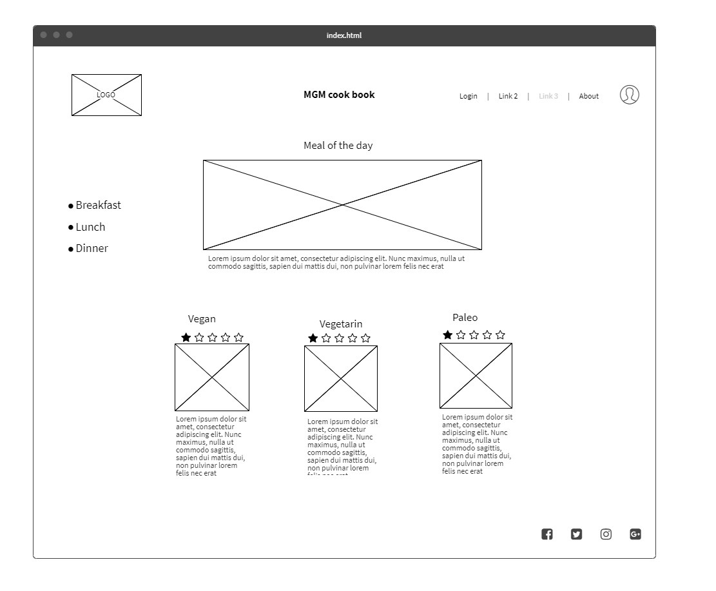
Index-Page
Row
Column

Slide 2
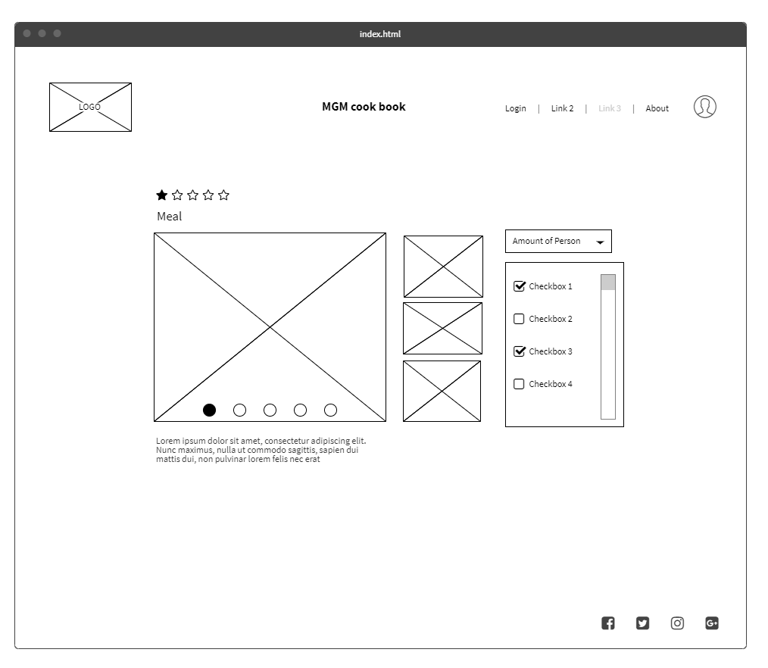
Content-Page
Row
Column

