Slide 1


Flutter

Slide 2
Table of Content
Introduction
History of Flutter
Understanding Flutter
Advantages of Flutter
Comparing Flutter with other frameworks
Setting up a Flutter development environment
Creating a simple Flutter application
Flutter Community and Resources
Conclusion
Q&A

Slide 3
Introduction - What is Flutter?
Open-source UI software development kit by Google
Develop applications for multiple platforms from a single codebase
Uses Dart language to provide its own widgets
Notes:
An open-source UI software development kit created by Google.
Used to develop applications for multiple platforms from a single codebase.
Flutter uses the Dart programming language and provides its own widgets, drawn with its own high-performance rendering engine.

Slide 4
Introduction - Importance of Flutter
Code once, deploy on multiple platforms
Complete framework with everything needed to create mobile apps
=> Saves development time and resources
Notes:
Allows developers to write code once and deploy it on multiple platforms.
It's a complete framework that includes everything needed to create mobile apps.
Saves time and resources in the development process.

Slide 5
History of Flutter
Announcement
Announced at Google’s I/O conference in May 2017
Stable Release
Flutter 1.0 released in December 2018
Evolution
Regular updates and new features since release
Current version: 3.10.3
Notes:
Announcement
Flutter was first announced as an early alpha at Google’s I/O conference in May 2017.
It was introduced as a new framework for creating mobile apps that looked great and shared a single codebase.
Stable Release
Flutter 1.0, the first stable version, was released in December 2018.
This marked a significant milestone in its development.
Evolution
Flutter has evolved significantly with regular updates and new features.
Gained popularity among developers due to its ease of use and flexibility.

Slide 6
Understanding Flutter - Dart Language
Object-oriented and strongly typed
Easy to understand for JavaScript or Java developers
No need for a separate declarative layout language
Notes:
Flutter uses Dart language, which is object-oriented and strongly typed.
Dart is easy to understand for JavaScript or Java developers.
Dart allows Flutter to avoid the need for a separate declarative layout language like JSX or XML, or separate visual interface builders.

Slide 7
Understanding Flutter - Flutter's Architecture
Based on reactive programming
Everything is a widget
Notes:
Flutter's architecture is based on reactive programming.
Everything in Flutter is a widget, including layout, styling, and even the application itself.
Widgets are composable: you can build complex UIs from small pieces.

Slide 8
Understanding Flutter - Rendering Engine
Built in C++
Supports low-level rendering
Responsible for system events, input and gestures, and compiling Dart code into native machine code
Notes:
Flutter's rendering engine is built in C++.
Supports low-level rendering, providing a flexible system for drawing a wide variety of graphics.
The engine is also responsible for system events, input and gestures, and compiling Dart code into native machine code.

Slide 9
Advantages of Flutter
Cross-platform Development
Code once, run on multiple platforms
Hot Reload
See changes in code instantly in the app
High Performance
Full native performance on both iOS and Android
Notes:
Cross-platform Development
Flutter allows developers to write code once and run it on multiple platforms.
Saves development time and resources.
Hot Reload
Hot Reload feature allows developers to see changes in code instantly in the app.
Makes it easier to experiment, build UIs, add features, and fix bugs faster.
High Performance
Flutter's widgets incorporate all critical platform differences.
Provides full native performance on both iOS and Android.

Slide 10
Comparing Flutter
Flutter vs React Native
More customization, better performance and a growing community
Flutter vs Xamarin
Better performance and simpler development process
Flutter vs Native Development
Reduce code duplication and accelerates development process
Notes:
Flutter vs React Native
Flutter offers more customization, better performance and a growing community.
Better performance compared to React Native.
Flutter vs Xamarin
Flutter provides better performance and a simpler development process compared to Xamarin.
Flutter vs Native Development
Flutter reduces code duplication and accelerates the development process.
Native development requires separate codebases for different platforms.
All lot of advantages, but con is relatively new technology and needs catching up with big players.
Very good comparisons can be found: https://www.thedroidsonroids.com/blog

Slide 11
Setting up a Flutter development environment
Required Tools
Flutter SDK and a text editor, Android Studio & Visual Studio IDE‘s
Android Emulator or iOS simulator for testing
Installation Process
Download Flutter SDK, update path, run Flutter doctor command
Notes:
Required Tools
Installation of the Flutter SDK, which includes the Dart SDK.
Setup of a text editor (Android Studio, IntelliJ, or Visual Studio Code).
Android Studio and Visual Studio IDE
Configuration of an Android Emulator or iOS simulator for testing the application.
Installation Process
Downloading the Flutter SDK, updating your path, and running the Flutter doctor command.

Slide 12
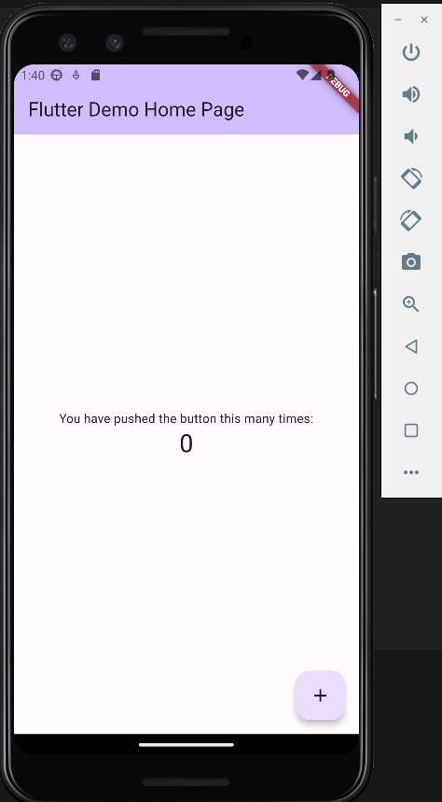
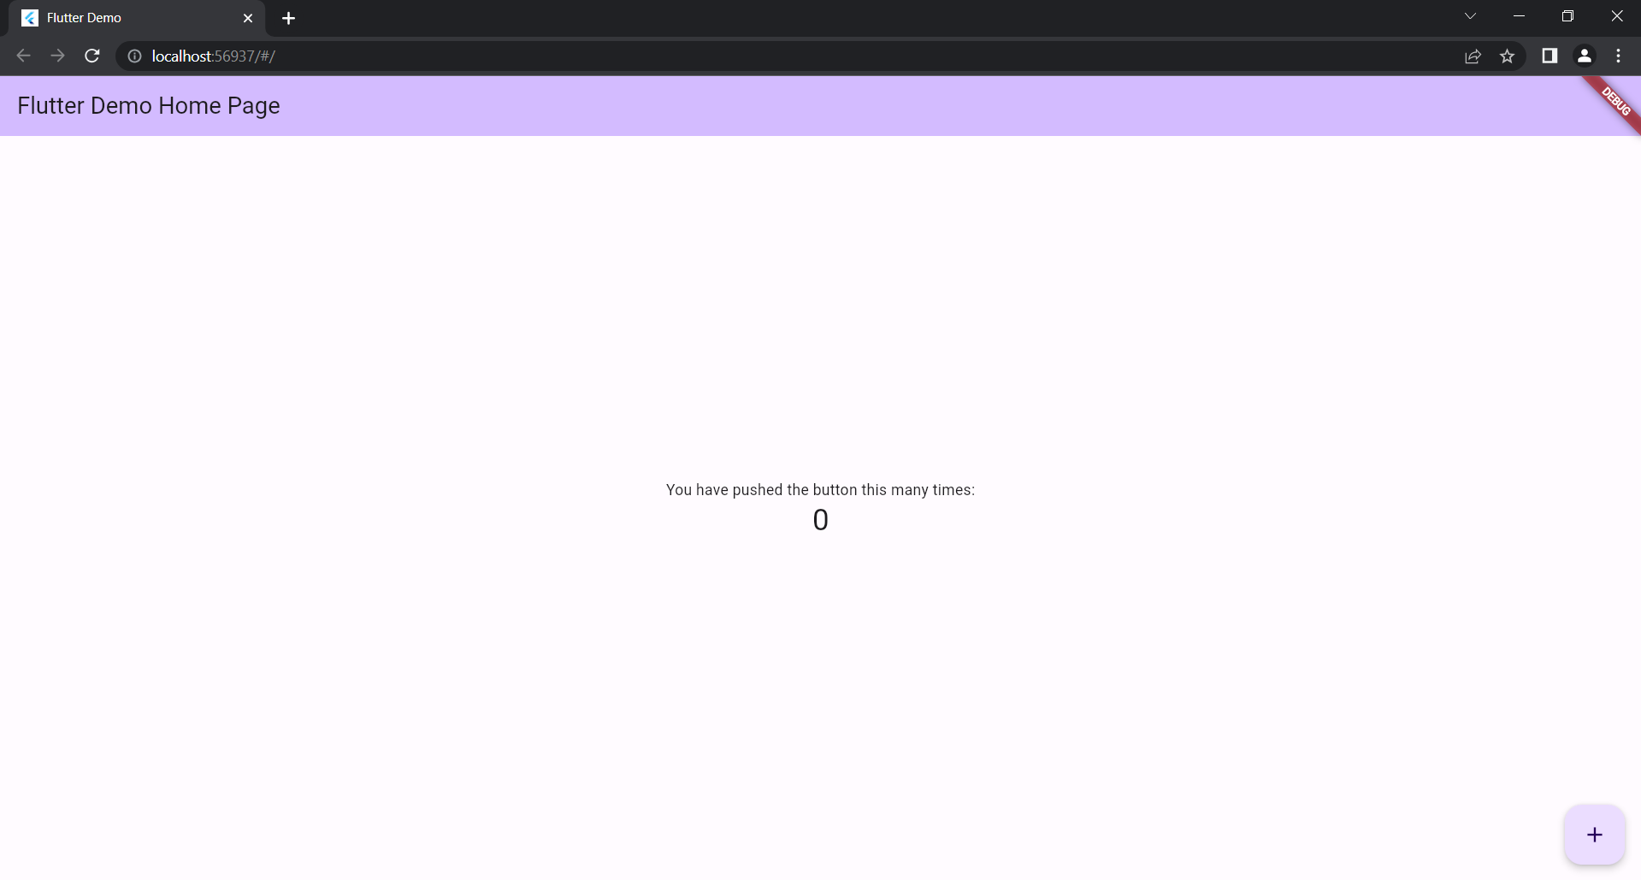
Creating a simple Flutter application
Code Walkthrough
Simple app includes a main.dart file
Running the Application
Run using the flutter run command
Fire-/Supabase Integration
Can be used as a backend service for Flutter apps
Notes:
Code Walkthrough
A simple Flutter app includes a main.dart file, the entry point of the application.
The main function calls runApp, which inflates the given widget and attaches it to the screen.
Running the Application
The application can be run using the flutter run command in the terminal.
Backend Integration
Fire- or Supabase can easily be used as a backend service for Flutter applications.
Provides features like authentication, database, and storage.

Slide 13
Flutter Community and Resources
Open-source Community
Large and growing open-source community
Learning Resources
Official documentation, YouTube channel, Community Medium, StackOverflow
Contribution
Report issues, propose changes, write code to improve Flutter
Notes:
Open-source Community
Flutter has a large and growing open-source community.
Developers around the world contribute to its development and help improve it.
Learning Resources
High quality resources for learning Flutter include Flutter's official documentation, Flutter YouTube channel, Flutter Community Medium, and StackOverflow.
Contribution
Developers can contribute to the Flutter community by reporting issues, proposingchanges, or writing code to improve Flutter.

Slide 14
Conclusion
Future Prospects
Rapid growth and adoption by companies worldwide
Summary
Powerful framework for developing mobile applications
Advantages: cross-platform development, hot reload, high performance
Notes:
Future Prospects
Flutter is growing rapidly and is being adopted by many companies worldwide.
Its ability to create high-quality applications for multiple platforms from a single codebase makes it a valuable tool for developers.
Summary
In conclusion, Flutter is a powerful framework for developing mobile applications.
Its advantages like cross-platform development, hot reload, and high performance make it a great choice for developers.
Even if its just to make a Proof of Concept for all platforms and later develop them natively

Slide 15
Q&A
Open questions? Feel free to ask

Slide 16
Sources
https://flutter.dev/
https://dart.dev/guides
https://medium.com/flutter-community
https://doi.org/10.22214/ijraset.2022.39958
https://www.thedroidsonroids.com/blog/flutter-vs-react-native-what-to-choose-in-2021
https://www.thedroidsonroids.com/blog/flutter-vs-xamarin-a-side-by-side-comparison-for-2021
https://www.cubix.co/blog/flutter-vs-native-app-development

Slide 17
Sources
https://doi.org/10.35940/ijrte.a7580.0512123
https://doi.org/10.15862/13inor420
https://doi.org/10.31294/inf.v9i2.12885
Images:
https://www.google.com/imgres?imgurl=https%3A%2F%2Fstorage.googleapis.com%2Fcms-storage-bucket%2F4fd5520fe28ebf839174.svg&tbnid=cQUy2A4OfhQyxM&vet=12ahUKEwjT9-TH7Kv_AhU8mScCHYtoCvoQMygCegUIARDmAQ..i&imgrefurl=https%3A%2F%2Fflutter.dev%2Fbrand&docid=MM4r-ALr3-nHNM&w=647&h=800&q=flutter%20logo&client=firefox-b-d&ved=2ahUKEwjT9-TH7Kv_AhU8mScCHYtoCvoQMygCegUIARDmAQ

