Slide 1
The Cognitive Cost of Speech Perception Adaptation
Are You Paying Attention?
Rachel Sabatello

Slide 2

Introduction
Speech production is variable
All speech sounds are produced on sound continuums
Today, we will be focusing on the /s/-/f/ continuum (“sss”-”shh”)
Listeners categorize these sounds based on subjective criteria
This criteria is based on prior exposure to other talkers
Notes:
Play the six sounds from right to left. Ask people to raise their hands if the talker is saying “ASI”, and lower their hands when the talker begins to sound like they are saying “ASHI”

Slide 3
2-AFC Lexical Decision Task
Hear a sound
Asi
Ashi
0
1

Slide 4
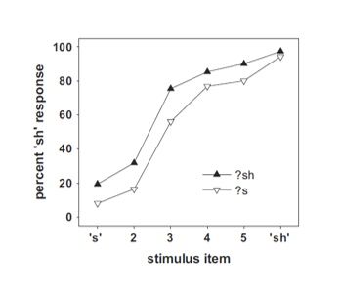

Measuring Categorization
Proportion of ASHI responses
100%
/ʃ/
We measure perception by certainty
The consistency of the perceived sound category along a continuum (e.g., ASI-ASHI)
Use lexical decision tasks
50%
Target the perceptual boundary
Where the proportion of responses is equal to chance (50%)
Dependent Variable!!
100%
/s/
Train participants to recognize an ambiguous sound as one end of the spectrum shifts the perceptual boundary
Steps that transition ASI $→$ ASHI

Slide 5
ASI
ASHI
S
?sh/?s
Sh
Continuum B
Continuum A
?s — Sh
S — ?sh

Slide 6
2-AFC Lexical Recognition Task
Hear a word or a nonword
Word
Nonword
Labeling

Slide 7


Samuel, 2016
Directing Attentional Resources & Perceptual Adaptation

Slide 8


Outline
O
Purpose
Methods
Results
Relevance

Slide 9
Purpose
1) Is attention necessary for speech perception adaptation?
2) How long is lexical perception malleable for after experience?
2) How long is lexical perception malleable for after experience?
If attention is required for adaptation, then redirecting the listener’s attention at different times during a talkers’ verbal stream can be used to interrupt the listener’s speech processing at different stages.
If attention is required for adaptation, then redirecting the listener’s attention at different times during a talkers’ verbal stream can be used to interrupt the listener’s speech processing at different stages.

Slide 10
Methods
Exp. 1a/1b
Exp. 2
Exp. 3
Exp. 4
Exp. 5
Female voice with ambiguous sound
Male voice interrupts
Adaptation only when attending to Female voice
Like Exp. 1a
Increase SOAs between female and male talker
Adaptation found with increased SOAs
Male voice replaced by a natural sound + new task
Inhibited adaptation by directing attention to a sound
Compresses female audio so finishes before male
Adaptation occurs after critical segment, not when the word begins
Interrupting lexical access vs perceptual adaptation
Interrupted perceptual adaptation process, not lexical access

Slide 11
Methods
Exp. 1a
Exp. 1b
A Female voice is presented, producing a word that contains an ambiguous s/sh sound
Male voice 200ms after female audio starts
no ambiguous sound
Perform a lexical recognition task for the Male Voice
A Female voice is presented, producing a word that contains an ambiguous s/sh sound
Male voice 200ms after female audio starts
no ambiguous sound
Count the syllables of the word produced by the Female Voice
No Adaptation
Adaptation

Slide 12

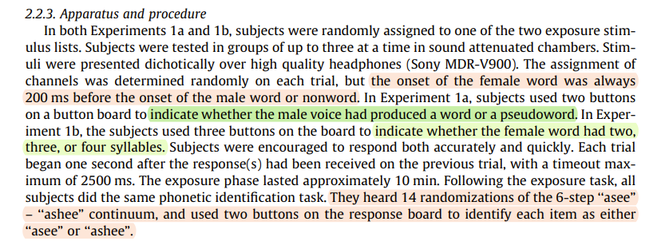
Business opportunities are like buses. There's always another one coming.
“
”
Richard Branson

Slide 13
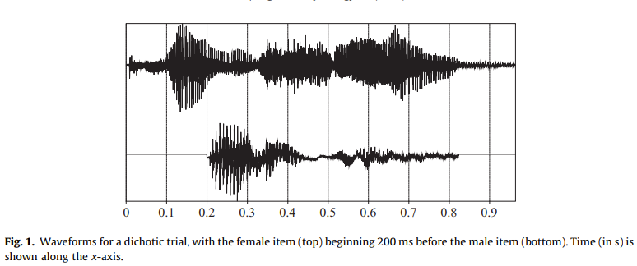
Stimulus Onset Asynchrony
Samuel (2016), p. 93

Slide 14
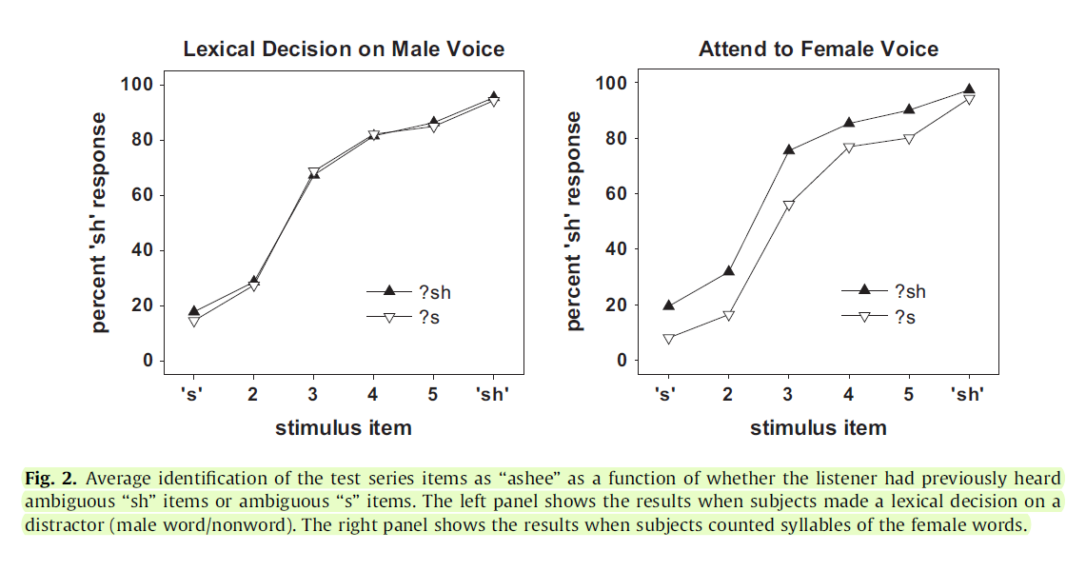
Business opportunities are like buses. There's always another one coming.
“
”
Richard Branson
Samuel (2016), p. 96

Slide 15
How does attention effect perceptual adaptation when two talkers are speaking simultaneously?

Slide 16
Why?
We know that perceptual adaptation does appear to require attentional resources, but we don’t know…
The degree of cognitive load required to inhibit adaptation
The extent of listeners’ ability to hone in on and maintain attention directed towards one verbal stream in a noisy environment
How listeners prioritize the many stimuli in their environment

Slide 17
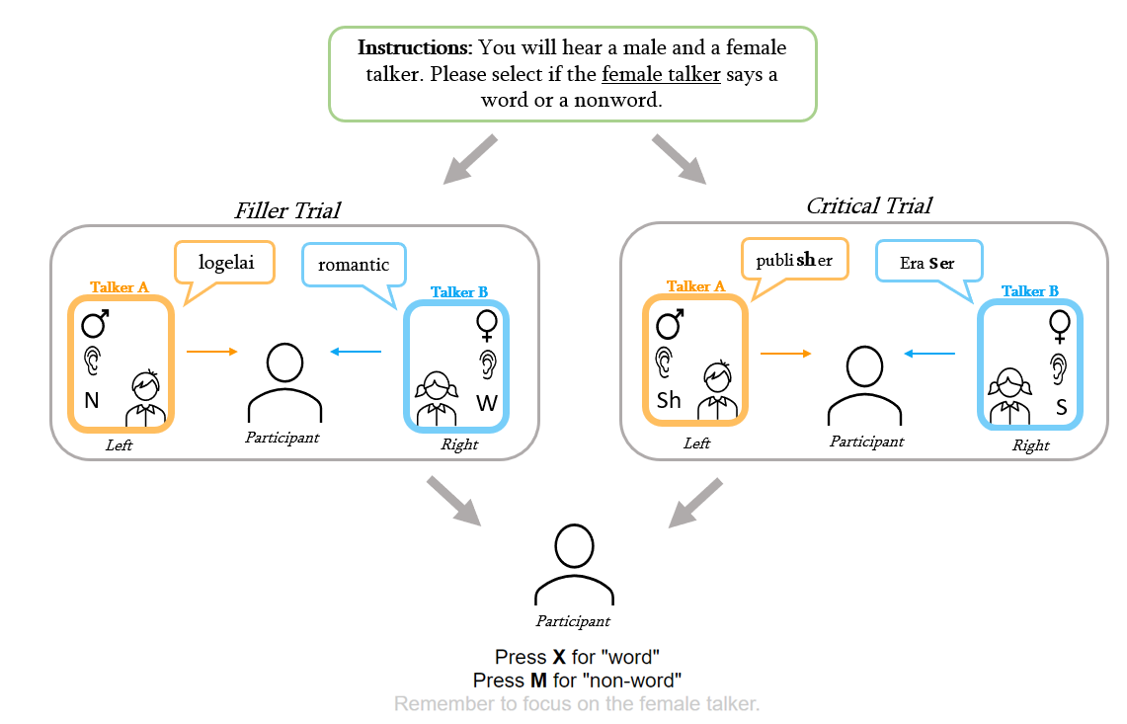
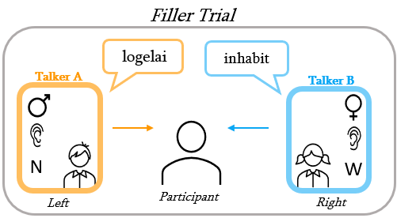

Notes:
A diagram of a single trial. Participants will be instructed to attend to either the male or female talker at the beginning of the experiment (left, green box). Each subsequent exposure trial will feature two talkers, either in a critical trial (top) where both talkers produce a word that contains a s/sh sound, or a filler trial (bottom) where one talker produces a word and the other a nonword. The participant must then select if the Attended Talker produced a word or a nonword for each exposure trial (right).

Slide 18
ASI
ASHI
S
?sh/?s
Sh
Talker B
Talker A
?s — Sh
S — ?sh

Slide 19
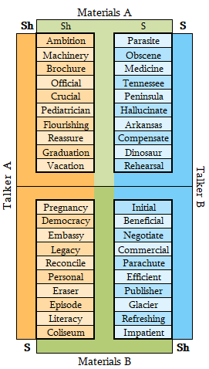
A visual illustrating how the Critical Words spoken by Talker A and Talker B are divided into Materials A and Materials B.
Notes:
A visual illustrating how the Critical Words spoken by Talker A and Talker B are divided into Materials A and Materials B. In this experiment, the words in Materials A are produced with an ambiguous sound and the words in Materials B are produced with an unambiguous sound. During the Critical Trials, each Talker is always heard in the same ear.

Slide 20
The 2 Talkers: Critical Items
Ambiguous
Assignment
Materials
Gender
Ear
Talker A
A
?s
Male
Left
Talker B
B
?sh
Female
Right

Slide 21
The 2 Talkers: Filler Items
Sound
Gender
Ear
Talker A
Word
Male
Left
Talker B
Nonword
Female
Right

Slide 22
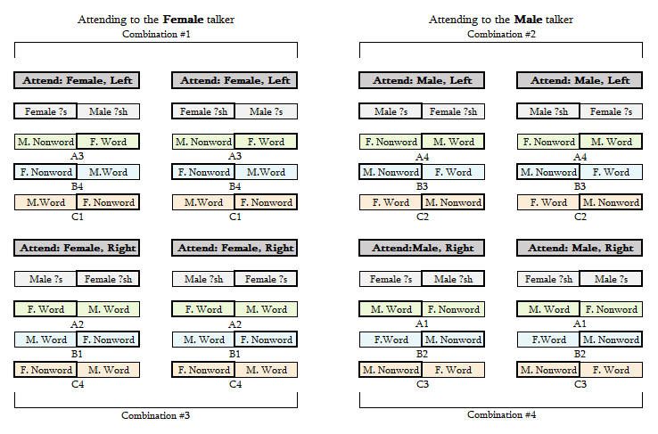
Notes:
The Set Version assigned to each Critical Item combination. The 20 Critical Items in each experiment are shown in gray, Set A in green, Set B in blue, and Set C in orange. The letter number combo below each pair (e.g., A3 below Set A in Combination #1 above) correlates to the Set and Version in Figure 4a. The ear the talker is presented in correlates to the position of the word in the pair (e.g., in Combination #1 above, the Female talker is presented in the Left Ear), and outline around the Attended Talker is bolded.

Slide 23
Exclusion Criteria
64 Participants Recruited
Self Report Following Directions
1 participant excluded for using external speakers
1 participant excluded for reporting they listened to the wrong talker
Lexical Decision Task Accuracy
2 participant excluded for answering more than 80% of the tasks incorrectly
0 participants excluded for answering more than 60% of the ambiguous critical items incorrectly

Slide 24
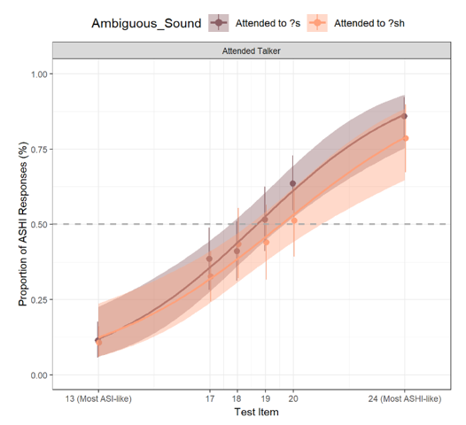
Results

Slide 25
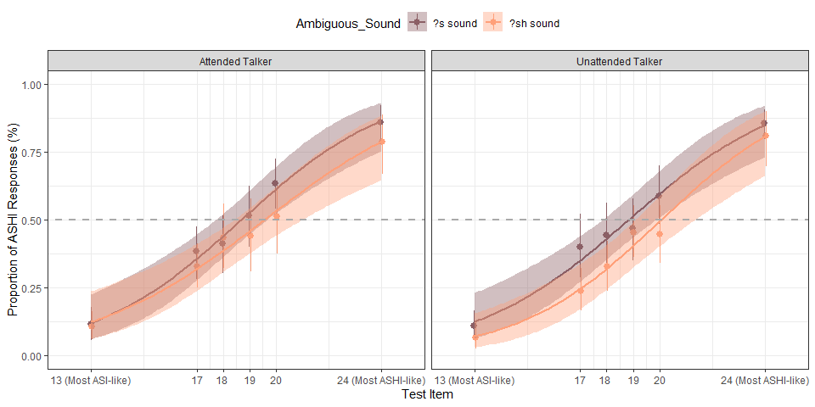

Slide 26
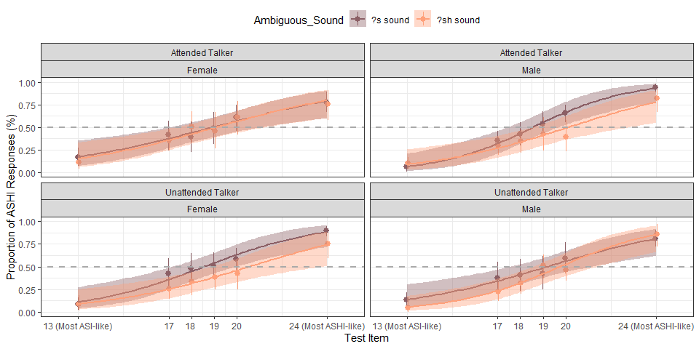
Categorization for Attended and Unattended Talker by Gender Assignment

Slide 27
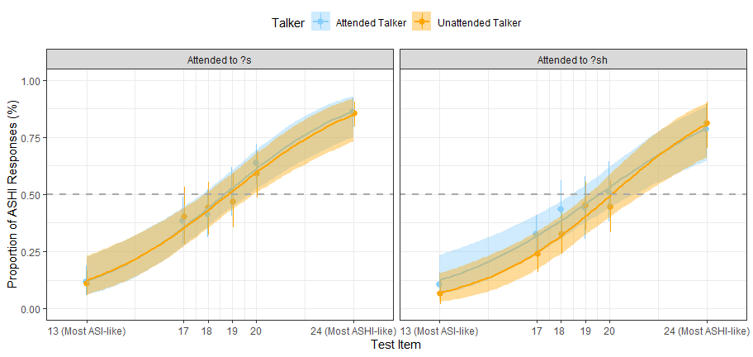
Categorization for Attended and Unattended Talker within Sound Assignment

Slide 28
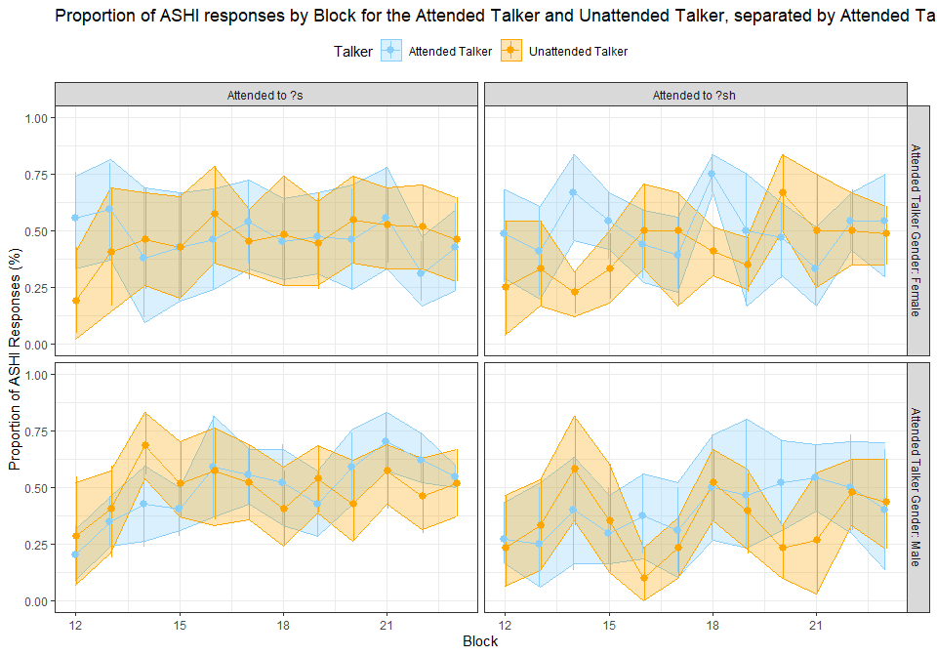

Slide 29
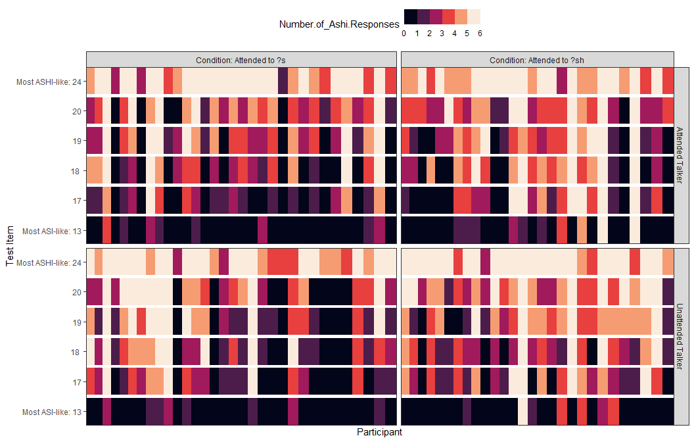

Slide 30
Implications/Discussion
No adaptation to either the Attended Talker or the Unattended Talker
High accuracy on the lexical recognition task
Accuracy for at least 6 of the labeled trials
Low number of exclusions (93.75% of participants)
No s/sh categorization prescreen + changes to test continuum?
Noise due to lack of SOA?
Only initial lexical access required for the task?
Notes:
(n = 60; Male = 29, Female = 28, NA = 3; Age μ = 34.036 years, Age σ = 10.966 years)

Slide 31
Thank You!
Notes:
The Set Version assigned to each Critical Item combination. The 20 Critical Items in each experiment are shown in gray, Set A in green, Set B in blue, and Set C in orange. The letter number combo below each pair (e.g., A3 below Set A in Combination #1 above) correlates to the Set and Version in Figure 4a. The ear the talker is presented in correlates to the position of the word in the pair (e.g., in Combination #1 above, the Female talker is presented in the Left Ear), and outline around the Attended Talker is bolded.

