Slide 1
VISTADEX
An idea-novelty and overlap screener for accelerators, universities, and VC funds.
Aditya Pradhan · Kushagra Agnihotri · Richeek Mishra · Lakshit Tanwar
BITS F364 — Human-AI Interaction · BITS Pilani, Pilani Campus

Slide 2
THE PROBLEM
“This is novel and unclaimed”
was wrong. Repeatedly.
Chip-design AI — Dominated by ChipAgents ($134M raised) and Synopsys
AI red-teaming — Crowded: HackerOne, Lakera, Confident AI
Generic idea validator — Occupied since 2022: Preuve AI, IdeaProof, ValidatorAI
“Proof of human” — A major-lab-backed competitor already live, with Tinder & Zoom integrations
This wasn't bad luck. Published research shows AI ideation is prone to mode collapse, and AI models are measurably more agreeable about a user's own proposal than a neutral evaluator would be.

Slide 3
MARKET REALITY
The obvious version of this idea
is already a crowded, 3-year-old market.
10+
2022
#1
competing idea-validator
products found
earliest competitor
date found
Google AI Overview already
names a competitor directly
Kill: a generic, founder-facing self-serve validator.
Keep, narrower: an institutional screening tool built around a proprietary graveyard database no one else maintains — sold to accelerators, universities, and VC funds, not individual founders.

Slide 4
DIFFERENTIATION
What makes VistaDex different
The graveyard database
Verify the live product
A structured record of dead & pivoted startups — nobody else builds this well.
Checked against the real, shipped product — not the marketing page.
Independence as a feature
Sold to institutions
An Objector agent argues against the system's own conclusion, countering AI sycophancy.
Bulk applicant screening for accelerators & funds — not another $10–$50 founder app.
“Every other tool tells you if your idea looks good today. We tell you if it already died once — and we're honest about how sure we actually are.”

Slide 5
THE PRODUCT
Two components, one report
01
02
The Verifier
The Graveyard Database
Decomposes a submitted idea into individual factual claims and checks each against live web sources, funding databases, and direct competitor product verification. Status per claim: confirmed, contradicted, disputed, or unverified.
A continuously growing database of startups that failed, pivoted, or shut down, each tagged with a cause of death. Every new idea is matched against it by meaning — always framed as a lead to verify, never a verdict.
The Objector — a third pass, run specifically to argue against the system's own conclusion, before anything is shown as final.

Slide 6
HOW IT WORKS
The Verifier pipeline
1
2
3
4
5
Claim extraction
Live retrieval
Verification
Confidence scoring
Structured output
An LLM splits the idea into individual, checkable claims
Web search + funding/patent databases + direct competitor product fetches
Each claim checked and classified against what was retrieved
Based on independent source agreement — never the model's self-report
A claim-by-claim report, every claim linked to its evidence
The graveyard database's pipeline mirrors this: raw signals in (news, dead sites, registry filings) → entity resolution → LLM tagging → meaning-based matching.

Slide 7
ACCURACY & TRUST
How we know VistaDex is honest with itself
Separate hard facts from judgment calls
Require 2+ independent sources before confirming anything
Test against a curated set of known failures AND known successes
Favor settled cases — outcomes 3+ years old, not ambiguous ones
The Objector pass — a step whose only job is to disagree
Always show evidence links, never a bare confidence score
Log every human reviewer override, to catch systematic mistakes

Slide 8
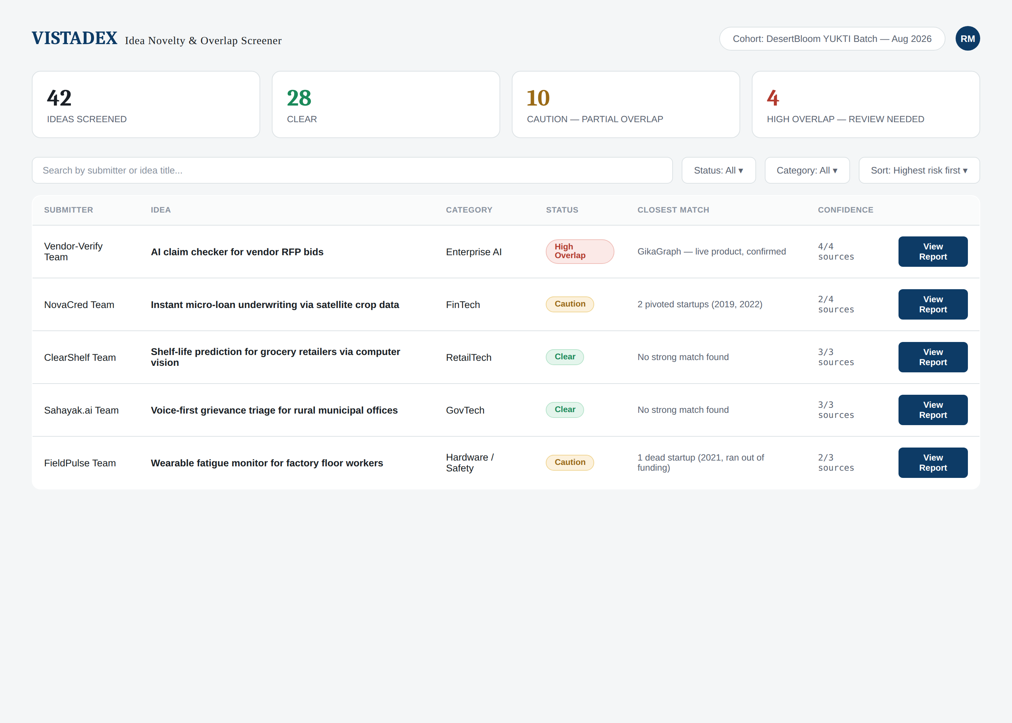
INTERFACE
The reviewer sees the worst cases first

Slide 9
BUSINESS MODEL
Priced per cohort, sold to institutions
Segment | Why they buy | First move
Accelerators & university programs | Screen large applicant batches | Pilot: PIEDS (BITS Pilani's incubator)
VC funds & angels | Already pay for diligence tooling | After the accelerator pilot builds a track record
Corporate innovation teams | Scouting gaps & acquisition targets | Later-stage segment
Individual founders | Same pain, personally experienced | Free tier only — a funnel, not the business
Avoids competing on price against $9–$49 founder apps — sells into a budget line that already exists for screening and diligence tools.

Slide 10
WHERE WE ARE
Current status & next steps
✓
Prof. Mehrotra — Presented the concept — positive response
✓
PIEDS — User-research interview arranged, via Prof. Mehrotra
✓
DesertBloom: YUKTI — Applied — AICTE Indovation Jaipur ideation & mentorship
✓
GikaGraph — Sept 4 — Call scheduled with founder Manoj Agarwal
Team
Aditya Pradhan (lead) · Kushagra Agnihotri · Richeek Mishra · Lakshit Tanwar
“Every other tool tells you if your idea looks good today. We tell you if it already died once.”

