Slide 1

ADVENTURE WORKS
By Group.1
Mr. Vyankatesh Magnur
Mr. ArjunSingh
Miss. Sharmila Shetty
Miss. Dhanya D Shetty
Mrs. Krutika Chougule
Mr. Sahil Palande

Slide 2


Introduction
Adventure Works Cycles, the company on which the Adventure Works sample databases are based, is a large, multinational manufacturing company. The company manufactures and sells metal and composite bicycles to North American, European and Asian commercial markets. While its base operation is in Bothell, Washington with 290 employees, several regional sales teams are located throughout their market base.
In 2000s, Adventure Works Cycles bought a small manufacturing plant in Mexico. Which manufactures several critical subcomponents for the Adventure Works Cycles product line. These subcomponents are shipped to the Bothell location for final product assembly. In 2001, this manufacturing plant became the sole manufacturer and distributor of the touring bicycle product group.
Coming off a successful fiscal year, Adventure Works Cycles is looking to broaden its market share by targeting their sales to their best customers, extending their product availability through an external Web site, and reducing their cost of sales through lower production costs.

Slide 3

Objective…..

Slide 4

Broaden Market Shares
Broadening market share by targeting sales to best customers involves focusing sales and marketing efforts on the most profitable and loyal customers within a market. Rather than spreading resources thinly across all customer segments, the company identifies and prioritizes customers who consistently generate the highest revenue or profits, exhibit strong brand loyalty, and have the potential for long-term value.
By understanding the needs, preferences, and behaviors of these best customers, the company can tailor its products, services, and marketing strategies to better serve and retain them. This targeted approach not only strengthens relationships with existing customers but also attracts similar high-value customers within the broader market. As a result, the company can expand its market share by capturing a larger portion of the most profitable customer segments.

Slide 5
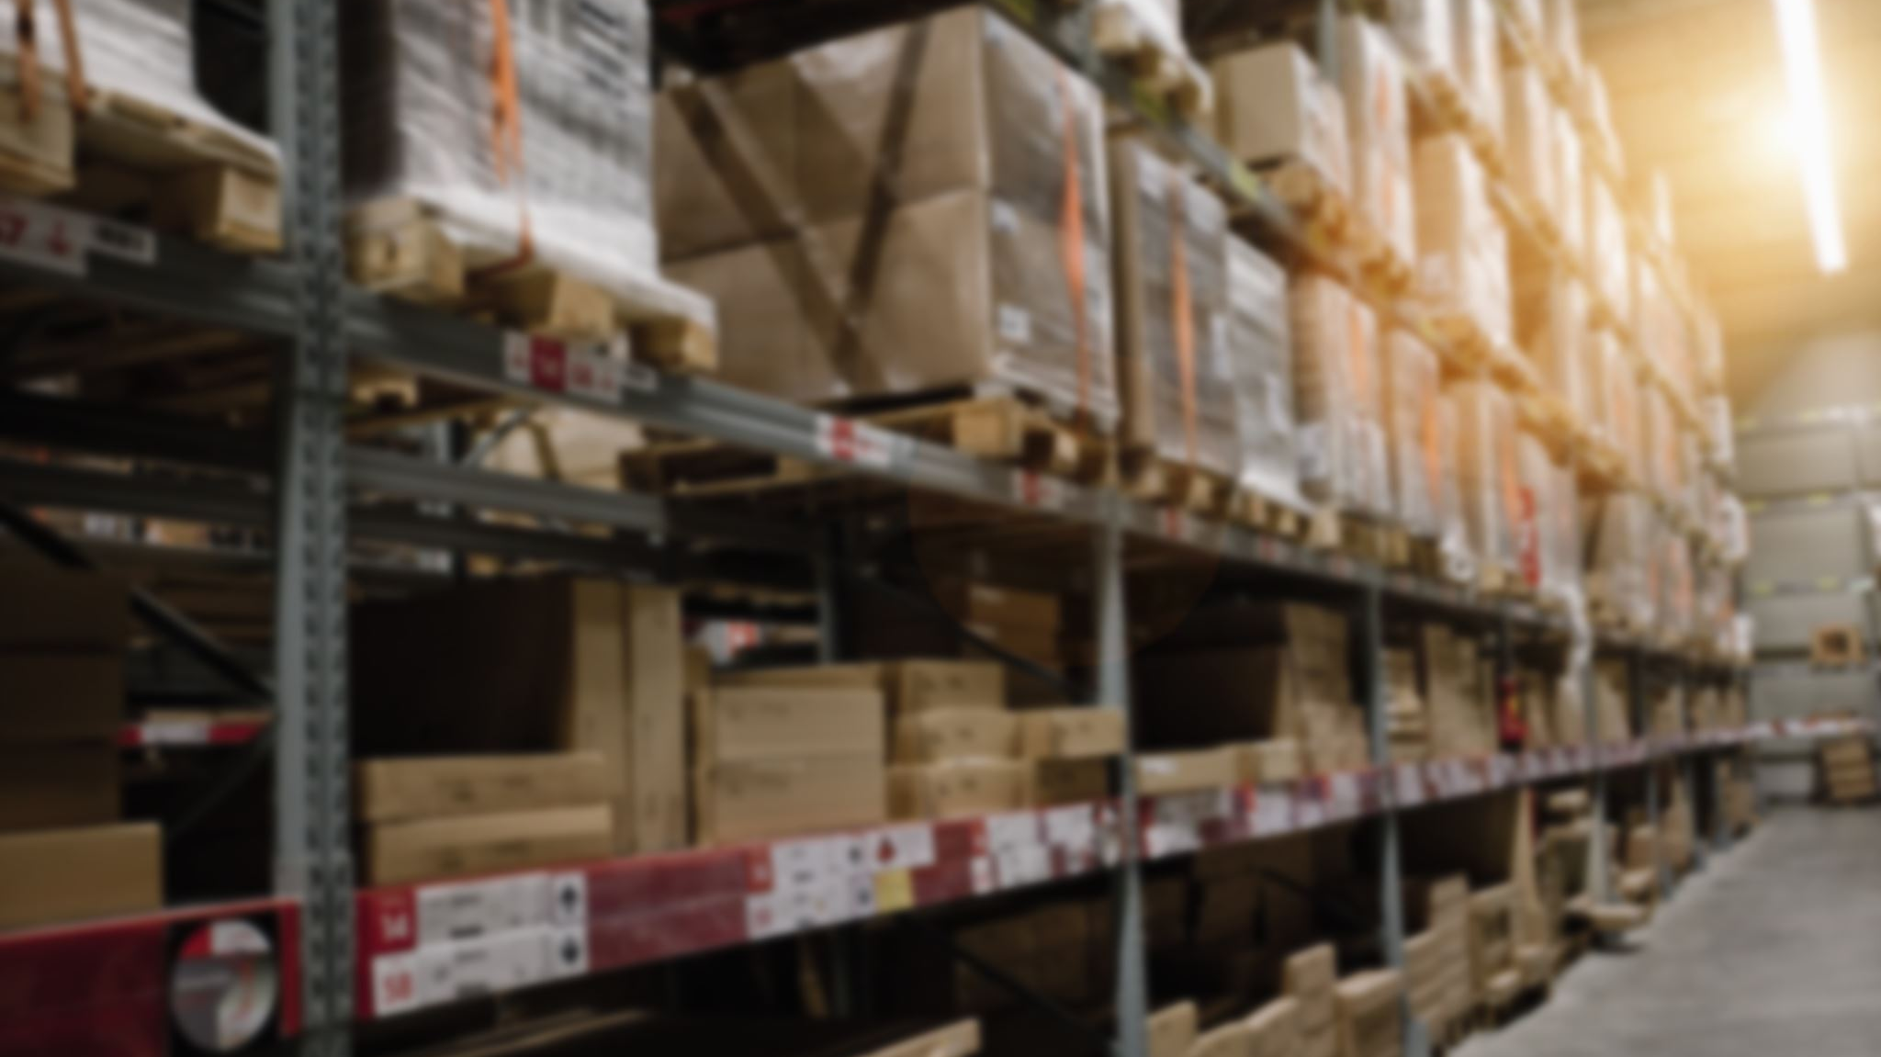
Product Availability
Extending product availability through an external website refers to the practice of making products available for purchase or access on a website that is not directly owned or managed by the company producing the products. This allows customers to find and purchase the products through additional channels beyond the company's official website or physical stores. For example, a company might partner with an online retailer or marketplace to list and sell their products, thereby reaching a broader audience and potentially increasing sales

Slide 6

Reducing Cost of Sales
Reducing the cost of sales through lower production costs involves finding ways to decrease the expenses associated with manufacturing goods or providing services. By optimizing production processes, negotiating better deals with suppliers, streamlining operations, or investing in more efficient technologies, a company can lower the overall cost of producing each unit. This reduction in production costs directly impacts the cost of sales, as it allows the company to maintain or improve profit margins while potentially offering competitive pricing to customers. Ultimately, reducing production costs can lead to increased profitability and competitiveness in the market.

Slide 7

Conclusion
So to analyse the sales and production cost we have made KPI’s and Dashboards

Slide 8

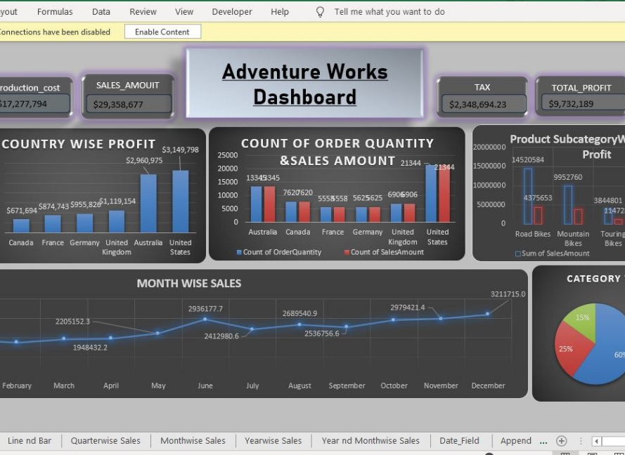
Excel Dashboard
Here’s the Excel Dashboard it shows the production cost, sales amount, Tax and Total Profit along with the year and product slicer.

Slide 9
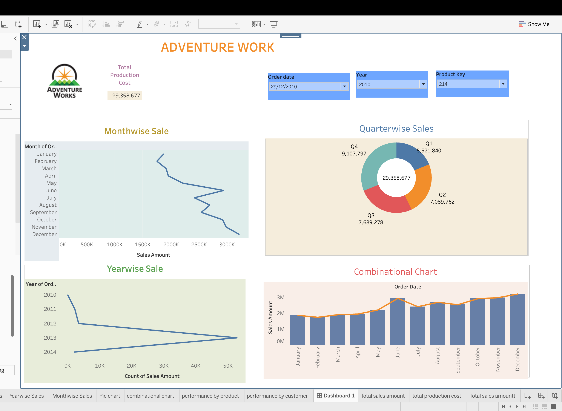
Tableau Dashboard
Followed by Tableau Dashboard that shows Year wise, Quarter wise and Month wise sales and combination chart of order date.

Slide 10
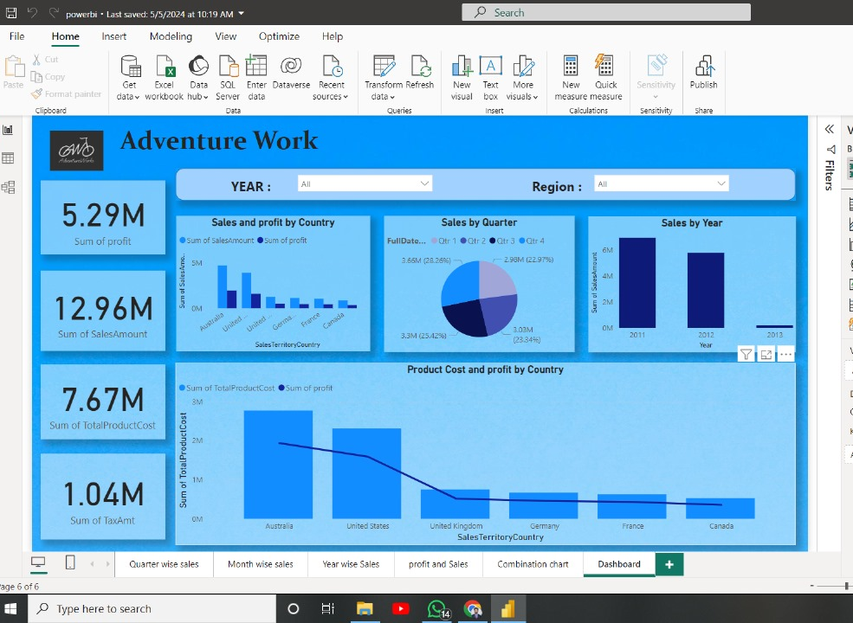
Power BI Dashboard
And finally we have Power BI Dashboard that shows Sum of Profit, Sum of Sales Amount, Sum of Total Product Cost & Sum of Total Amt followed with year and Region slicer.

Slide 11

Thankyou

