Slide 1
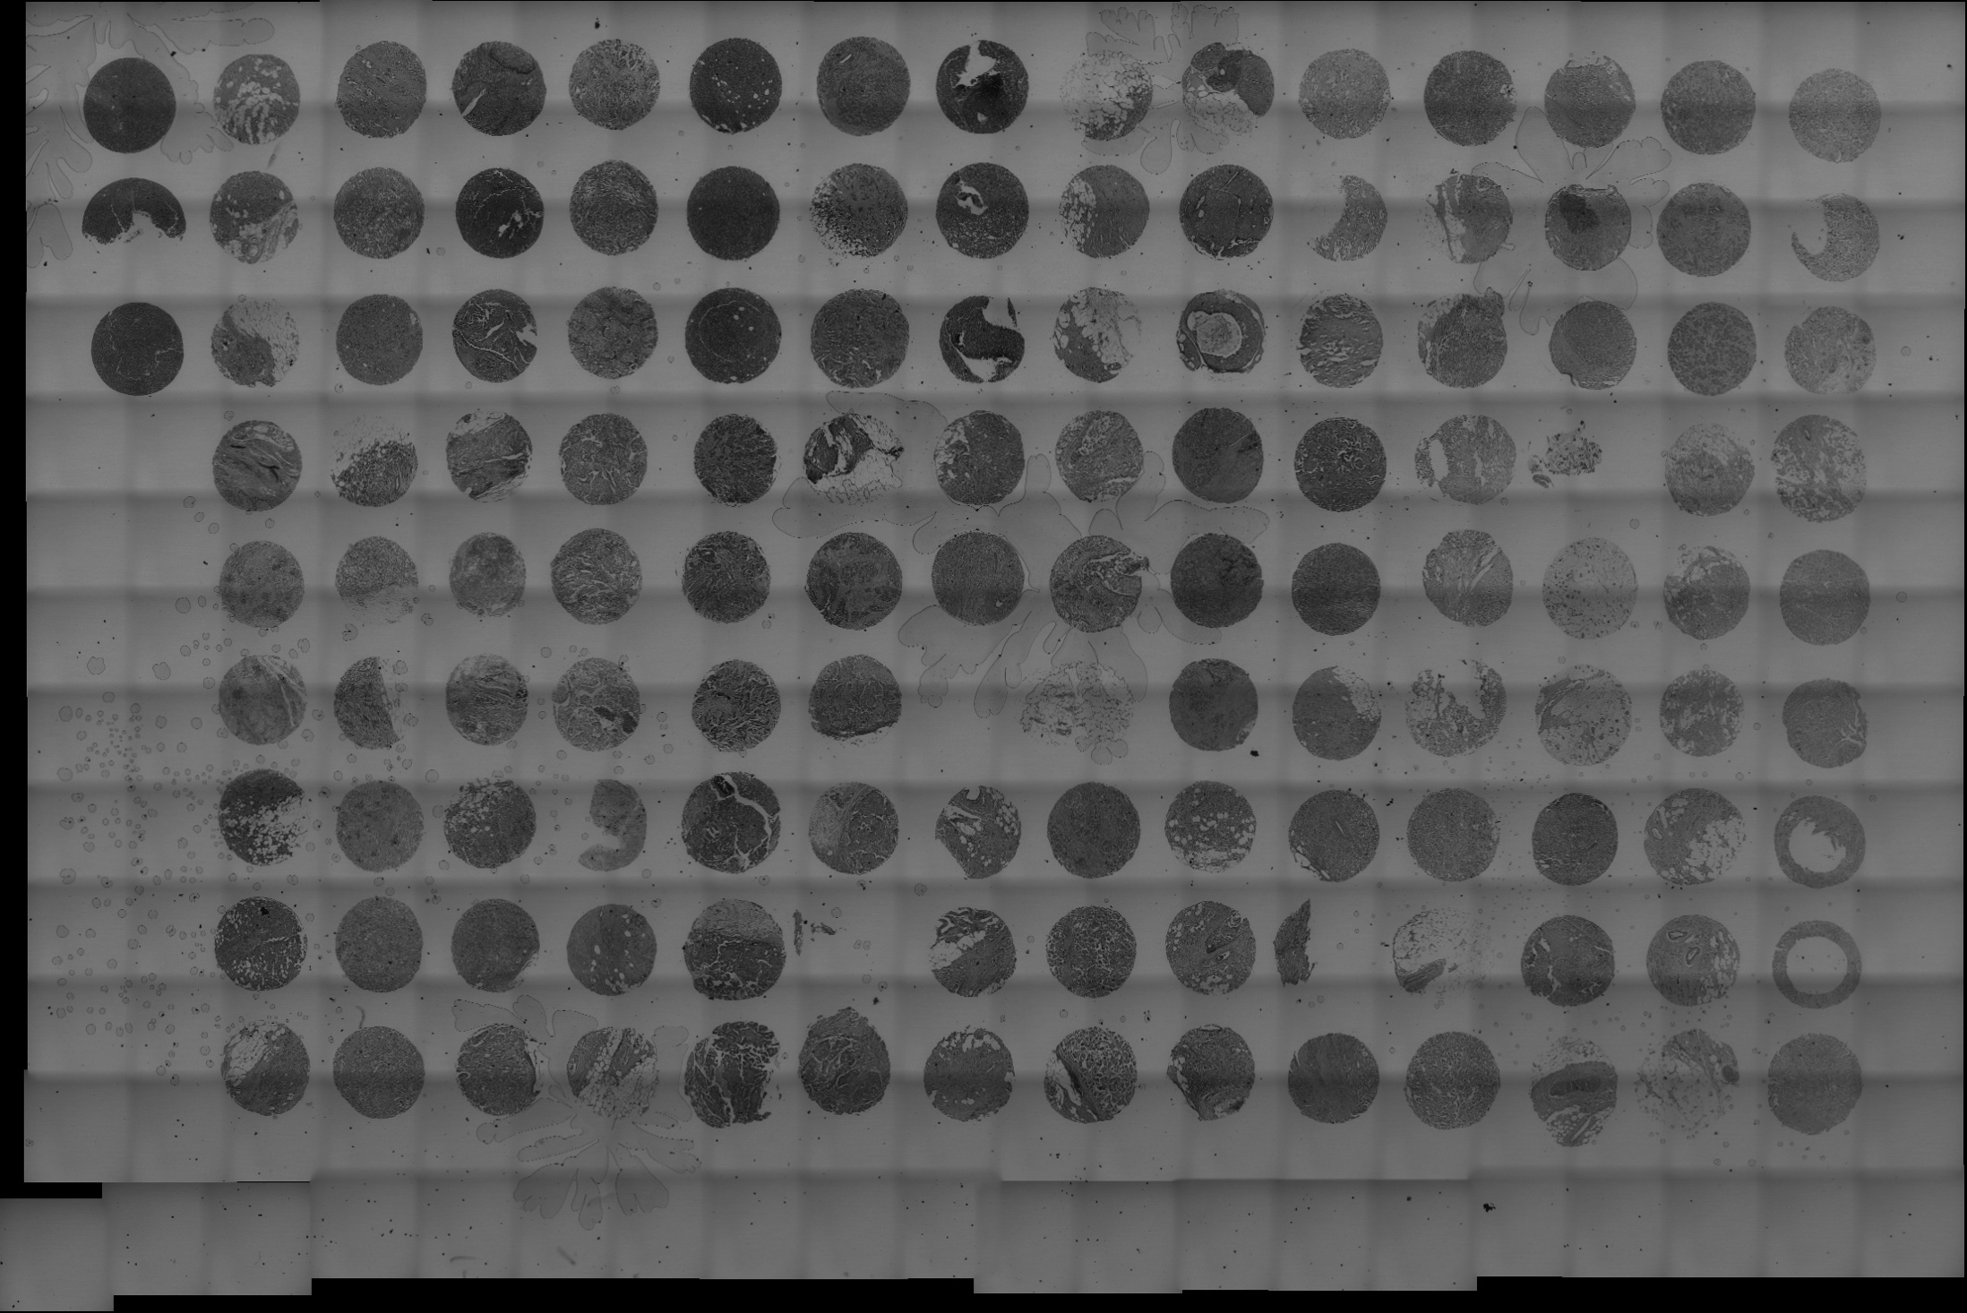
Notes:
Automated microscopy
Experience already?
Why?
Collecting data from breast cancer samples
About 900 pasients
Type of cells, cancer classification, survival patient
42 pasients each slide
22 slides
1 slide 12 GB raw data

Slide 2
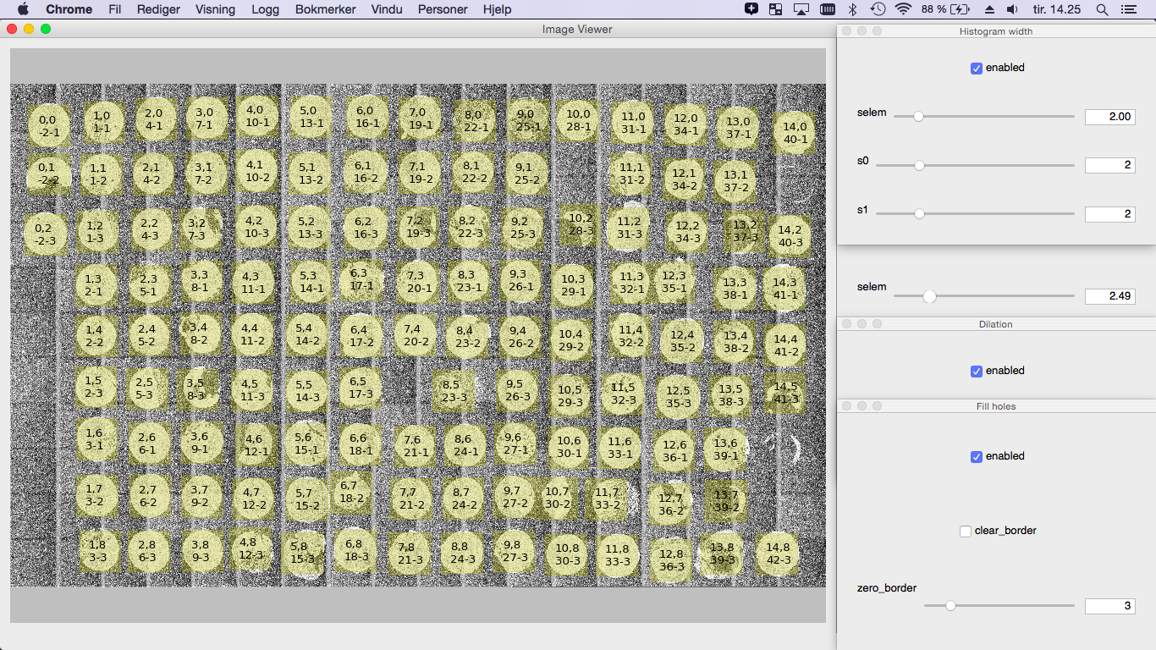
Notes:
Apply filters
Noise, Segmentation, Label

Slide 3
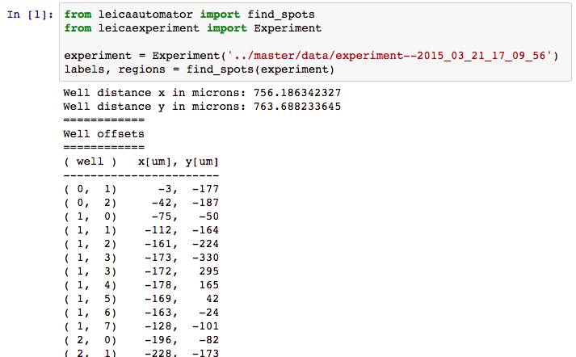
Notes:
Result
Automated scan
Or list of regions

Slide 4
Useful for what?
Automation
Rare events like cell division
Controlling external hardware
Irregular scan intervals
Analysis
Working with OME.TIFs experiments
Automating ImageJ
Notes:
Examples
Zoom, laser settings, gain, z-stack
Polarization, adding fluid, move
Non linear time lapse
LAS X does not open experiment files
Interface with other python software + Stitching, cell counting, feature extraction

Slide 5
leicacam
Computer Assisted Microscopy
leicaautomator
Automated scan
leicascanningtemplate
Read/edit experiment settings (laser, obj, det)
leicaexperiment
Read OME.TIF experiments
fijibin
Talk with ImageJ from python

