Slide 1
The Battle Of Neighbourhoods Week 2
Magomed Anasov

Slide 2
Introduction
This final project explores the best locations for Russian restaurants throughout the city of New York.
The largest Russian-American communities in New York City are located in Brighton Beach and Sheepshead Bay in Brooklyn. Brighton Beach has been nicknamed Little Odessa due to its population of Russian-speaking immigrants from Ukraine and Russia.
There are already some good Russian restaurants in New York like Farida Central Asian Cuisine & Grill or Russian Samovar Restaurant and Piano Bar, but in this project I will try to explore new opportnities. Especially, today in time of Corona crisis it is possible that some of the exisiting restaurants will go bankrupt, so we have to start exploring these opportunities today in order to open a new Russian restauran after crisis has ended.
This report explores which neighborhoods and boroughs of New York City have the most as well as the best Russian restaurants. Additionally, I will attempt to answer the questions “Where should I open an Russian Restaurant?” and “Where should I stay If I want good Russian food?”

Slide 3
Data
In order to answer the above questions, data on New York City neighborhoods, boroughs to include boundaries, latitude, longitude, restaurants, and restaurant ratings and tips are required.
New York City data containing the neighborhoods and boroughs, latitudes, and longitudes will be obtained from the data source: https://cocl.us/new_york_dataset
New York City data containing neighborhood boundaries will be obtained from the data source: https://data.cityofnewyork.us/City-Government/Borough-Boundaries/tqmj-j8zm
All data related to locations and quality of Russian restaurants will be obtained via the FourSquare API utilized via the Request library in Python.
First, I explored Foursquare API to find the relevant property. Different categories can be found under: https://developer.foursquare.com/docs/build-with-foursquare/categories/
I will be using the property "Russian Restaurant" without differentiation between Blini House or Pelmeni House:

Slide 4
Methodology
Data will be collected from https://cocl.us/new_york_dataset and cleaned and processed into a dataframe.
FourSquare be used to locate all venues and then filtered by Russian restaurants. Ratings, tips, and likes by users will be counted and added to the dataframe.
Data will be sorted based on rankings
Finally, the data be will be visually assessed using graphing from various Python libraries.

Slide 5
PROBLEM STATEMENT
What is / are the best location(s) for Russian cuisine in New York City?
In what Neighborhood and/or borough should I open an Russian restaurant to have the best chance of being successful?
Where would I go in New York City to have the best Russian food?

Slide 6
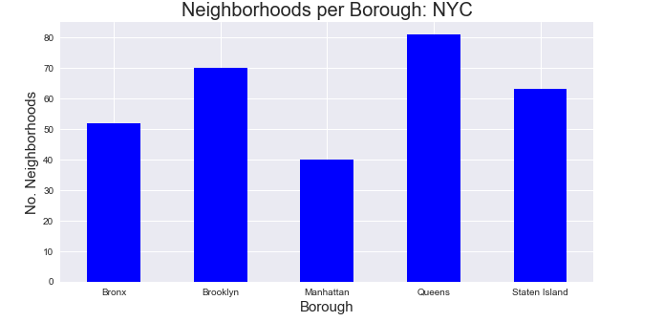
Neighborhoods per borough: NYC

Slide 7
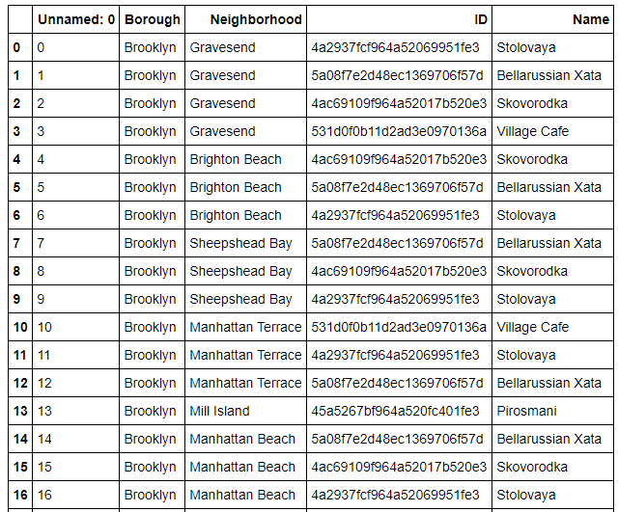
Restaurants with ids and names

Slide 8
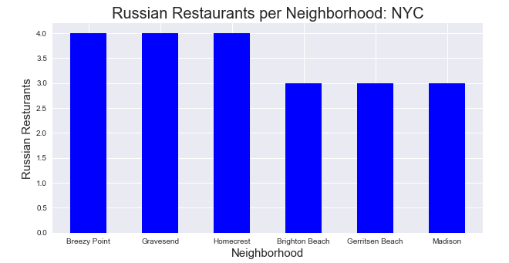
Russian restaurants per neihborhood: NYC

Slide 9
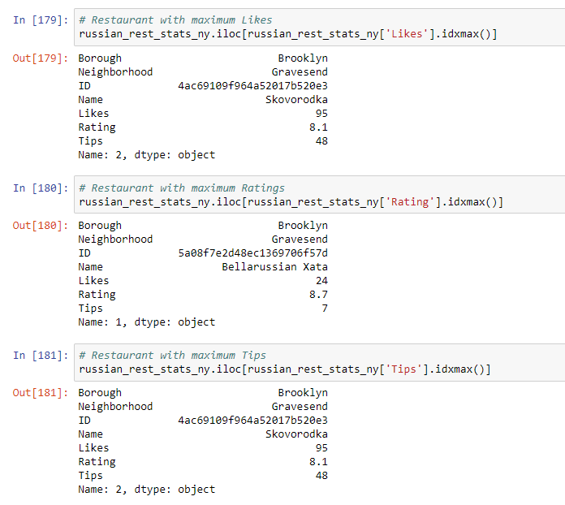
Russian restaurants by likes, rating and tips

Slide 10
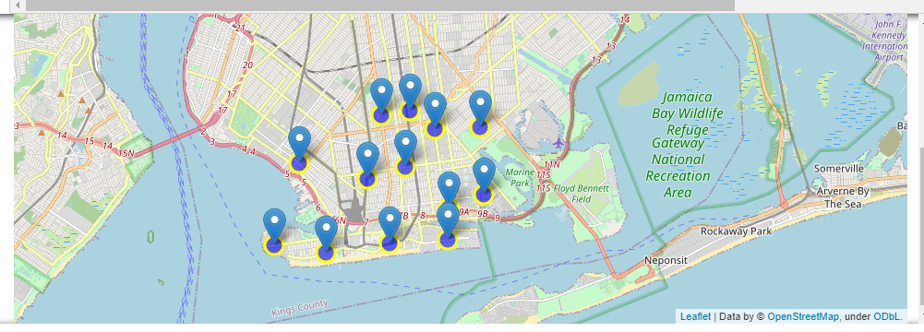
Data visualization

Slide 11
Conclusion
Coney Island and Marine Park have the best rated Russian restaurants on average. Gravesend has the highest number of Russian restaurants. The lowest ratings among Russian restaurant have Bath Beach and Sea Gate (8,1 per neighborhood).
As expected, Brooklyn is the borough with the most Russian restaurants due to high number of russian immigrants.
Based on this information, I am ready to answer the questions stated at the beginning:
I would state that Coney Island and Marine Park are the best locations for Russian cuisine in NYC.
To have the best shot of success, I would open a Russian restaurant in Sea Gate. It is one of two neighborhoods with the lowest rating (8,1), so competition would be easier than in other neighborhoods.
Finally, I would go to Bellarussian Xata in Gravesend for the best Russian food based on the best overall rating of 8,7.
All of the above analysis is depended on the adequacy and accuracy of Four Square data. A more comprehensive analysis and future work would need to incorporate data from other external databases.

