Slide 1
Dress Code Policy
Learning & Development · New Joiner Orientation Series

Slide 2
WHAT WE'LL COVER
Your Path Through This Module
01
Our Philosophy & Vision
02
General Principles
Why the policy exists
The foundation for everyone
03
Guidelines for Men & Women
04
Grooming Standards
Everyday attire & client meetings
Presenting yourself with polish
05
Do's and Don'ts
06
Compliance
The quick-reference view
What's expected of you
07
Corrective Measures
Upholding the brand's image

Slide 3

OUR PHILOSOPHY
Why the Dress Code Matters at MAGPPIE
“
Our workplace environment should reflect professionalism, mutual respect, and comfort for everyone.
Why It Matters
• Builds trust with every client interaction
• Reflects your own professionalism and confidence
• Protects the reputation you and MAGPPIE share
At MAGPPIE, every interaction is a reflection of who we are — a luxury brand built on precision, care, and comfort. Our dress code isn't about restricting who you are; it's simply an extension of the same elegance and comfort we promise every client, worn by the people who bring it to life.
Culture isn't just what we say — it's what we choose to wear, every single day.

Slide 4





General Principles — for Every Team Member
Professional & Presentable
Neat & Modest
Attire should be professional and presentable at all times.
Dress in a manner that is neat, modest, and appropriate for a professional workplace.
Well-Fitted & Pressed
Respectful & Comfortable
Clean, well-fitted attire that's put together.
Maintains a respectful, comfortable environment for all colleagues.
When in Doubt: Choose the more professional, understated option. It's easy to remember, and guides judgment gently.
MAGPPIE · Dress Code Policy · L&D Onboarding

Slide 5


GUIDELINES FOR MEN
Everyday Attire & Client Meetings
Everyday Attire
Client Meetings (For Sales team & Client facing roles)
Collared shirts (long or short sleeved), tucked into trousers, pants, or chinos
Smart casuals — Polo T-shirts with smart jeans (for non-client-dealing members only)
Clean, well-fitted clothing that’s looks put together
Closed shoes or neat sneakers
Blazers or suits, with ties as appropriate
Collared shirts in solid colours or subtle textures (avoid loud prints), tucked in
Formal trousers or well-fitted chinos in neutral tones — navy, charcoal, beige, black
Leather shoes or loafers, well-maintained, with a matching belt
Trimmed hair/beard, minimal accessories
Grooming tips
Neat hair and well-maintained facial hair — attention to detail makes all the difference.

Slide 6
GUIDELINES FOR WOMEN
Everyday Attire & Client Meetings
Everyday Attire
Client Meetings (For Sales team & Client facing roles)
Formal tops, shirts, tunics or formal dresses
Ethnic wear is warmly welcomed — saris, salwar kameez, and similar styles are a beautiful part of our workplace
Blazers or suits, with ties as appropriate
Blouses or formal shirts, kurtas with trousers, or well-fitted formal dresses (knee-length or longer), in sober colours
Saree or salwar-kameez as an optional traditional-wear choice, if it fits your brand culture
Closed-toe flats or low heels — practical for walking client homes or active sites
Minimal jewellery and makeup, hair neatly tied back
Grooming tips
Neat and well-maintained hair, with minimal or no makeup/accessories, as per personal choice and comfortable footwear.
MAGPPIE · Dress Code Policy · L&D Onboarding

Slide 7




GROOMING STANDARDS
Presenting Yourself with Polish
Hair
Nails
Neat, well-maintained hair, styled appropriately for a professional setting.
Trimmed, clean nails. If nail polish is worn, keep it neat and chip-free.
Personal Hygiene
Fragrance & Breath
Maintain good personal hygiene, including managing body odour through daily hygiene and deodorant use.
Keep breath fresh; use mild fragrances and avoid overpowering perfumes or deodorants.
Grooming reflects professionalism: kept simple and gender-neutral, it protects the dignity of our brand and of everyone who represents it.
MAGPPIE · Dress Code Policy · L&D Onboarding

Slide 8
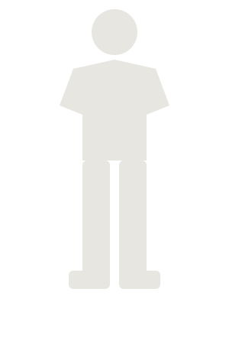
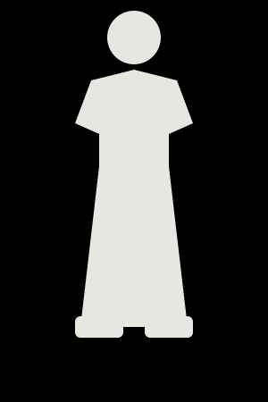
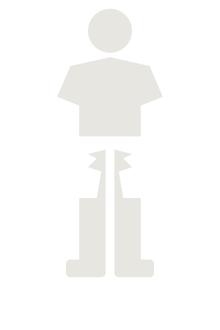





Do's and Don'ts
Men — Do
Women — Do
Men — Don't
Women — Don't
DO
DON'T
Clean, well-fitted, ironed clothing
Excessively short/cropped clothing, ripped jeans
Collared shirts, formal tops or professional dresses
Garments with very deep necklines
Ethnic wear — sarees, salwar kameez, co-ord sets
Overly casual, unkempt or wrinkled attire
Business formal for client meetings
Polo T-shirts + jeans for client-facing roles
Solid colours or subtle patterns
Loud prints, oversized graphics, big visible logos
Polished, role-appropriate footwear
Bulky, overly casual or distracting footwear
Neat hair and well-maintained grooming
Casual/lounge attire on video calls while working remotely

Slide 9

Compliance & Accountability
This dress code applies to every team member, every working day. Adherence reflects your professionalism and your respect for colleagues and clients — and it upholds the image our guests trust MAGPPIE for.
Failure to adhere to the dress code may result in corrective action — so if you're ever unsure what's appropriate, ask before you dress, not after.
In case of a grey area, discuss with your manager or HR. We'd always rather clarify upfront than correct after the fact.

Slide 10
BEFORE YOU HEAD OUT
Your Quick Self-Check
Is my outfit clean and fitted?
Is it appropriate for my role today?
Am I representing MAGPPIE confidently?

Slide 11



Corrective Measures
Stage 1 — Verbal Feedback: If something doesn't align with our guidelines, HR will offer a quick, private conversation to help you course-correct. It's a simple, respectful heads-up — not a formal mark against you.
Stage 2 — Written Feedback: If the same concern comes up again, HR will share written feedback outlining the guideline and next steps. This may include a brief request to go home, change, and return — simply so you can meet clients at your best, never as a penalty.
This process exists to protect the trust our clients place in MAGPPIE — not to penalize anyone. Our goal is always to guide with care, so every team member feels confident representing our brand.

