Slide 1
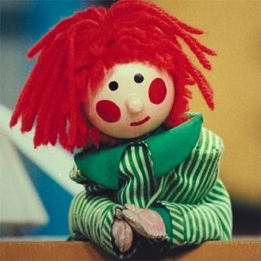
Bosco
Presentation
Mags McCarthy
Higher Diploma in Computer Science
20095610
Notes:
Introduction
Here to present Bosco which is a work based project that was built for ServisBOT, Waterford
Bosco is basically a test runner that runs end to end tests for chatbot technology

Slide 2
Overview
Introduction
Motivation
Bosco Workflow
Demo
Development
Features
Future Work
Q & A
Notes:
This is an overview of what we will cover in this presentation
Introduction
Motivation behind Bosco
Bosco’s Workflow
Demo
Development
Features
Future Work
Q & A

Slide 3
INTRODUCTION
Notes:
So I’’ll start the presentation with giving some background

Slide 4

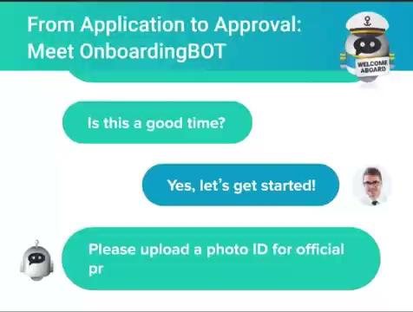
What do?
Notes:
So what do ServisBOT do?
ServisBOT is a conversational artificial intelligence provider that has been in existence since 2017. ServisBOT provides conversational chatbots mainly in the customer service space across Europe, US and the middle east. ServisBOT also provides AI model optimisation services to companies running their own or third party AI models.

Slide 5

Overview of Bosco
ServisBOT’s chatbots are currently tested using a test runner called Frankenstein.
Bosco was built to replace Frankenstein.
Bosco, named because it uses Puppeteer which will replace Testcafe
AWS Lambda replaces EC2
Simple
Notes:
ServisBOT’s chatbots currently use a test runner called Frankenstein.
Bosco was built to replace Frankenstein
Bosco, named because it uses Puppeteer whereas Frankenstein uses Testcafe.
It is run on an AWS Lambda instead of EC2
We will look at Lambda and Puppete during this presentation and why they are a vast improvement on Frankenstein.

Slide 6
MOTIVATION
Notes:
Before I demo Bosco I’ll first go through the motivation behind Bosco

Slide 7
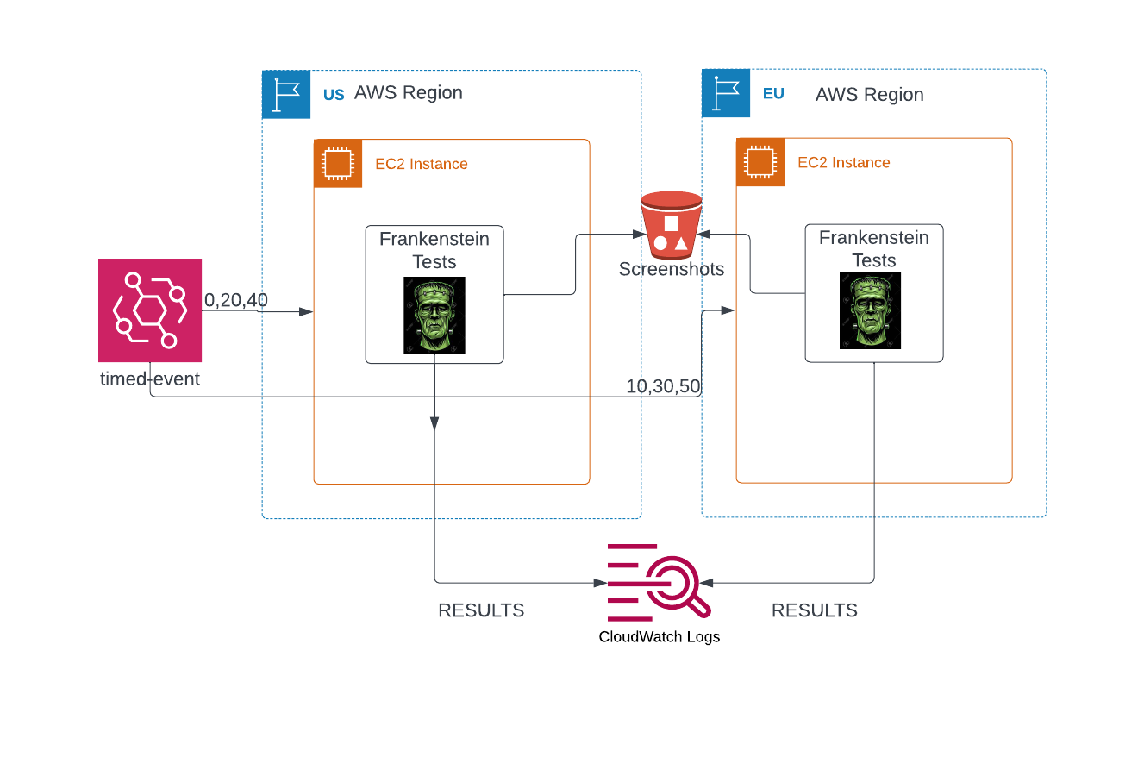
FRANKENSTEIN WORKFLOW
Notes:
We’ll start with Frankenstein
Frankenstein tests are currently run in 2 EC2 instances (virtual computers ) that are run in 2 x different AWS regions (EU & US)
Like Bosco they are triggered by a timed event, save screenshots of failed tests to an S3 bucket and report the results to Cloudwatch

Slide 8



FRANKENSTEIN ISSUES
Inefficient: tests compete for memory
Speed: 6 minute test runs
Cost: $15,000 / year
Scalability: instances are at their limit
EC2 Instances are always running
Unreliable: flexibility of Testcafe causes issues
: tavel.trade.gov
Notes:
However, there are issues with Frankenstein
All the tests are run on one instance which means they are all competing for memory
A test run takes 6 minutes. ServisBOT are billed per second of this test run. Bosco tests on the other hand will be run in parallel with each so a test run will only take a minute or two.
Cost analysis puts Frank testing at $15,000 per year, just to run the instances, there are other costs. This is a significant cost just for testing.
The instances are at their limit, they do not scale and therefore ServisBOT cannot add more tests without doubling the cost as they would need to create and get billed for a new instance
The frankenstein EC2 instances are always running because they are run in multiple regions across the globe so they have to run 24/7. This is why Frankenstein is so costly.
Testcafe can be unreliable when identifying elements on a webpage. Some elements cannot be uniquely identified in a complex user interface

Slide 9
Puppeteer vs Testcafe
PUPPETEER | TESTCAFE
NodeJS library run in Lambda | Javascript-based testing framework
Complex API | High level API
Strong community support | Less support as developers are now choosing Puppeteer
4,723,620 weekly downloads* | 222,812 weekly downloads*
AWS Synthetics uses Puppeteer
*npmjs.com 18/04/23
Notes:
Puppeteer and Testcafe both automate browser interactions from a user.
I’ve outlined here why we ServisBot have chosen Puppeteer as the browser automation tool for Bosco
Puppeteer is a NodeJS library which can be run in Lambda as Lambda has better support for NodeJS environments.
Puppeteer provides more control for the developers through a complex API.
TestCafe on the other hand is a JavaScript-based testing framework which offers a simpler API for browser automation but is less reliable.
Puppeteer now has a strong community support network with 4.7 million weekly downloads compared to Testcafe close to 223k.
AWS Synthetics uses Puppeteer which is proof that Puppeteer runs well in Lambda if AWS chose it.
(The main difference between a Node.js library and a JavaScript-based testing framework is that a Node.js library is a collection of reusable code that can be used for a wide range of tasks, including building web applications, interacting with databases, and performing various system tasks. Whereas, a JavaScript-based testing framework is specifically designed for the purpose of testing, and provides a set of tools and conventions for organizing, running and reporting on tests.
Node.js libraries can be used within testing frameworks to provide additional functionality, while testing frameworks can be used in Node.js applications to provide automated testing. )

Slide 10
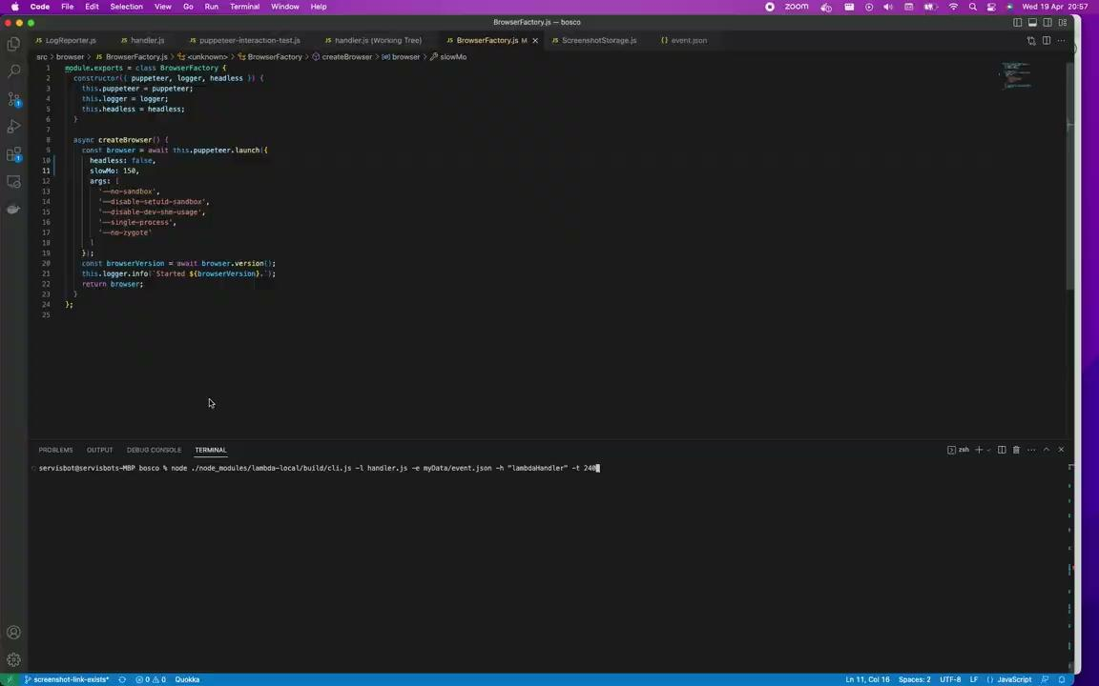
Puppeteer Interaction Test
Notes:
This is a Puppeteer test that is run locally on my machine with the browser displaying and I’ve slowed it down for demo purposes
This is testing the interaction node of a bot
Messenger is opened and the first two items are selected and the bot prints out the items selected
Messenger is reset and instead of selecting an item the user types a message and the bot replies with a message
The test passes if the bot behaves as expected

Slide 11
Lambda vs EC2
LAMBDA | EC2
Executes self-contained functions | Creates an operating system
AWS maintained | AWS and user maintenance required
Parallel function executions | Instances with tests competing for memory
Container deploys dependencies | Manual management of dependencies
Starts in ms | Starts in seconds to minutes
Billed per 100ms | Billed per second
Notes:
Bosco is run on Lambda, whereas Frankenstein is run on EC2
I’ve outlined some differences between Lambda and EC2 here
Lambdas are self contained functions that allow you to run code without having to manage any of the underlying infrastructure
EC2 are virtual machines where you have to customize your own software and configuration
Lambdas are managed by AWS whereas EC2 require configuration as well as maintenance from AWS
Lambdas can be run in parallel as we will see from our step function whereas with EC2 all the tests are run on the same vm and compete for memory
A docker container can be run in a Lambda which allows us to run Puppeteer and package and deploy all its dependencies.
Running Testcafe in EC2 requires manual management of dependencies.
A lambda fx will start in ms which is more efficient compared to seconds or minutes for EC2
And finally lambdas are billed per ms which is more cost effective than EC2 being billed per second

Slide 12
DEMO
Notes:
Before I demo Bosco I am going to give a quick overview of Bosco’s workflow.

Slide 13
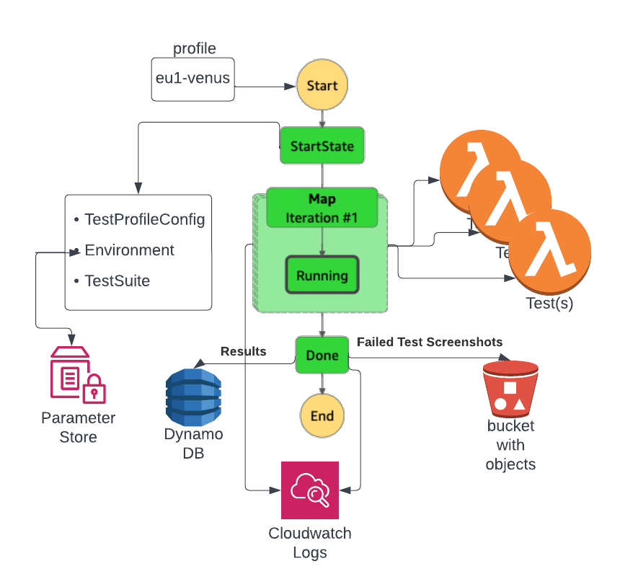
Bosco Workflow
Notes:
The centrepiece here is the Bosco Step function with a workflow from Start to End
How it works is a test profile, in this case eu1-venus is inputted into Bosco
The StartState fetches the TestProfileConfig,the Environment variables from the parameter store and the Testsuite which is the array of tests
The Map state creates a lambda function for each of the tests in the testSuite so all the test are run in parallel with each other and individually
The tests are run using Puppeteer for browser automation and Mocha as the testing framework
The results are outputted from the map state to the Done state which processes the results by
Storing the latest results in a DynamoDB table
Reporting results to cloudwatch
And if there are failed tests it stores the screenshots of the failed tests in an S3 bucket
Historical results are saved in Amazon Open Search or Elastic Search as it is also called. Bosco is using an existing subscription to this service which is why the Cloudwatch logs are outputted in a similar format to Frankenstein.

Slide 14
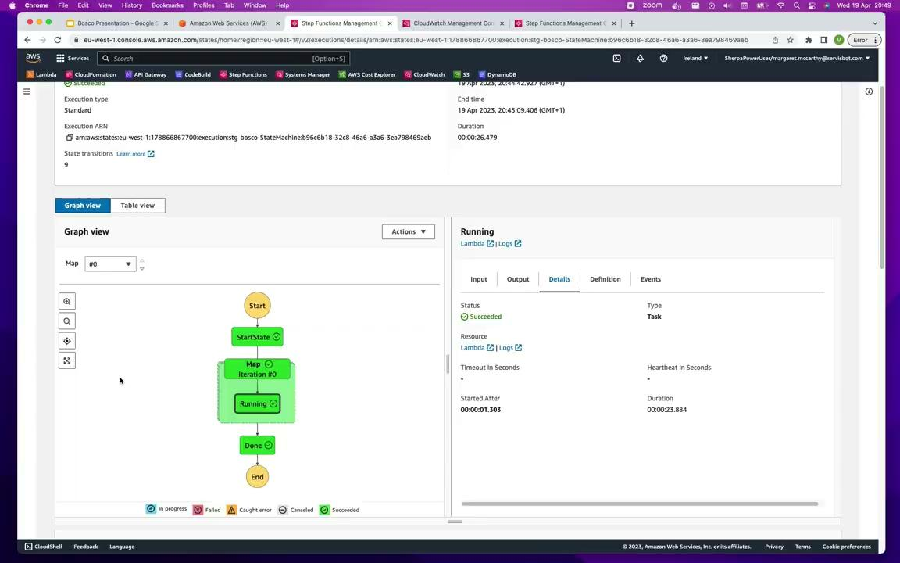
Bosco Step Function
Notes:
So now I’m going execute a Bosco Test Run
Profile is the input to the step function
Fetches the testProfileConfiguration, the Environment variables from the SSM parameter store and the testSuite
The Map state spins up a lambda function for each test or array of tests, and the test is executed with the environment variables and test config that it received from the start state
You can see each iteration of the map state here is a test
Mocha is used to run the tests and output the results.
When all the tests are complete the results are passed in an array to the Done state which processes the results.
The results are pushed to Cloudwatch which then sends them to ElasticSearch
The latest results are sent to the DynamoDB table
And screenshots are sent to S3

Slide 15
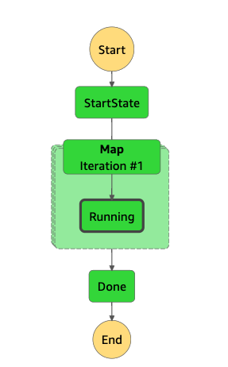
Bosco Development Phase
Puppeteer test locally
Run Puppeteer test in Lambda
Step Function
Cloud Formation
SSM
Test Profiles
Cloudwatch Triggers
DynamoDB
Cloudwatch Logs
S3
: tavel.trade.gov
Notes:
Now I’ll give an overview as to how Bosco was built
The initial step was to run a test locally using Puppeteer and mocha. This is what we saw earlier
This was then pushed to a docker container and run in a Lambda
Once this was proven to work, the step function using an inline map state to iterate over the tests was designed and built
Cloudformation used to deploy the lambdas and the step function in the dev environment
The Environment variables were configured so they are read from SSM parameter store
Test profiles added so that the team can decide on what tests to run in what regions and environments
Scheduled events in the form of Cloudwatch triggers were configured to trigger the test runs.
A DynamoDB table to serve latest test results was added
At this stage Bosco was deployed to staging and production environments
Cloudwatch Logs to report on test results was added
And finally S3 - screenshots of failed tests stored in S3

Slide 16
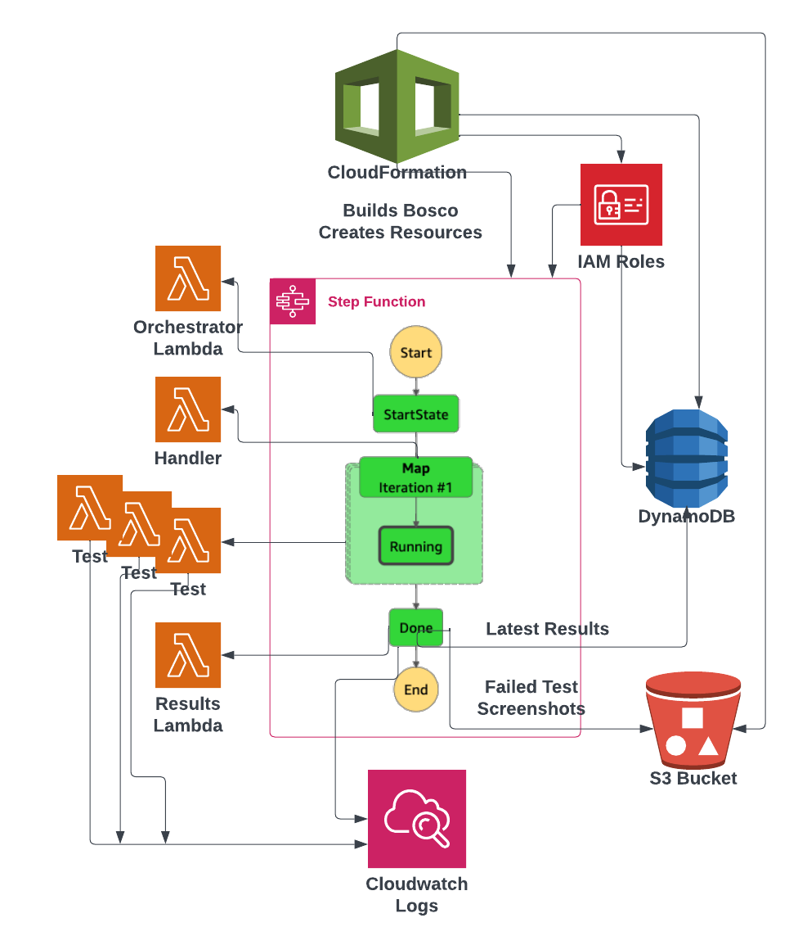
BOSCO COMPLETE WORKFLOW
Notes:
This is the complete workflow of Bosco
You can see the orchestrator lambda is what executes the start state
The output from the start state is passed to the handler which executes a lambda function per test in the testSuite
The results are passed to the results lambda or the Done state.
The latest test results of each profile is stored in a dynamo db table
Individual test results plus completion logs are reported to Cloudwatch
Failed test screenshots are stored in S3

Slide 17
Features

Slide 18
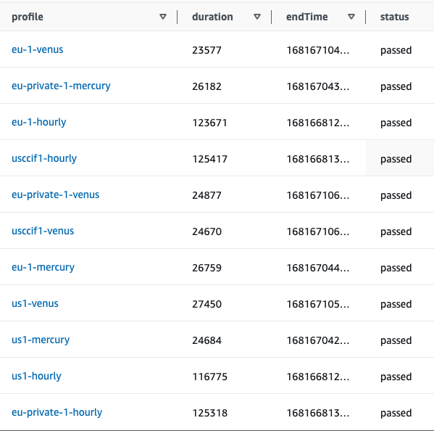
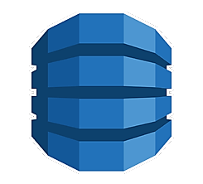
Dynamo DB
Latest test results stored in DynamoDB
Notes:
This is Bosco’s DynamoDB table and we can see it stores the latest test run result for each test profile

Slide 19

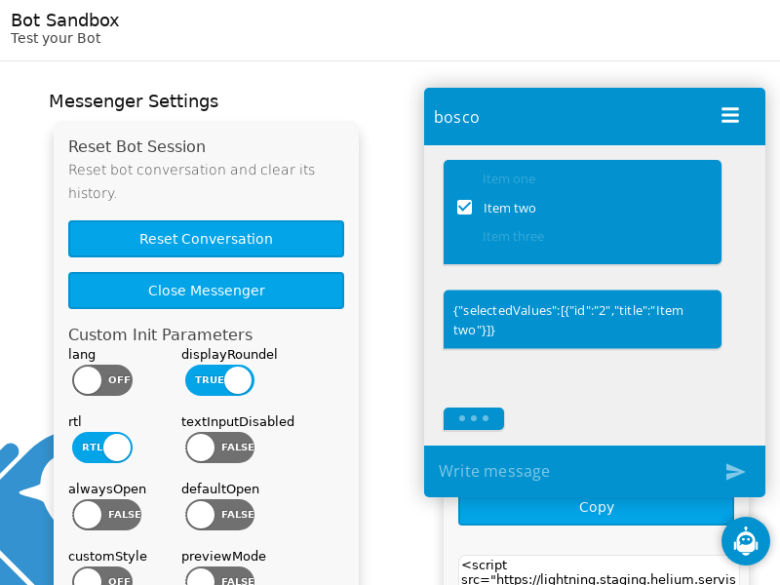
S3
Failed test screenshots stored in S3
Notes:
This is a screenshot of a failed test that is stored in S3

Slide 20
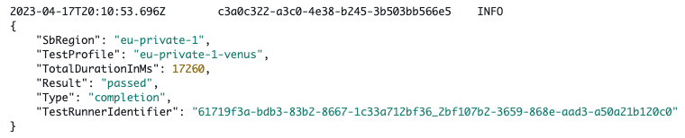

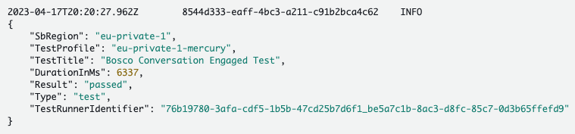
Cloudwatch Logs
Test results reported to Cloudwatch
Notes:
Individual test results are reported to Cloudwatch as well as a completion report of all the tests in a test profile.

Slide 21
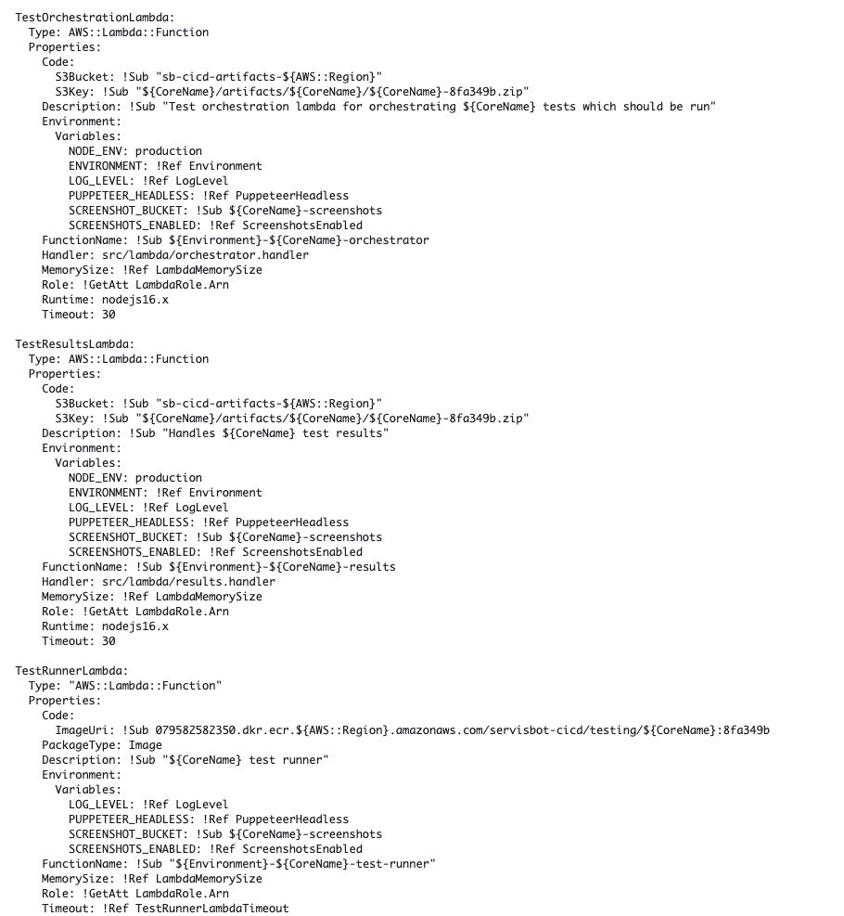
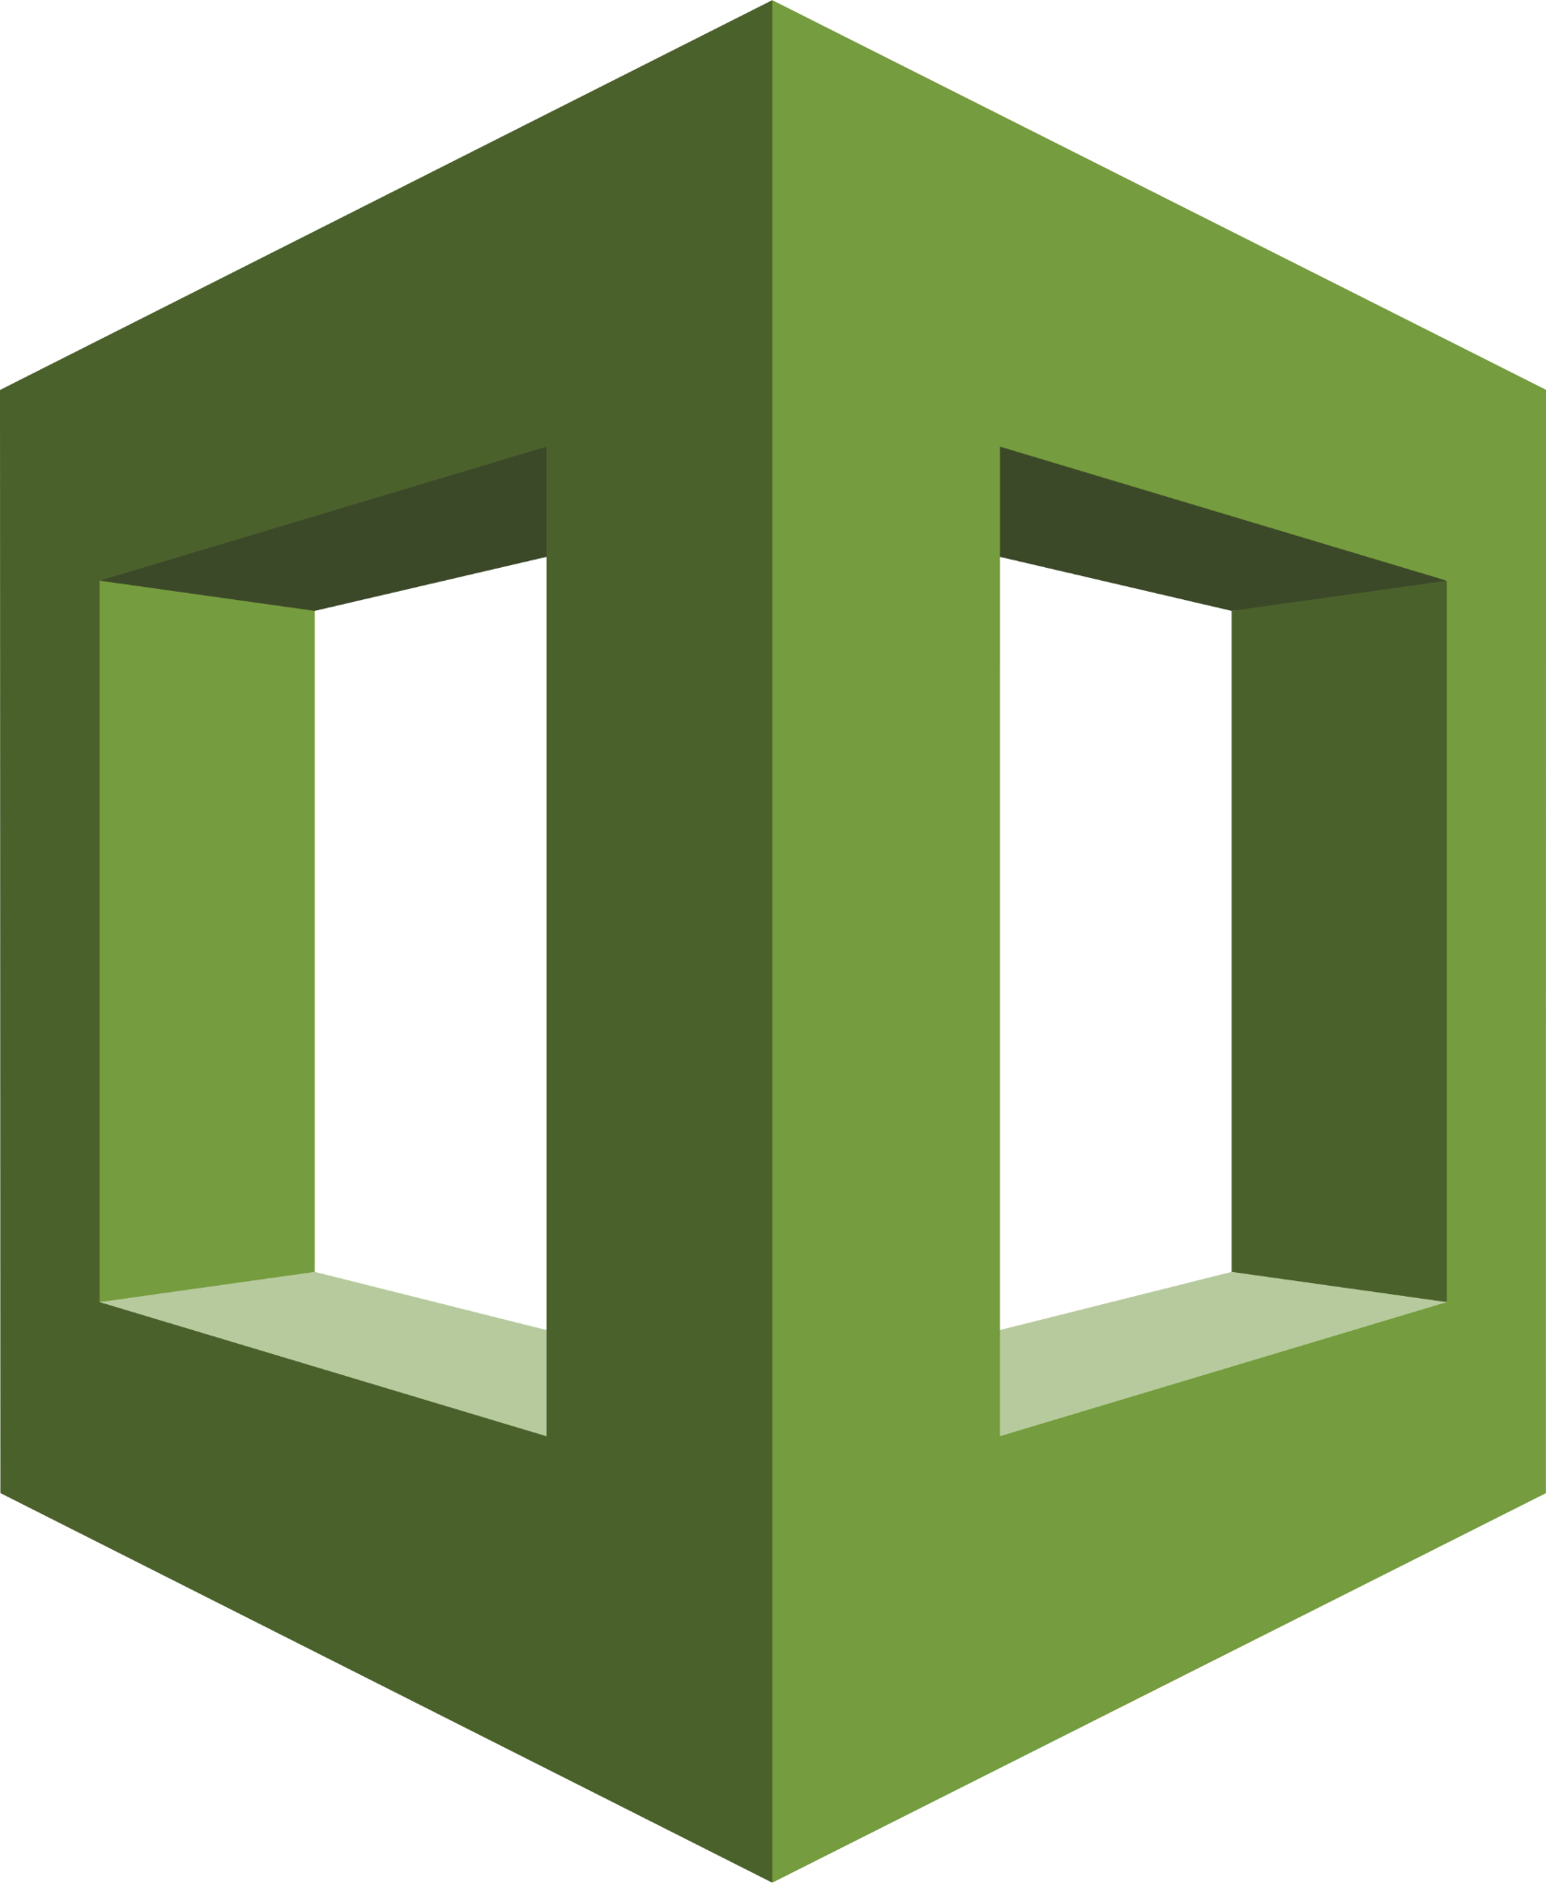
Cloud Formation
Deployed using Cloud Formation written in YAML
Notes:
Bosco is also deployed using a Cloud Formation template which was written in YAML. This template defines all the resources Bosco uses.
For example
The orchestrator lambda
The handler lambda
The results lambda
The state machine
The dynamo db table
The S3 bucket
Any roles or policies attached to these resources

Slide 22
Future Work
Notes:
Quick overview of what is to come for Bosco

Slide 23

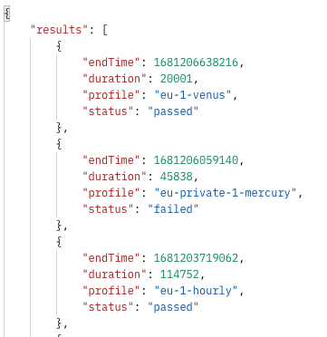
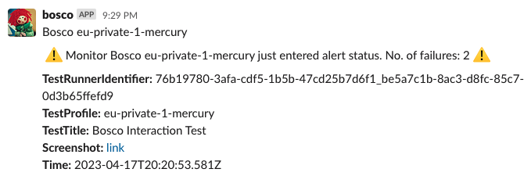

Future Work
Slack Alerts
For failed tests with screenshot link
API Gateway
To serve latest
test results
Kill Frankenstein
x
Notes:
Work has been ongoing for Bosco. These are some features that Bosco now has and some to come
Bosco is now sending alerts to ServisBOT’s Slack channels to notify the team of any test failures. The Slack alerts contain previews of the failed test screenshots.
Bosco also has an API gateway which retrieves the latest test results
Finally the goal of Bosco is to turn off the Frankenstein tests. Now that the infrastructure of Bosco is in place this is the next step for the team.

Slide 24
Q & A
Notes:
So that’s the end of my presentation. Thanks for listening.
If you’ve any questions let me know.

