Slide 1
Troll Catching in Al-Jazeera
By: Chase Renick

Slide 2
What is a troll?

Slide 3
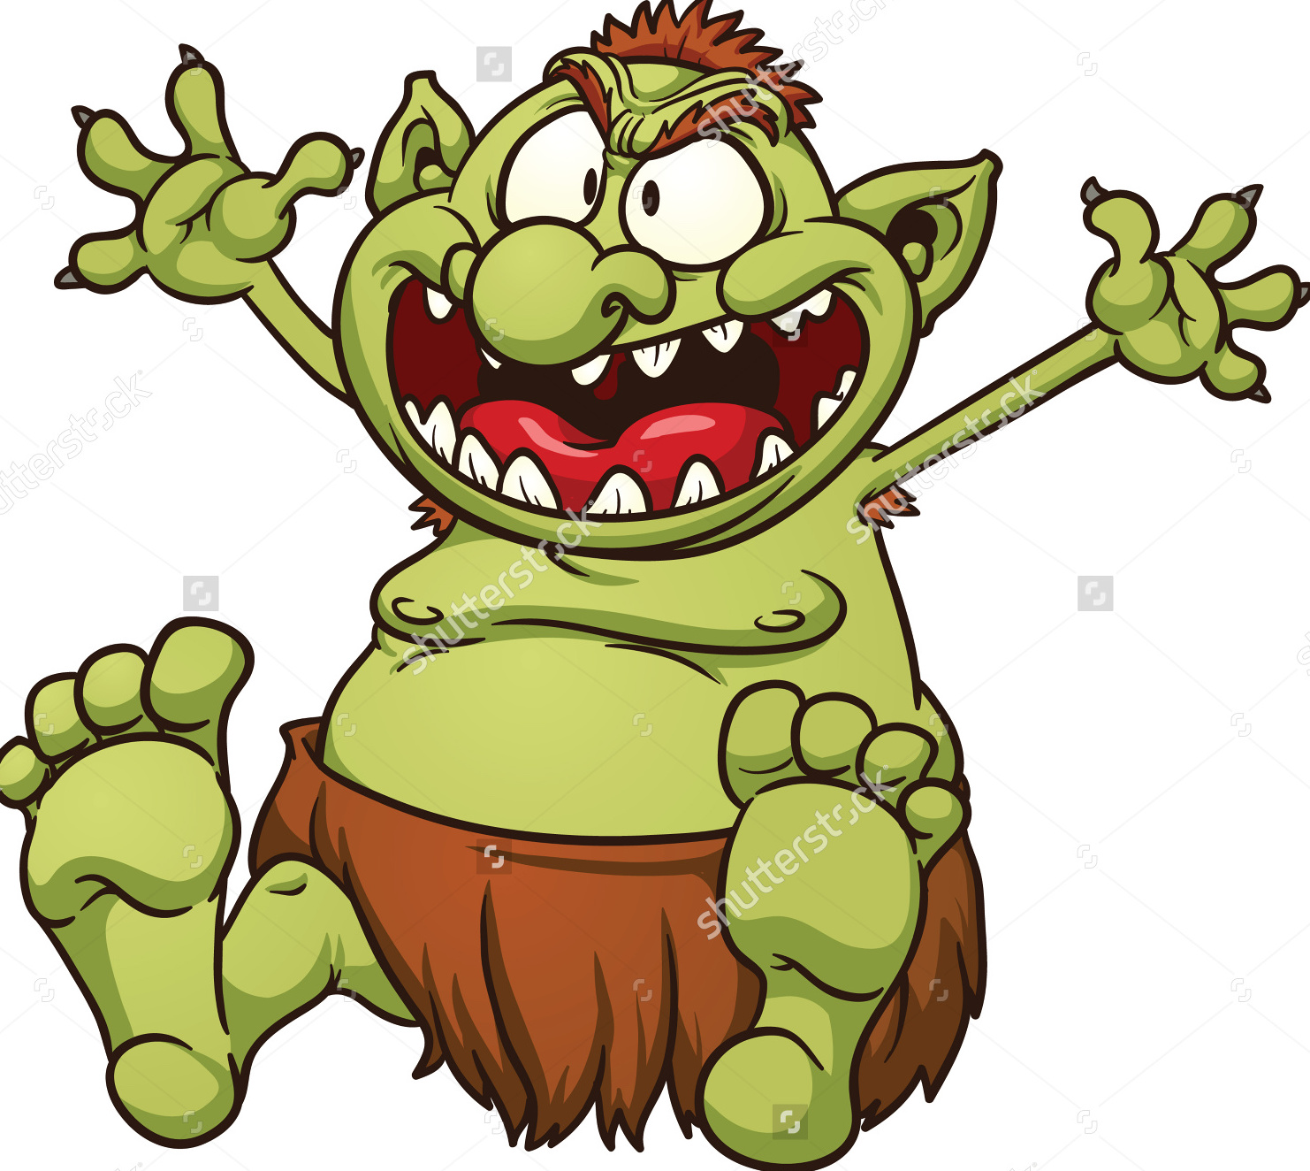

Slide 4
Are trolls a problem?

Slide 5
Companies deal with trolls differently
Some ban comments altogether, like CNN:http://www.cnn.com/2014/11/21/tech/web/online-comment-sections/),
Others tolerate negative comments under the umbrella of “free speech, like Breitbart:http://www.breitbart.com/tech/2015/10/27/the-lefts-war-on-comment-sections/),
Others are hiring labor force to flag negative comments, like Facebook:http://www.npr.org/sections/thetwo-way/2017/05/03/526727711/facebook-plans-to-add-3-000-workers-to-monitor-remove-violent-content)
Others leverage technology to curb the volume of negative comments, like Twitter: https://www.nytimes.com/2016/11/16/technology/twitter-adds-new-ways-to-curb-abuse-and-hate-speech.html?_r=0).

Slide 6
Trolls are actually a big problem for news companies and social networks
Create an unhealthy social ecosystem (reduces users desire to participate in discussion)
Can create a legal liability for a company (Ex: Terrorism on Youtube)
Can impact company ROI, churn rate, ability to attract talent or investors (Leslie Jones and Twitter)
Among other problems

Slide 7

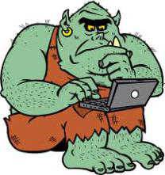
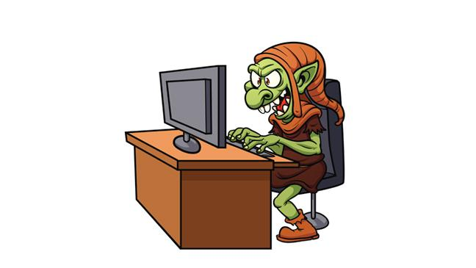
Trolls in the land of Al-Jazeera: (We will look at 3 prominent types)
Type 1
Type 3
Type 2

Slide 8
Type 1: The Business Troll
Try to sell a product or service when their product or service is irrelevant to the article, website, or conversation
Typically post a lot of comments

Slide 9

Type 2: The Hate Troll
Typically threaten other users (or people in general) with racist, lewd, foul language inappropriate for a comment forum
Typically really short or really long comments – in caps

Slide 10
Type 3: The Sarcastic Troll
Clever trolls who may or may not use offensive, racist, or threatening remarks, but whose underlying intention for the comment is dubious even hurtful
Basically a Hate troll, just not as explicit about it

Slide 11
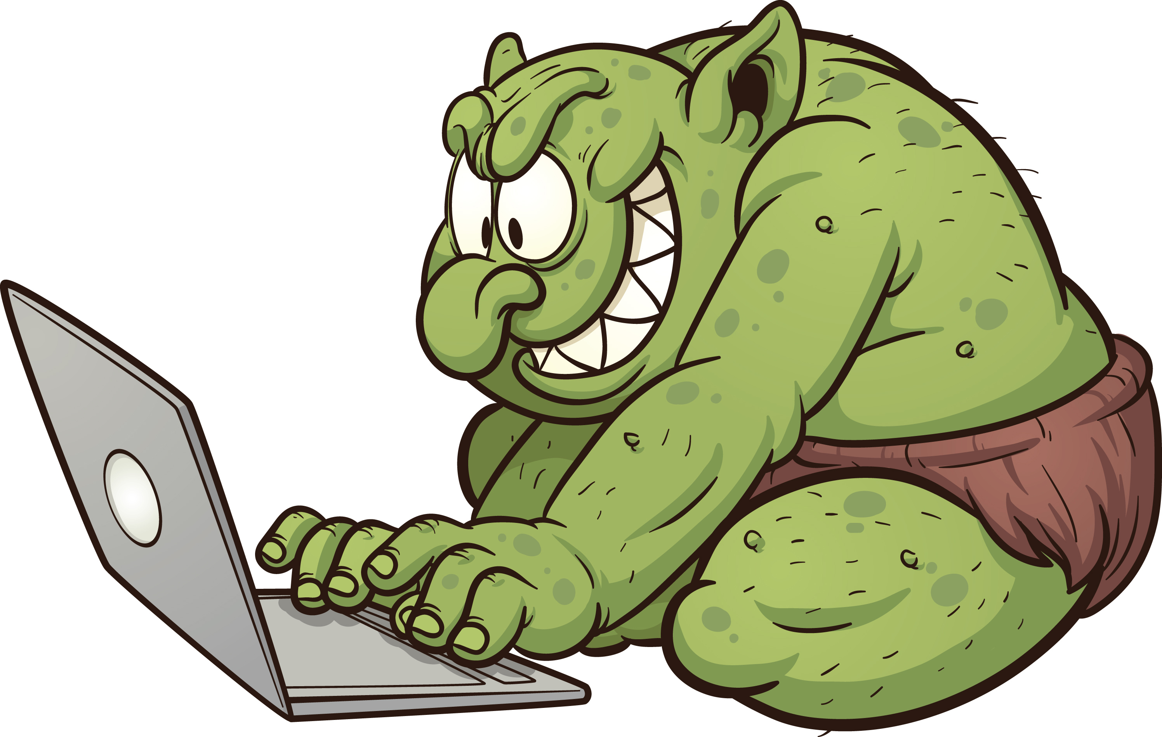

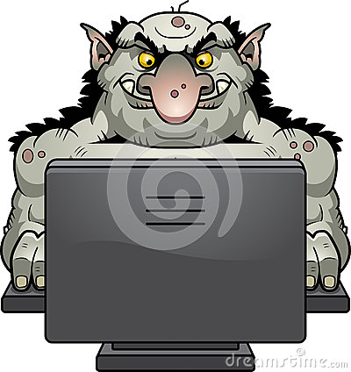
There are many other types of al-Jazzera trolls…
But they are outside the scope of this presentation. You get the idea.

Slide 12
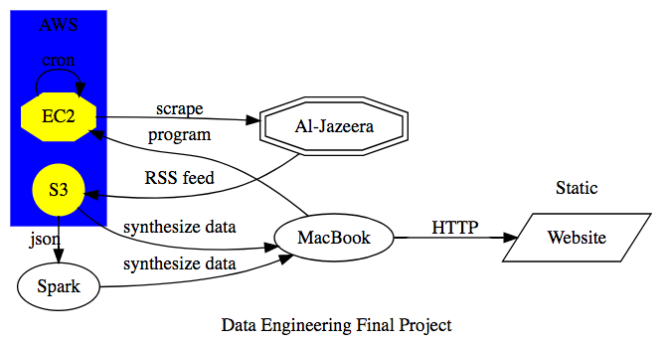
Methodology
Scraped files from Al-Jazeera
Put them on Amazon S3
Analyzed the text to build feature matrix
Classified over 1000 comments based on Type 1 & Type 2 Troll
Performed some initial analysis using Spark
Used a boosted Multinomial Naive Bayes model to make prediction
Verified Cross Value Score and examined Comments
Pushed the information to a static webpage
Working towards updating it daily based on a 14 day model.

Slide 13
Some Important Details:
Ratio of Troll Comments on a given day:
Trolls were classified based on if they fit Type 1 or Type 2 profile. Type 3 is a toss up of free speech or not.
Model is valuable because company can decided to automate troll catching or use it as a dashboard tool for flagging that saves people time.
At this point, not enough data in S3 to leverage the full capabilities of Spark.
There are many ways to improve this model as well as build on the existing framework. Time series, profile tracking, key word clustering to name a few.

Slide 14

You will know a troll by their comments…
Life is short. Don’t be a troll

