Slide 1
Classifying Yelp Images
DSCI6005: Deep Learning
Chase Renick

Slide 2
Context

Slide 3
Overview

Slide 4
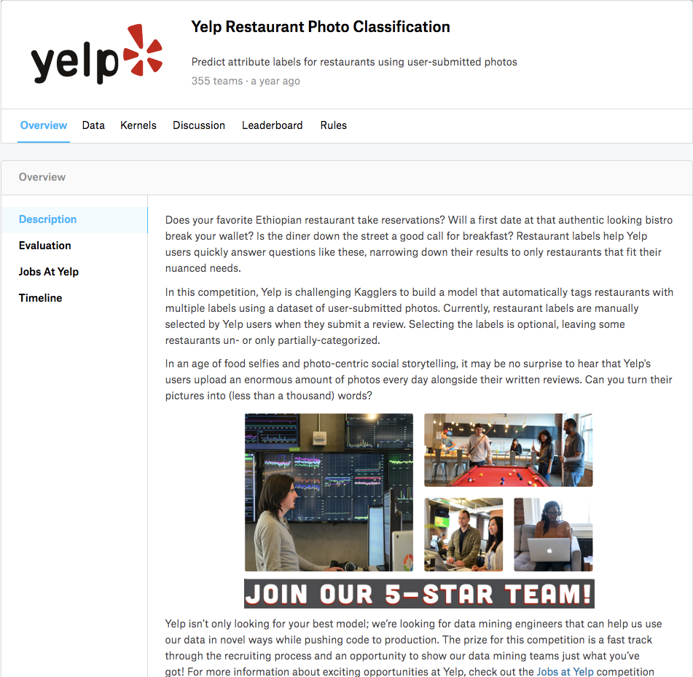

Slide 5


Slide 6
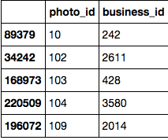
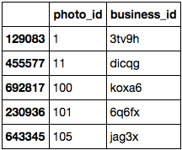
Train Set
Test Set

Slide 7
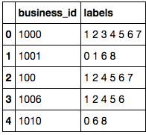
Train Labels

Slide 8
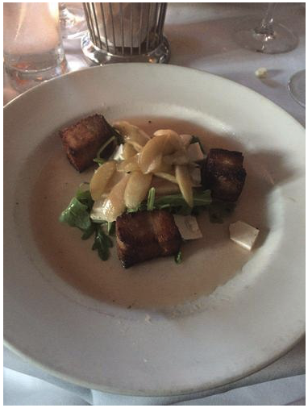
Sample Image

Slide 9
Includes business ids and corresponding labels
Maps TRAIN photo ids to business ids
Maps TEST photo ids to business ids
Train Photos
Test Photos

Slide 10
Challenges

Slide 11
Preprocessing:
Originally 7458 train photos, 8303 test photos…
Yelp provided more photo ids than there were photos.
Only 2800 labels could be found for 8303 test photos
Many duplicates photos in train and test set
Photo dimensions not standardized
Labels were contained as a string sequence ‘1 2 3 4 5 6 7 8’. Changed to one hot encoding
Notes:
What was the biggest challenge?
First it was preprocessing,
Second it was figuring out which was the best model to use (baseline KNN, regular neural net, or convolutional)
Then it was training the VGG net and figuring out that I needed more GPU and CPU’s

Slide 12
Labels
Train Set
Test Set

Slide 13
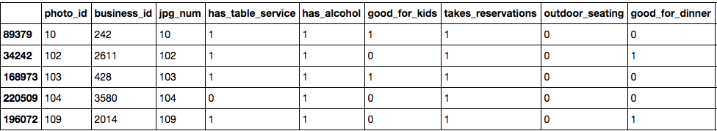
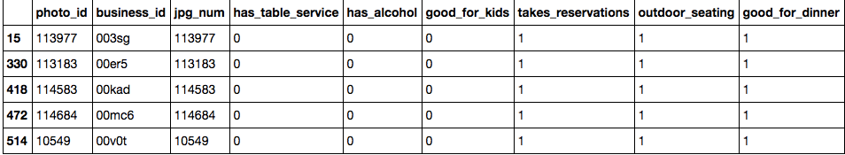
Train Set
Test Set

Slide 14
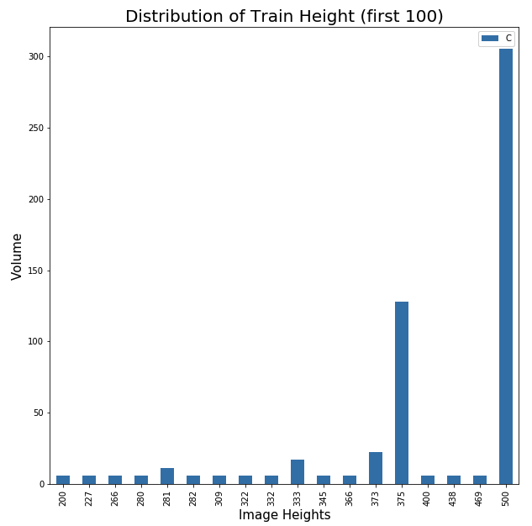
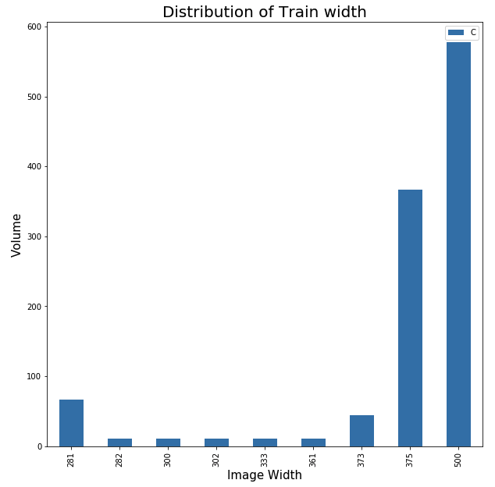
Training Image Dimensions

Slide 15
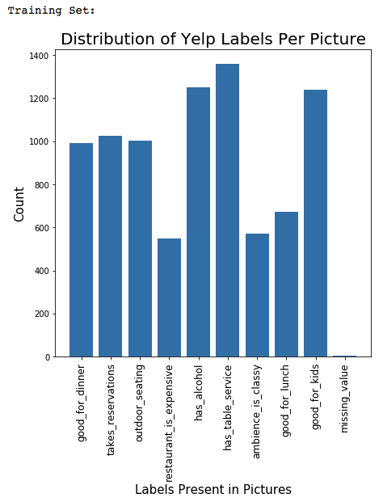
Class Imbalance

Slide 16
Approaches
Baseline: KNN One-Class
Neural Net: One-Class
Neural Net: Predicting Multi-Class
CNN Predicting: Multi-Class
Mock VGG Net Using Convolution: Multi-Class
VGG Net 16: Multi-Class

Slide 17
Hyper-parameters
Filters = 32
Padding = ‘Same’
Kernel Regularization L2 = .01
Activation = Sigmoid
Loss = Binary Cross Entropy
Optimizer = Adam
Epochs = 10
Metrics = F1 Score
Notes:
Basically everything mattered except for the number of Epochs beyond 10. Some hyperparamters that really mattered were
Activation = hard sigmoid changed the accuracy from 77% to 96% with two convolutional layers
Kernel Regularization L2 = .01 we had to penalize certain classes in order to for the neural net to learn during training
For
Chose to use accuracy as a metric because I was producing a probability between 0 and 1 for each class across all data points. Seemed like a descent example.

Slide 18
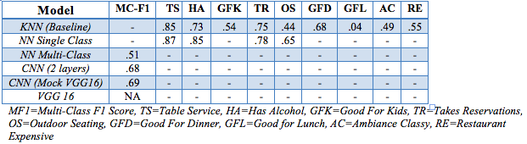
Results:
CNN similar to VGG16 produced an F1-score of ~ 69%
Notes:
Does my neural net beat my baseline?
Yes, it does. For a while it seemed hard to beat given that my KNN was predicting nearly 95% for two classes, but the hard sigmoid activation function changed that.
What are the tradeoff between the baseline model and neural net?
The trade off is that
Are the results significant?
Yes, the results are significant given that they are a probability between 0 and 1 for each class and it correctly predicted them 96% of the time.

Slide 19
Generalizability:
How well would a human perform on this exact same task?
A human would struggle to make accurate predictions > 50% on 8 classes for each photo.
Are there enough features in the photos to even make the labels classified?
Current CNN F1 score seems fairly realistic, not over fitting.

Slide 20
With more time?
Examine images to see what features are actually being discovered by the neural net based on existing NN tools.
Better use multi-processing / threading for Sklearn models such as KNN baseline
Incorporate ingredient lists for each food type based on classification.
Reach out to Yelp and ask them why they provided an equal number of classes in the Test set

Slide 21
SF Recommendations
Mensho Tokyo SF (Ramen on Geary St.)
Kiss Sushi (REAL Japanese $$$)
Dragon Eats (Thai)
Del Popolo (Pizza on Bush St.)
Sweet Greens (Salad)
Eatsa (Robots making food? Only in SF)
Yemeni’s Restaurant (Sutter St.)

Slide 22
Thanks

