Slide 1
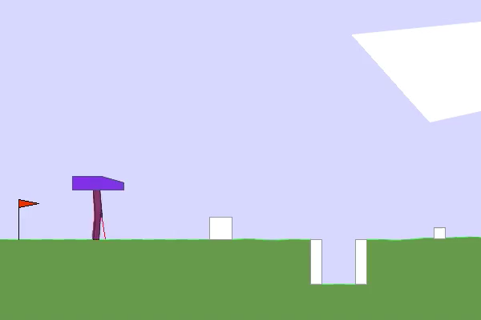
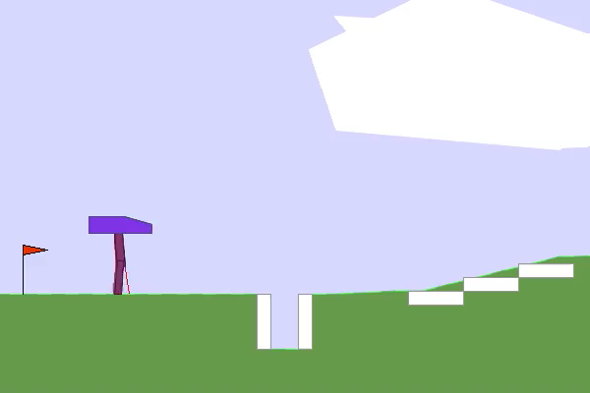
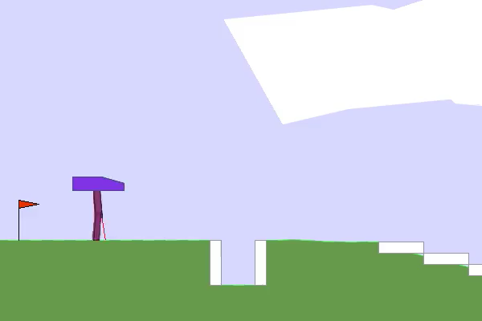
FIRST PHASE – Test 1
PPO
SAC
TRPO
As we can see, the agents all had the same reaction, which consisted of standing still when faced with obstacles.

Slide 2
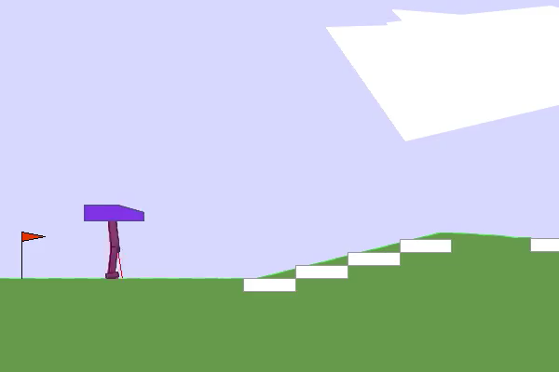
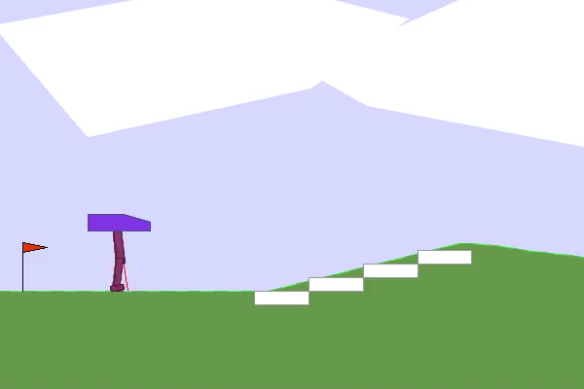
FIRST PHASE – Test 2
PPO
SAC
We concluded that although the idea of ​​controlling the use of both feet is theoretically good, in practice, this implementation of using the feet alternately was not the best, as the models focus on using both feet instead of walking forward. Since this error was detected, we ended up not testing for TRPO.

Slide 3
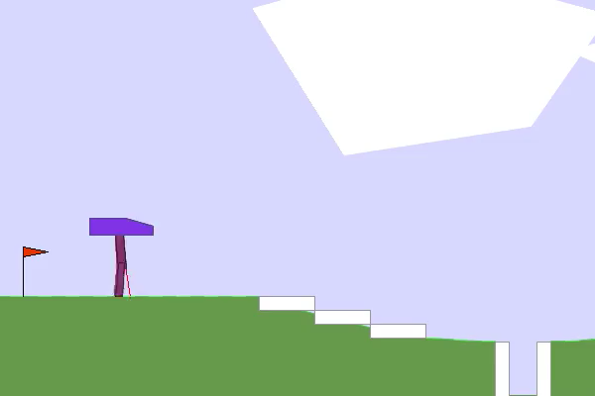
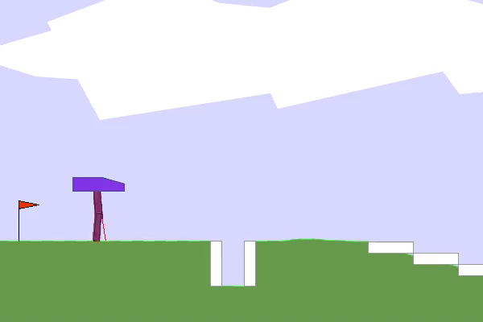
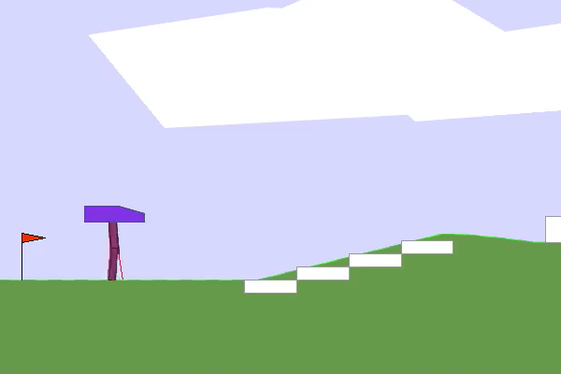
SECOND PHASE
PPO
SAC
TRPO
It seems that the ‘moving forward’ incentive was very effective, as we can see from the videos the agents actually try to overcome obstacles. However, in some cases that we tested, some agents encountered problems with overcoming some blocks and holes.

Slide 4
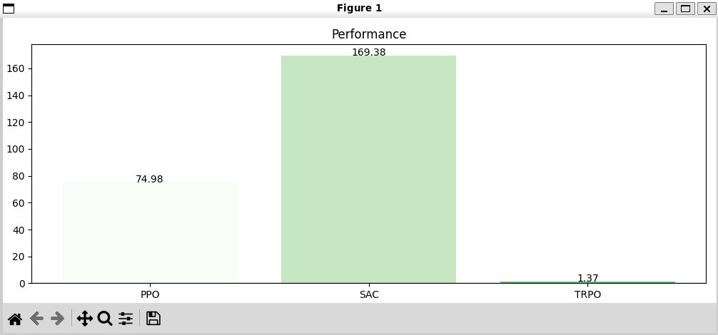
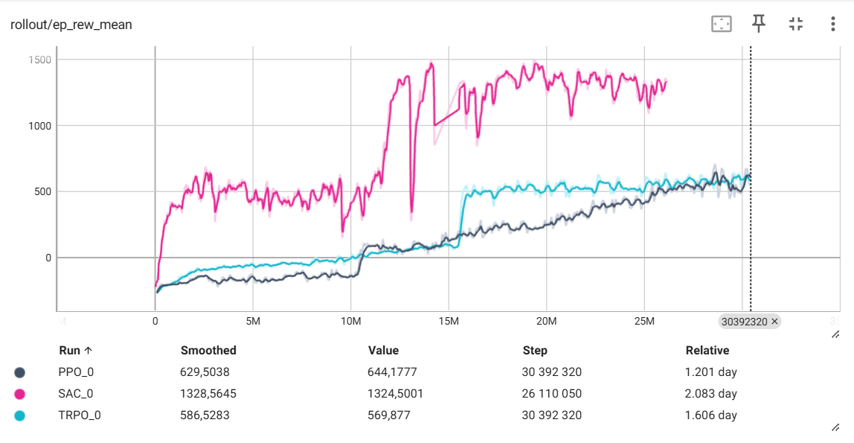
SECOND PHASE

Slide 5
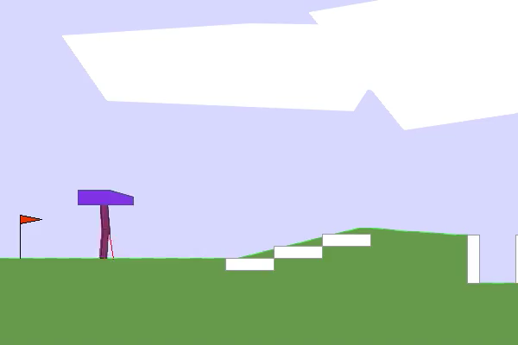
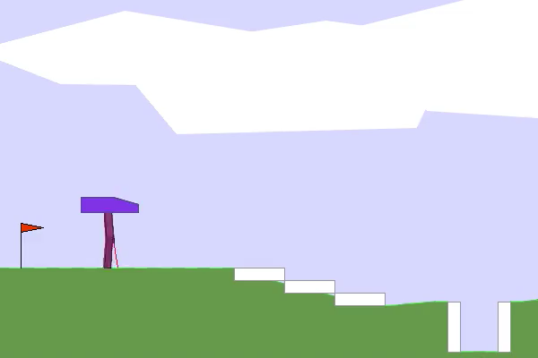
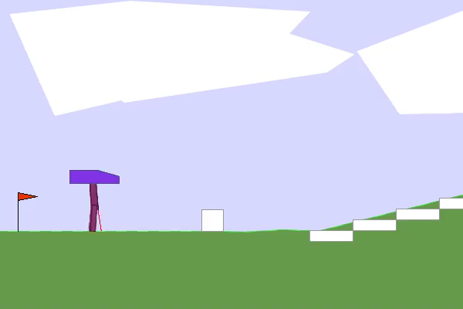
THIRD PHASE
PPO
SAC
TRPO
Although we tried to improve the model, no improvements were observed.

Slide 6
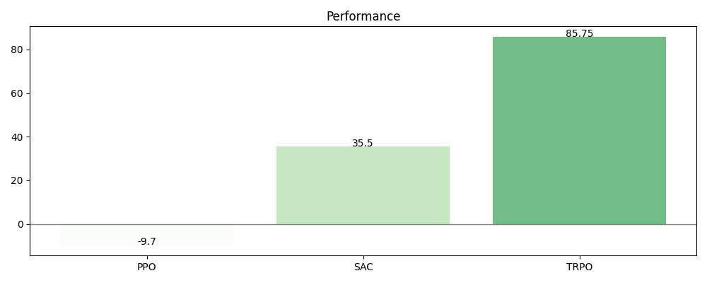
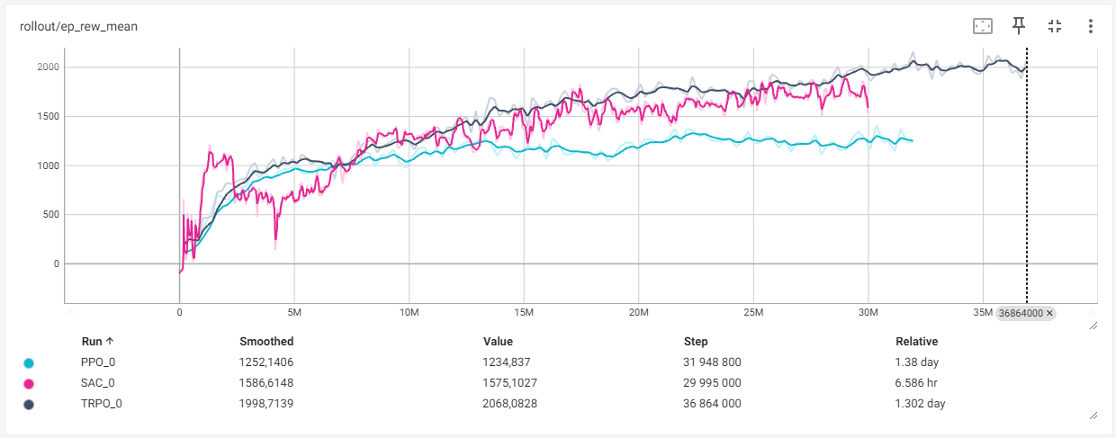
THIRD PHASE

Slide 7
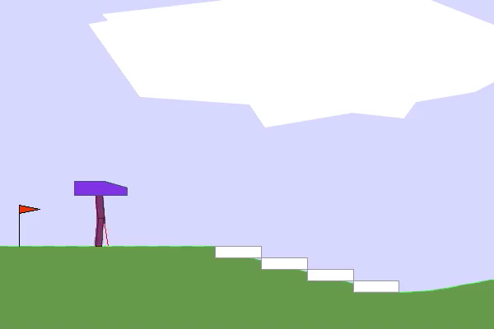
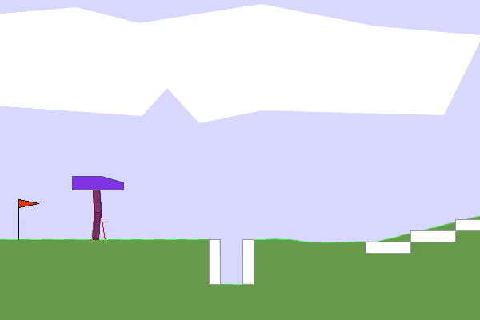
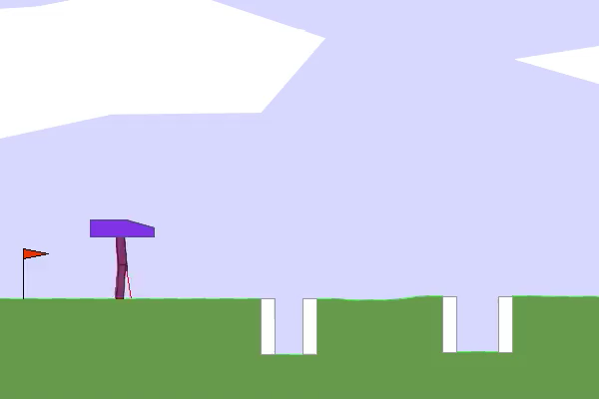
CONTROL
PPO
SAC
TRPO
These are the control videos, that is, how the agents would behave without the use of personalized rewards or feet. (30M timesteps)

Slide 8
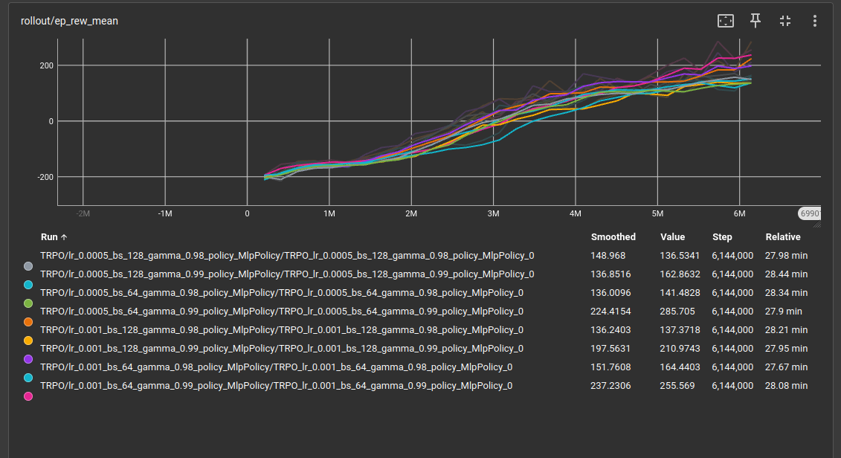
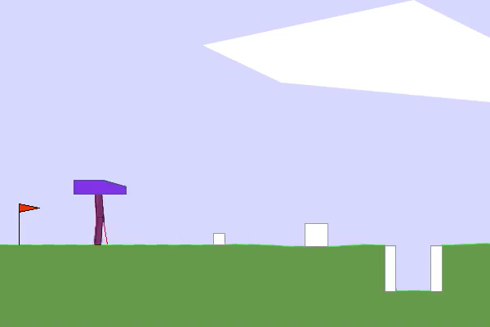
HYPERPAREMETER TUNNING (HT)
TRPO – PHASE 2 (without HT)
TRPO – PHASE 2 (with HT)

Slide 9

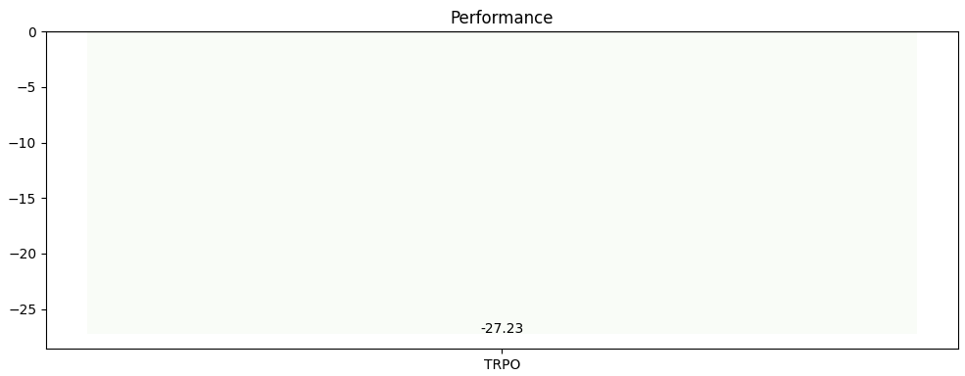
HYPERPAREMETER TUNNING (HT)
Without HP
With HP
Unfortunately, this hyperparameter tuning was only done with 10M time steps, however, we can already see the difference between using the hyperparameter tuning and without.

Slide 10
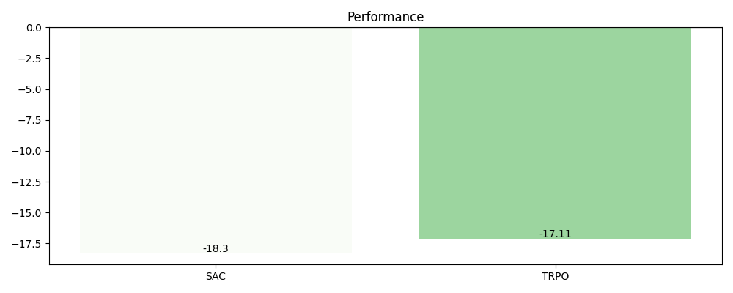
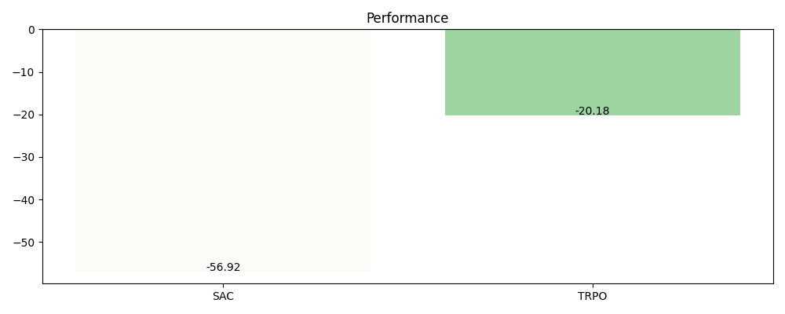
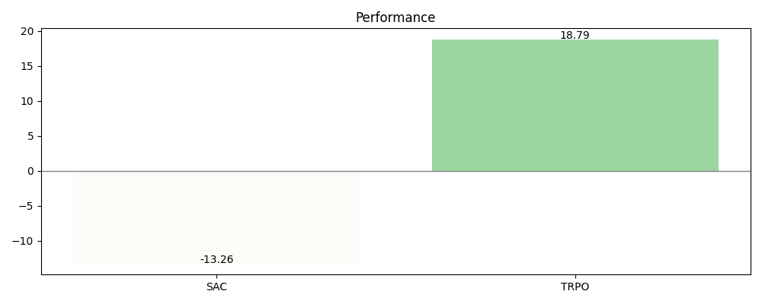
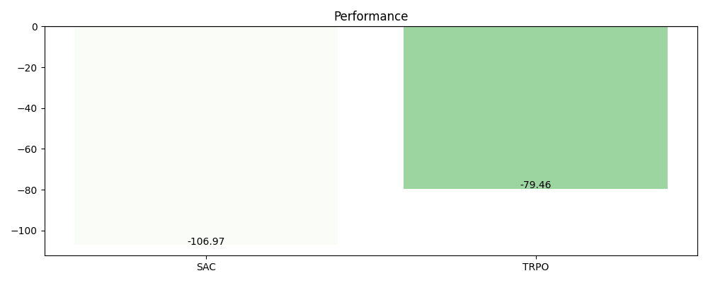
FEET VS NO FEET
No feet and no rewards
With feet and no rewards
No feet and with rewards phase 3
With feet and with rewards phase 3

