Slide 1
Workshop: Introducción a ASP.NET Core con Angular 2
Nicolas Bello Camilletti
@nbellocam

Slide 2
Contenido en github
nbellocam/asp-net-core-angular-workshop

Slide 3
Conceptos del workshop
Angular 2 + Webpack
API REST con ASP.NET Core
Single Page Applications (SPA)
ASP.NET Core’s JavaScript Services

Slide 4
Módulos
Configurando el ambiente
Creando una app de Angular 2 con Webpack
Creando una API REST con ASP.NET Core
Integrando Angular 2 con ASP.NET Core
Introducción a Javascript Services

Slide 5
Introducción a las tecnologías

Slide 6
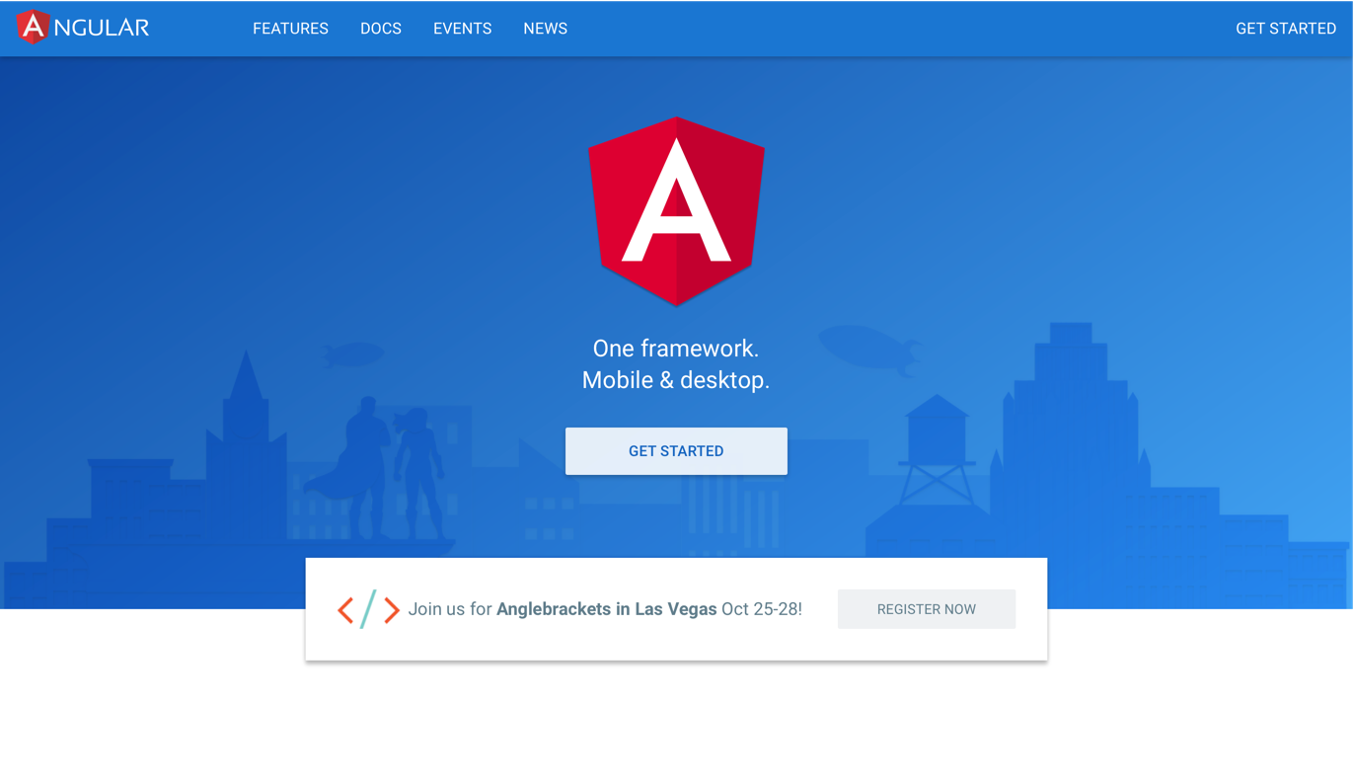

Slide 7
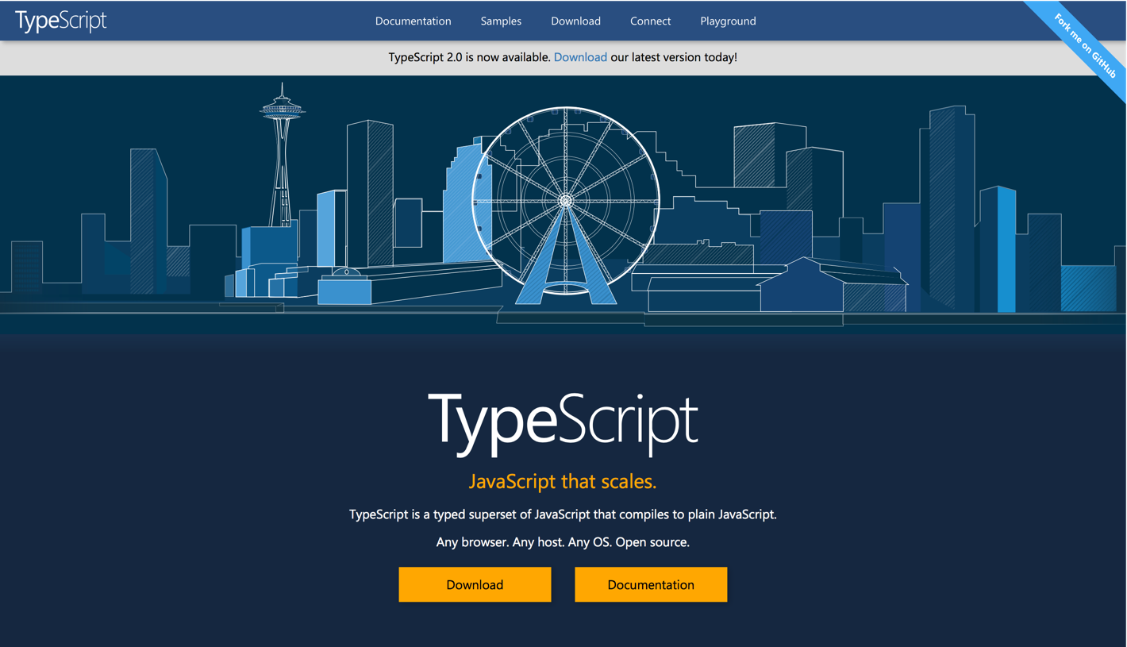

Slide 8
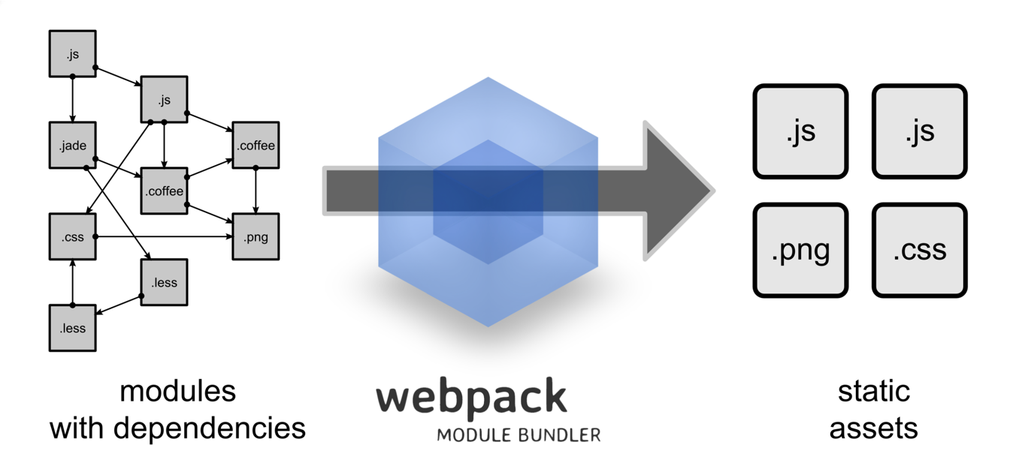

Slide 9
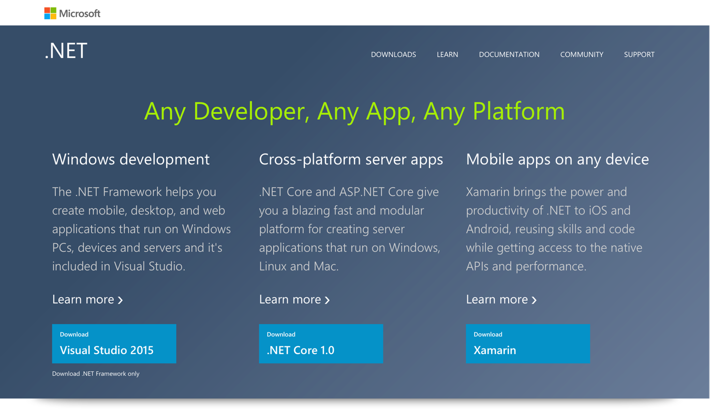

Slide 10
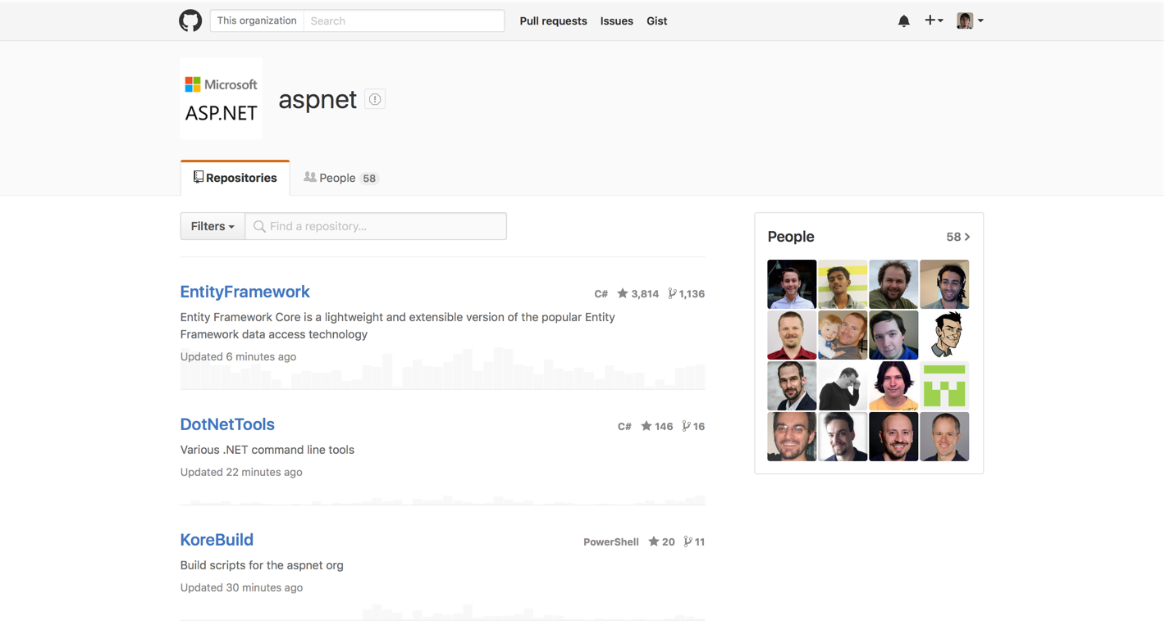

Slide 11


ASP.NET Core and the Modern Web
Totally Modular
Faster Development Cycle
Seamless transition from on-premises to cloud
Choose your Editors
and Tools
Open Source with Contributions
OSS
Cross-Platform
Fast

Slide 12
Modern Web - Agility
Faster Development Cycle
Features are shipped as packages
Framework ships as part of the application
More Control
Zero day security bugs patched by Microsoft
Same code runs in development and production
Developer opts into new versions, allowing breaking changes

Slide 13
Modern Web - Fast
Runtime Performance
Faster startup times
Lower memory / higher density (> 90% reduction)
Modular, opt into just features needed
Use a raw socket, framework or both
Development productivity and low friction
Edit code and refresh browser
Flexibility of dynamic environment with the power of .NET
Develop with Visual Studio, third party and cloud editors

Slide 14
Modern Web - Cloud
Seamless transition from on-premises to cloud
Cloud ready
Configuration
Session
Cache
Diagnostics
Run/Debug in Cloud
Tracing/Logging without re-deploy

Slide 15
Modern Web – Cross Platform
Runtime
Windows, Mac, Linux
Editors
Visual Studio, Text, Cloud editors
No editors (command line)
OSS
Open Source with Contributions

Slide 16
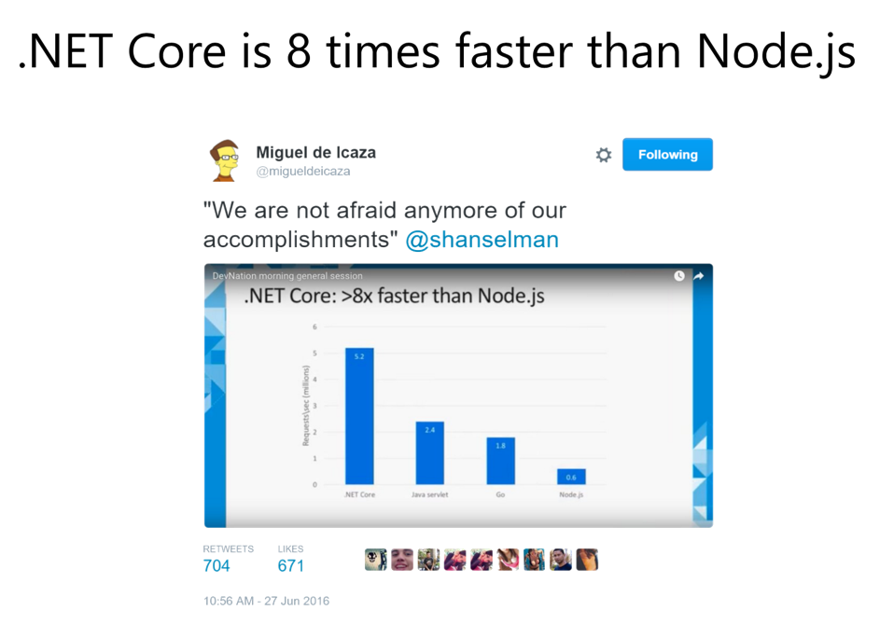

Slide 17
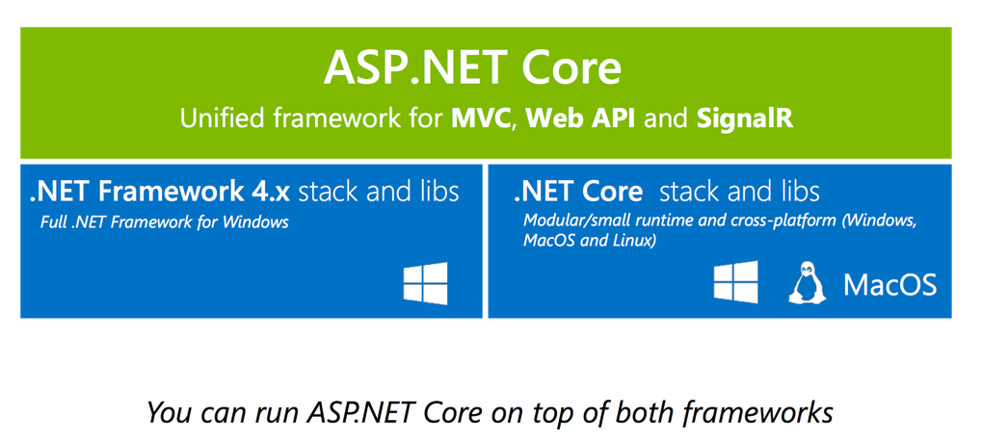
Notes:
ASP.NET Core puede correr en las 2 plataformas

Slide 18
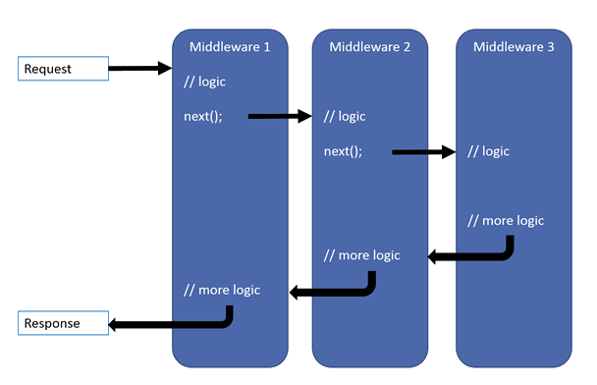
Middlewares

Slide 19
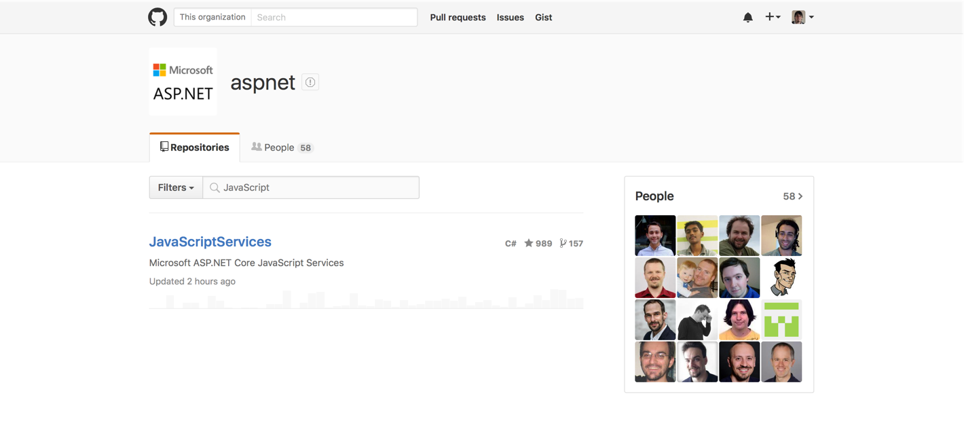
JavaScript Services

Slide 20
Preguntas?

Slide 21
Módulos
Configurando el ambiente
Creando una app de Angular 2 con Webpack
Creando una API REST con ASP.NET Core
Integrando Angular 2 con ASP.NET Core
Introducción a Javascript Services

Slide 22
Arrancamos!
GitHub: nbellocam/asp-net-core-angular-workshop

Slide 23
Muchas Gracias!
Nicolas Bello Camilletti
@nbellocam

Slide 24
Arrancamos!
GitHub: nbellocam/asp-net-core-angular-workshop

