Slide 1

Azure Cloud Migration & Resource Deployment
This presentation will guide you through the key aspects of migrating and deploying resources on Azure, exploring the benefits and steps involved in a successful cloud journey.

Slide 2
Team Members
Mohamed Aymen
Abdullah Ahmed
Mahmoud Atef
Ahmed Hesham

Slide 3

Introduction to Cloud Computing
Definition of Cloud Computing
Cloud Computing Models
Cloud computing is the delivery of computing services—including servers, storage, databases, networking, software, and analytics—over the internet ("the cloud") to offer faster innovation, flexible resources, and economies of scale.
·IaaS (Infrastructure as a Service): Provides virtualized computing resources over the internet.
·PaaS (Platform as a Service): Offers a platform allowing customers to develop, run, and manage applications.
·SaaS (Software as a Service): Delivers software applications over the internet, eliminating the need for installation and maintenance.
Benefits of Cloud Computing
·Scalability – Easily scale up or down based on demand.
·Cost Efficiency – Pay-as-you-go pricing models reduce upfront costs.
·Security – Cloud providers implement advanced security measures.
·High Availability – Global redundancy ensures uptime.
·Disaster Recovery – Cloud backups ensure quick data recovery.

Slide 4
Azure Migration Overview
Why Azure?
Migration Strategies
Key Azure Resources
Scalability, security, and cost-effectiveness are key advantages of Azure.
Rehost, Refactor, Rearchitect, Rebuild
Virtual Machines, Storage Accounts, Networking, Azure Active Directory

Slide 5
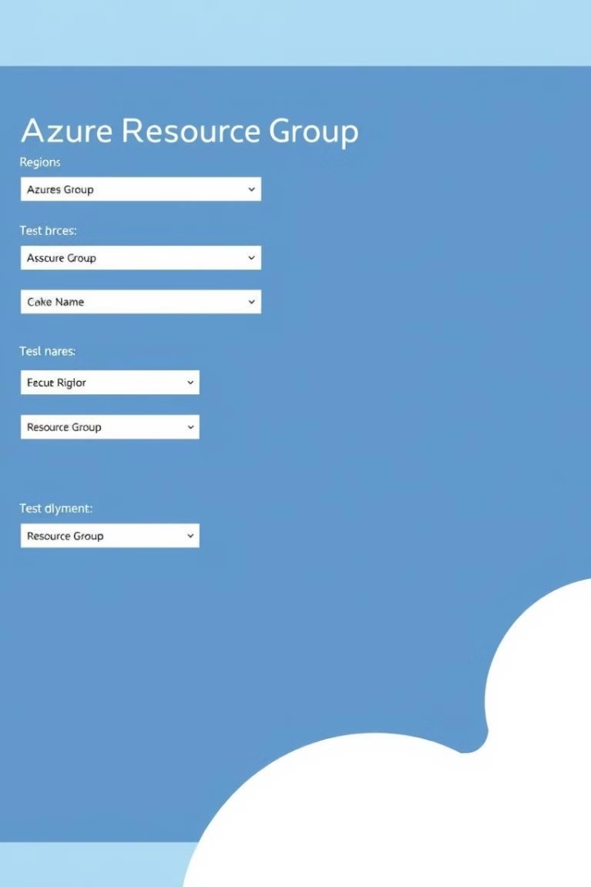
Setting Up Azure Subscription & Resource Groups
Create an Azure Subscription
Go to Azure Portal
Create a free trial account or use an existing subscription
Create a Resource Group
Navigate to Azure Portal → Resource Groups → Create New
Choose a region and assign a meaningful name (e.g., MyResourceGroup)
Click Review + Create to complete the setup

Slide 6
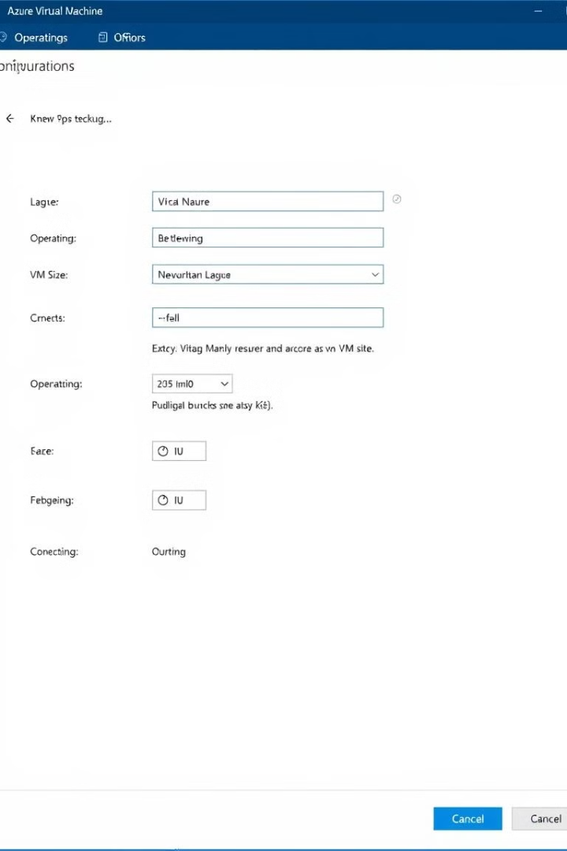
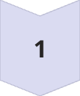


Deploying Virtual Machines & Networking
Create a Virtual Machine
Go to Azure Portal → Virtual Machines → Create New VM
Configure VM Settings
Select:
Operating System (Windows/Linux)
VM Size (based on performance needs)
Region & Resource Group
Set up Administrator Credentials
Networking Setup
Create a Virtual Network (VNet)
Add a Subnet
Assign a Public/Private IP Address
Click Review + Create → Deploy

Slide 7
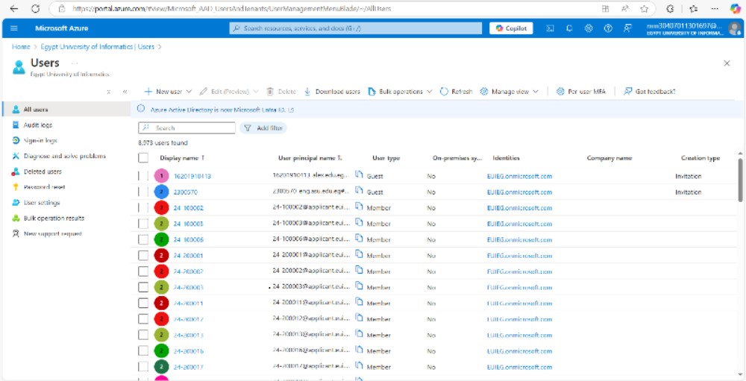


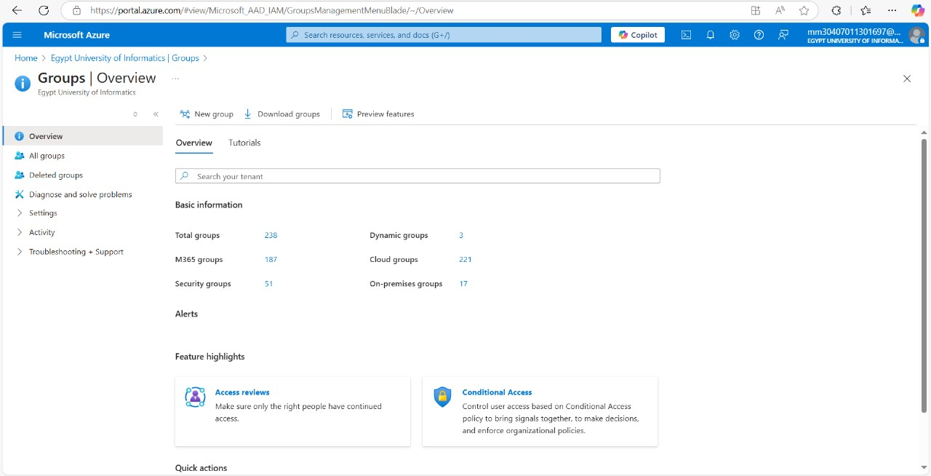
Azure Active Directory (Azure AD) Setup
Creating Users & Groups
Assigning RBAC
Go to Azure Portal → Azure Active Directory
Enable Role-Based Access Control (RBAC)
Add new users (e.g., IT Admin, Developer)
Assign roles (Owner, Contributor, Reader) based on access needs
Create Groups (e.g., Security Group for permissions)

Slide 8

Summary & Lessons Learned
✅ Cloud Computing Principles & Azure Benefits ✅ Deployed VMs, Networking & Azure AD ✅ Challenges Faced & How They Were Resolved

