Slide 1


ROS Projects
Supervisors:
Raphael DUVERNE, Daniel BRAUN & Ralph SEULIN
Students:
Arsalan Khawaja, Mahmoud Badran

Slide 2
Contents
Introduction
Objectives
Implementation and Methodology
Resources
Robot Motion
Navigation
Mapping
Localization
Path planning
Custom waypoints
Demo
Conclusion

Slide 3
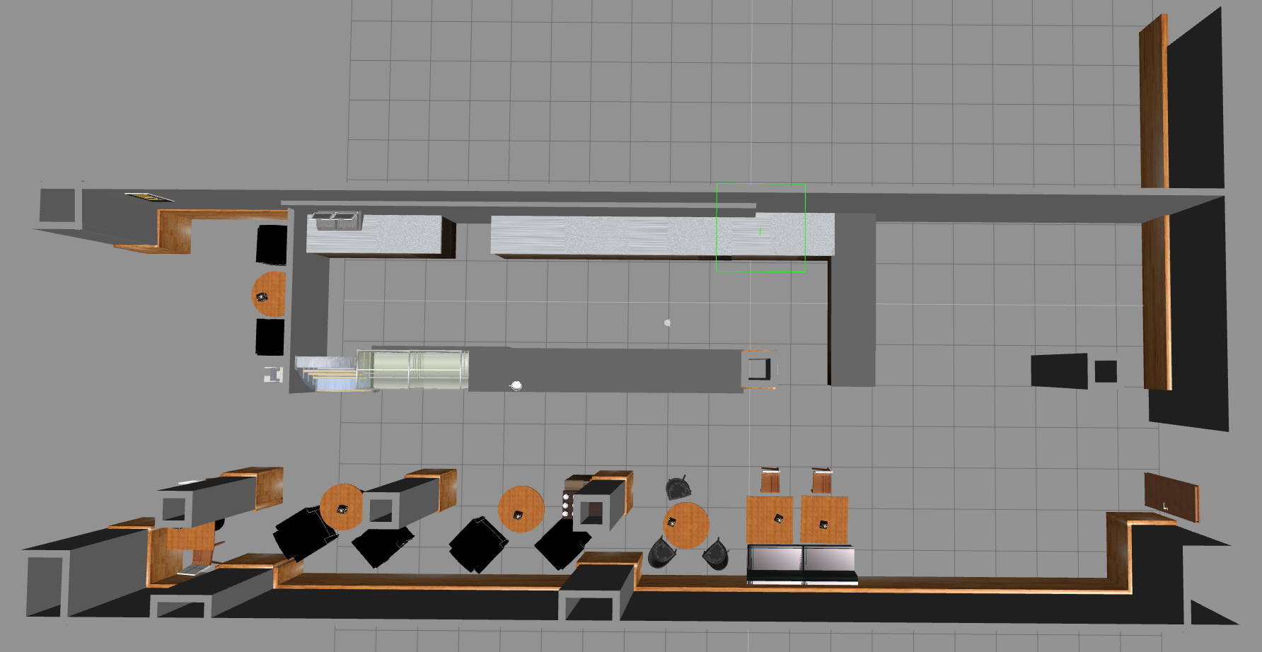
Introduction
An implementation of the studied ROS techniques to achieve the navigation task
Map provided: Costa Coffee

Slide 4
Contents
Introduction
Objectives
Implementation and Methodology
Resources
Robot Motion
Navigation
Mapping
Localization
Path planning
Custom waypoints
Demo
Conclusion

Slide 5
Objectives
Tasks to be achieved:
Simple Robotic Movement
Mapping
Localization
Path Planning
Create Custom waypoints

Slide 6
Contents
Introduction
Objectives
Implementation and Methodology
Resources
Robot Motion
Navigation
Mapping
Localization
Path planning
Custom waypoints
Demo
Conclusion

Slide 7

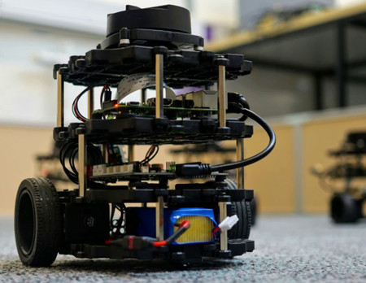


Implementation
Platform And Resources :
ROS KINETIC
The Construct
Ubuntu 16.04
TurtleBot3 Model
Constraints
Internet
Instability of Platform
Time

Slide 8
Contents
Introduction
Objectives
Implementation and Methodology
Resources
Robot Motion
Navigation
Mapping
Localization
Path planning
Custom waypoints
Demo
Conclusion

Slide 9
Implementation
Robot Motion (The map)

Slide 10
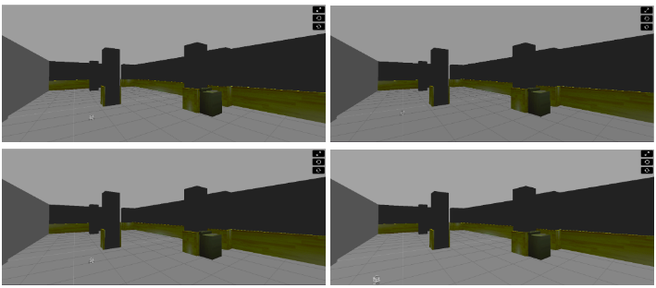
Implementation
Robot Motion
Notes:
HINT 2: The 'ranges' array has a lot of values. The ones that are in the middle of the array represent the distances that the laser is detecting right in front of him. This means that the values in the middle of the array will be the ones that detect the wall. So in order to avoid the wall, you just have to read these values.
HINT 3: The scope of the laser is about 180 degrees from right to left. This means that the values at the beginning and at the end of the 'ranges' array will be the ones related to the readings on the sides of the laser (left and right), while the values in the middle of the array will be the ones related to the front of the laser. Have a look at the image below in order to better understand this.
HINT 4: The laser has a range of 30m. So, if you get a value that is under 30, this will mean that the laser is detecting some kind of obstacle in that direction (the wall). When the laser doesn't detect any obstacle on its way, it returns an inf (infinite) value.

Slide 11

Implementation
Robot Motion
Detailed Video:
Press Here
Notes:
HINT 2: The 'ranges' array has a lot of values. The ones that are in the middle of the array represent the distances that the laser is detecting right in front of him. This means that the values in the middle of the array will be the ones that detect the wall. So in order to avoid the wall, you just have to read these values.
HINT 3: The scope of the laser is about 180 degrees from right to left. This means that the values at the beginning and at the end of the 'ranges' array will be the ones related to the readings on the sides of the laser (left and right), while the values in the middle of the array will be the ones related to the front of the laser. Have a look at the image below in order to better understand this.
HINT 4: The laser has a range of 30m. So, if you get a value that is under 30, this will mean that the laser is detecting some kind of obstacle in that direction (the wall). When the laser doesn't detect any obstacle on its way, it returns an inf (infinite) value.

Slide 12
Contents
Introduction
Objectives
Implementation and Methodology
Resources
Robot Motion
Navigation
Mapping
Localization
Path planning
Custom waypoints
Demo
Conclusion

Slide 13
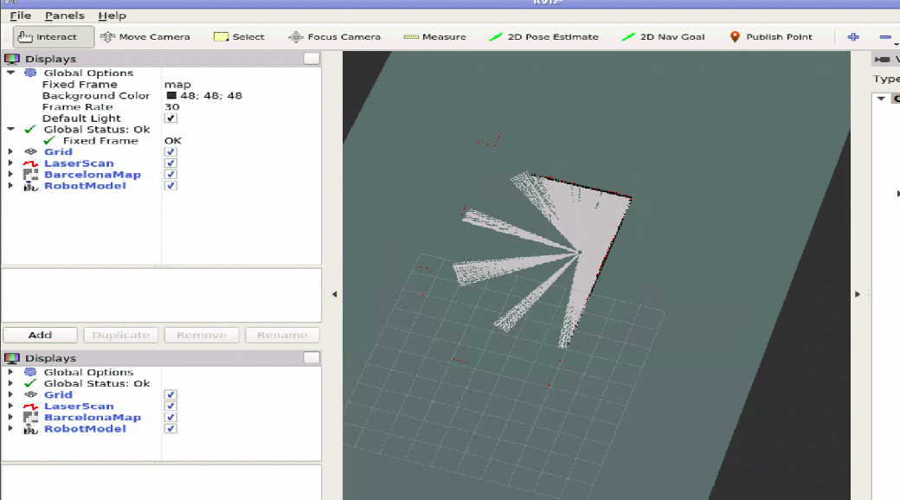
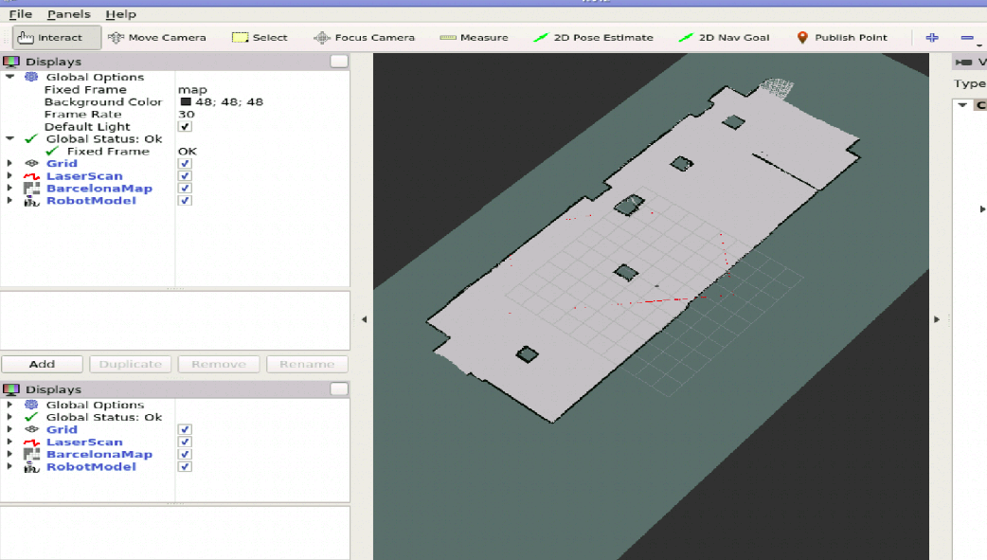
Implementation
Mapping

Slide 14
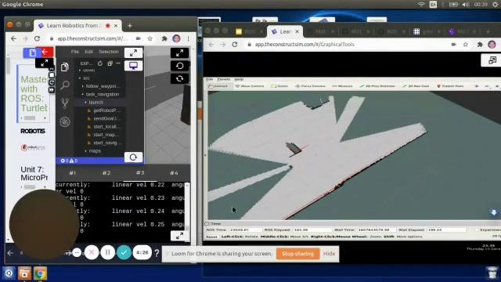
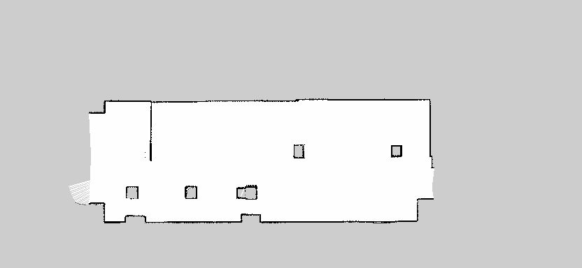
Implementation
Mapping
PGM Map File
Detailed Video: Press Here

Slide 15
Contents
Introduction
Objectives
Implementation and Methodology
Resources
Robot Motion
Navigation
Mapping
Localization
Path planning
Custom waypoints
Demo
Conclusion

Slide 16
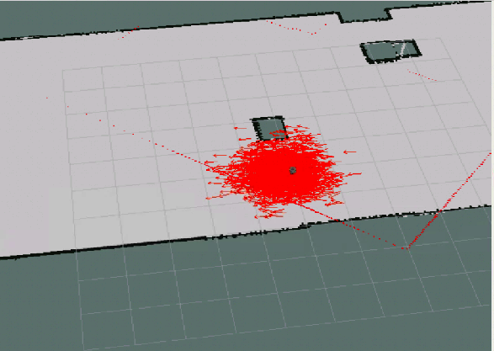
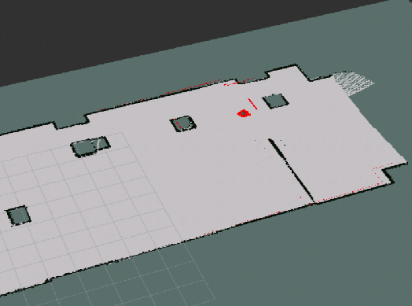
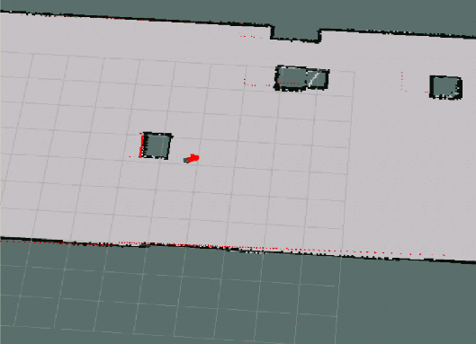
Implementation
Localization

Slide 17
Contents
Introduction
Objectives
Implementation and Methodology
Resources
Robot Motion
Navigation
Mapping
Localization
Path planning
Custom waypoints
Demo
Conclusion

Slide 18
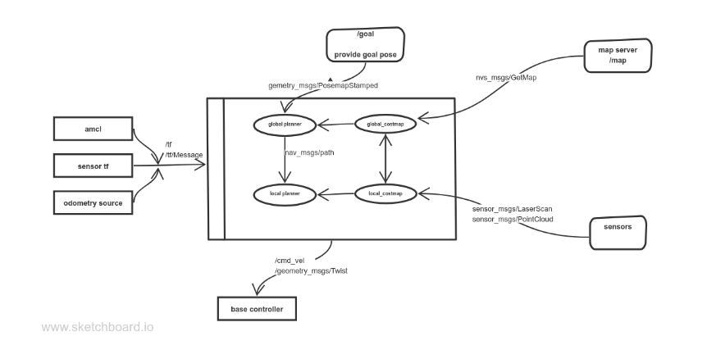
Implementation
Path Planning - Navigation Task

Slide 19
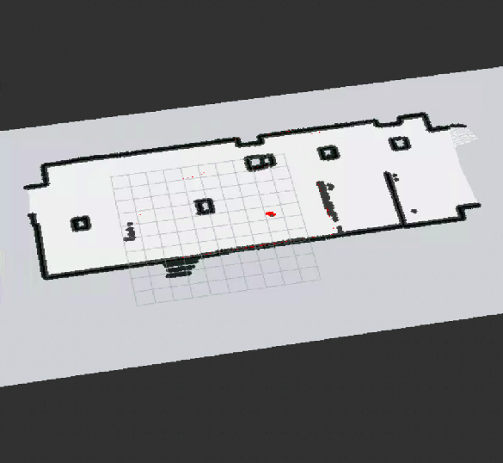
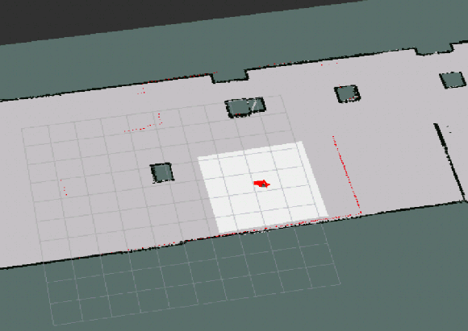
Implementation
Path Planning
Global CostMap Local CostMap

Slide 20
Implementation
Path Planning
Detailed Video: Press Here
Sending goal using simple Action server
Notes:
Send Goal using SimpleActionServer.

Slide 21
Contents
Introduction
Objectives
Implementation and Methodology
Resources
Robot Motion
Navigation
Mapping
Localization
Path planning
Custom waypoints
Demo
Conclusion

Slide 22
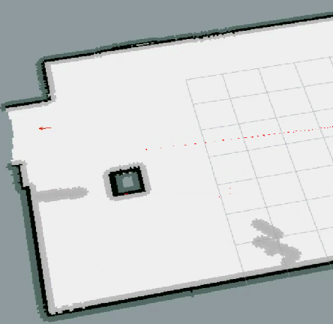
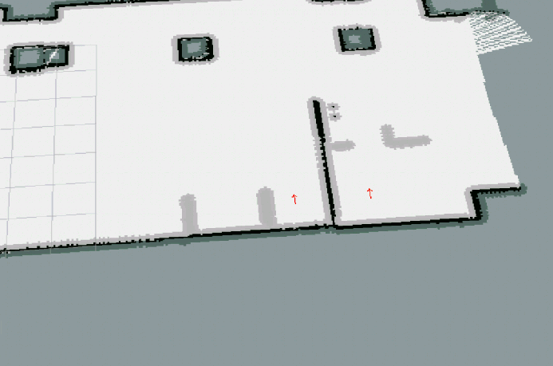
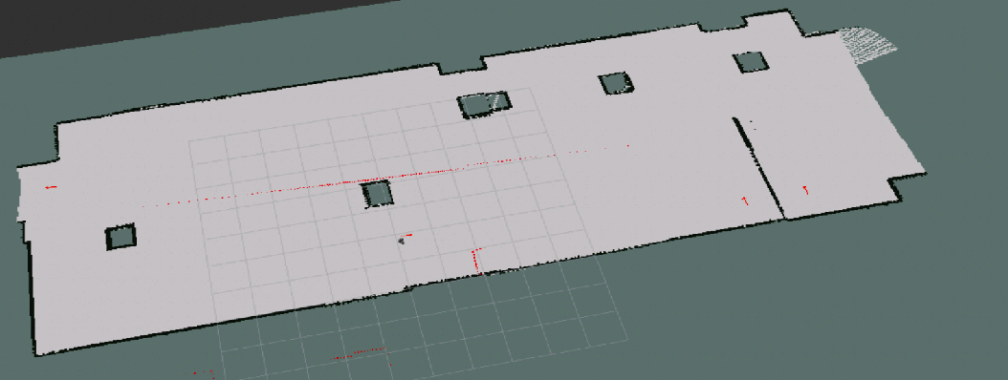
Implementation
WayPoints
Notes:
Send Goal using SimpleActionServer.

Slide 23
Implementation
WayPoints
Notes:
Send Goal using SimpleActionServer.

Slide 24
Implementation
WayPoints using the package
Detailed Video: Press Here
Notes:
Send Goal using SimpleActionServer.

Slide 25
Implementation
Our Custom WayPoints
Detailed Video: Press Here
Notes:
Send Goal using SimpleActionServer.

Slide 26
Contents
Introduction
Objectives
Implementation and Methodology
Resources
Robot Motion
Navigation
Mapping
Localization
Path planning
Custom waypoints
Conclusion

Slide 27
Conclusion

