Slide 1


Slide 2
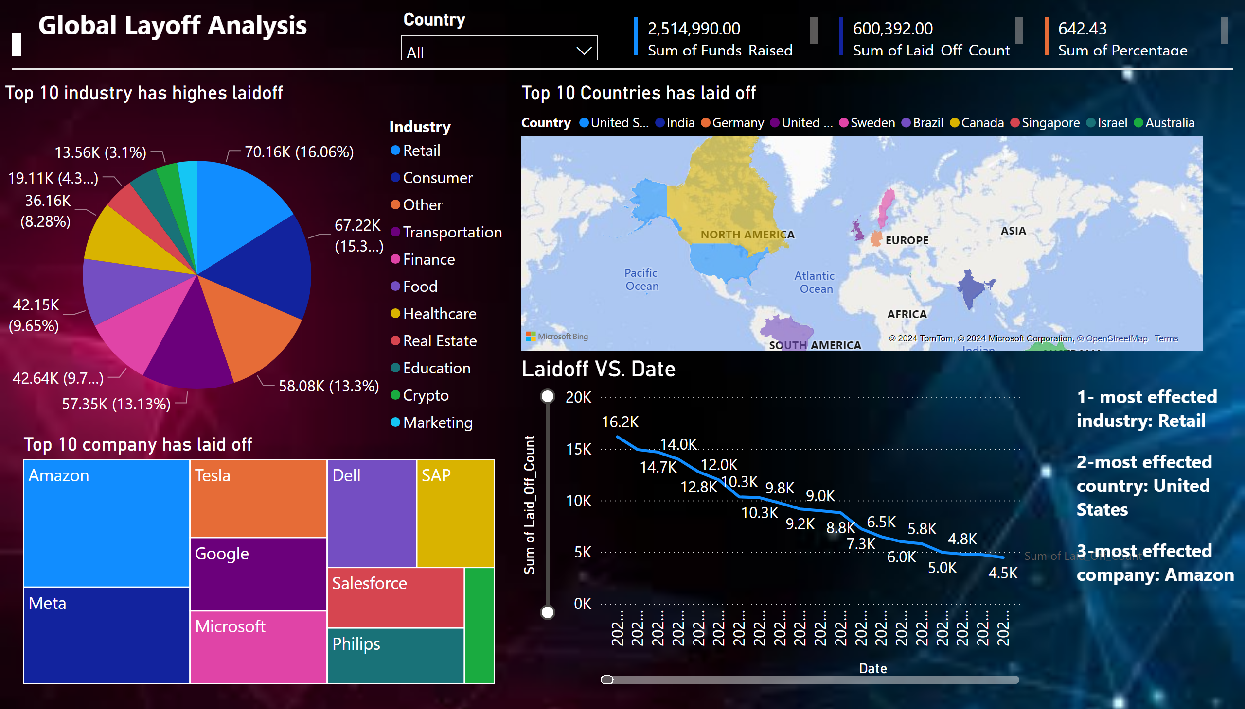
Page 1

