Slide 1


Slide 2
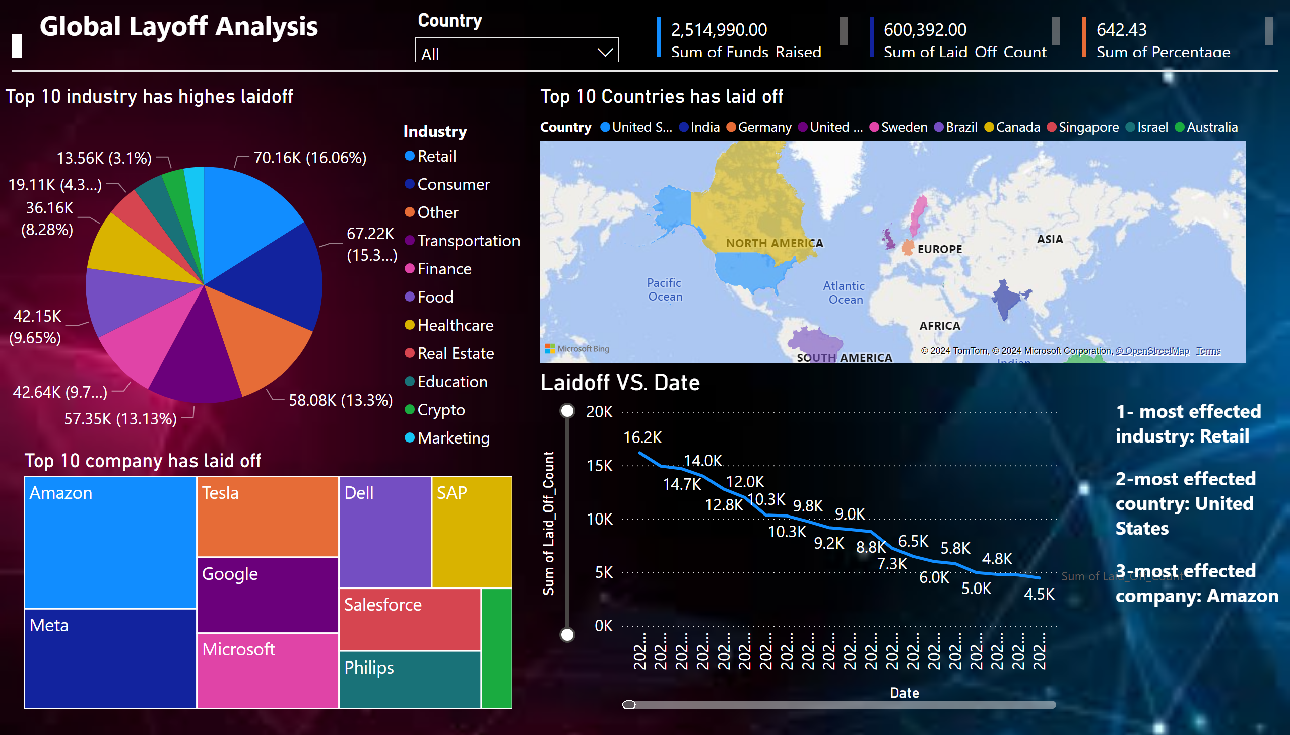
Page 1
Notes:
Top 10 industry has highes laidoff
No alt text provided
Top 10 Countries has laid off
No alt text provided
Laidoff VS. Date
No alt text provided
textbox
No alt text provided
textbox
No alt text provided
multiRowCard
No alt text provided
multiRowCard
No alt text provided
multiRowCard
No alt text provided
shape
No alt text provided
slicer
No alt text provided
Top 10 company has laid off
No alt text provided
textbox
No alt text provided

