Slide 1
Smart Waste Classification Using Vision Transformers
♻
⚠
🌱
🗑
Evaluating hazardous-waste detection and classification reliability
Shaikh Maha (1560980)
· MAAI901 Deep Learning for Visual Data
· Dr. Milan Dordevic
· 27 October 2026
Notes:
Good evening. My project is about teaching an AI model to look at a photo of waste and tell which bin it belongs to – and more importantly, checking whether we can trust it when the item is hazardous.

Slide 2
What is Smart Waste Classification?
Take a photo of a waste item → the model says which bin it belongs to
Four bins: Hazardous (batteries, e-waste, paints, pesticides), Recyclable, Organic, Non-Recyclable
Why it matters: recycling plants sort mixed items on fast conveyor belts; people at home often guess wrong
The model: a Vision Transformer (ViT) – a deep-learning model that reads an image as a grid of small patches
I did not build the model from scratch – I took Google's pretrained ViT and fine-tuned it on waste photos
⚠
Hazardous
♻
Recyclable
🌱
Organic
🗑
Non-Recyclable
Notes:
Smart waste classification simply means: you give the system a photo, it tells you the bin. I used four bins. The model is a Vision Transformer, and instead of training from zero, I took Google's pretrained version and fine-tuned it on waste photos – that is called transfer learning.

Slide 3
Why I focused on hazardous waste
Low-cost mistake
High-cost mistake
Cardboard in the plastics bin → a small inefficiency. Nobody gets hurt.
Lithium battery in organic waste → fire in a truck.
Pesticide bottle in compost → contaminated soil and water.
Research question: How reliably can a Vision Transformer classify waste images, and what types of errors could create risks when identifying hazardous waste?
Notes:
Not every mistake costs the same. If the model confuses paper and plastic, nothing bad happens. If it says a battery is recyclable, that battery can start a fire. So my research question is not just how accurate the model is, but what kind of errors it makes on hazardous items.

Slide 4
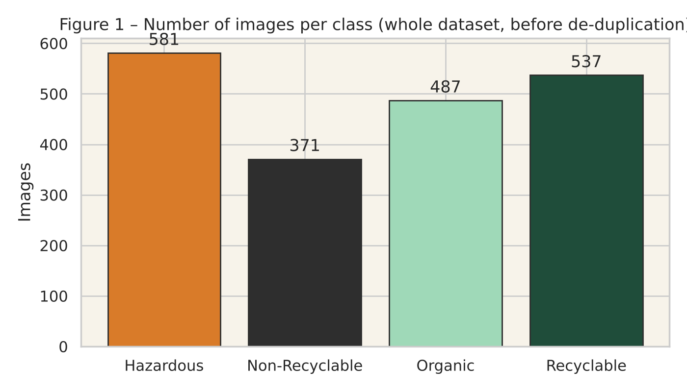
Step 1 – Dataset
huaweilin/waste-classification on Hugging Face – real photos, MIT licence
1,976 images · 4 classes · 18 subclasses (e.g. batteries, diapers, eggshells, cans)
Chosen because it has a real Hazardous class – most waste datasets don't
Not perfect: small, uneven (e-waste 359 photos, batteries only 68), and mostly clean product-style photos
Images per class
Notes:
The dataset has about two thousand real photos in four classes. I picked it because it actually has a hazardous class – batteries, e-waste, paints and pesticides. It is not perfect: it is small, uneven, and the photos are cleaner than real rubbish. I come back to that in the limitations.

Slide 5
Step 2 – Pre-processing
1
Clean
Opened every image, converted to RGB, checked for broken files (none found)
2
Remove duplicates
188 identical photos removed using an image hash → 1,788 images left. Done before splitting so the same photo can't be in both train and test
3
Split
70 % train / 15 % validation / 15 % test = 1,251 / 268 / 269 images, stratified so every subclass appears in every split
4
Resize & normalise
Every image → 224×224 pixels, normalised the way the ViT expects
5
Augment (training only)
Random crop, flip, small colour changes – so the model sees more variety. Test images untouched
Notes:
Pre-processing was mostly about being careful. The most important step was removing duplicate photos before splitting – otherwise the same image could appear in training and testing and make the results look better than they are. Augmentation was only applied to training images.

Slide 6
Step 3 – The Vision Transformer
Photo
Patches
Embedding
Self-attention
Prediction
224 × 224
196 × (16 × 16)
768 numbers + position
12 layers
4 classes
The image is cut into 196 small squares (patches), like words in a sentence
Self-attention lets every patch "look at" every other patch – so the model sees the whole object, not just local texture
I used google/vit-base-patch16-224, already trained on 14 million ImageNet photos
I replaced its 1000-class output layer with a new 4-class layer and fine-tuned the whole model (transfer learning)
Notes:
A Vision Transformer treats an image like a sentence. It cuts the photo into 196 small patches, turns each patch into a list of numbers, and self-attention lets every patch look at every other patch. I used Google's pretrained ViT and only replaced the final layer so it outputs four classes.

Slide 7
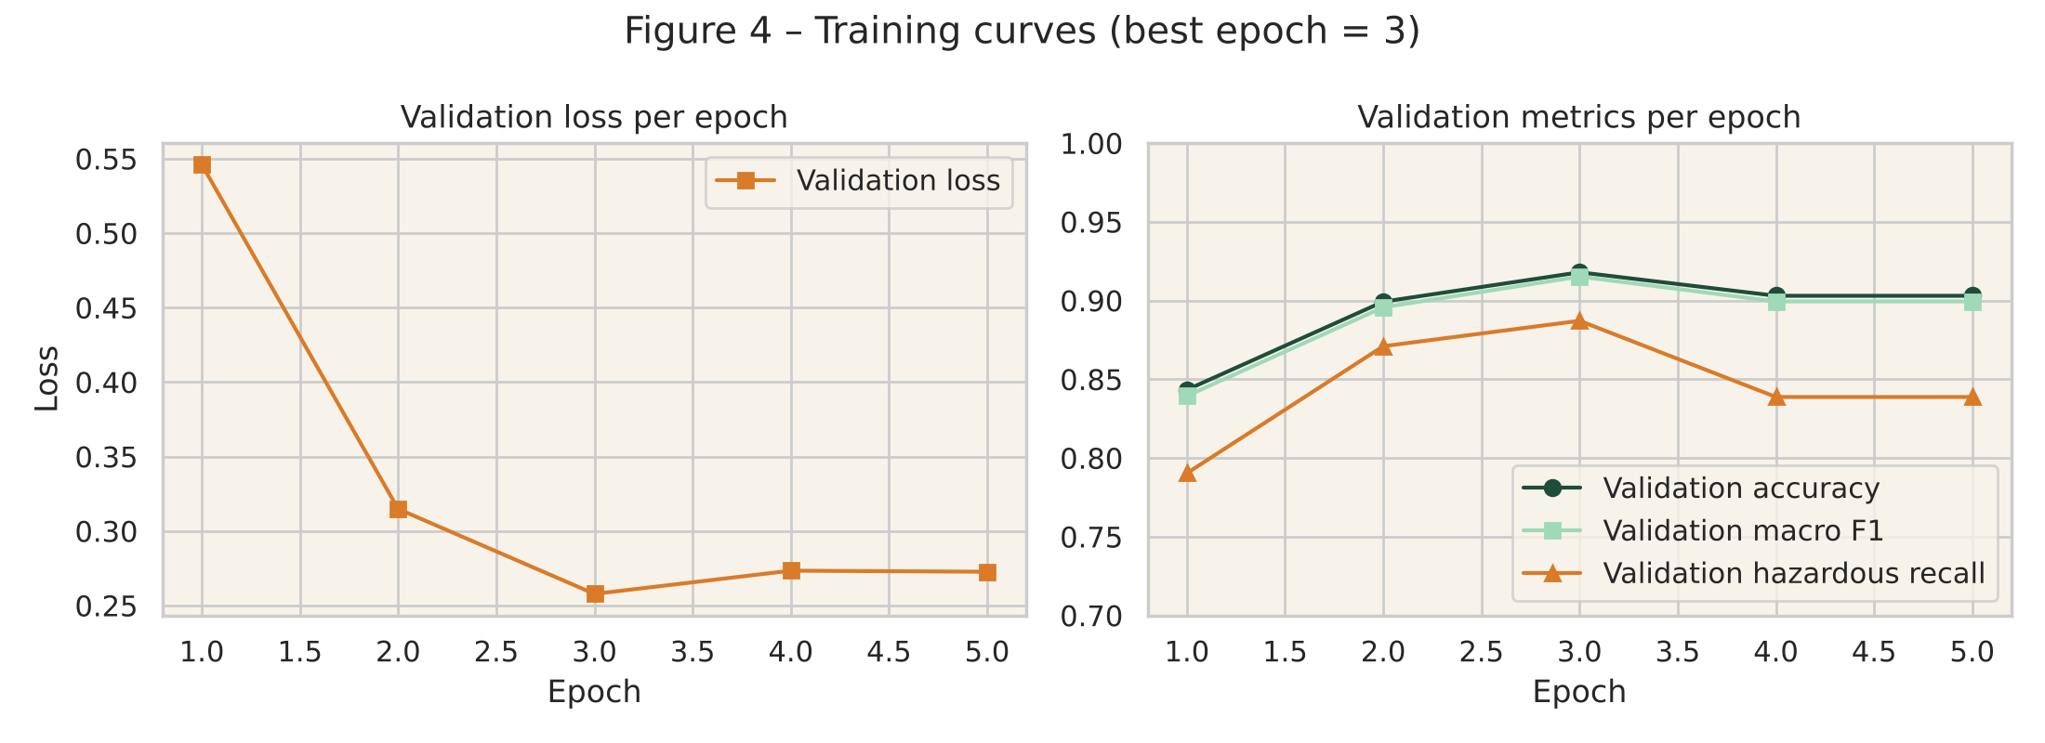
Step 4 – Training
Google Colab, free Tesla T4 GPU
5 epochs (the model sees all training images 5 times) · batch of 32 images
Small learning rate (5e-5) so the pretrained knowledge is not destroyed
After each epoch I checked the validation set and kept the best one → epoch 3
After epoch 3 the model started to over-fit (memorise), so stopping there was correct
Total training time: 5.2 minutes
Validation loss and accuracy per epoch
Notes:
Training took about five minutes on a free Colab GPU. I trained for five epochs and checked the validation set after each one. The best was epoch three – after that the model started memorising the training set, so I used the epoch-three version for all the results.

Slide 8
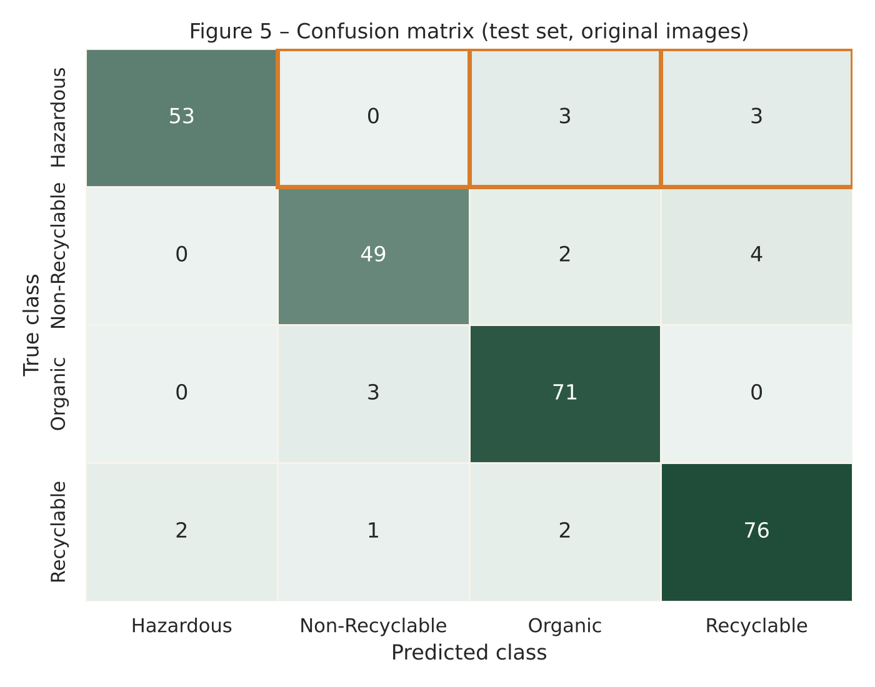
Step 5 – Results on the test set
92.6%
0.925
accuracy
249 of 269 correct
macro F1
(all 4 classes equal)
53 / 59
6
hazardous items
caught
hazardous items
missed (10 %)
Confusion matrix – orange boxes = hazardous items sent to the wrong bin
Notes:
On the 269 test images the model got 92.6 percent right. But the number I care about is in orange: 59 hazardous items, 53 caught, 6 missed. The confusion matrix shows where every mistake went – the orange boxes are the hazardous items that ended up in the wrong bin.

Slide 9
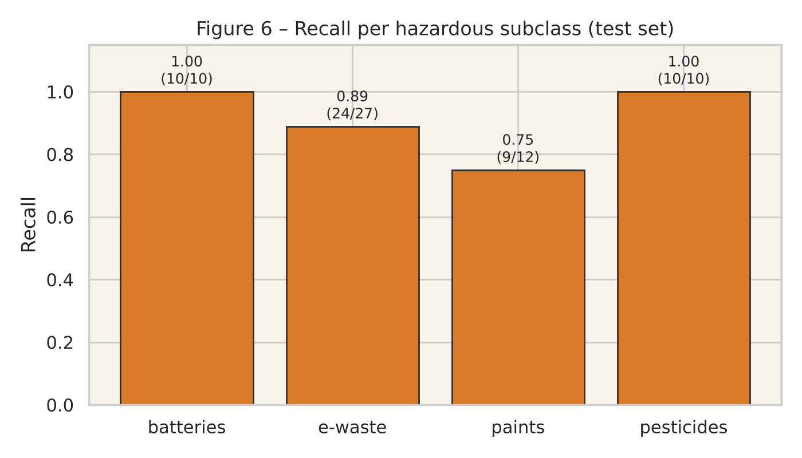
Which hazardous items were missed – and why
Batteries & pesticides: 100 % caught
Paints: 3 of 12 missed · e-waste: 3 of 27 missed
All 6 went to Organic or Recyclable – a paint tin looks like a food can, a paint bottle like a plastic bottle
4 of the 6 misses had low confidence (< 0.55) → a rule "if unsure, ask a human" would have caught them
Image-quality test (blur / dark / JPEG on the same photos): accuracy dropped at most 2.2 points
Notes:
Looking closer: batteries and pesticides were all caught. The misses were paints and e-waste – things that physically look like ordinary packaging. Four of the six misses had low confidence, so a simple rule – if the model is unsure, send it to a human – would have caught most of them. I also tested blurred, dark and compressed versions of the same photos; the drop was small, at most two points.

Slide 10
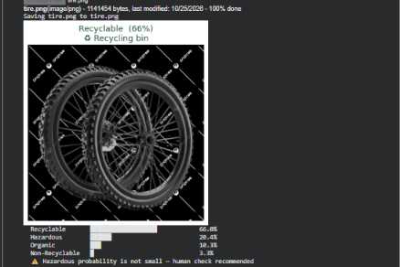
Live demo
Upload any photo in Colab → class, confidence, and disposal advice
Example: a tyre – not in any of the 4 classes – came out 66 % Recyclable / 20 % Hazardous and was flagged for human check
That is the behaviour I want: when unsure, say so
Notes:
Here I can run the demo. Upload a photo, and it shows the class, the confidence and what to do with it. If you upload something outside the four classes, like this tyre, the model is unsure and flags it for a human – which is exactly the behaviour I want.

Slide 11
Limitations and ethics
1
Clean photos ≠ real bins
Training photos are product-style; real waste is dirty, crushed and mixed
2
Only 4 hazardous types
No medicines, chemicals or gas canisters – the model cannot recognise what it never saw
3
Small, uneven dataset, one run
Rare subclasses (10 test images) give fragile numbers
4
Unknown origin of photos
Packaging and recycling rules differ by country – bias cannot be checked
5
Must assist humans, not replace them
A 10 % hazardous miss rate is too high for unsupervised use – "when unsure, treat as hazardous"
Notes:
I want to be honest about the limits. The data is clean product photos. The hazardous class covers only four item types. And a ten percent miss rate on hazardous items is too high for a machine to decide alone – it should assist a human sorter, with a conservative rule: when unsure, treat it as hazardous.

Slide 12
Conclusion
What I found
What I would do next
• A pretrained ViT fine-tuned in 5 minutes reaches 92.6 % accuracy on waste photos
• It still misses about 1 in 10 hazardous items – mostly paints and e-waste that look like normal packaging
• Image quality changes the kind of error, not just the amount
Answer: reliable enough to assist, not to decide alone
• Make the model cautious: lower the threshold for "Hazardous"
• Train with blurred / dark / compressed images
• Read labels (OCR) and hazard symbols
• Collect real bin-camera photos with multiple items
• Compare with a CNN and repeat with more seeds
· Thank you
Notes:
To conclude: a fine-tuned Vision Transformer is a strong waste classifier on clean images, but it still misses about one in ten hazardous items. So it is reliable enough to help a human, not to replace one. The most useful next step is to make it deliberately cautious on the hazardous class. Thank you – happy to take questions.

