Slide 1

Deep Learning Module-2 Target-2
BRAIN TUMOUR DETECTION SYSTEM
SUBMITTED BY:
BATCH-08
211FA04609
211FA04610
211FA04654
211FA04672
Submitted to:
Dr. SV Phani Kumar
1

Slide 2
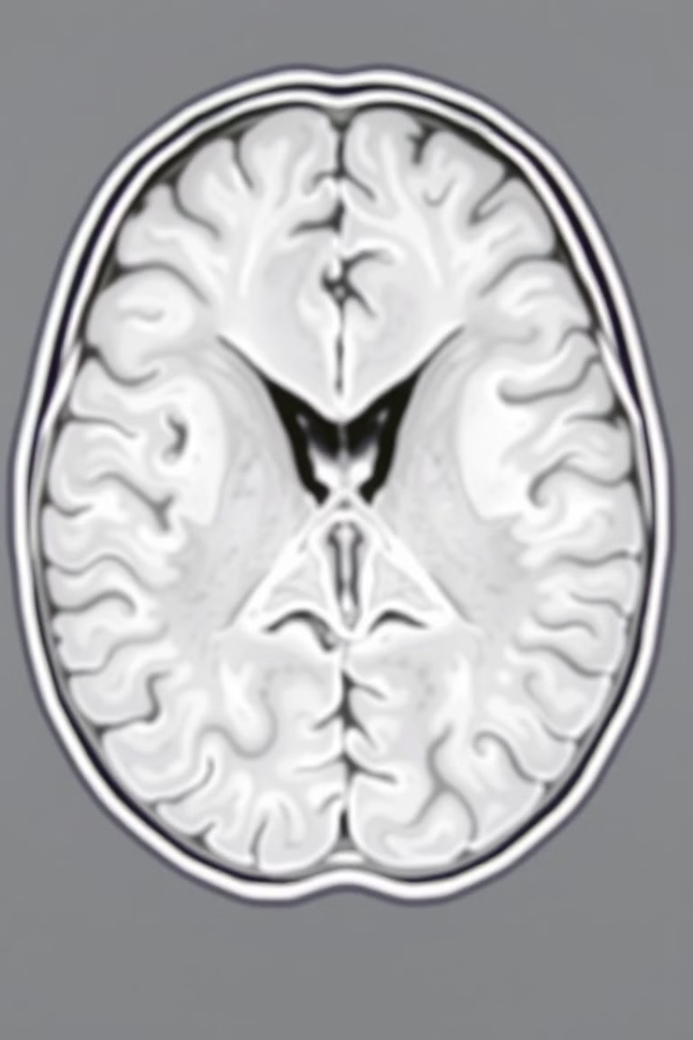
Ensemble Deep Learning for Brain Tumor Detection
Abstract:
This study evaluates deep learning models for brain tumor detection using MRI images. It focuses on popular architectures like VGG16, VGG19, ResNet50, MobileNet, and Inception V3 to accurately diagnose brain cancers. The research aims to overcome challenges in tumor identification due to complex brain structures and image noise. It proposes a novel approach combining deep learning with boosting techniques to enhance detection accuracy and classification of tumor types.
2

Slide 3
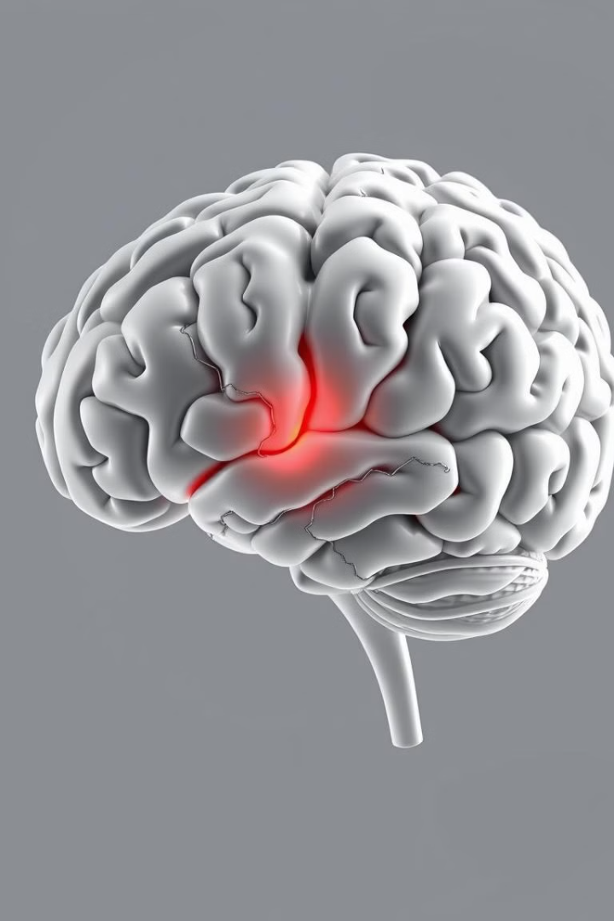
Challenges in Brain Tumor Detection
Identifying and categorizing brain tumors remains challenging due to the complex brain architecture, variances in tumor size, shape, and location, and noise in medical images. Current models may struggle to generalize across different datasets and may not work well on uncommon tumor forms. Symptoms of brain tumors include headaches, seizures, blurred vision, and difficulty concentrating, though not all tumors present the same symptoms.
1
Complex Brain Structure
2
Tumor Variability
Intricate neural pathways and varied tissue types complicate tumor identification.
Differences in size, shape, and location of tumors pose detection challenges.
3
Image Noise
4
Symptom Variability
Medical imaging artifacts and noise can obscure tumor boundaries.
Brain tumors can manifest with diverse and sometimes subtle symptoms.
3

Slide 4
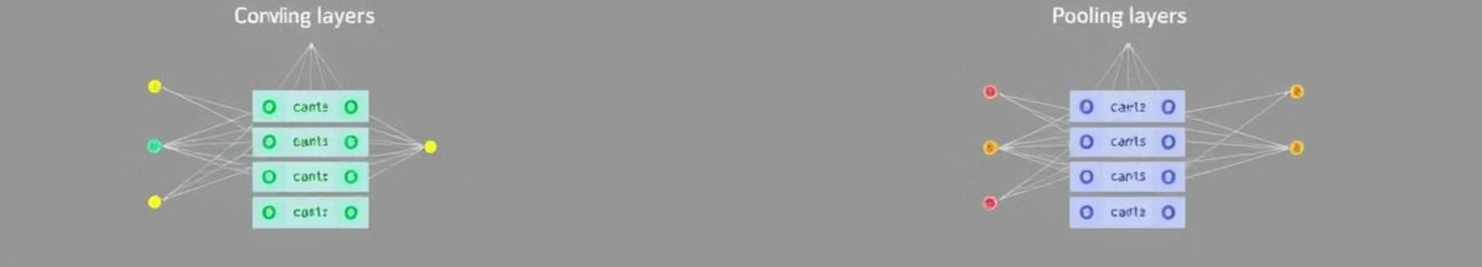




Deep Learning Architectures
The study employs several pre-trained convolutional neural network (CNN) architectures to extract deep features from MRI images. These include VGG19, VGG16, ResNet, MobileNet, and Inception V3. Each model has unique characteristics: VGG19 and VGG16 focus on intricate pattern recognition, ResNet uses skip connections for deeper networks, MobileNet is optimized for mobile devices, and Inception V3 captures multi-scale features.
VGG19/16
ResNet
MobileNet
Inception V3
Deep networks for intricate feature extraction
Residual learning for deeper architectures
Lightweight CNN for efficient processing
Multi-scale feature capture
4

Slide 5
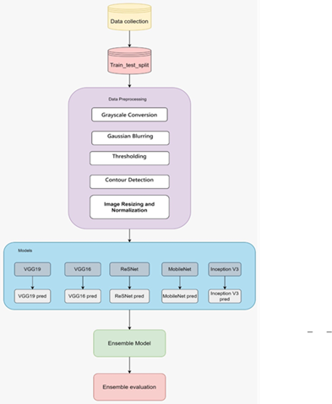
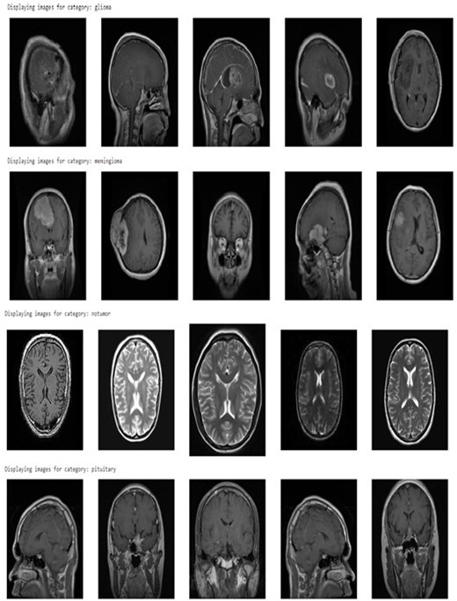
Proposed architecture
Dataset Images
5

Slide 6




Ensemble Learning Techniques
The study incorporates ensemble learning techniques to further improve accuracy. These include XGBoost, AdaBoost, CatBoost, Gradient Boosting Decision Trees (GBDT), and LightGBM. The ensemble model combines predictions from multiple base models, weighted to optimize overall performance. This approach aims to leverage the strengths of different models and mitigate individual weaknesses.
Base Models
Individual deep learning models provide initial predictions
Ensemble Combination
Predictions are combined using weighted averaging
Optimized Output
Final prediction leverages strengths of multiple models
6

Slide 7
Data Collection and Preprocessing
The study utilizes MRI datasets of brain tumors, including glioma, meningioma, pituitary tumors, and non-tumor samples from public repositories. The dataset comprises 7,023 human brain MRI images across four classes. Preprocessing steps include grayscale conversion, Gaussian blurring for noise reduction, binary thresholding for segmentation, and image normalization to ensure consistent input data.
Data Collection
1
Gathering diverse MRI datasets from public repositories
2
Grayscale Conversion
Converting images to grayscale for uniformity
Noise Reduction
3
Applying Gaussian blurring to minimize image noise
4
Segmentation
Using binary thresholding for tumor segmentation
Normalization
5
Scaling pixel values for consistent input data
7

Slide 8
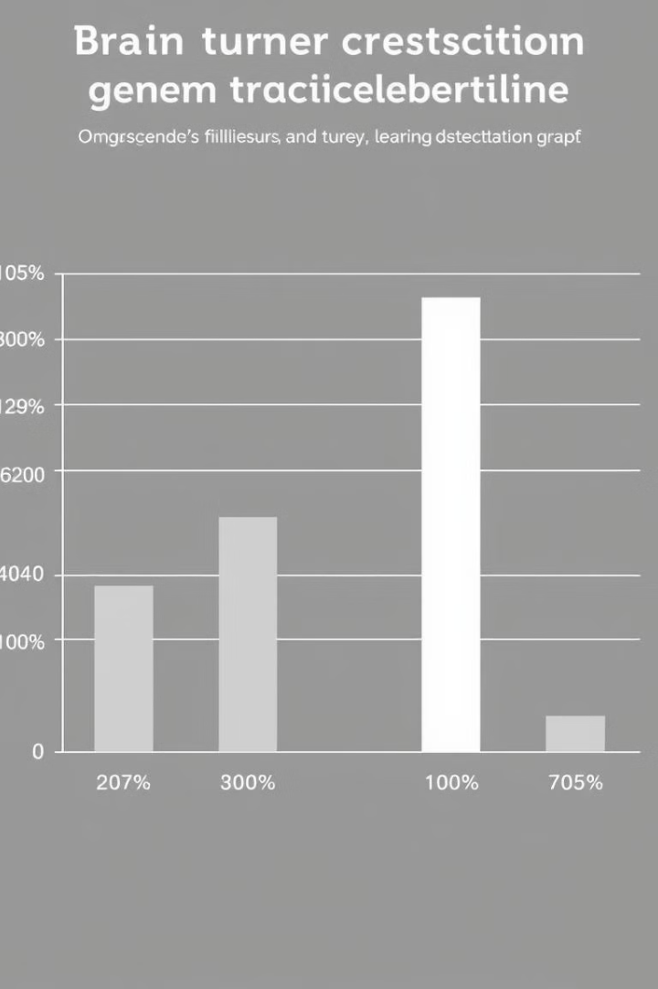

Model Evaluation Results
The study evaluates the performance of different models using metrics such as accuracy, precision, recall, and F1-score. MobileNet achieved the highest accuracy at 94.99%, followed by Inception V3 at 92.42%. VGG19 and VGG16 showed similar performance with accuracies of 87.57% and 87.87% respectively. ResNet had the lowest accuracy at 69.09%. The models generally performed well in detecting non-tumor cases and showed varying performance across different tumor types.
Model
Accuracy
MobileNet
94.99%
Inception V3
92.42%
VGG16
87.87%
VGG19
87.57%
ResNet
69.09%
8

Slide 9
Ensemble Model Performance
The ensemble approach, integrating VGG16, Inception V3, and MobileNet models, demonstrated improved performance across all tumor classes. It achieved high precision, recall, and F1-scores for glioma, meningioma, no tumor, and pituitary tumor categories. The ensemble model showed particular strength in detecting non-tumor cases with 99% accuracy. This approach effectively leveraged the strengths of individual models to provide more reliable tumor detection across all classes.
Glioma
Meningioma
No Tumor
Precision: 0.95 Recall: 0.92 F1-score: 0.93
Precision: 0.90 Recall: 0.92 F1-score: 0.91
Precision: 0.98 Recall: 0.99 F1-score: 0.99
9

Slide 10
Conclusion and Future Directions
The study concludes that ensemble techniques play a crucial role in improving the diagnostic precision of brain tumor detection systems. By integrating multiple deep learning models, the ensemble approach achieved a considerable improvement in tumor identification accuracy. The research emphasizes the importance of carefully selecting and combining models to optimize performance across various tumor types. Future work could focus on expanding the dataset, incorporating more diverse tumor types, and exploring advanced ensemble techniques to further enhance detection accuracy and generalizability.
Ensemble Superiority
Model Selection
Future Research
Combining models improved overall accuracy and reliability in tumor detection.
Careful choice of base models is crucial for ensemble performance.
Expanding datasets and exploring advanced ensemble techniques could further enhance detection systems.
10

Slide 11
THANK YOU

