Slide 1
Artificial Intelligence UNIT-III

Slide 2
The Wumpus World
The Wumpus World’s agent is an example of a knowledge-based agent that represents Knowledge representation, reasoning and planning.
Knowledge-Based agent links general knowledge with current percepts to infer hidden characters of current state before selecting actions. Its necessity is vital in partially observable environments.

Slide 3
Problem Statement:
The Wumpus world is a cave with 16 rooms (4×4). Each room is connected to others through walkways (no rooms are connected diagonally).
The knowledge-based agent starts from Room[1, 1]. The cave has – some pits, a treasure and a beast named Wumpus. The Wumpus can not move but eats the one who enters its room. If the agent enters the pit, it gets stuck there.
The goal of the agent is to take the treasure and come out of the cave. The agent is rewarded, when the goal conditions are met. The agent is penalized, when it falls into a pit or being eaten by the Wumpus.

Slide 4
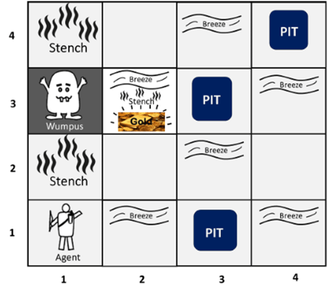
sample diagram for representing the Wumpus world.

Slide 5
components which can help the agent to navigate the cave
The rooms adjacent to the Wumpus room are smelly, so that it would have some stench.
The room adjacent to PITs has a breeze, so if the agent reaches near to PIT, then he will perceive the breeze.
There will be glitter in the room if and only if the room has gold.
The agent is given one arrow which it can use to kill the wumpus when facing it (Wumpus screams when it is killed).

Slide 6
PEAS description of Wumpus world:
Performance measure:
+1000 reward points if the agent comes out of the cave with the gold.
-1000 points penalty for being eaten by the Wumpus or falling into the pit.
-1 for each action, and -10 for using an arrow.
The game ends if either agent dies or came out of the cave.

Slide 7
Continue..
Environment:
A 4*4 grid of rooms.
The agent initially in room square [1, 1], facing toward the right.
Location of Wumpus and gold are chosen randomly except the first square [1,1].
Each square of the cave can be a pit with probability 0.2 except the first square.

Slide 8
Continue..
Actuators:
Left turn,
Right turn
Move forward
Grab
Release
Shoot.

Slide 9
Continue..
Sensors:
The agent will perceive the stench if he is in the room adjacent to the Wumpus. (Not diagonally).
The agent will perceive breeze if he is in the room directly adjacent to the Pit.
The agent will perceive the glitter in the room where the gold is present.
The agent will perceive the bump if he walks into a wall.
When the Wumpus is shot, it emits a horrible scream which can be perceived anywhere in the cave.
These percepts can be represented as five element list, in which we will have different indicators for each sensor.
Example if agent perceives stench, breeze, but no glitter, no bump, and no scream then it can be represented as: [Stench, Breeze, None, None, None].

Slide 10
The Wumpus world Properties:
Partially observable: The Wumpus world is partially observable because the agent can only perceive the close environment such as an adjacent room.
Deterministic: It is deterministic, as the result and outcome of the world are already known.
Sequential: The order is important, so it is sequential.
Static: It is static as Wumpus and Pits are not moving.
Discrete: The environment is discrete.
One agent: The environment is a single agent as we have one agent only and Wumpus is not considered as an agent.

Slide 11
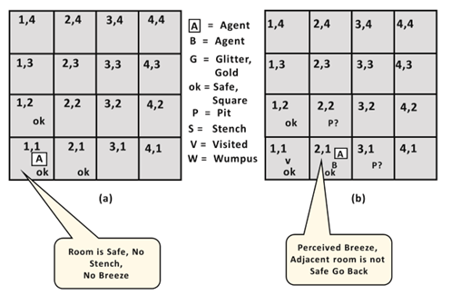
Exploring the Wumpus world:

Slide 12
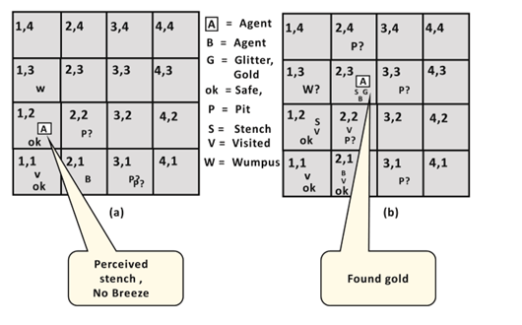

Slide 13
Knowledge base for Wumpus world in Artificial intelligence
Atomic proposition variable for Wumpus world:
Let P_{i,j} be true if there is a Pit in the room [i, j].
Let B_{i,j} be true if agent perceives breeze in [i, j], (dead or alive).
Let W_{i,j} be true if there is wumpus in the square[i, j].
Let S_{i,j} be true if agent perceives stench in the square [i, j].
Let V_{i,j} be true if that square[i, j] is visited.
Let G_{i,j} be true if there is gold (and glitter) in the square [i, j].
Let OK_{i,j} be true if the room is safe.

Slide 14
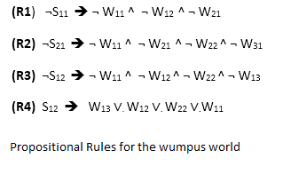
[Note: There will be 7*4*4= 112 propositional variables for a 4 * 4 square board. ]
Some Propositional Rules for the wumpus world:

Slide 15
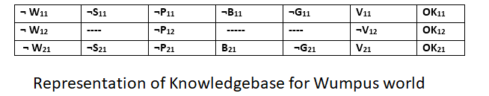
Representation of Knowledgebase for Wumpus world:
The Simple KB for wumpus world when an agent moves from room [1, 1], to room [2,1] is as follows:

Slide 16
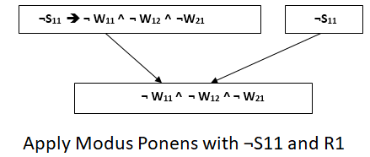
Prove that Wumpus is in the room (1, 3)
We can prove that wumpus is in the room (1, 3) using propositional rules which we have derived for the wumpus world and using inference rule.
Apply Modus Ponens with ¬S11 and R1: At first we will apply MP rule with R1 which is ¬S11 → ¬W11^ ¬W12 ^ ¬W21, and ¬S11 which will give this output ¬ W11 ^ W12 ^ W12

Slide 17
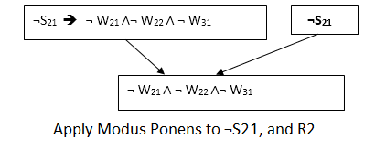
Apply And-Elimination Rule: After we apply And-elimination rule to ¬W₁₁ ∧ ¬W₁₂ ∧ ¬W₂₁, we will see three statements: ¬W₁₁, ¬W₁₂, and ¬W₂₁.
Apply Modus Ponens to ¬S₂₁, and R2: We will now apply Modus Ponens to ¬S₂₁ and R2 which is ¬S₂₁ → ¬W₂₁ ∧¬ W₂₂ ∧ ¬W₃₁, which will give the Output as ¬W₂₁ ∧ ¬W₂₂ ∧ ¬W_{31.}

Slide 18
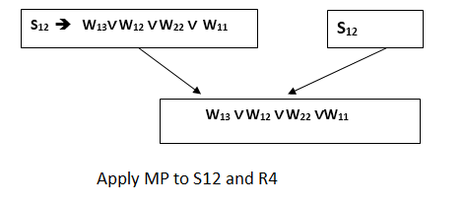
Apply And -Elimination rule: Again we will now apply And-elimination rule to ¬ W21 ∧ ¬ W22 ∧¬ W31, We will see three statements: ¬W₂₁, ¬W₂₂, and ¬W₃₁.
Apply MP to S₁₂ and R4: Apply Modus Ponens to S₁₂ and R4 which is S₁₂ → W₁₃ ∨. W₁₂ ∨. W₂₂ ∨. W₁₁, we will get the output as W₁₃ ∨ W₁₂ ∨ W₂₂ ∨ W₁₁.

Slide 19
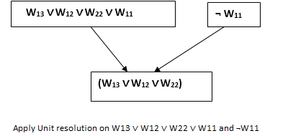
Apply Unit resolution on W₁₃ ∨ W₁₂ ∨ W₂₂ ∨ W₁₁ and ¬W₁₁ : After applying Unit resolution formula on W₁₃ ∨ W₁₂ ∨ W₂₂ ∨ W₁₁ and ¬W₁₁ we will see W₁₃ ∨ W₁₂ ∨ W₂₂

Slide 20
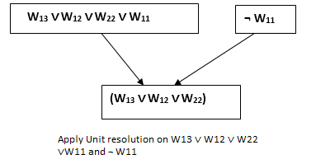
Apply Unit resolution on W₁₃ ∨ W₁₂ ∨ W₂₂ ∨ W₁₁ and ¬W₁₁ : After applying Unit resolution formula on W₁₃ ∨ W₁₂ ∨ W₂₂ ∨ W₁₁ and ¬W₁₁ we will see W13 ∨ W12 ∨ W22.

Slide 21
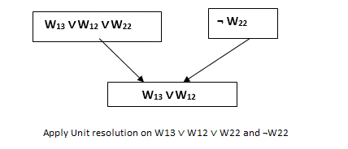
Apply Unit resolution on W₁₃ ∨ W₁₂ ∨ W₂₂ and ¬W₂₂ : After applying Unit resolution on W₁₃ ∨ W₁₂ ∨ W₂₂, and ¬W₂₂, we will get W₁₃ ∨ W₁₂ as output.

Slide 22
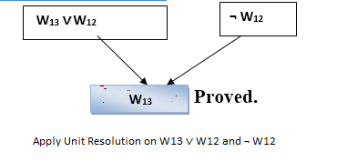
Apply Unit Resolution on W₁₃ ∨ W₁₂ and ¬W₁₂ : After Applying Unit resolution on W₁₃ ∨ W₁₂ and ¬W₁₂, we will see W₁₃ as an output, therefore, it is proved that the Wumpus is in the room [1, 3].

