Slide 1
SOFT SKILLS
211FA04610
G.M.SUDHESHNA

Slide 2
MOJO
PROGRAMMING LANGUAGE

Slide 3
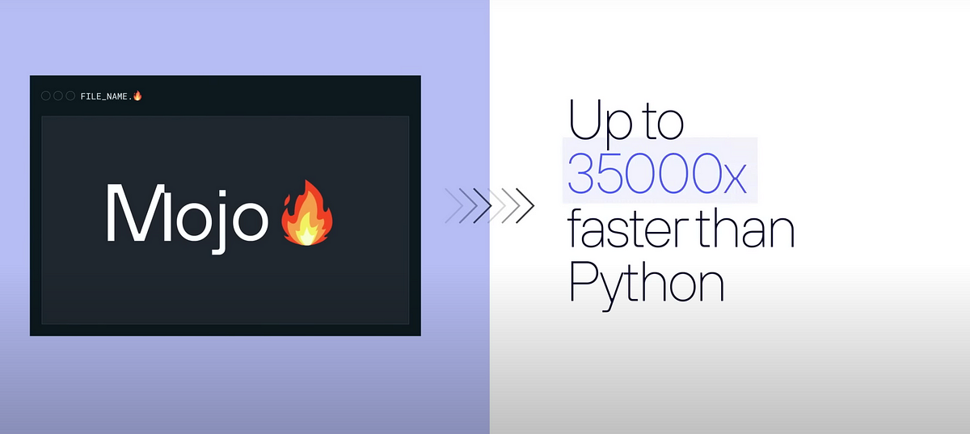

Slide 4
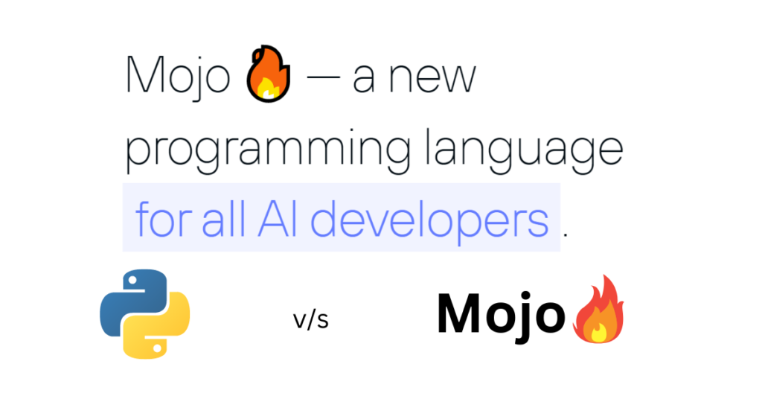
INTRODUCTION :-
Mojo is brand-new programming language that aims to bridge the research and production aspects of software development by combining Python’s syntax with systems programming and meta-programming capabilities.
Some say that Mojo is basically Python++ - a link between the great usability and accessibility of Python and high performance of C.

Slide 5
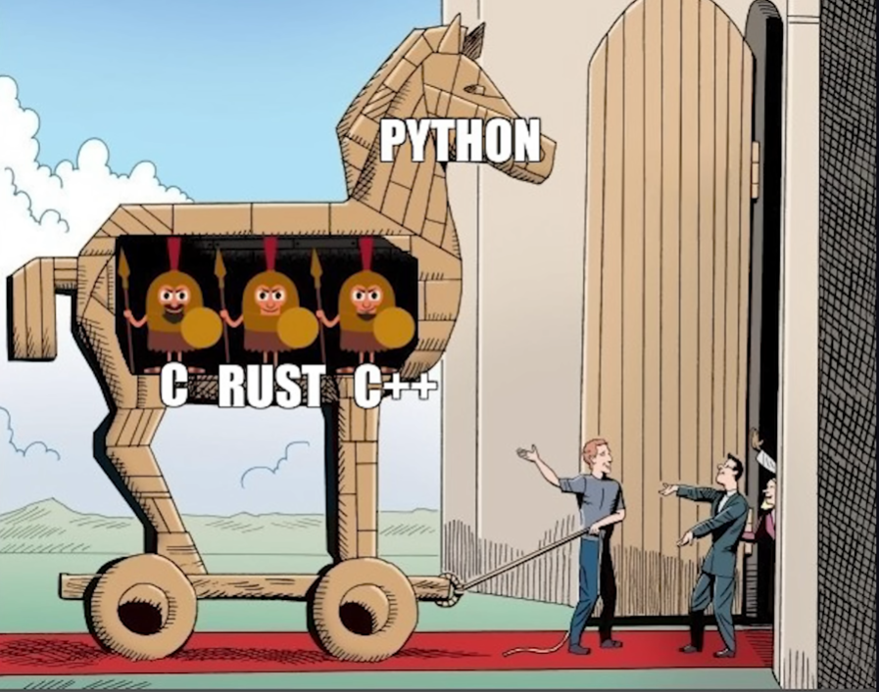

Slide 6
FEATURES OF MOJO :-
Fast Compile Times: Mojo prioritizes fast compilation, allowing developers to iterate quickly, feature contributes to a smoother development experience and faster feedback loops.Overall, Mojo combines these features to deliver a programming language that excels in performance, safety, portability, and developer productivity.
Parallel Heterogeneous Runtime: Mojo supports parallel execution across different hardware architectures. This feature enables efficient utilization of available resources and boosts performance in multi-device or distributed computing scenarios.
Interoperability : Developers can seamlessly intermix popular libraries such as Numpy and Matplotlib with their Mojo code. This integration allows them to harness the powerful array manipulation capabilities of Numpy or create visually appealing plots with Matplotlib, all within the Mojo programming environment.

Slide 7
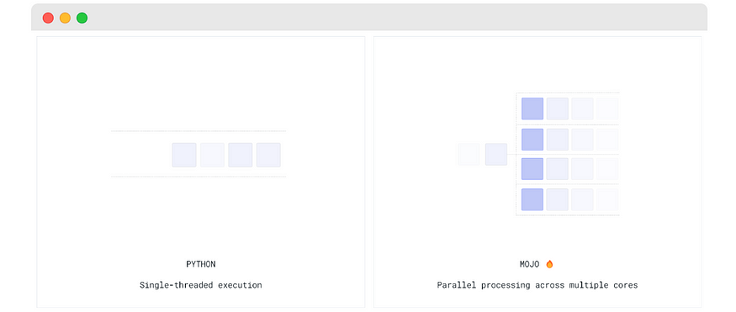
Parallel Processing :-

Slide 8
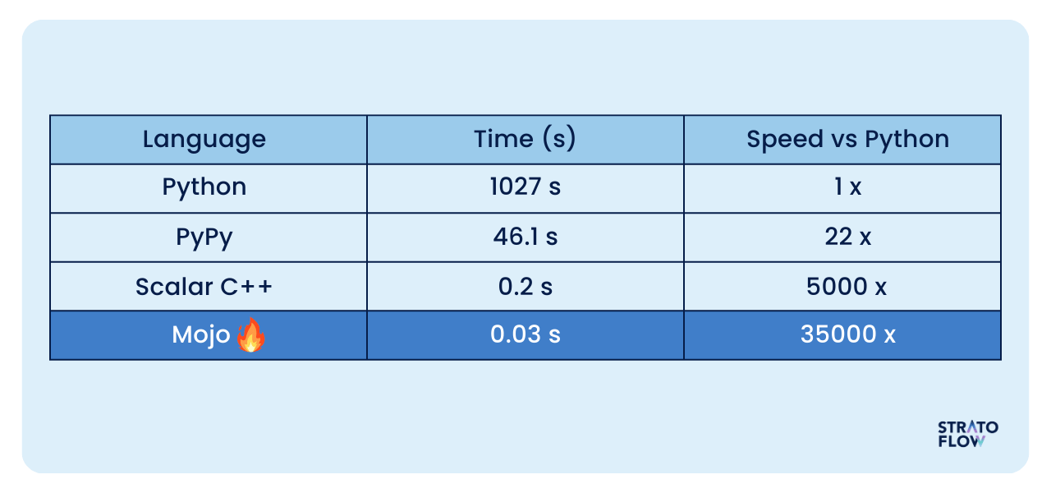

Slide 9
ADVANTAGES :-
Conciseness and Readability: Mojo Lang emphasizes clean and expressive code, allowing developers to write programs that are easy to read and understand. Its syntax is designed to be concise, reducing unnecessary verbosity and promoting code clarity.
Versatility and Flexibility: Mojo Lang supports multiple programming paradigms, including object-oriented, functional, and procedural programming. This versatility enables developers to choose the most suitable approach for their specific needs, fostering code reusability and adaptability.
Memory Management: Mojo Lang employs automatic memory management through garbage collection, alleviating the burden of manual memory allocation and deallocation. This feature enhances code robustness and reduces the risk of memory leaks and other related issues.

Slide 10
DISADVANTAGES : -
New language: Mojo is still a relatively new language, which means that documentation and support resources may be more limited compared to widely used languages like Python. However, as more information becomes available about Mojo’s potential, you can expect the availability of resources to increase. You can refer to the documentation here.
Less widespread usage: Mojo is not as popular as Python yet, and it is still in the early access stage. Consequently, the number of available libraries and tools may be somewhat limited. Nevertheless, the Mojo community is growing every day, and new features and resources are being developed, so there is no doubt that it will offer more options in the future.

Slide 11
Applications of Mojo :-
Web Development
Data Analysis and Visualization
Automation and Scripting
Game Development
Internet of Things
Scientific Computing
Automation Testing
Education and Learning

Slide 12
FAQs :
Is Mojo suitable for beginners in programming?
Can Mojo be used for large-scale entreprise application ?
What advantages does Mojo offer over other progrogramming languages ?
Why Mojo file have extension as🔥(fire symbol) , is there any alternative extension ?

Slide 13
CONCLUSION : -
The Mojo programming language is still in development ,but what’s available is already mind-blowing.
We will have one question : Will it kill Python and C at the same time ?
We’re a little skeptical at this point , but only time will tell.
Regardless , Mojo will be an incredibly powerful tool in the hands of Python Developers, offering immense benefits for digital transformation, especially when introducing new AI-based solutions

Slide 14
THANK YOU

