Slide 1
Map-Reduce Programming
-Ref: Hadoop in Action Ch 4

Slide 2
DataSet
http://www.nber.org/patents/
Download
1. acite75_99.zip
2. apat63_99.zip

Slide 3
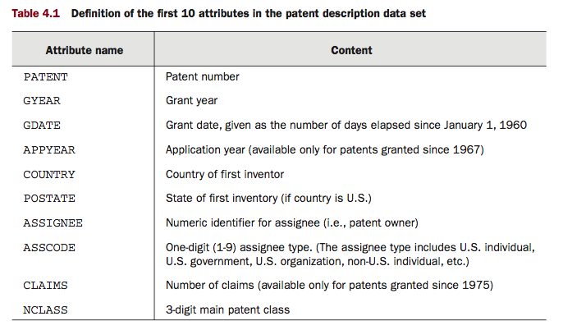

Slide 4
Map Reduce Code
Main Class
- Map Class
- Reduce Class
- Run method
- Main method

Slide 5
Run method
Specify :
- Configuration
- Input/Output File Path
- Input/Output File Format
- Mapper/Reducer Class
- Key/Value Format

Slide 6
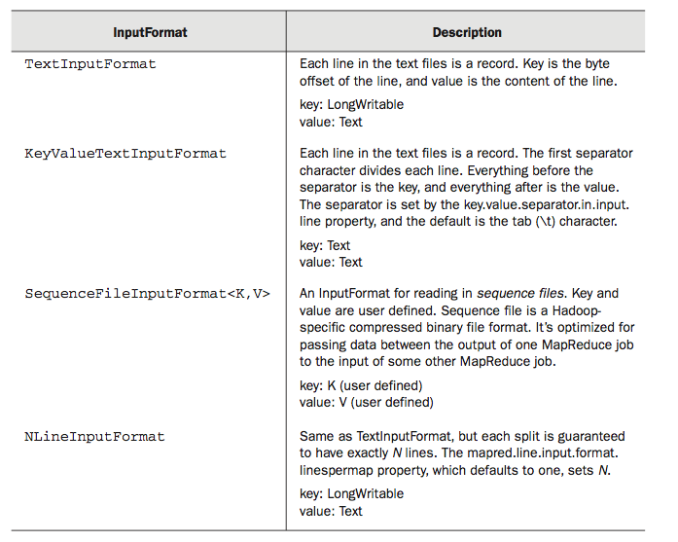

Slide 7
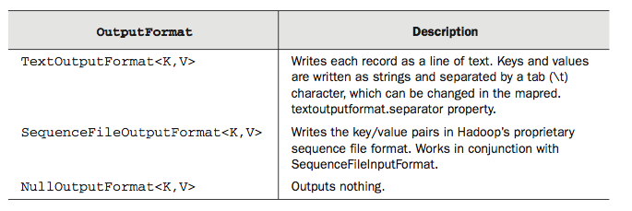

Slide 8
Template
public class MyJob extends Configured implements Tool {
public static class MapClass extends MapReduceBase implements Mapper<Text, Text, Text, Text> {
public void map(Text key, Text value, OutputCollector<Text, Text> output, Reporter reporter) throws IOException {
//Mapper Code here
}
}
public static class Reduce extends MapReduceBase implements Reducer<Text, Text, Text, Text> {
public void reduce(Text key, Iterator<Text> values, OutputCollector<Text, Text> output, Reporter reporter) throws IOException {
//Reducer Code here
}
}
public int run(String[] args) throws Exception {
Configuration conf = getConf();
JobConf job = new JobConf(conf, MyJob.class);
Path in = new Path(args[0]);
Path out = new Path(args[1]);
FileInputFormat.setInputPaths(job, in);
FileOutputFormat.setOutputPath(job, out);
job.setJobName("MyJob");
job.setMapperClass(MapClass.class);
job.setReducerClass(Reduce.class);
job.setInputFormat(KeyValueTextInputFormat.class);
job.setOutputFormat(TextOutputFormat.class);
job.setOutputKeyClass(Text.class);
job.setOutputValueClass(Text.class);
job.set("key.value.separator.in.input.line", ",");
JobClient.runJob(job);
return 0; }
public static void main(String[] args) throws Exception {
int res = ToolRunner.run(new Configuration(), new MyJob(), args);
System.exit(res);
}
}

Slide 9
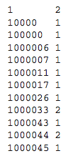
Problem Statement
For the patent citation data, we may want the number of citations a patent has received.
Output :

Slide 10
Map Class
public static class MapClass extends MapReduceBase implements Mapper<Text, Text, Text, Text> {
public void map(Text key, Text value, OutputCollector<Text, Text> output, Reporter reporter) throws IOException {
output.collect(value, key);
}
}

Slide 11
Reduce Class
public void reduce(Text key, Iterator<Text> values,OutputCollector<Text, IntWritable> output, Reporter reporter) throws IOException {
int count = 0;
while (values.hasNext()) {
values.next();
count++;
}
output.collect(key, new IntWritable(count));
}

Slide 12
Joining In Hadoop

Slide 13
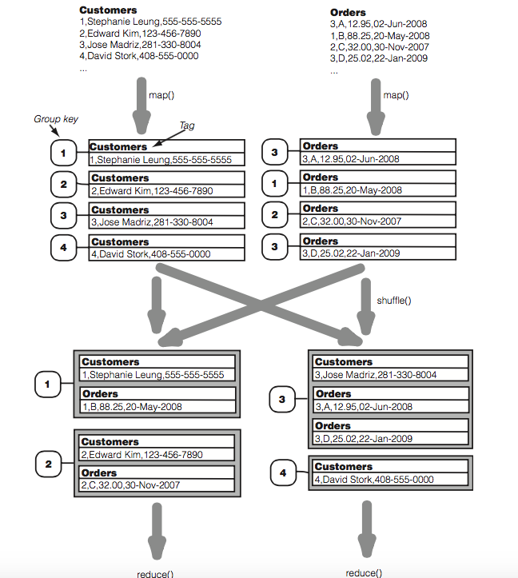

Slide 14
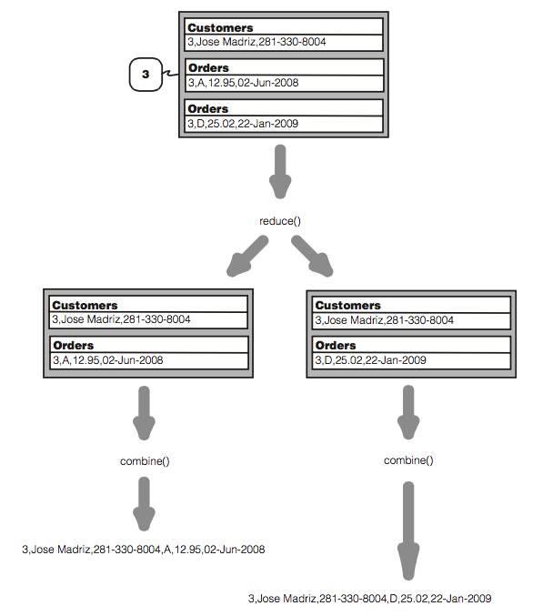

Slide 15
Classes to Use
DataJoinMapperBase
DataJoinReducerBase
TaggedMapOutput

Slide 16
DataJoinMapperBase
protected abstract Text generateInputTag(String inputFile);
protected abstract TaggedMapOutput generateTaggedMapOutput(Object value);
protected abstract Text generateGroupKey(TaggedMapOutput aRecord);

Slide 17
DataJoinReducerBase
Combine()
protected abstract TaggedMapOutput combine(Object[] tags, Object[] values);
tags = {"Customers", "Orders"};
values = {"3,Jose Madriz,281-330-8004", "A,12.95,02-Jun-2008"};

