Slide 1
Web Design Project NU BOX
Varun Murthy
Mansi Shamsingh Raghuwanshi
Mahalakshmi Arunachalam
Akash Bangera

Slide 2
Description
An online shopping website designed using Angular 5 with Spree API.
The website has wide range of products divided amongst different categories
Users can login and order the products, view their orders.
State of the application is maintained browsing between different projects

Slide 3
Technologies used
Angular 5
REST API
BootStrap
SCSS
Spree API

Slide 4
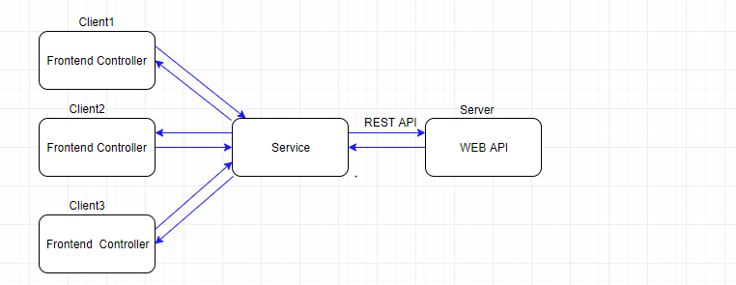
The Workflow

Slide 5
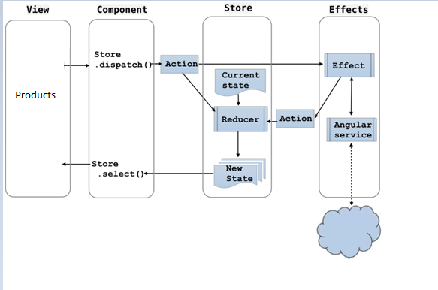
Architecture

Slide 6
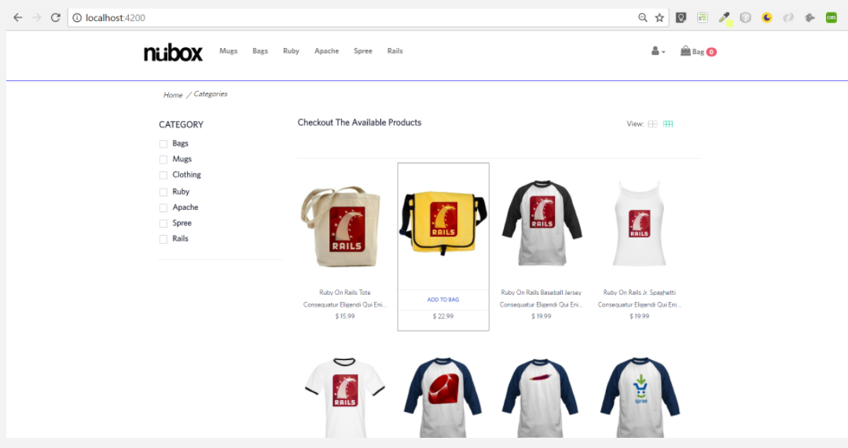
Screenshots of the E-commerce Site Home Page

Slide 7
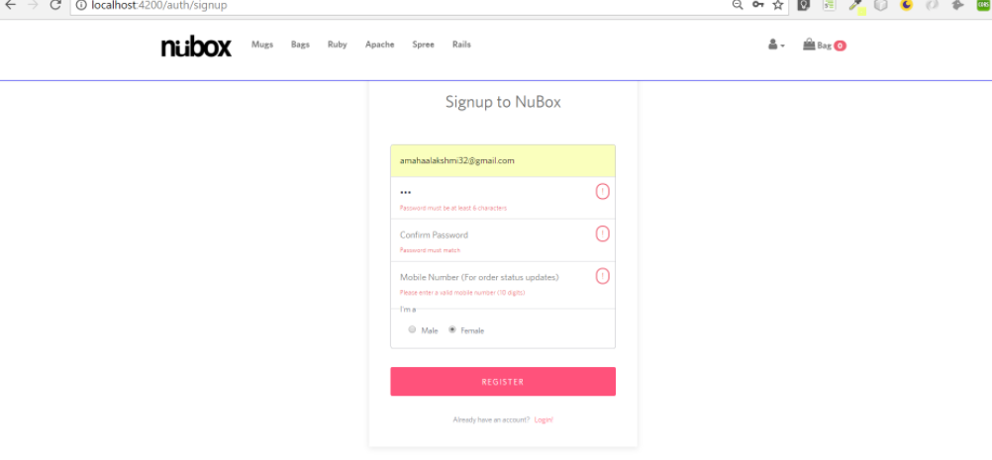
Login Page

Slide 8
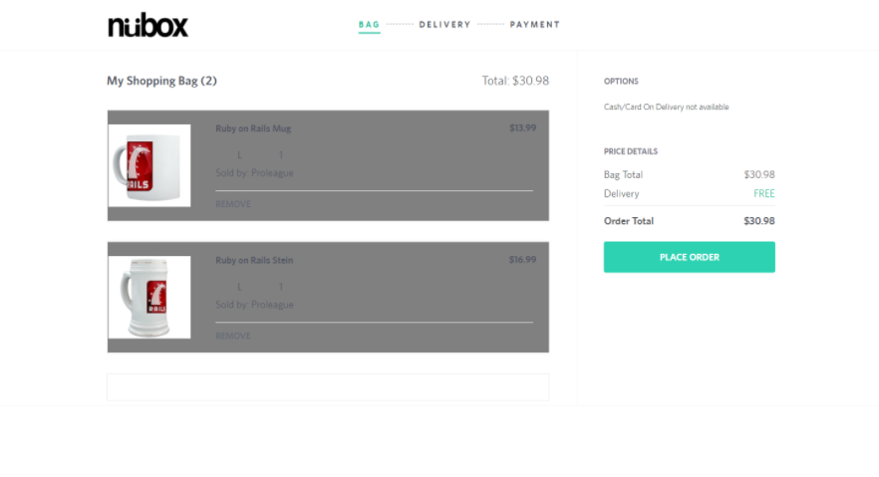
Cart

Slide 9
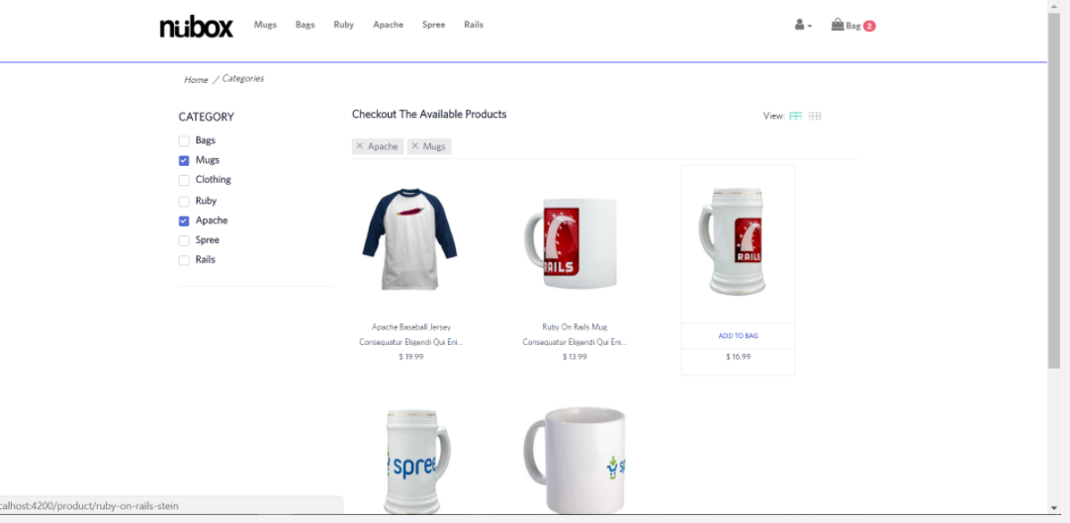
Search and filter for products

Slide 10
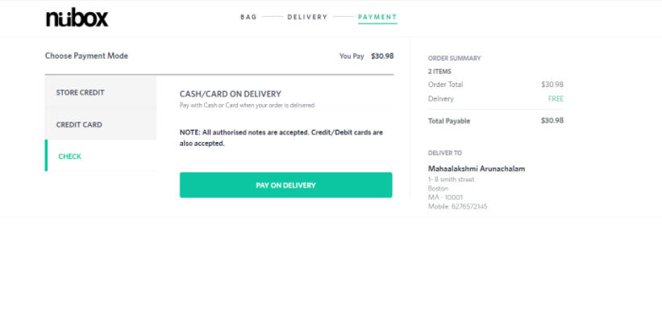
Order Added

Slide 11
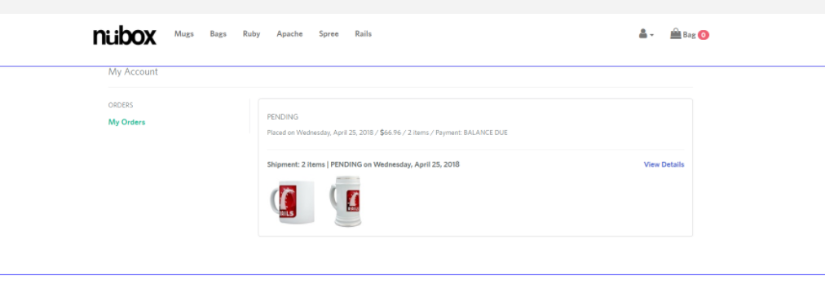
My orders

Slide 12
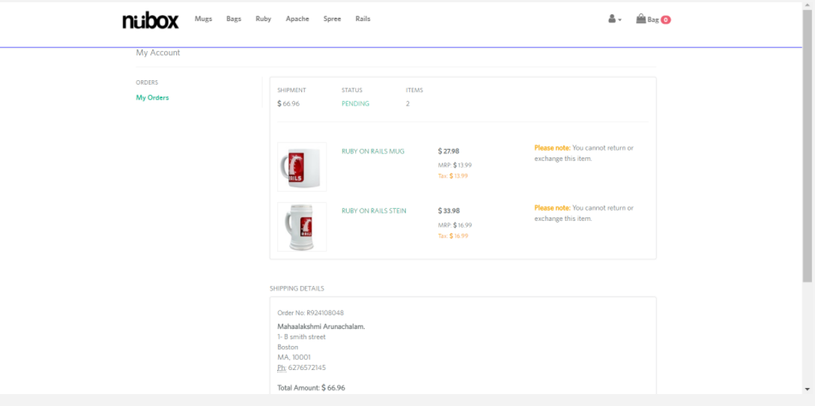
My orders after payment

Slide 13
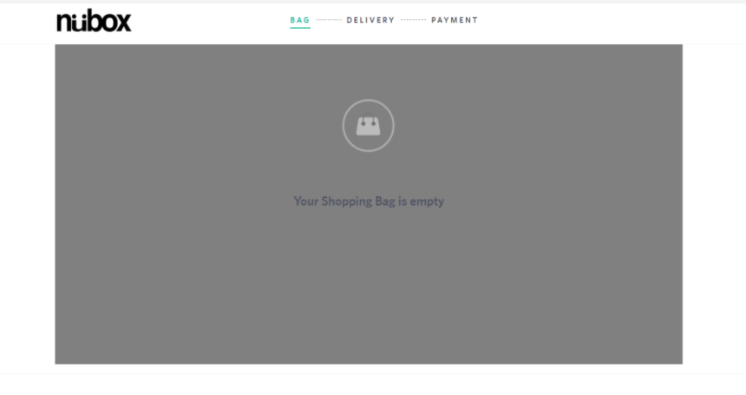
Remove from the cart

Slide 14
Thank you

