Slide 1
SPEECH TO SIGN LANGUAGE TRANSLATION
Under the guidance of
Dr.Ch.Meher Babu
Project Associates
K.MahaLakshmi (20KT1A4223)
Sarah Crysolite.P (20KT1A4249)
K.B.V.subramayeswara reddy (21KT5A4201)

Slide 2
Introduction
Speech to sign language translation (SSLT) is a technology that helps people who use spoken language communicate with those who use sign language. For people who are deaf or hard of hearing, sign language is important for talking and understanding others. But when someone speaks to them, it can be hard to understand without an interpreter. SSLT solves this by turning spoken words into sign language in real-time.
. It uses advanced technology like machine learning and computer vision to understand spoken words and translate them into sign language gestures accurately. While SSLT has made progress, there are still challenges, like making sure the translation is accurate and fast, and handling the complexity of sign language.

Slide 3
Dataset
The data have been collected from internet resources like kaggle dataset(include),youtube. The ISL dataset consists the sing gesture videos.
Links :
https://www.kaggle.com/datasets/daskoushik/include
https://www.kaggle.com/datasets/harsh0239/isl-indian-sign-language-video-dataset?rvi=1

Slide 4
Methodologies
The speech-to-sing language translator transforms audio and generates visual motions based on input. We utilized the voice-to-text API to transform the speech from the microphone to text. The converted text was processed using nltk techniques such as tokenization and lemmatization. If the appropriate text is found in the database, it will generate a video of sing gestures. If not, it combines the various letters into sign motions for a word. It also generates sing gestures for sentences by combining the individual word sing gestures into a single movie. We utilized Flask for the web interface to connect with the user.

Slide 5
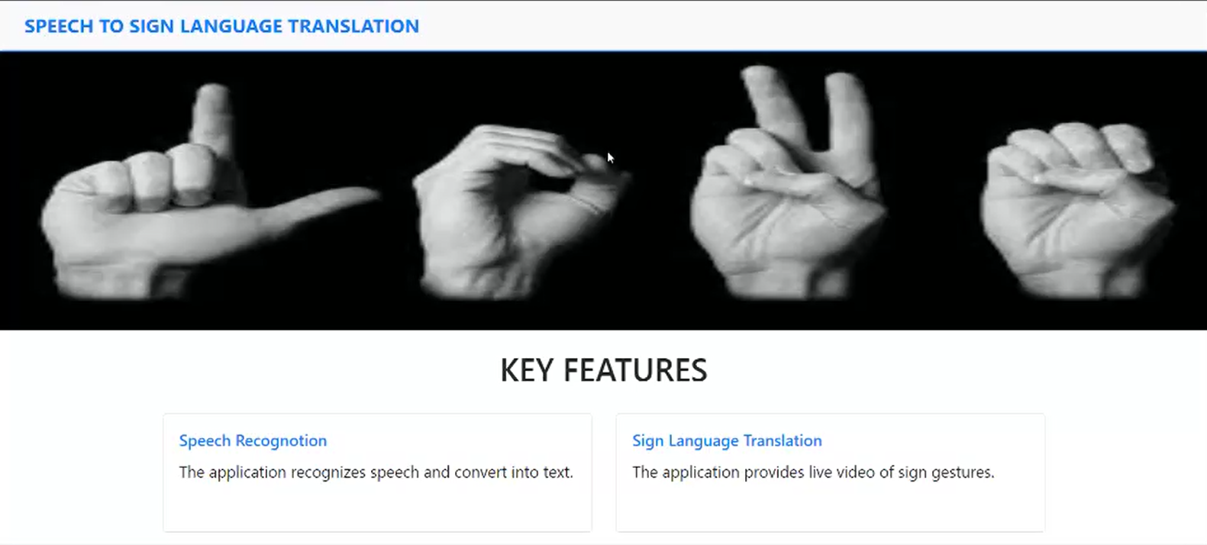
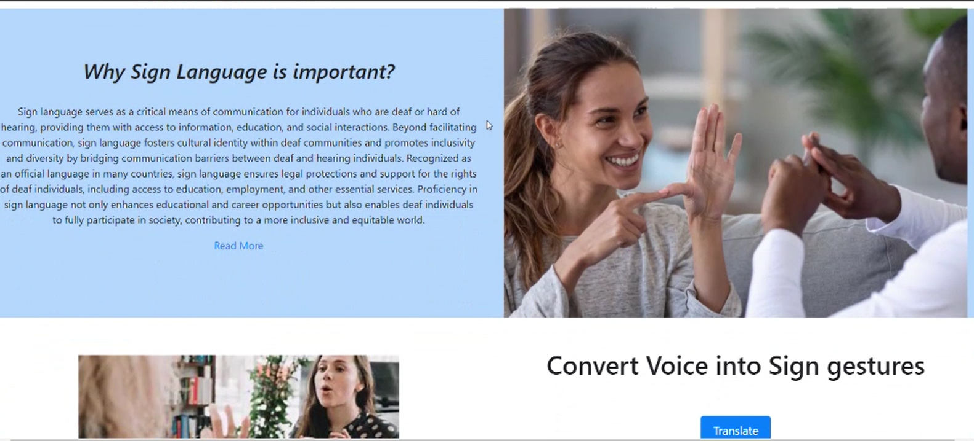
Overview of Project The SSLT can convert real-time speech's from the microphone into text and, using the text, get videos of sign gestures from the ISL database. We used flask to implement the website. By clicking the "translate" button, we can record our voice and the sign gestures video will be produced based on the speech. The accuracy is 80 percent.

Slide 6
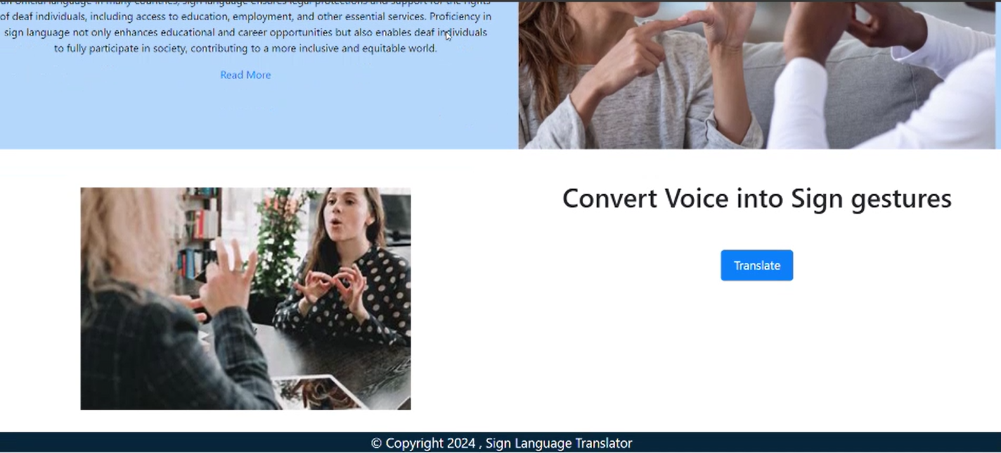
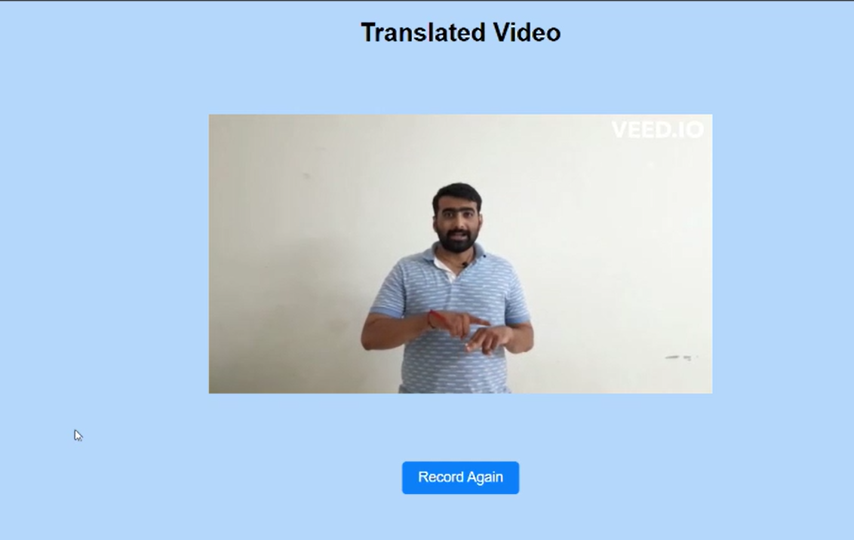

Slide 7
Conclusion
People who are deaf or dumb use sign language to express what they wish to say. For those who are deaf or dumb, it serves as a fundamental form of communication; without it, interactions with regular people may be challenging. In order to enable interaction with deaf people, the main goal of this study is to design an automated software system that translates voice to sign language gestures.

