Slide 1
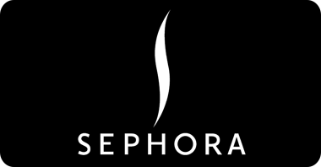
Maha AlHarqan
Intern At SDAIA BootCamp T5
EDA Project

Slide 2
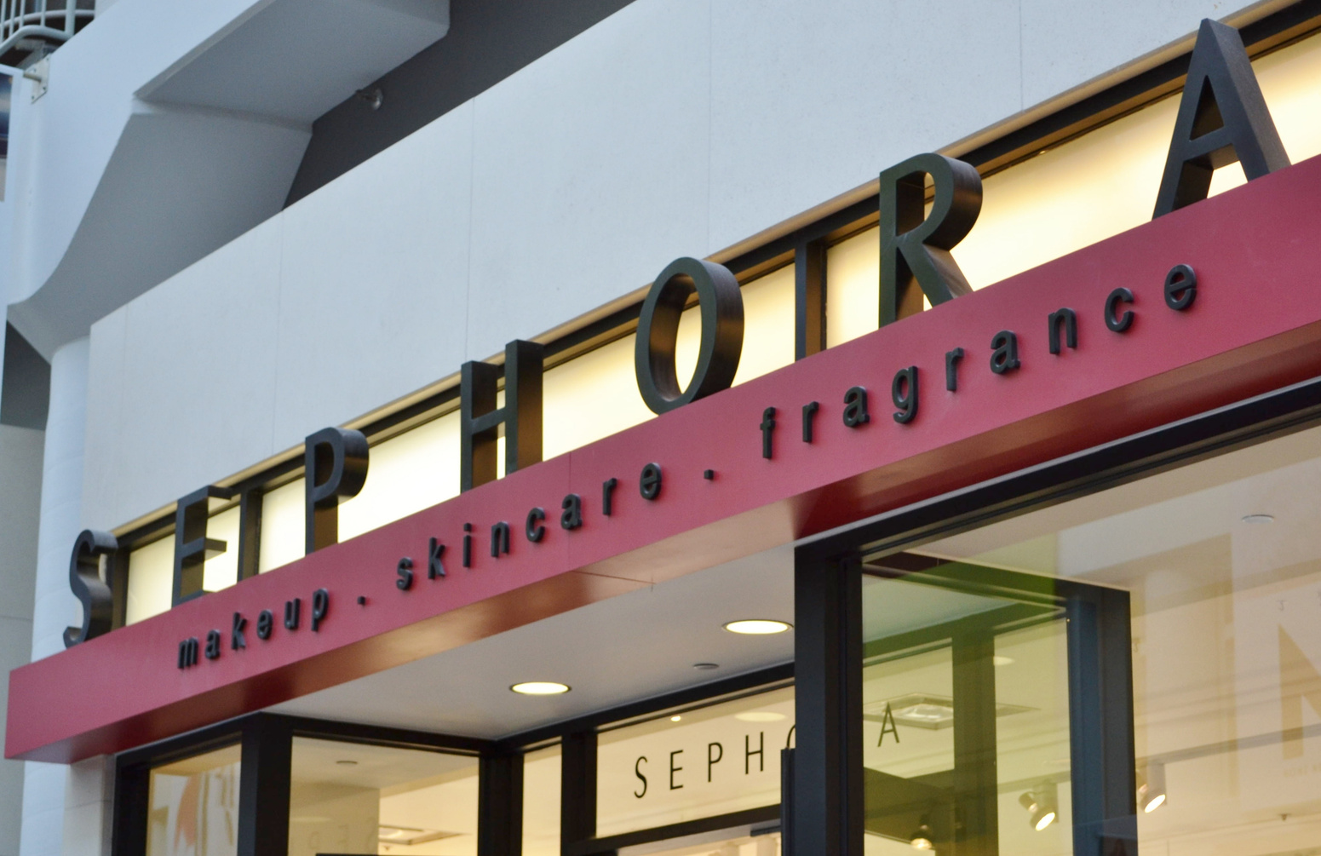
AGENDA
- Sephora Overview
- Sephora Website
- Frequently Asked Questions
- About the Dataset & Tools
- Algorithms
-Conclusion

Slide 3
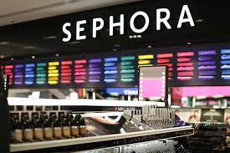
SEPHORA OVERVIEW
It is a French multinational chain of personal care and beauty stores.
Featuring nearly 3,000 brands, along with its own brand,
Sephora provides beauty products including cosmetics, skin care, body, fragrances, nail polish colours, beauty tools, and hair care.

Slide 4
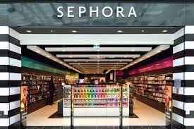
Sephora was founded in 1973
Sephora currently operates more than 2,300 stores in 33 countries around the world
Sephora launched its online store to the US in 1999,
in 2016, Sephora launched its own app for tablets and smartphones

Slide 5
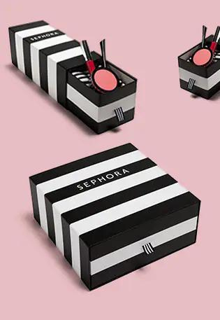
SEPHORA WEBSITE
Sephora is one of the most popular online shopping sites
Accordingly, we have collected and analyzed website data to answer the most frequently asked questions

Slide 6
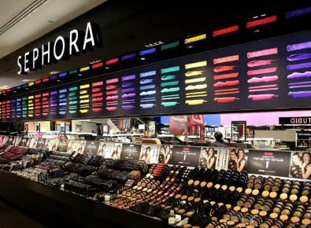
FREQUENTLY ASKED QUESTIONS
- What is the most loved product by people
at Sephora ?
- How many Sephora products have a rating of 5.0 ?
- What is the most popular category of products at Sephora website ?
- What is the most expensive product on Sephora website ?

Slide 7
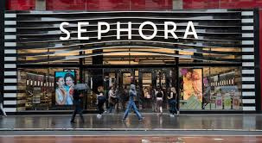
ABOUT THE DATASET & TOOLS
Dataset Titel : Sephora website
Taken : Keggel website
The data contains: 9168 rows, 21 columns
This data set is completely cleaned ,
But we encountered a difficulty because
it contains many columns
and is also similar
Tools :
" Numpay, Matplotlib, Pandas" Of course the work will be done through" Jupyter" notebook

Slide 8
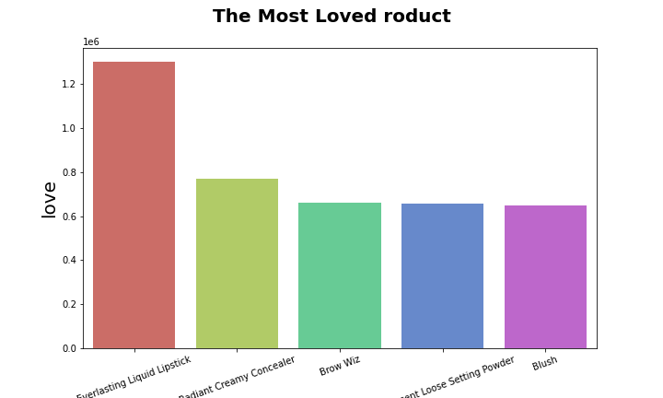
1 . WHAT IS THE MOST LOVED PRODUCT BY PEOPLE AT SEPHORA ?
08
After looking at the graph
We found that "Everlasting Liquid Lipstick" is the most preferred product by people Get 1,300,000 likes

Slide 9
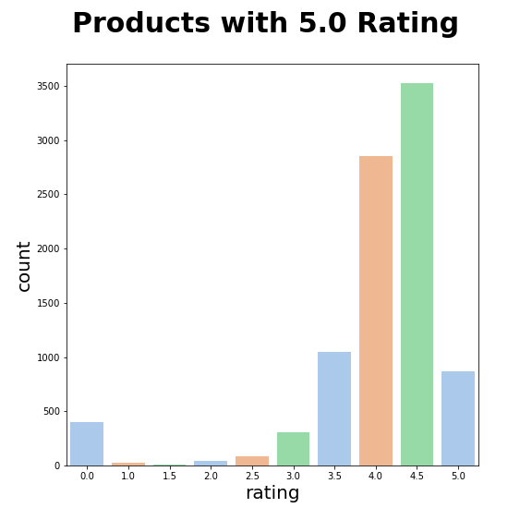
HOW MANY SEPHORA PRODUCTS HAVE A RATING OF 5.0 ?
Through the following chart, we found that there are
about 872 products that have a rating of 5.0,
we also noticed that there are 3527 products that have a
rating of 4.5

Slide 10
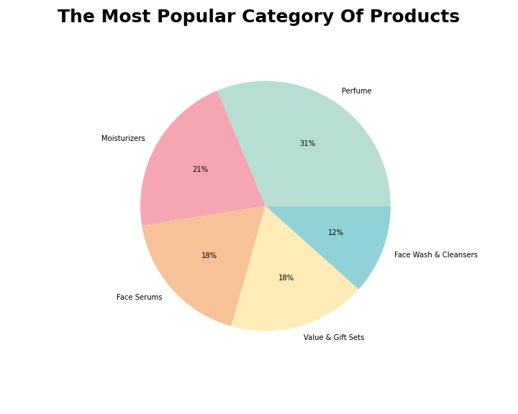
WHAT IS THE MOST POPULAR CATEGORY OF PRODUCTS AT SEPHORA WEBSITE ?
After looking at the graph,
We found that the most popular category with products on
Sephora is "perfumes" with approximately 665 products,
followed by "Moisturizers" with 451 products

Slide 11
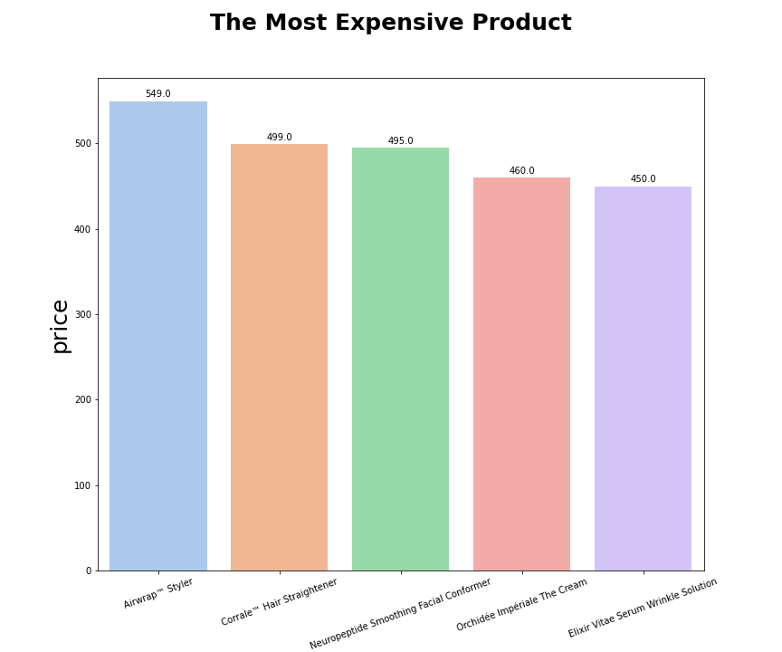
WHAT IS THE MOST EXPENSIVE PRODUCT ON SEPHORA WEBSITE ?
From the following chart it is clear to us that the
most expensive product
is “Airwrap™ Styler” at 549.0

Slide 12
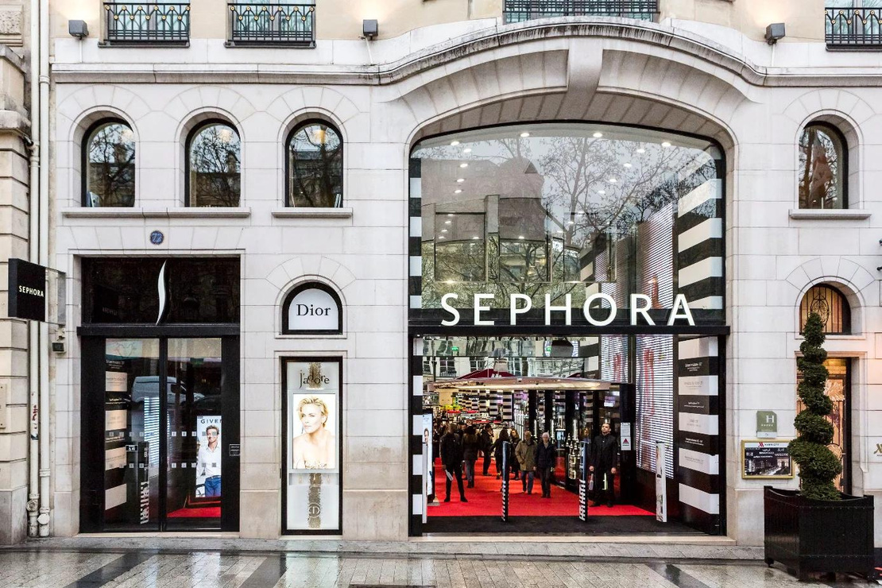
Conclusion
- Sephora is one of the best shopping destinations in the world
- It has many categories , and many highly rated products, which are preferred by many people.
- Improving customer experience
- Get more revenue
Notes:
Sephora is one of the best shopping sites in the world, because it contains many categories and many high-quality products, and it is preferred by many people.

