Slide 1
NET-352 Lab 10 – Implement EtherChannel

Slide 2
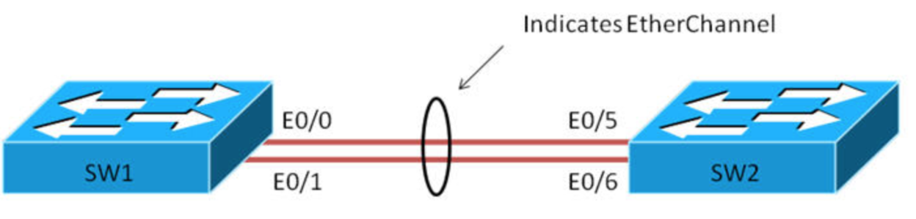
EtherChannel
Link Aggregation, commonly known as EtherChannel, is a networking process that allows you to bundle several physical network links into a single logical link.

Slide 3
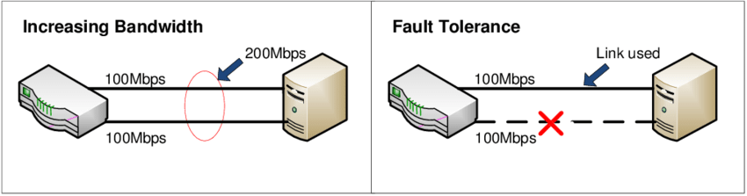
Objectives of EtherChannel
1. Redundancy
If one of the aggregated links fails, the traffic is automatically shifted to the remaining operational links.
2. Increased Bandwidth
For example, if you combine four 1Gbps links, you can achieve a combined bandwidth of 4Gbps

Slide 4
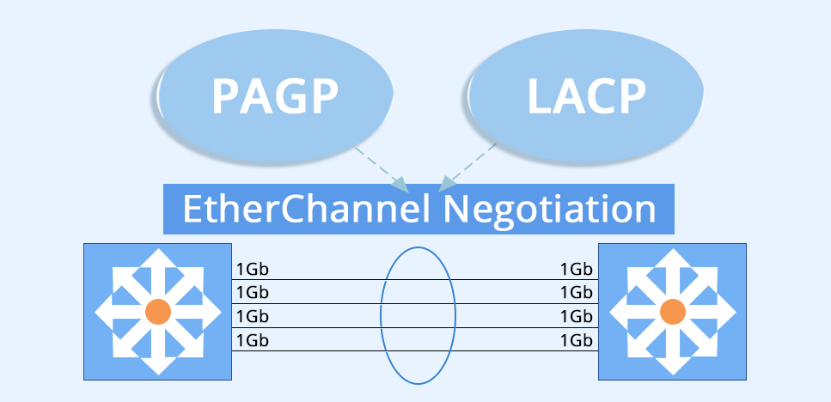
EtherChannel Protocols
LACP (Link Aggregation Control Protocol) is one of the protocols used to establish EtherChannels.
It is an open standard, meaning it is not vendor-specific, and is defined under IEEE 802.3ad.
This contrasts with PAgP (Port Aggregation Protocol), which is a Cisco proprietary protocol.
Notes:
to determine the best path for data to travel from one router to another within the network.

Slide 5
LACP Protocol
In LACP, you can configure a maximum of 16 ports into a single bundle. However, only 8 of these can be active at one time.
If one of the active links fails, a standby link takes its place, ensuring no loss of service. This standby mechanism is specific to LACP and is not available with PAgP.
Notes:
to compute the shortest path to a destination. To do this effectively, the algorithm requires a complete view of the network topology

Slide 6
LACP Protocol (cont’d)
For EtherChannel to work correctly, all the physical links that are aggregated should have the same speed, duplex setting, and other interface configurations.
Notes:
to compute the shortest path to a destination. To do this effectively, the algorithm requires a complete view of the network topology

