Slide 1
NET-257 Lab 6 – IPv6 Addressing

Slide 2
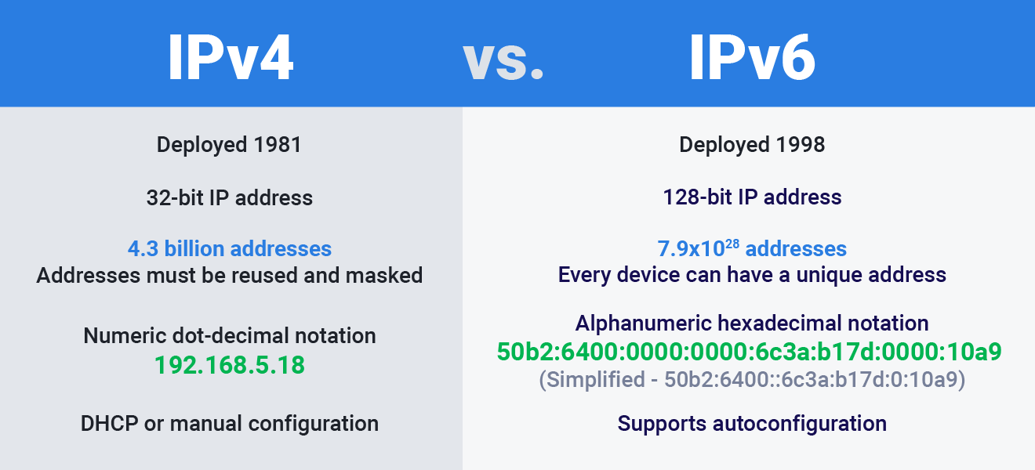
Why Use IPv6 Addresses?

Slide 3
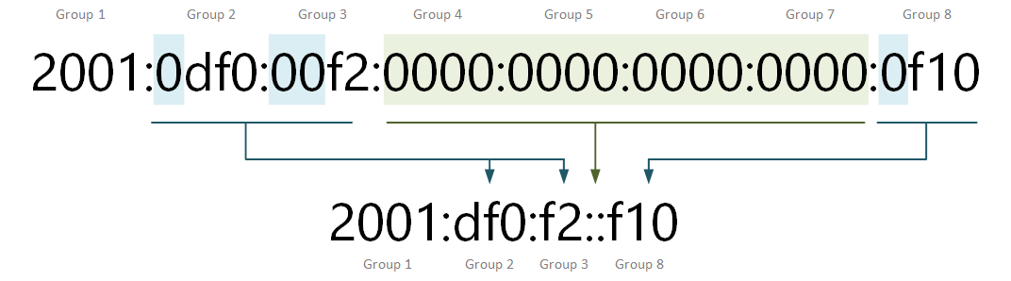
IPv6 Addresses Compression

Slide 4
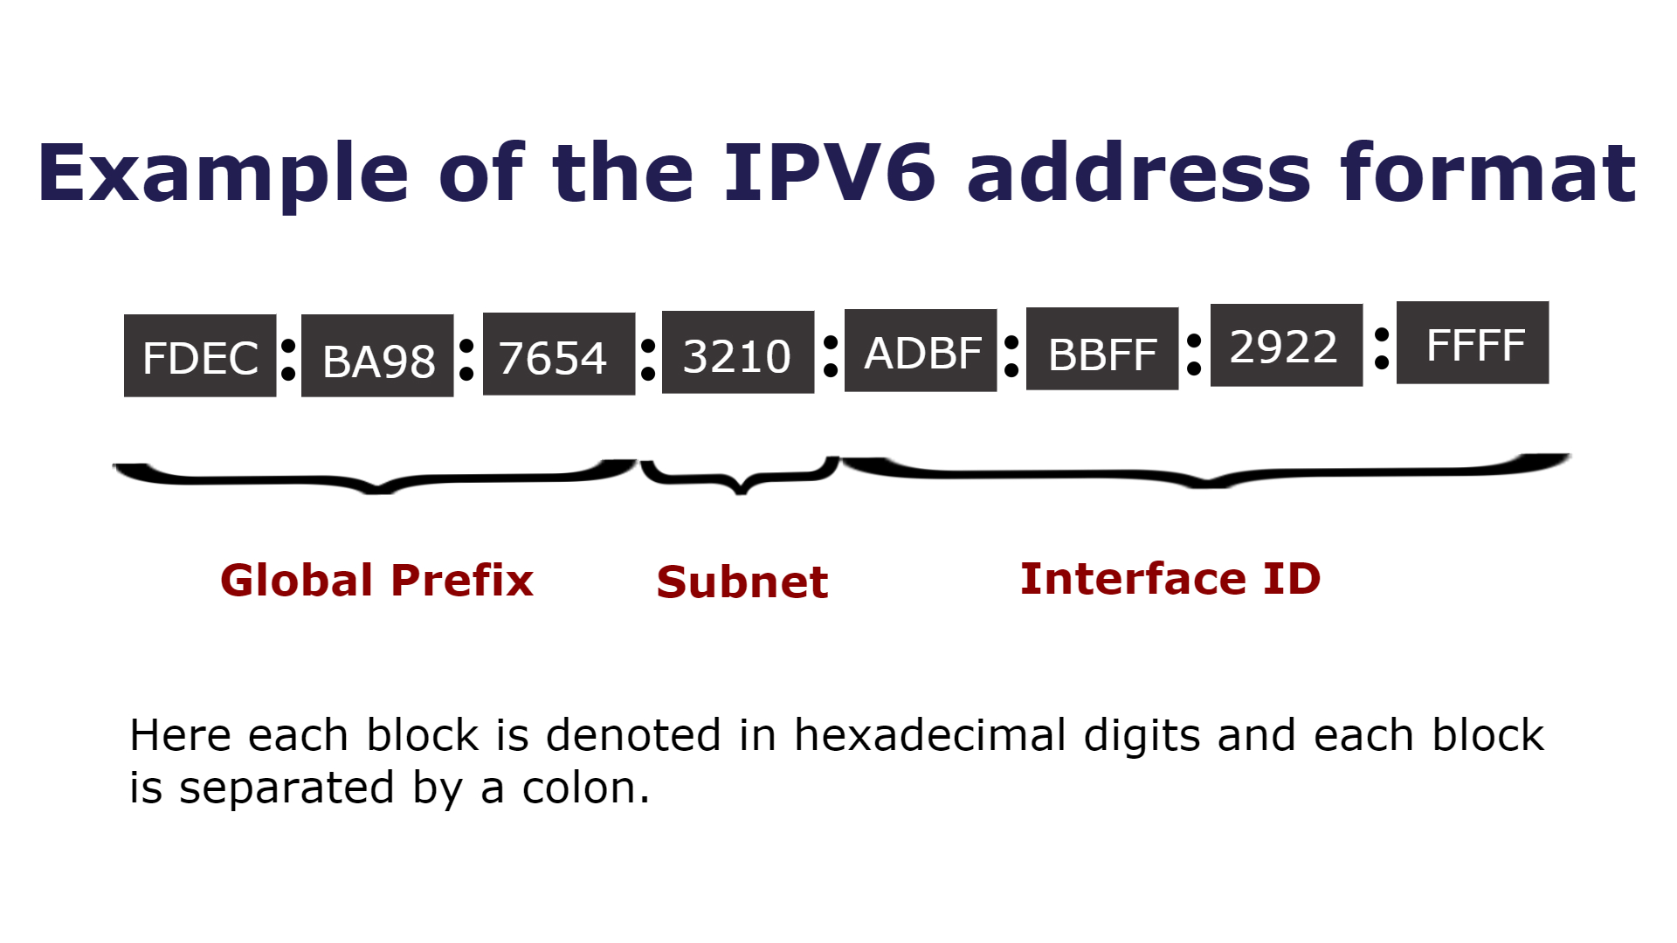
Components of IPv6 Address

Slide 5
Components of IPv6 Address (cont’d)
Recommended prefix length /64
Global routing prefix is assigned by ISP
Notes:
In IPv6, routers send Router Advertisements (RAs) to communicate various pieces of information to hosts, including the presence of the router on the network. When a device receives an RA from a router, it learns about the link-local address of the router and sets it as the default gateway for IPv6 traffic.

Slide 6
IPv6 Addresses
Loopback address
::1
Test internal IP stack
Unique-local address
fd00::/8
for local communications
Link-local address
FE80::1
Same network communication
Multicast address
ff00::/8
send to multiple recipients
Global unicast address
2001:0db8:85a3:0000:0000:8a2e:0370:7334
Like public IPv4 address
Notes:
GUA: These are globally unique, internet-routable addresses. GUAs can be configured statically or assigned dynamically.

