Slide 1

NET-257 Lab 1 – Part a: Navigate the IOS by Using Tera Term for Console Connectivity

Slide 2
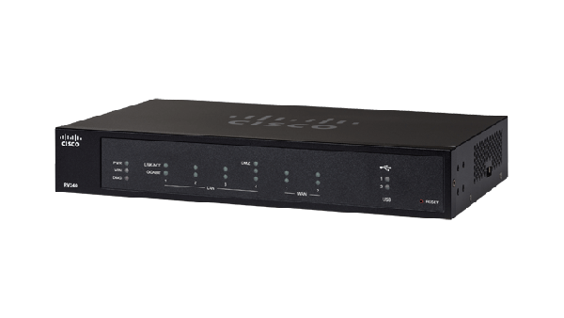
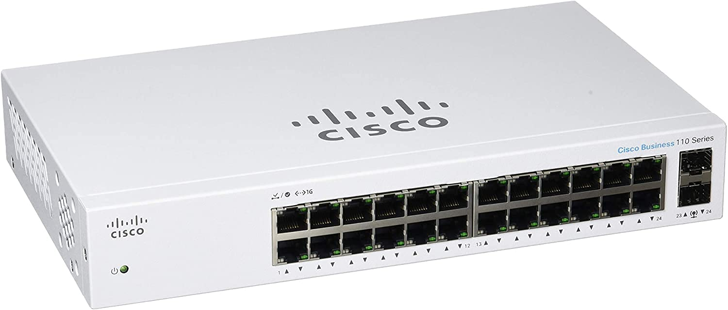
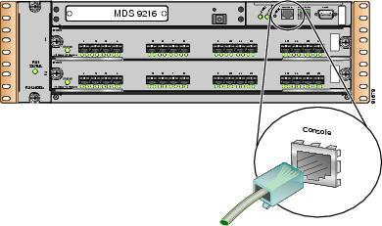
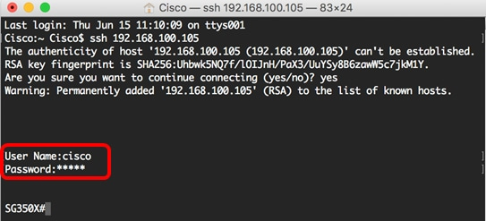
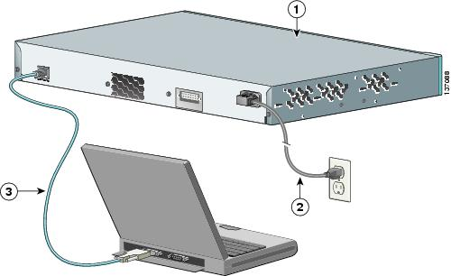
Connections
Router
Switch

Slide 3
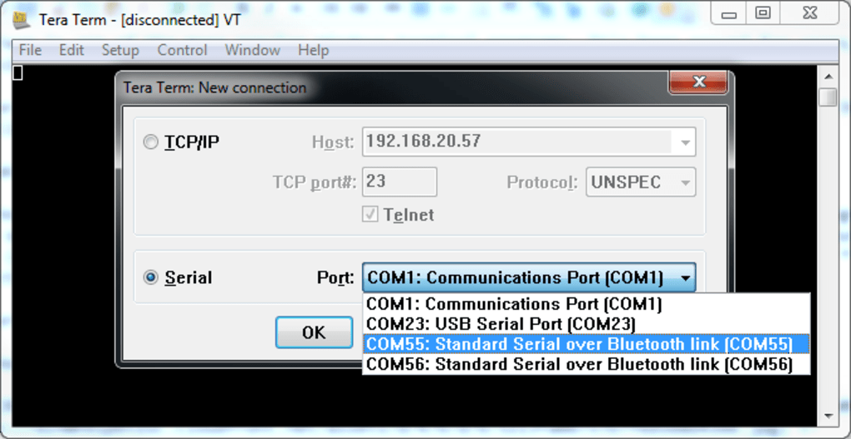

Tera Term terminal emulation program

Slide 4
Start Fresh
enable
erase startup-config
reload

Slide 5
Cisco Device Modes
User Exec Mode (>)
Privileged Exec Mode (#)
Global Configuration Mode (configure terminal or conf t)
Interface Configuration Mode (interface interface_name)
Ethernet port or a VLAN interface
Line Configuration Mode (line line_type line_number)
console lines or virtual terminal (VTY) lines used for remote access

