Slide 1

NET-257 Lab 1 – Part a: Navigate the IOS by Using Tera Term for Console Connectivity

Slide 2
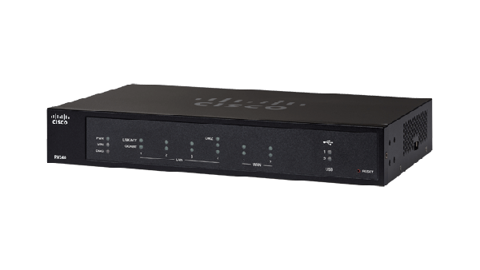
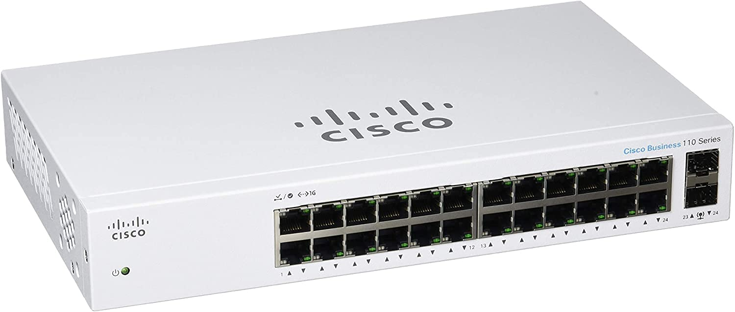
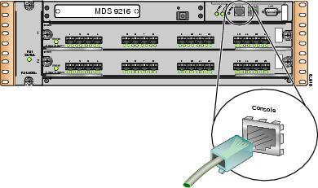
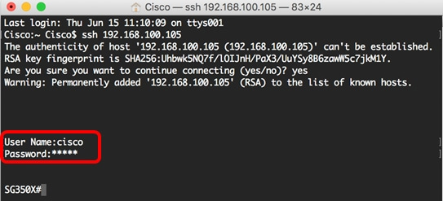
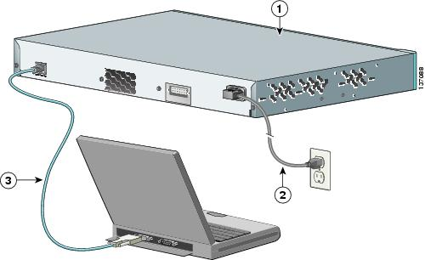
Connections
Router
Switch

Slide 3
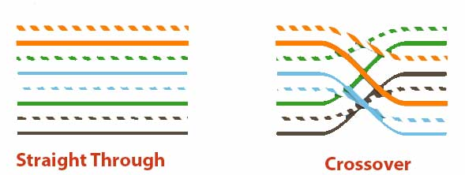
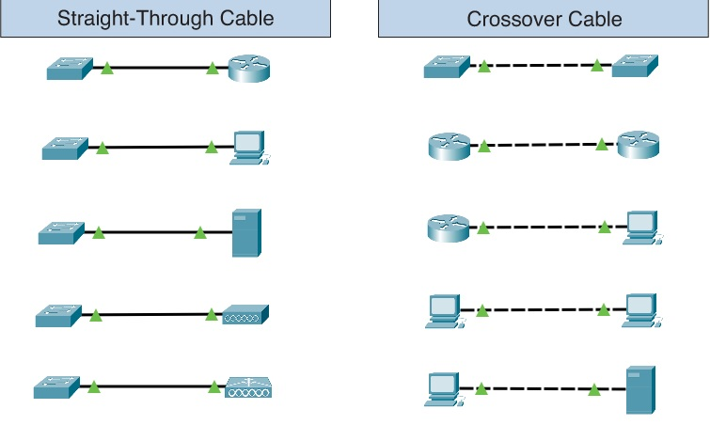
Types of Cables
Straight-through for unlike devices.
Cross-over for like devices.
Auto-MDIX detects the type of cable and adjust the configuration accordingly.

Slide 4
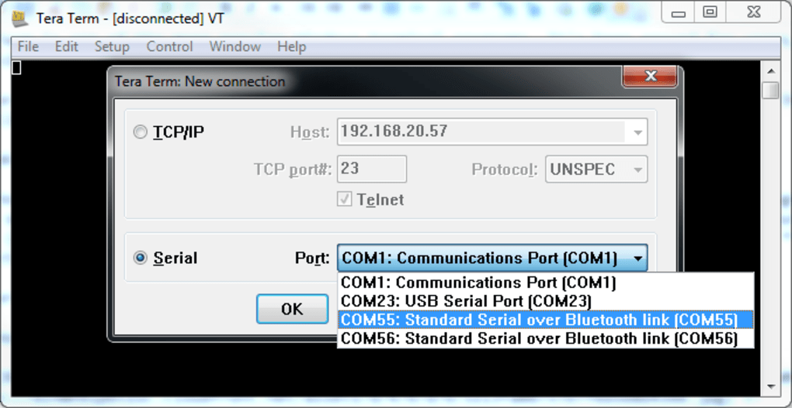

Tera Term terminal emulation program

Slide 5
Start Fresh
enable
erase startup-config
reload

Slide 6
Cisco Device Modes
User Exec Mode (>)
Privileged Exec Mode (#)
Global Configuration Mode (configure terminal or conf t)
Interface Configuration Mode (interface interface_name)
Ethernet port or a VLAN interface
Line Configuration Mode (line line_type line_number)
console lines or virtual terminal (VTY) lines used for remote access

Slide 7
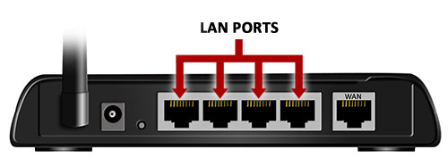
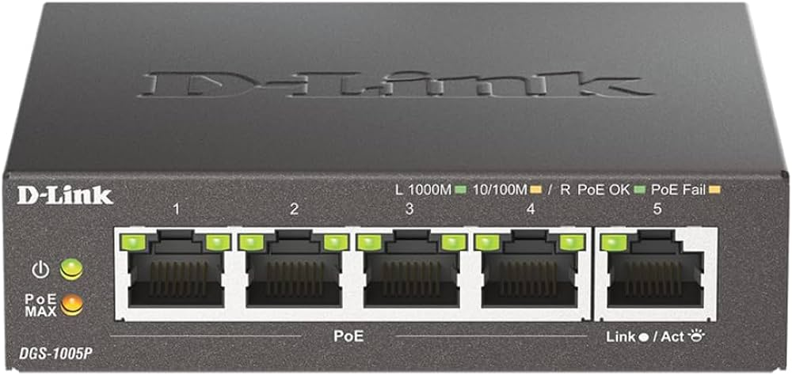
Switch/Router Interfaces

Slide 8
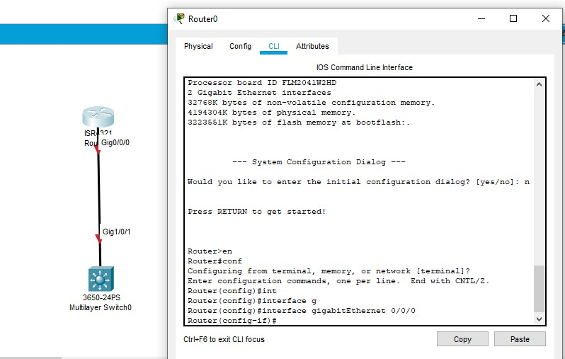

Slide 9
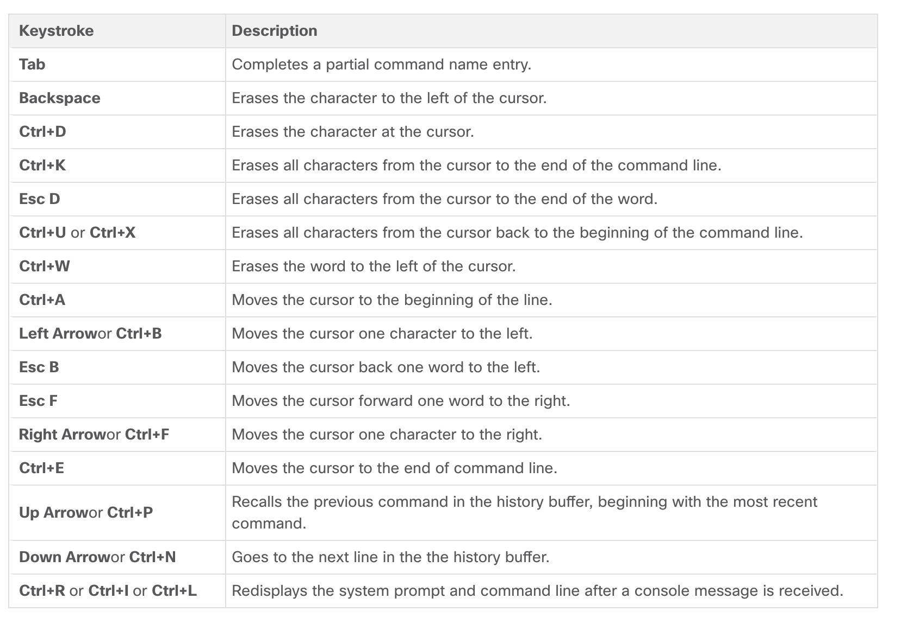
Cisco IOS shortcuts

