Slide 1

EventSync AI – Agentic Event Volunteer Coordination Platform
SOA Project Review-2
22-09-26 / 1:20 pm
Team Members P.Sri Maha Lakshmi – 2420030313 B.Nageshwari – 2420030426 R.Ananya - 2420030086
 | Under the Guidance of Dr.Neelima Gogineni Department of Computer Science and Engineering, KLH CSE Bowrampet Campus

Slide 2
Problem Statement
Coordinating volunteers for events is still largely manual, relying on spreadsheets, phone calls, and personal judgement to match people to tasks.
Organizers struggle to assign volunteers based on skills, availability, experience, and current workload, often leading to mismatched or overloaded volunteers.
When a volunteer becomes unavailable at short notice, finding and briefing a suitable replacement is slow and manual, creating gaps in event execution.
There is no unified system that intelligently allocates, monitors, and re-allocates volunteer tasks in real time.

Slide 3
Objectives
Design and develop EventSync AI, a microservices-based Event Volunteer Management System (Event, Volunteer, Task/Assignment, and Notification services).
Build an AI Event Coordination Agent that assigns volunteers to tasks based on skills, availability, experience, and workload.
Enable dynamic AI-driven reassignment: detect volunteer unavailability, identify a suitable replacement, update the assignment, and trigger a notification.
Implement secure, scalable communication between services using REST APIs, Eureka service discovery, and Spring Cloud Gateway with JWT/RBAC-based access control.
Support SDG 11 (Sustainable Cities and Communities) by improving the efficiency and reliability of community and civic event operations.

Slide 4
Feasibility and Project Plan
Technical feasibility: built entirely on established, freely available technologies – Java, Spring Boot, Spring Cloud, React, and PostgreSQL/MySQL – with strong community and documentation support.
Tooling feasibility: Postman Agent Mode and Semgrep support API testing and security scanning; GitHub Actions enables CI/CD; Jira supports sprint-based task tracking.
Team feasibility: the team is familiar with REST API design and microservices patterns, and uses AI-assisted development tools (ChatGPT/Gemini, GitHub Copilot, Lucidchart AI) to accelerate design and coding.
Economic feasibility: relies on open-source frameworks and free-tier developer tools, keeping the project cost-effective for an academic setting.
Proposed Project Timeline (Tentative)
Phase | Key Activities
1. Requirements & Design | Requirement analysis; SOA/microservices architecture design; UI/UX wireframes (Lucidchart AI)
2. Core Services Development | Event Service, Volunteer Service, Task/Assignment Service (Spring Boot, REST APIs)
3. AI Agent & Notification Layer | AI Coordination Agent (allocation, dynamic reassignment, workload balancing); Notification Service
4. Integration, Security & Testing | Eureka, Spring Cloud Gateway, JWT/RBAC, CORS; API testing (Postman Agent Mode); security scan (Semgrep)
5. Deployment & Final Demo | CI/CD pipeline (GitHub Actions); deployment and final review

Slide 5
Methodology
• Requirement Analysis – identify organizer, volunteer and event-coordination requirements.
• Service Design – define independent services and API contracts using SOA / microservices principles.
• Volunteer & Task Modeling – capture skills, availability, experience, workload and task requirements.
• AI-Based Allocation – select suitable volunteers and balance workload using project/event data.
• Dynamic Reassignment – detect unavailability, identify a replacement and update the assignment.
• Integration & Security – connect services using Eureka/Gateway and protect APIs with JWT/RBAC.
• Testing & Evaluation – validate service workflows, API behavior and security controls.

Slide 6
Conclusion & Future Scope
CONCLUSION
FUTURE SCOPE
• Improve matching using historical event and volunteer data.
• Add richer workload and availability prediction.
• Expand analytics, monitoring and automated notifications.
• Complete CI/CD and deployment integration for final demonstration.
• EventSync AI addresses manual volunteer coordination through intelligent allocation and dynamic reassignment.
• The SOA / microservices architecture separates responsibilities and supports scalable service integration.
• AI-based workload and availability awareness is designed to improve assignment decisions during event operations.

Slide 7
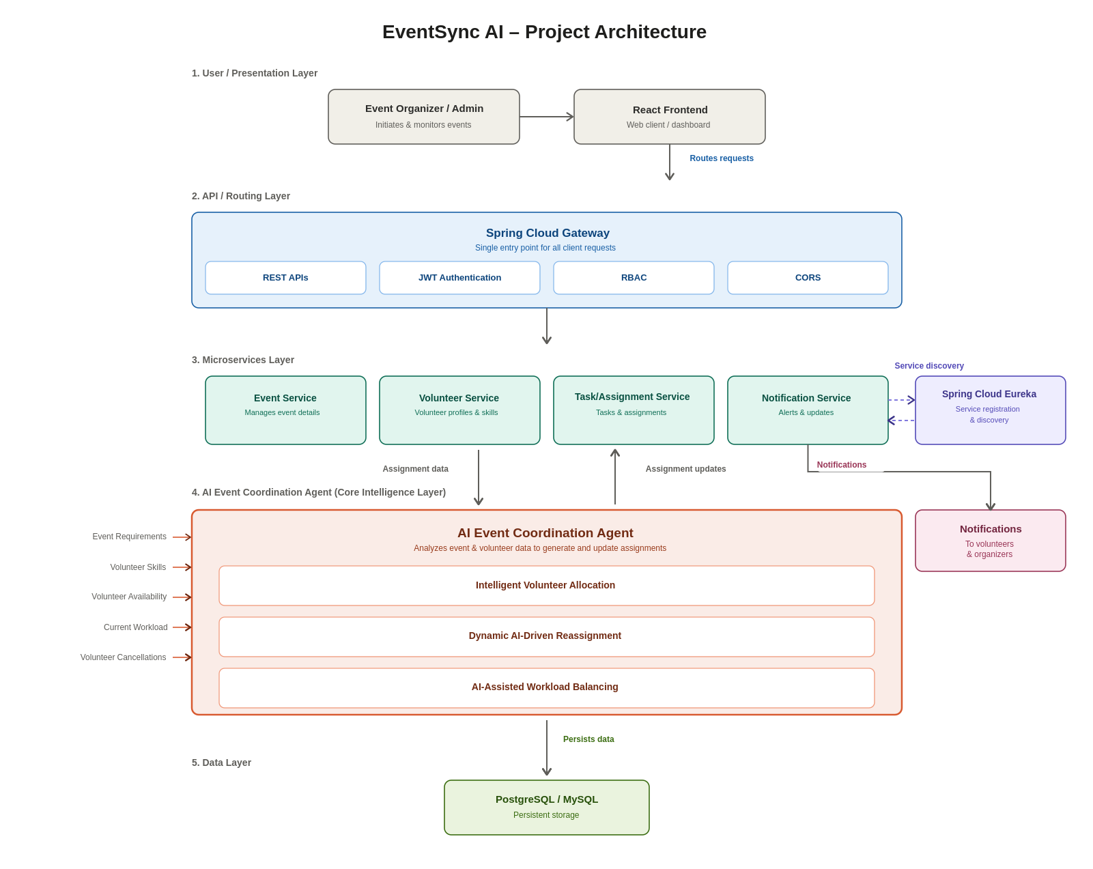

Slide 8
Technical Soundness of the Project
Technology choices support a modular, secure and scalable SOA / Microservices platform.
Architecture
SOA + Microservices
Independent Event, Volunteer, Task/Assignment and Notification services.
Backend
Java + Spring Boot + Spring Cloud
REST APIs provide service-to-service communication.
Service Integration
Eureka Service Discovery + Spring Cloud Gateway
Supports service registration and API routing.
Security
JWT + RBAC + CORS
Protects APIs and provides role-based access control.
Data Layer
PostgreSQL / MySQL
Stores event, volunteer, task and assignment information.
AI Layer
AI Coordination Agent
Supports allocation, dynamic reassignment and workload balancing.
Testing & Security
Postman Agent Mode + Semgrep
API testing and security scanning are included in the project plan.
DevOps / Tools
GitHub Actions + Jira
CI/CD support and sprint-based project tracking.
Feasibility: established, freely available technologies with strong community and documentation support.

Slide 9
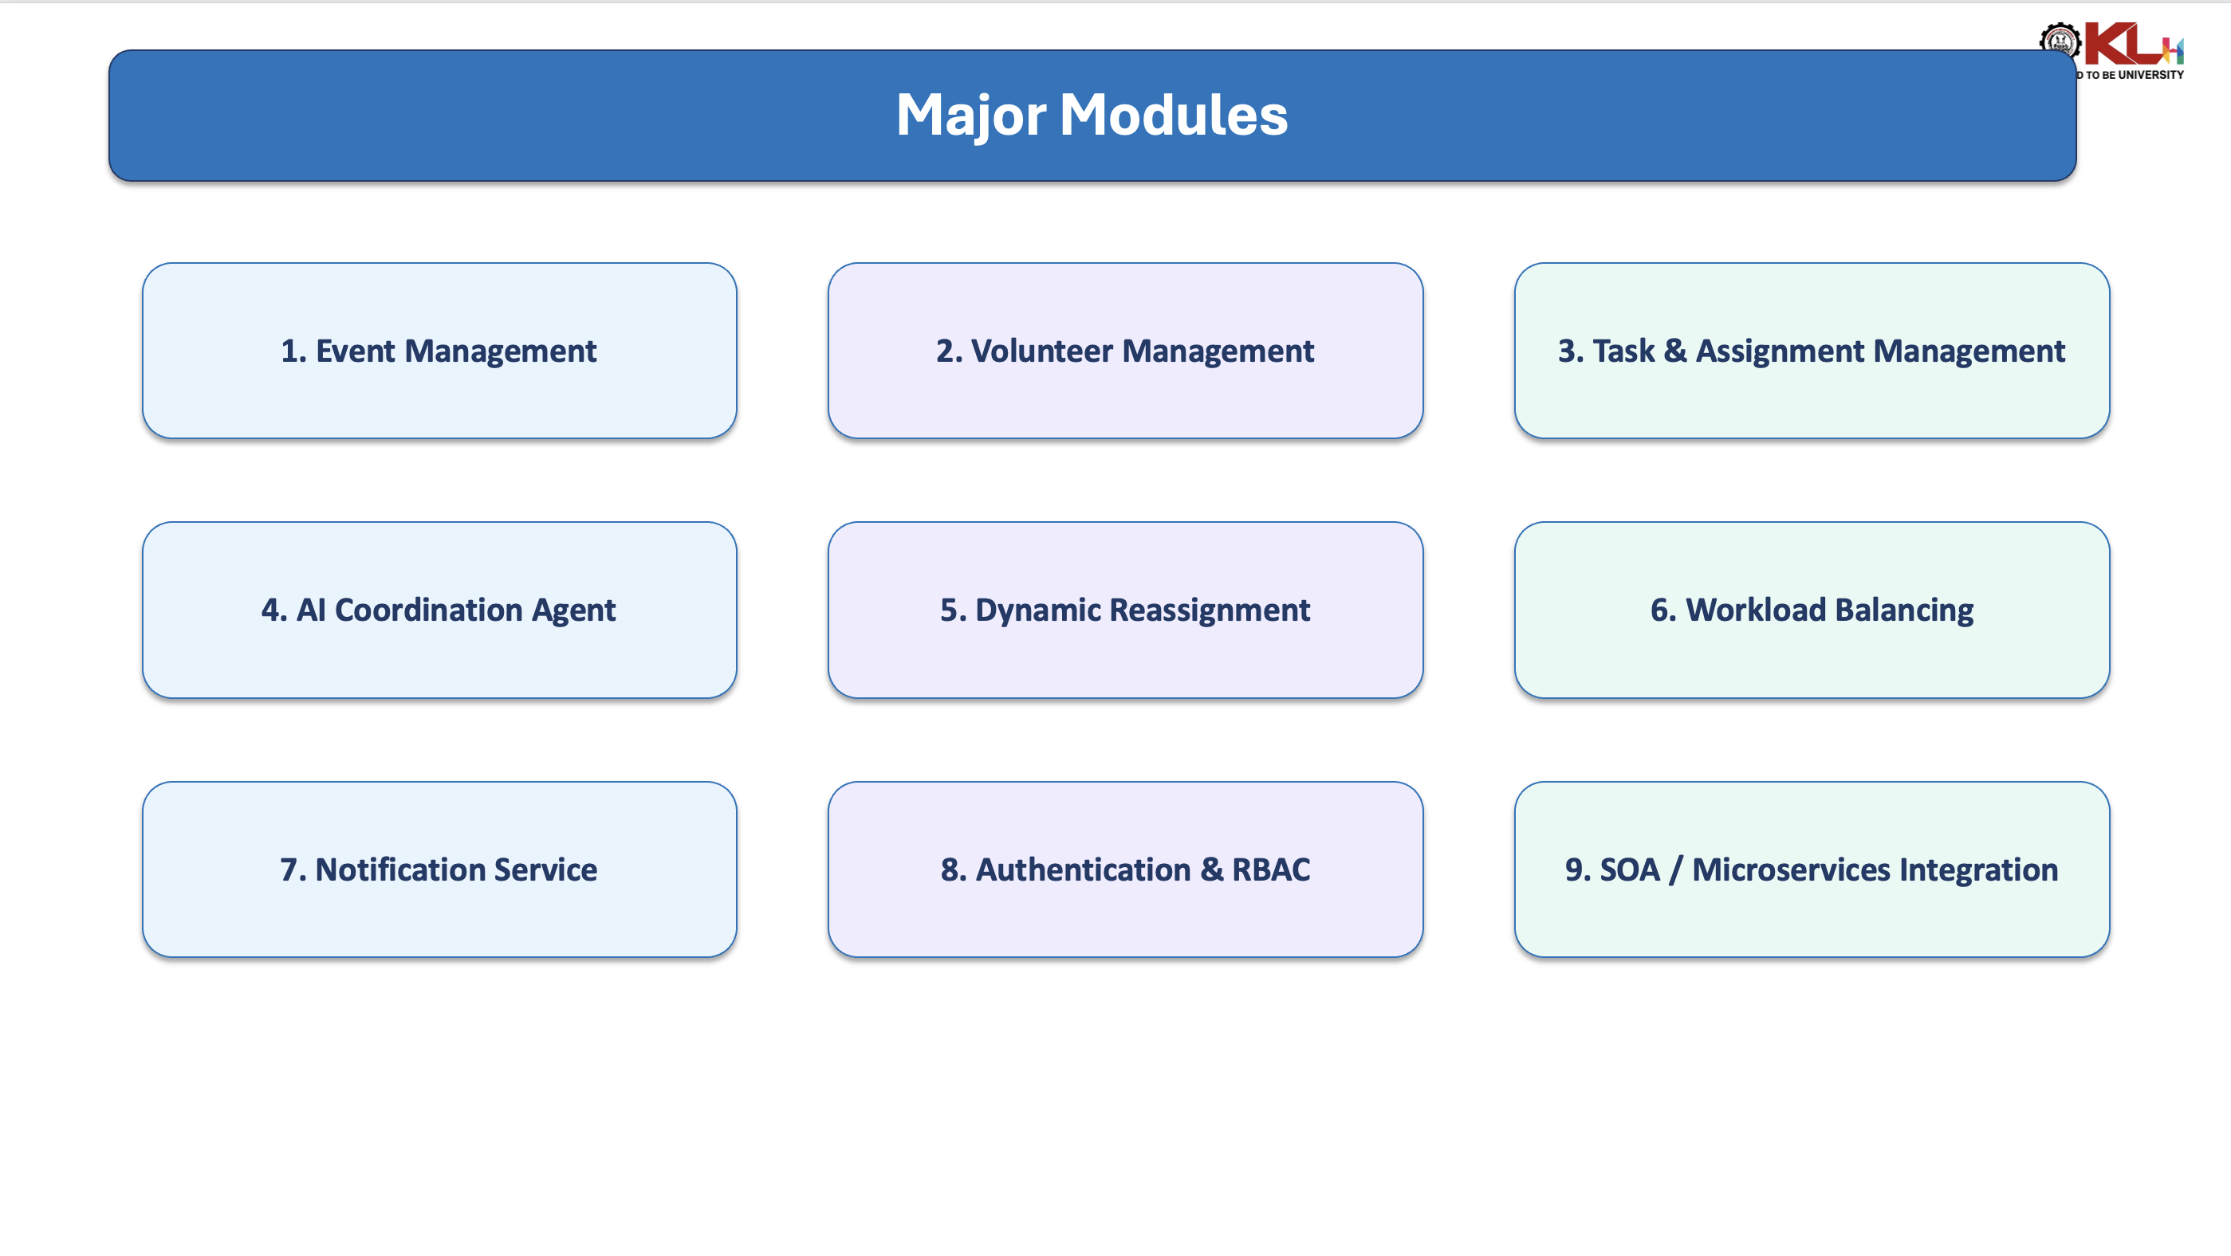

Slide 10
Major Modules of EventSync AI
1. Event Management
Create and manage events, schedules and requirements
3. Task & Assignment
Create tasks and assign suitable volunteers
AI COORDINATION AGENT
Intelligent allocation • Dynamic reassignment • Workload balancing
2. Volunteer Management
Manage profiles, skills, availability and workload
4. Dynamic Reassignment
Detect unavailability and select a replacement
5. Notification Service
Send assignment, reassignment and event alerts
6. Authentication & RBAC
Secure APIs with role-based access control
7. SOA / Microservices
Independent services connected through REST APIs
All modules integrate through the SOA / Microservices architecture.

Slide 11
THANK YOU
EventSync AI – Agentic Event Volunteer Coordination Platform
13

