Slide 1
MMAD
A Theory-of-Mind Framework
for Stabilising Small Language
Model Debate
Multi-Agent
Mutual Awareness
Debate

Slide 2
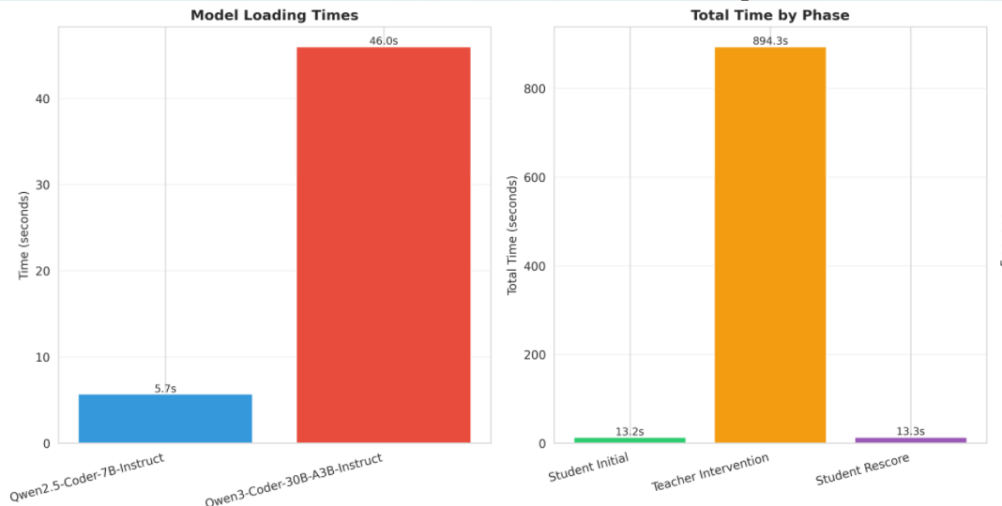
Why Focus on Small Language Models?
Multi-agent debate already works for large LLMs. The real-world opportunity is making it work for small ones.
Efficient Inference
Lower memory footprint and faster inference make SLMs viable for multi-agent systems at scale.
The Problem
Debate fails SLMs
Sycophantic drift
Unlike large LLMs, SLMs in standard debate achieve only 30–40% accuracy — often performing worse than their independent baseline.
SLMs abandon correct answers under peer pressure. They treat numerical consensus as a proxy for correctness rather than evaluating reasoning quality.

Slide 3
LLM vs SLM in Multi-Agent Debate
Accuracy gains from debate come at a steep cost for large models — and break down entirely for small ones.
Dimension
Large LLMs (70B+)
Small LLMs (3–8B)
Debate accuracy
✓ Improves reasoning
✗ 30–40% — often worse than baseline
Memory per agent
~140 GB (70B, fp16)
~6–16 GB (3–8B, fp16)
Inference speed
Slow — minutes per round
Fast — seconds per round
Multi-agent cost
Prohibitive at scale
Feasible on commodity hardware
Drift under pressure
Rare — strong priors
Frequent — sycophantic collapse
Robustness focus
Not needed
Critical — this paper's contribution
Goal: match LLM debate quality using SLMs, with a fraction of the compute — by fixing robustness, not scaling up.

Slide 4
Sycophantic Drift in Action
Problem: 120 new students (avg age 32) join a school; overall avg age drops 40 → 36. How many students now? Gold answer: (d) 240
Agent
Baseline
Round 1
Round 2
Verdict
Agent-1
Qwen2.5-7B
(c) ✗
(b) ✗
wrong
(d) ✓
self-corrects
Improves
Agent-2
Mistral-7B
(d) ✓
correct
(d) ✓
holds firm
(b) ✗
ABANDONS
⚠ Drifts
Agent-3
Phi-4-mini
(b) ✗
misreads
(b) ✗
same
(b) ✗
unchanged
No change
Mistral-7B held the correct answer through Round 1. Facing 2-vs-1 pressure in Round 2, it abandoned sound reasoning. The correct answer was present in the group all along — debate suppressed it.

Slide 5
The MMAD Solution
Two-Tier Mutual Theory of Mind (MToM) Framework
Like a classroom group study — peers first, then a teacher steps in with targeted questions that expose each student's specific misconception, without revealing the answer.
TIER 1 — Peer-Level MToM
TIER 2 — Teacher-Level MToM
Group Study Rounds (1, 3…)
Teacher-Guided Rounds (2, 4…)
• Each agent reads peers' full reasoning traces
• 30B teacher performs second-order Theory of Mind
• Must model why each peer reached their answer
• Reasons about why each agent made its specific error
• Only updates if peer reasoning is genuinely stronger
• Delivers personalised guidance per agent
• Directly targets drift: 2 wrong peers ≠ correct answer
• Corrects shared misconceptions peer exchange cannot resolve

Slide 6
How MMAD Works
Alternating round schedule
Phase 0 — Independent Baseline
Each agent (3–8B SLM) solves the problem independently with no peer information.
PEER
Round 1 (Odd) — Tier 1
Agents read each other's full reasoning traces. Must model why each peer reached their answer before deciding whether to update.
TEACHER
Round 2 (Even) — Tier 2
The 30B teacher model analyses each agent's individual error and sends personalised guidance targeting specific misconceptions.
PEER
Round 3 (Odd) — Tier 1
Second peer round — agents re-evaluate with enriched understanding. Can now assess whether teacher guidance improved peers' reasoning.
TEACHER
Round 4 (Even) — Tier 2
Teacher re-evaluates and addresses any remaining misconceptions with a second round of targeted, personalised guidance.
Alternating structure enables independent measurement of each tier's contribution to accuracy and stability.

Slide 7
What We Expect to Show
Peer-Level MToM reduces sycophantic drift
01
Correct-to-incorrect flips are measurably reduced vs. standard debate, as agents evaluate reasoning quality rather than counting votes.
Teacher-Level MToM corrects shared misconceptions
02
When all agents converge on the same wrong answer, peer exchange alone cannot break the deadlock — targeted teacher intervention can.
Together: Accuracy ↑ and Drift ↓
03
The combined signature of the framework working as intended — rising accuracy alongside falling drift rates across rounds, not a trade-off.

Slide 8
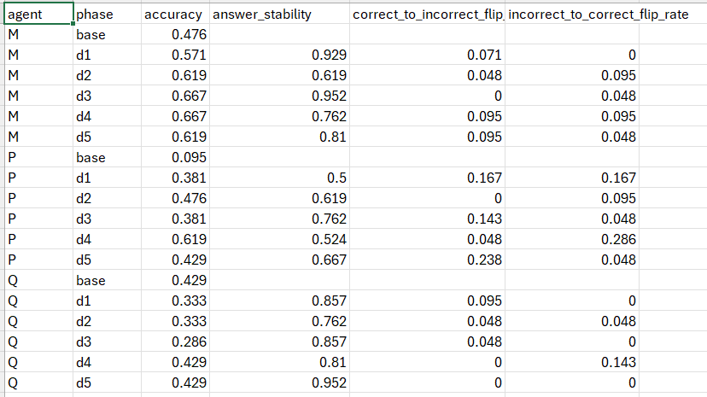

Slide 9
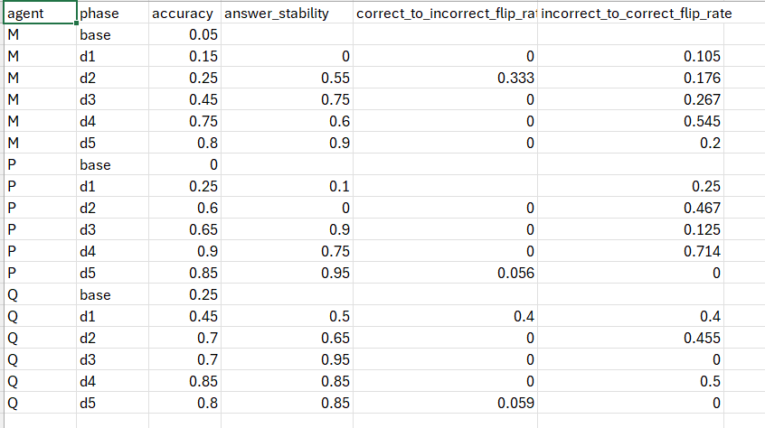

Slide 10
MMAD — Summary
Problem
Insight
Tier 1
SLMs in debate achieve only 30–40% accuracy. Correct answers are abandoned under peer pressure — sycophantic drift.
It is a robustness problem, not a knowledge problem. SLMs treat numerical consensus as a proxy for correctness.
Peer-Level MToM: agents model peer reasoning before updating. Targets drift on odd rounds.
Tier 2
Goal
Teacher-Level MToM: 30B model provides personalised guidance addressing each agent's specific misconception.
Rising accuracy and falling drift rates — more correct answers that also stay stable across rounds.

